Slide 1
Siracusa (Sicilia), fourth century. Lucy was a beautiful young woman. Her family was noble and rich.

Slide 2
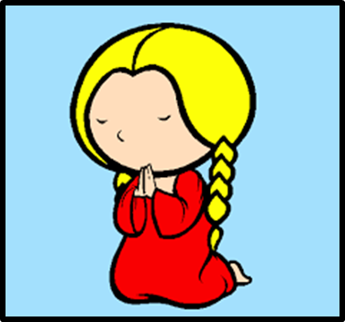
Her mother was very ill. Lucy prayed Saint Agata that appeared and asked Lucy to give her life for poor people.

Slide 3
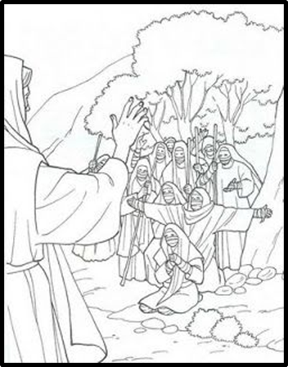
Her mother was safe and Lucy went to live among poor people to help them.

Slide 4
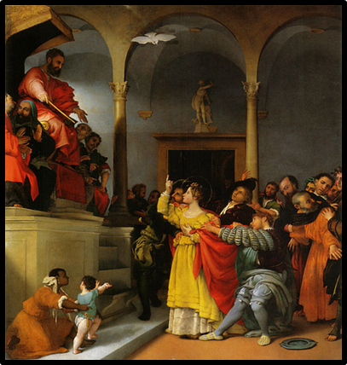
Her future husband became very very angry and he denounced Lucy because she was a Christian.

Slide 5
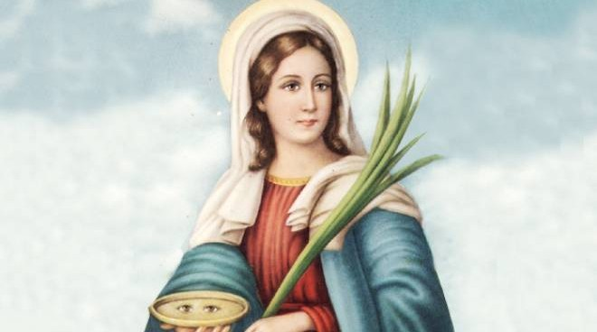
Lucy didn’t renounce her faith and a soldier took her eyes away and at last she died and became a saint.

Slide 6
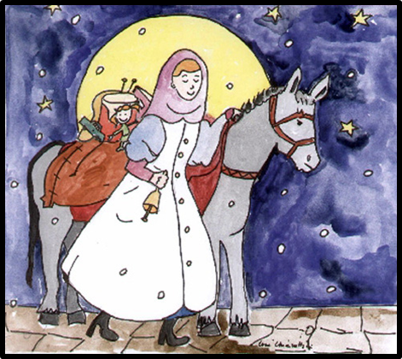
In Italy we believe that during the night between 12th and 13th of December Saint Lucy with her donkey takes toys and sweets to good children, even if she is blind.

Slide 7
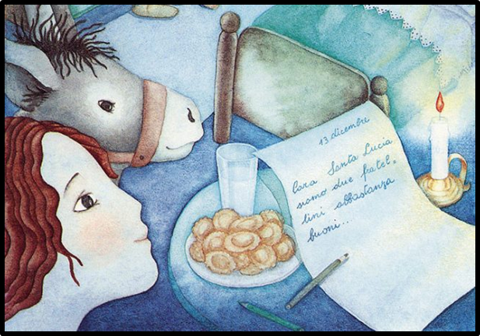
Children write letters to ask presents and to promise to be good. They leave milk and biscuits for Saint Lucy and bread or hay for the donkey.

Slide 8
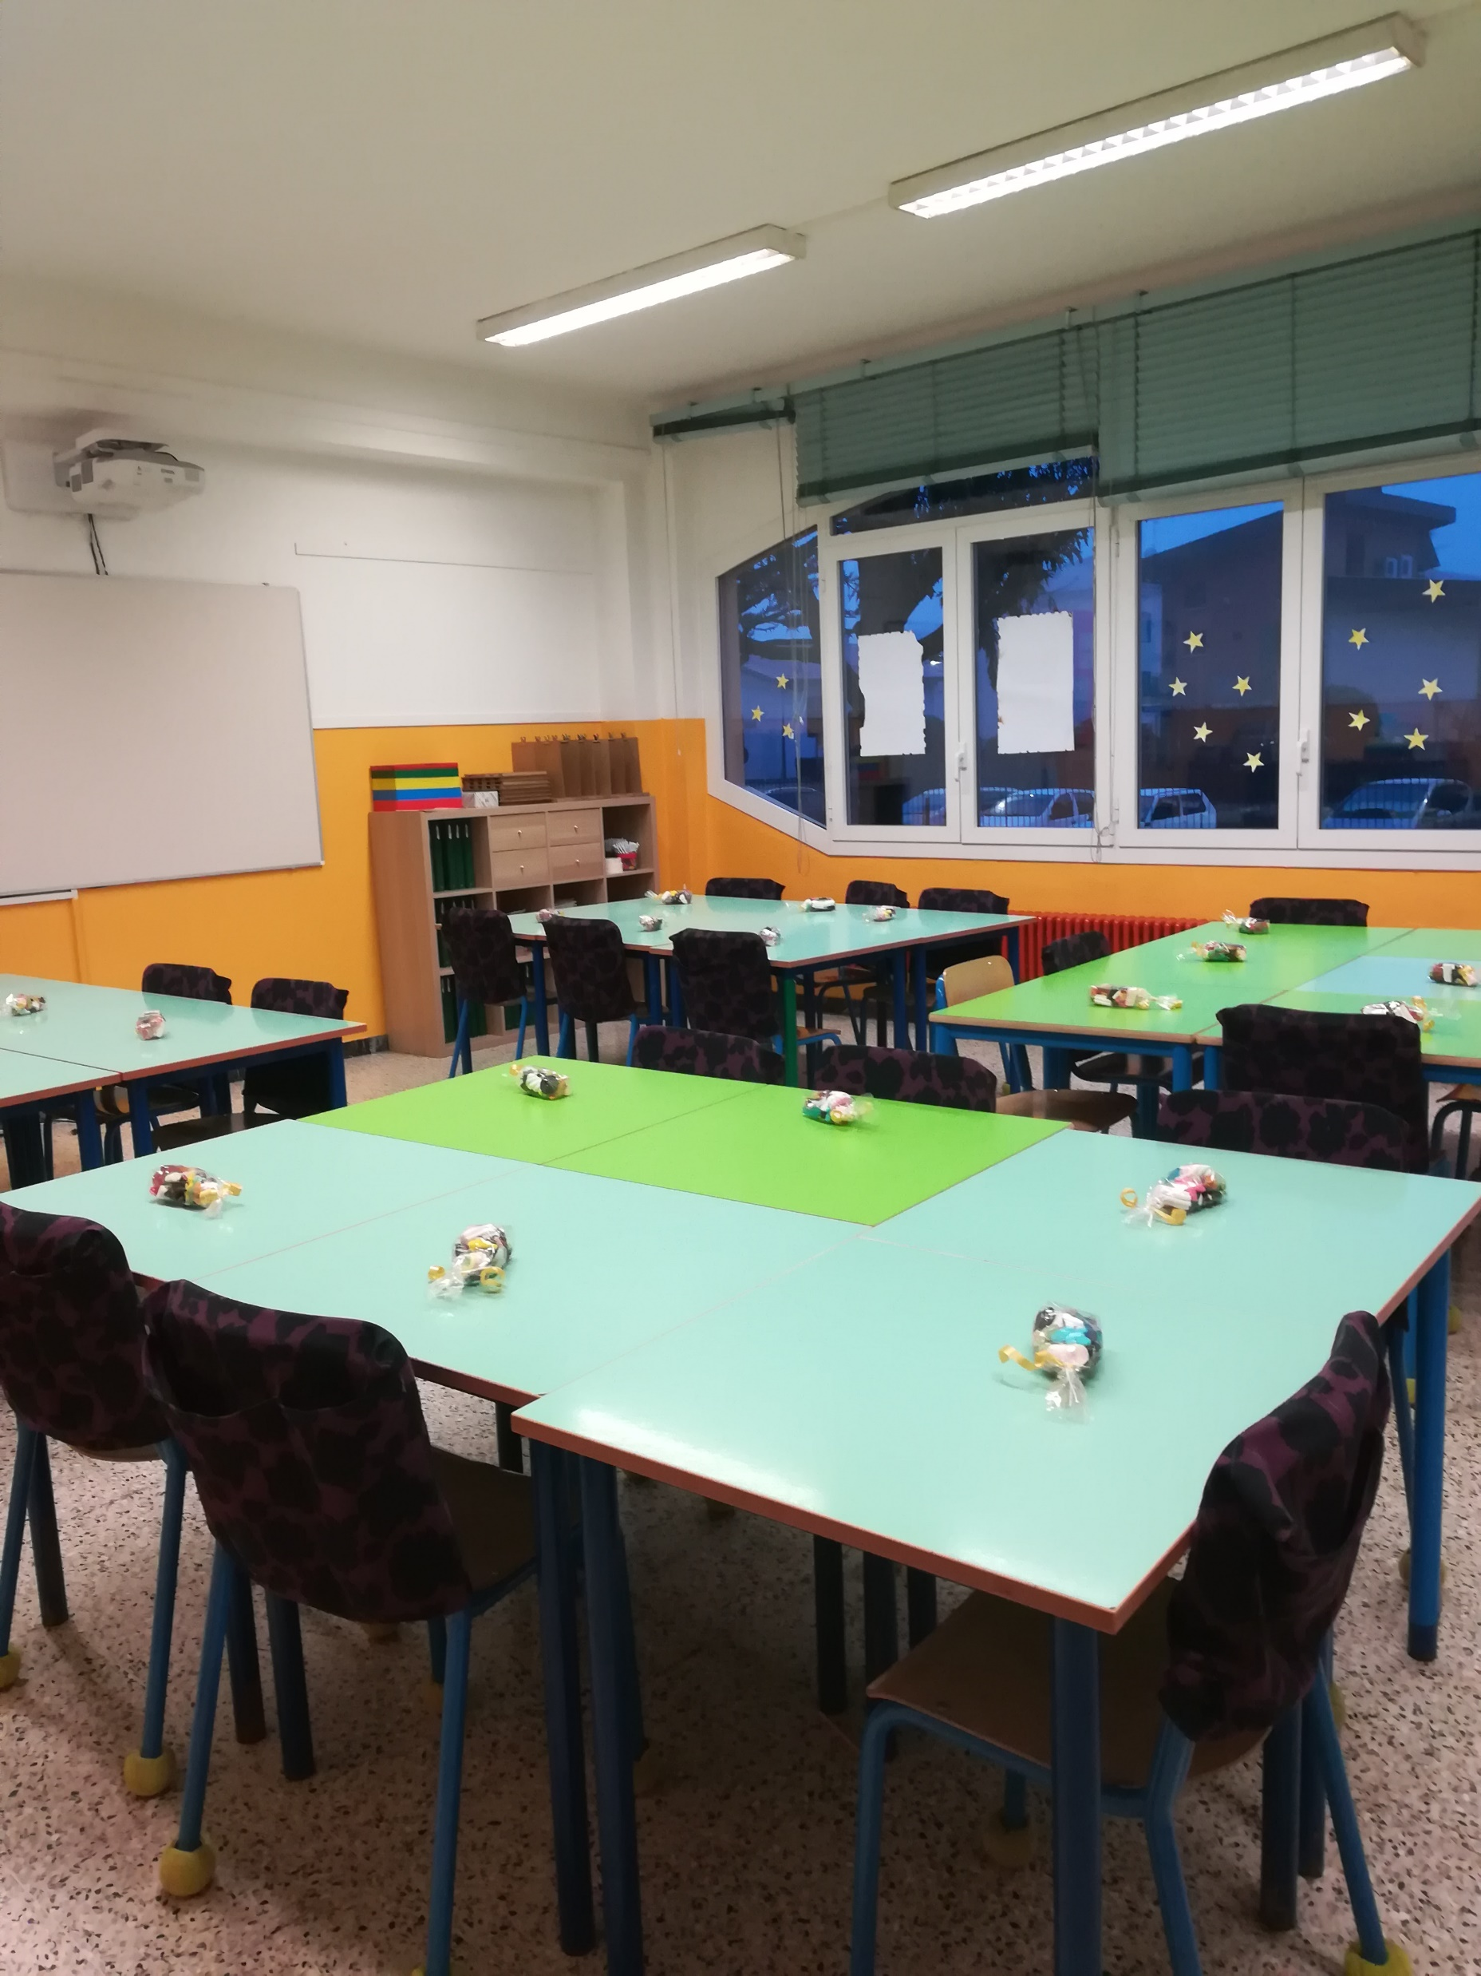
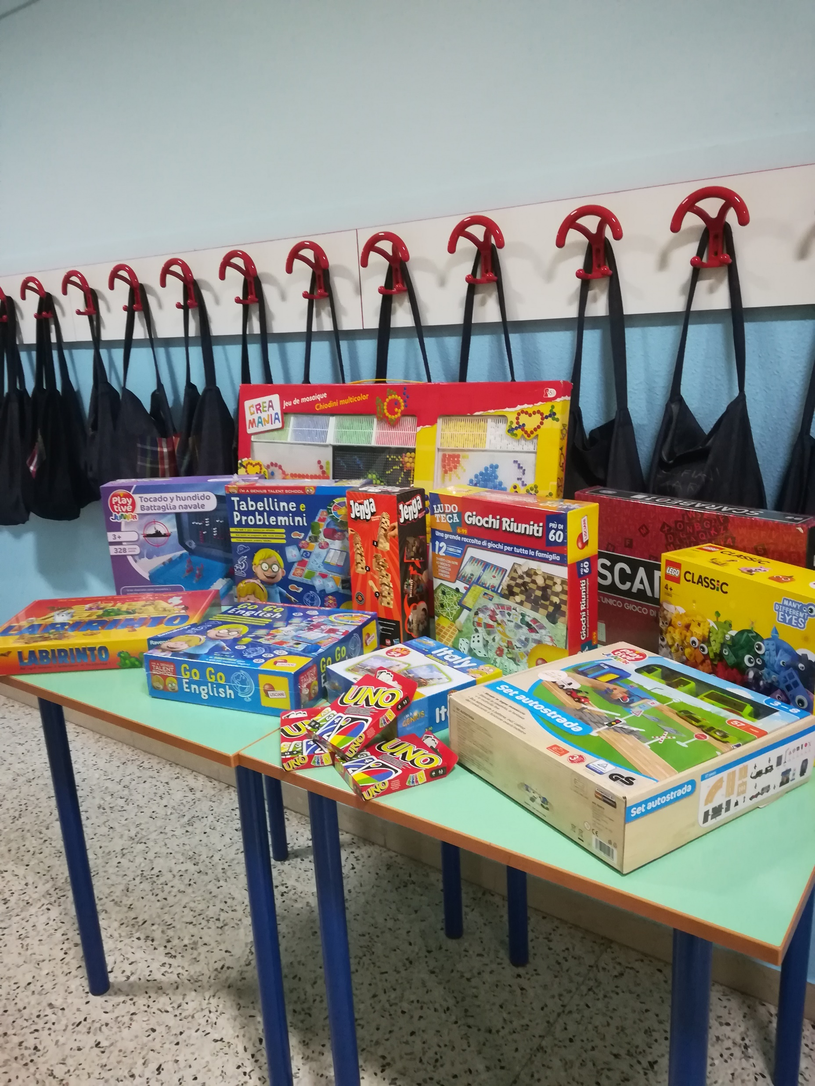
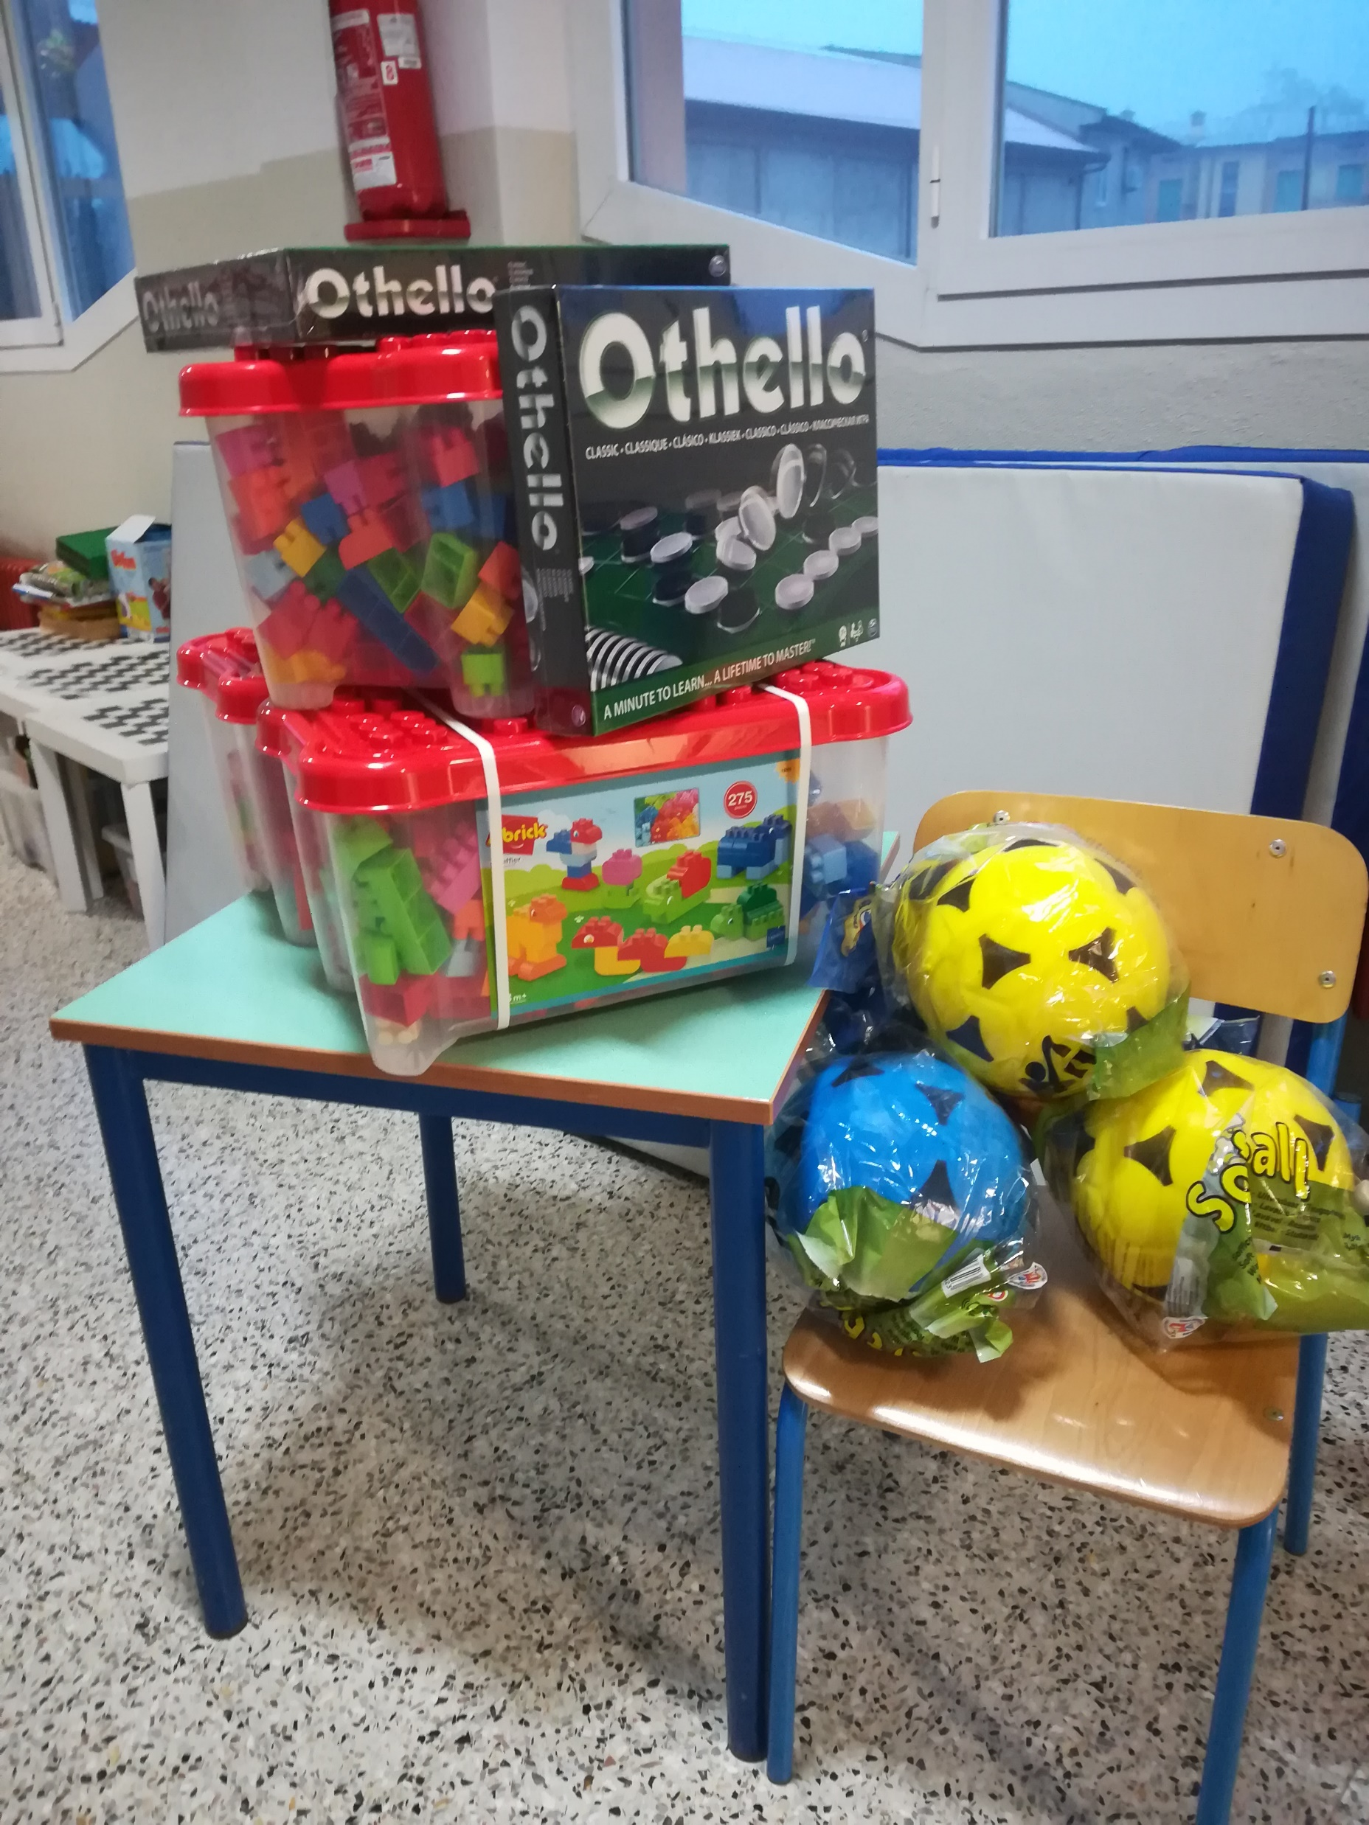
Saint Lucy in our school. She left sweets and toys

Slide 9
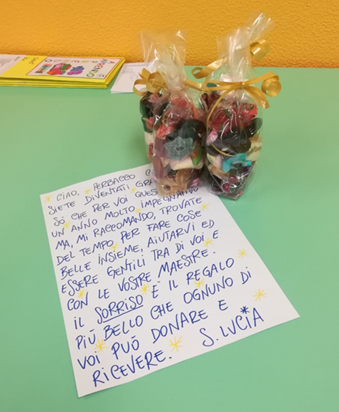
A missive from Saint Lucy!

