Slide 1
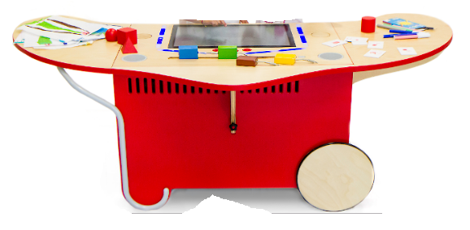
The i-Theater is a new integrated interactive system for the narrative invention of multimedia stories dedicated to children between 4-10 years of age.
In its conception, the i-Theater is designed as a tool to support the child during all the creative activity: from the preparation of characters and backgrounds drawings on paper with the preferred technique, to the transition to digital format and the subsequent creation and sharing of the animated story .
The i-Theater is born according to the innovative vision of the collaborative learning environment: an environment aimed at stimulating sharing and relationship.

Slide 2
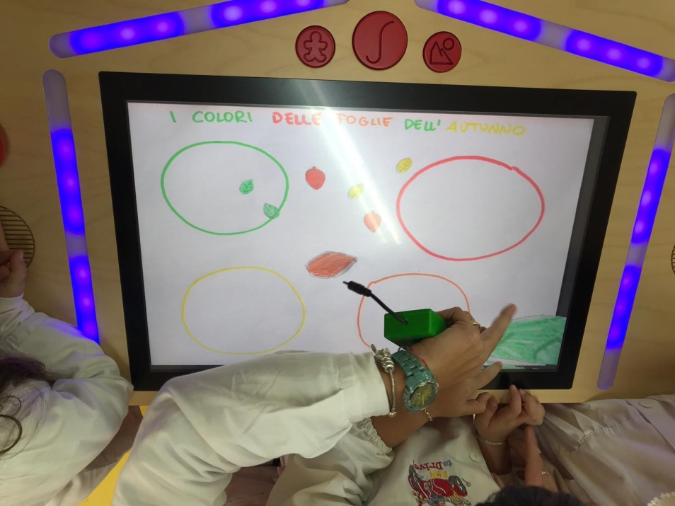
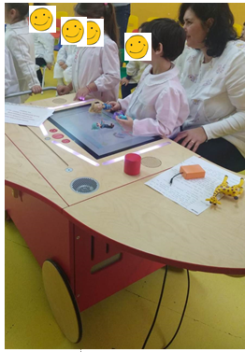
Our pupils at the Kindrgaten are studying colours and inventing stories.

Slide 3
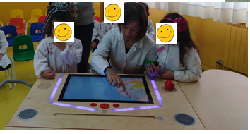
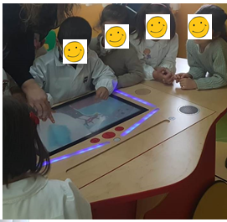
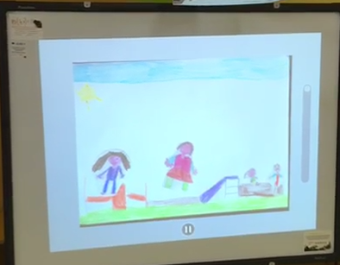
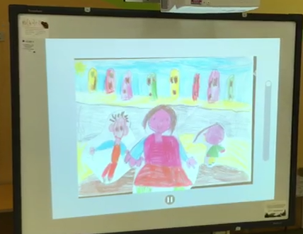
The story is ready!

Slide 4
