Slide 1
How to design a good logo?
Basic info

Slide 2
Logo (emblem, trademark)
unique and characteristic graphic form, stylised inscription, symbol,
used to identify a brand, company or organisation,
placed on printed materials, advertisements, stationery, buildings, and vehicles.
occurs in three forms - a sign, a logotype or a full logo

Slide 3
How to design a perfect logo?

Slide 4
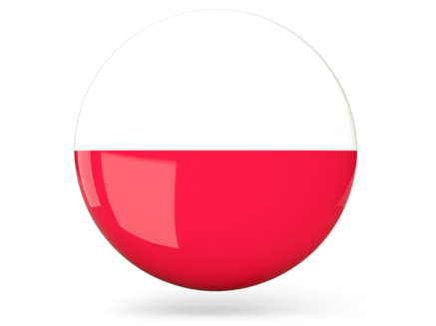
Rule 1: Simplicity

Slide 5
Rule 2: Recongisability

Slide 6
Rule 3: Timelessness

Slide 7
Some advice on how to design a logo.

Slide 8
1. Do not use more than 3 colours.
Avoid too bright but also gloomy colours. Learn about the meaning of colours before applying them.

Slide 9
2. Get rid of anything that is not absolutely necessary.
The perfect logo creation does not mean that you can’t add anything to it. The ideal logo design is characterised by the fact that you can’t remove anything.

Slide 10
3. A logo must be easy to remember
A good sign should be easy to describe over the phone. Something that is easy to remember cannot be complicated.

Slide 11
4. Do not combine elements of already existing signs
Do not use ready-made graphics (clip art).

Slide 12
6. The logo should always look good
Make sure that the logo is recognisable when you reverse the colours or reduce the size.

Slide 13
You can design your logo manually, or you can use programs available online:
https://www.canva.com/pl_pl/tworzyc/logo/
https://www.otologo.pl/
https://pl.onlinelogomaker.com/
https://www.logaster.com/pl/

Slide 14
Authors
Text and presentation: Magdalena Sycik
Translation: Hanna Wilk
Szkoła Podstawowa nr 7 z Oddziałami Integracyjnymi im. Królowej Jadwigi w Wołominie

