Slide 1
Polish Education System
The Queen Jadwiga Primary School no 7
with Integration Classes in Wołomin

Slide 2
Stages of Education in Poland
Nursery Schools
Primary Schools
Secondary Schools
Higher Education

Slide 3
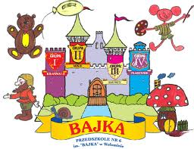
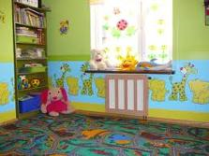
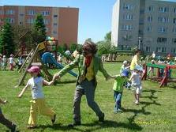
Nursery Education
This stage is the first one of the educational system in Poland.

Slide 4
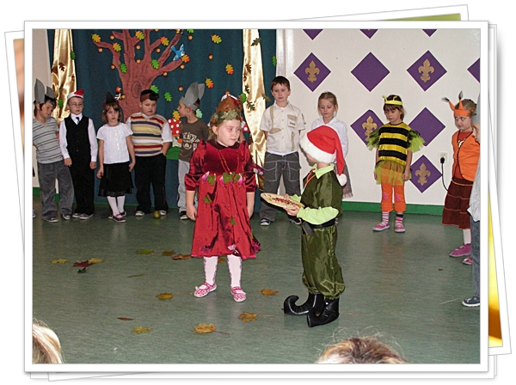
Nursery education applies to children between 3 and 6 years old.
From 2004/2005 all six-year-old children attend a compulsory „0 grade”, which is to prepare the children to begin the compulsary education in primary schools.
„0-grades” function in kindergartens or are attached to primary schools and called pre-primary classes.
They are administrated and financed by local governments.

Slide 5
Compulsory Education
Compulsory education from 6 to 18 years old
Stages | The period/age of education
0 grade | Age: 6-years-old
8-years Primary School | Age: 7-15-years-old Stage I – integrated teaching: 7-10-years-old Stage II- teaching arranged by subjects: 10-15-years-old
Secondary School | Age: 15-19-years-old Stage III - teaching arranged by subjects

Slide 6
Daily/weekly/yearly number of teaching hours
A school year lasts 185 days, from September to June, and is divided into 2 terms.
The number of compulsory subjects’ classes per week is appointed by the core curriculum and depends on the stage of eduacation (for stage I it is 22-24 lessons, for stage II it is 26-32 lessons, for stage III it is 33-36)
Classes are arranged during 5 days, lessons last 45 minutes. Aproximately there are from 4 to 8 lessons per day.

Slide 7
Organization of teaching
Groups usually consist of 20-28 children.
In the I stage, one teacher teaches all subjects – English is usually thaught by an English teacher, Religious Education is thaught by an R.E. teacher, while in next stages, each subject is taught by a different teacher.

Slide 8
Grades
During the I stage pupils get descriptive assessment
During the II and III stages:
1- insufficient (niedostateczny)
2- passing (dopuszczający)
3- sufficient (dostateczny)
4- good (dobry)
5- very good (bardzo dobry)
6- excellent (celujący)

Slide 9
Curricula and teaching content
Teachers are obliged to follow educational activites (teaching content) according to the Core Curriculum for a particular stage of education, which is included in the Regulation by the Minister of National Education.
Teachers can choose textbooks from the list approved by the Ministry of Education and they can individually decide on the methods of teaching and evaluation, introducing innovative methods of teaching and curricula based on the Core Curriculum.

Slide 10
Assessment
The assessment of student’s knowledge and skills during the school year is unified in the whole country.
The assessment is carried out during the whole school year and is divided into partial, periodical and annual assessment and regular oral and written tests. Final marks per semester and at the end of the school year have to be approved by Teachers’ Council in each school.

Slide 11
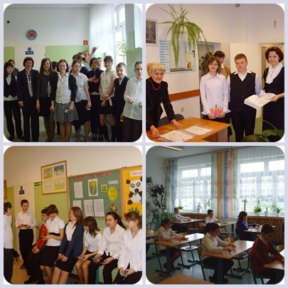
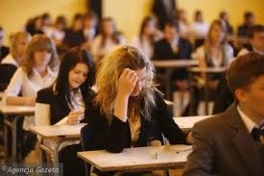
Types of exams at the end of each stage
Within the confines of compulsory education the system of external assessment repressents the following unified tests and examinations:
School Leaving Exam at the end of the II stage of education (students aged 15),
Maturity Certificate at the end of the III stage of education (students aged 19).

Slide 12
Post-compulsory Education
Stage of education | The period/ age of education
Secondary School/High School | Age: 15-19
Technical School | Age 15-20
I grade Vocational School | Age: 15-18
II grade Vocational School | Age 18-20
Upper/Post Secondary School | Age: 19-21

Slide 13
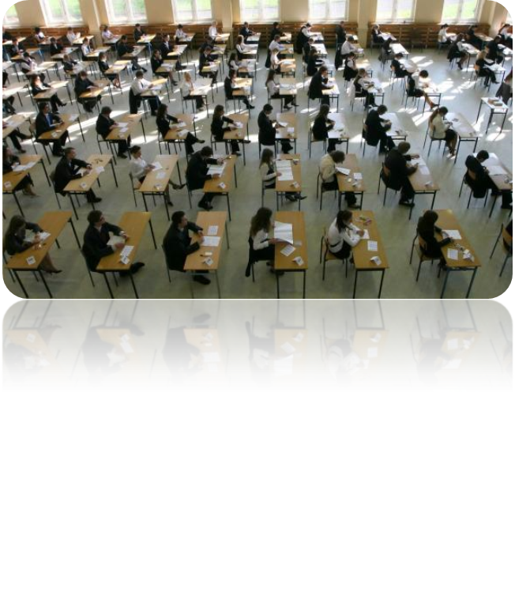
Access to higher education
Students of Secondary Schools and Technical Schools, who have passed their final exams will get the Maturity Certificate (required to apply for admission to higher education).
Post-secondary schools’ examinations are unified and external. Secondary school Finals contain of 2 parts: external written exam(prepared and assessed by Regional Examination Commissions) and oral examinations, prepared by school teachers.

Slide 14
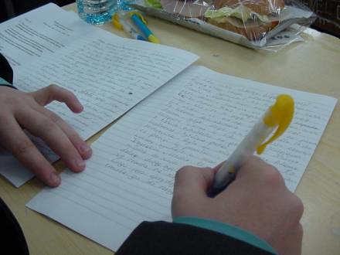
Vocational examination
At the end of the I grade Vocational School, students are evaluated by means of a compulsory vocational examination . The success in the theoretical and practical parts of this examination, relating to the occupation, gives students the title of skilled worker.

Slide 15
Types of Higher Schools/Universities
Universities
Technical Universities
Agricultural Schools
Academies of Physical Education
Schools of Art
Schools of Theology
Maritime Schools

Slide 16
Systems of Studies
Full-time studies – daily system of studies, at state universities they are free of charge.
Part-time studies – extramural students have to pay for their learning.

Slide 17
Titles after studies
A Bachelor’s degree or Engineer- after studies which last 3 years. They end with a diploma of professional qualifications and title of graduate, which entitles people to work or continue their education.
A Master’s degree- after Uniform Masters studies which last from 5 to 6 years and are conducted at universities. As a result, students receive a university degree and professional title of master.
Graduates holding the professional title of master’s degree may apply for admission to doctoral studies.

Slide 18
Special Education
educating children
with special educational needs

Slide 19
Special education is an integral part of Polish Education System,which reflected in the common law.
The children are taught according to special educational needs on the basis of the results of psychological, educational and medical research.
The majority of children with special needs study in special schools or special classes.

Slide 20
Teachers
Teachers must have a university degree. The type of required studies depend on the stage of teaching.
Teachers ougth to have one of the following qualifications:
- University education or equivalent completed(Master’s degree)
- 3-year teachers training college completed (Bachelor’s degree)
Teachers at each stage ought to have completed pedagogical training/teacher education faculties and a particular subject they want to teach.

Slide 21
Current Reforms
The presentation was prepared on the basis of the reform from 2017 and the present school year is the most challenging as it combines both systems before and after the change.

Slide 22
THANK YOU

