Slide 1
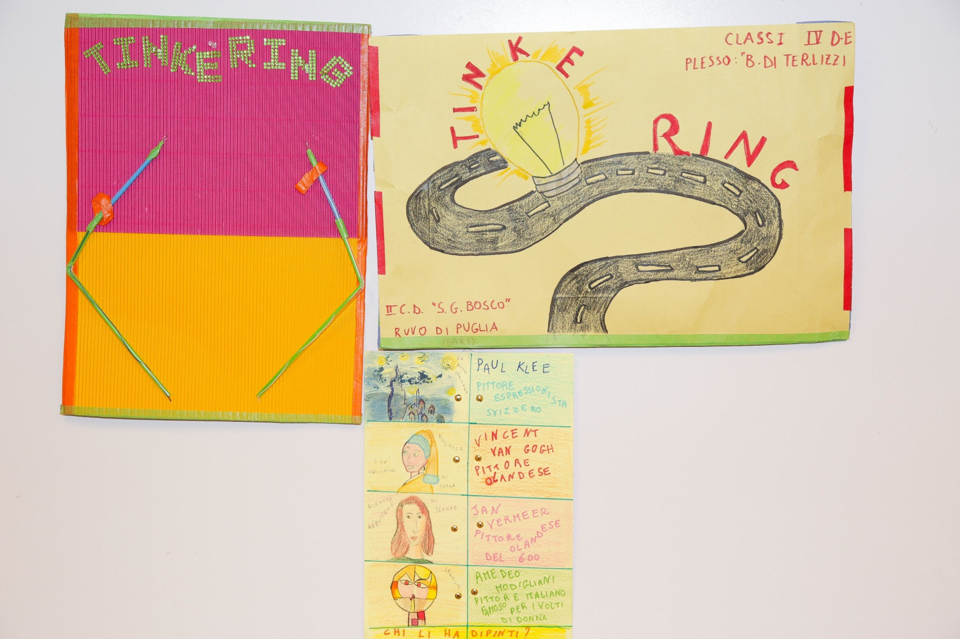
THE Tinke-ring

Slide 2
The TINKE-RING comes from the idea of ​​developing the STEAM disciplines in class by creating Tinkerlabs. Children are naturally ready to try new activities.The classes were divided into groups (cooperative learning) they designed the graphics, chose the best designers (some of them are really smart) then each of them has provided his own contribution to the creation of the cards. THE moments of doubt? Yes, there were but the teachers promptly dispelled them. The pupils have chosen to design cards with topics from various disciplines that present difficulties for them such as: the W questions, the telling the time in English, the H of the verb to have in Italian or the fractions, other cards, instead, gave them only the pleasure of doing -learn by doing. What a satisfaction the light comes on!
The objectives and aims of the project were: -To develop logical skills and ability to analyze, solve problems creatively and efficiently. -Develop the ability to elaborate constructive procedures to support fantasy and creativity. - To encourage the development of communication and interpersonal skills - Improve the educational success of students in the curriculum disciplines. -Promote processes that enable students to become builders of their knowledge. -Develop operational autonomy. - Make group work experience. - increase decision-making skills, sense of responsibility e self-esteem. The workshop paths, based on concrete experiences, have favored full integration, as the pupils have operated in a context in which everyone was called a implement an active-cooperative behavior.

Slide 3
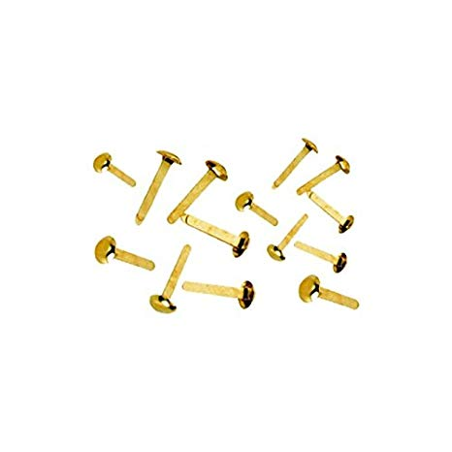
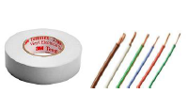
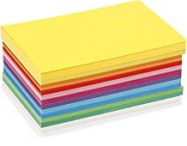
YOU NEED: a led, a tape for electrician, wires, botton like batteries, carboards, colours and specimen holder

Slide 4
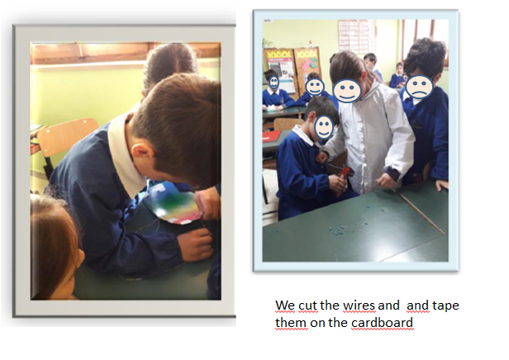

Slide 5
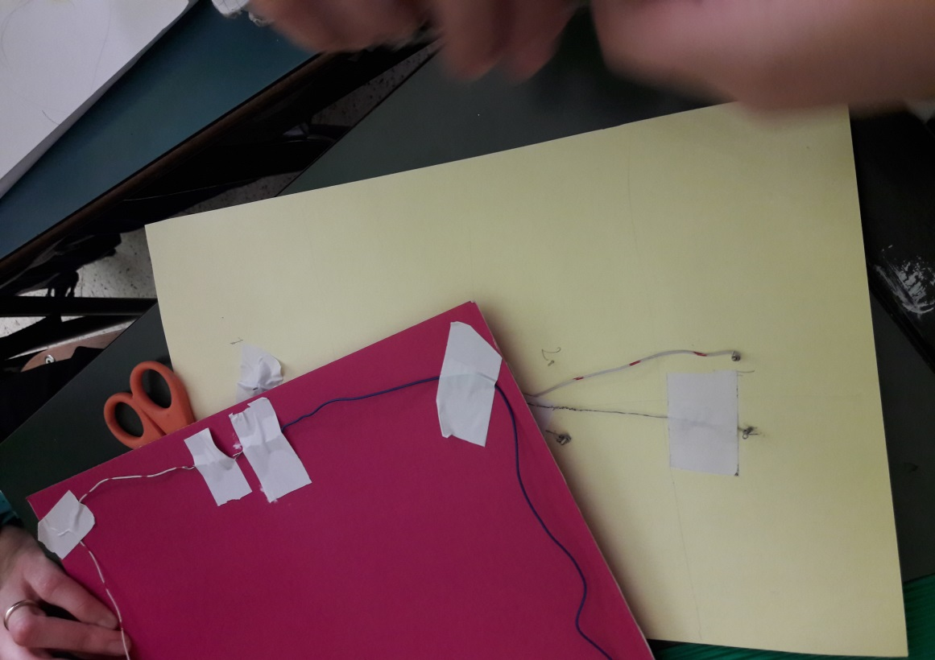
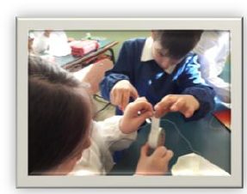
Make 2 holes on the top of the cardboard and insert the led. The longest led is the anode, shortest one is the catode. Take a wire wrap it around a leg of the led then fix it with a tape, let the wire go round the paper, then make 2 holes at the opposite side of the led and let the wire pass through it.
Take a second wire and wrap it around the 2nd leg. This is the catode. At the half of the side you stop and insert the battery. Connect the minus of the battery with the catode. The other wire goes on the opposite side.

Slide 6
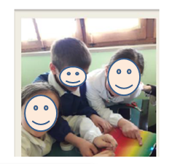
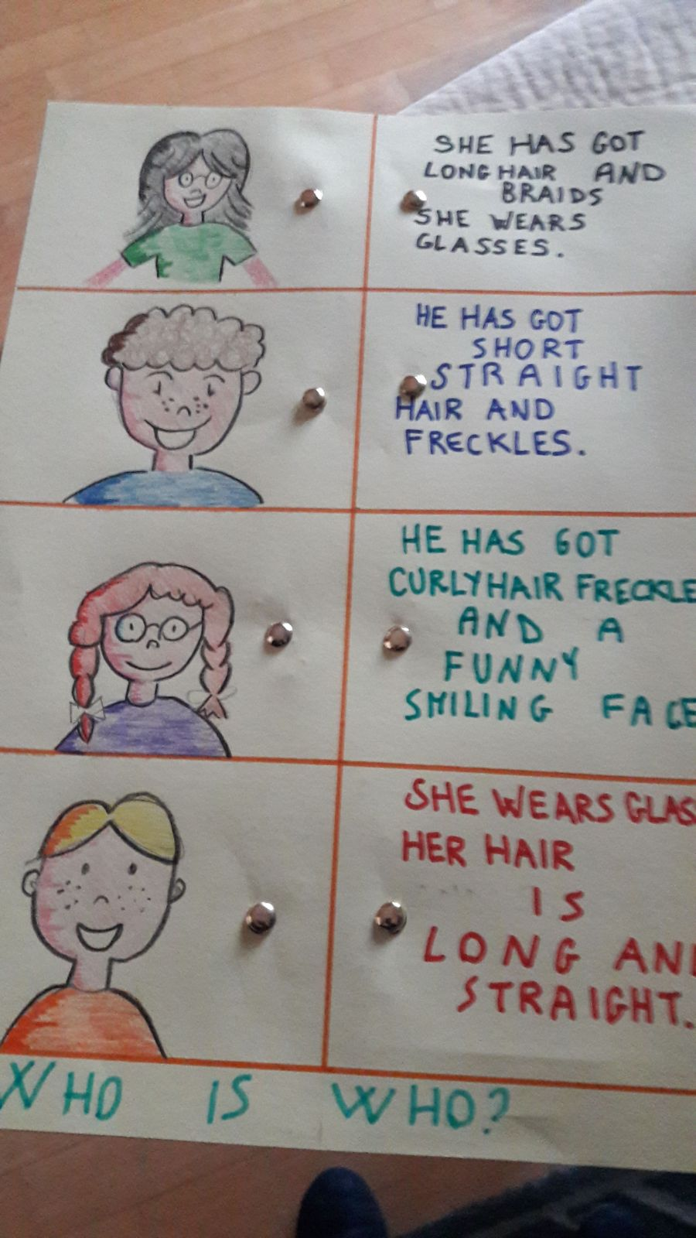
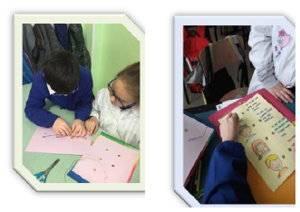
Put a tape on the battery, let the 2nd wire into the 2nd hole. Try it; it works! Now we make the quiz!
Connect the 2right answers in pairs.
Now we are ready to play!

Slide 7
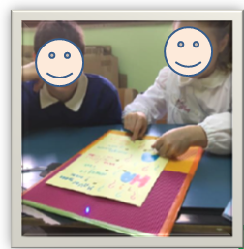
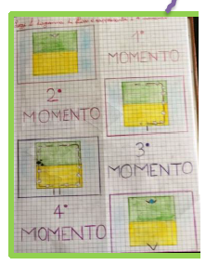
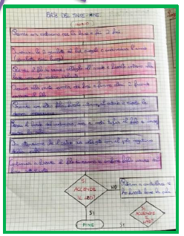
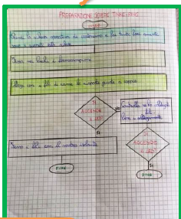
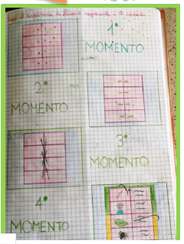
This is our report!

Slide 8
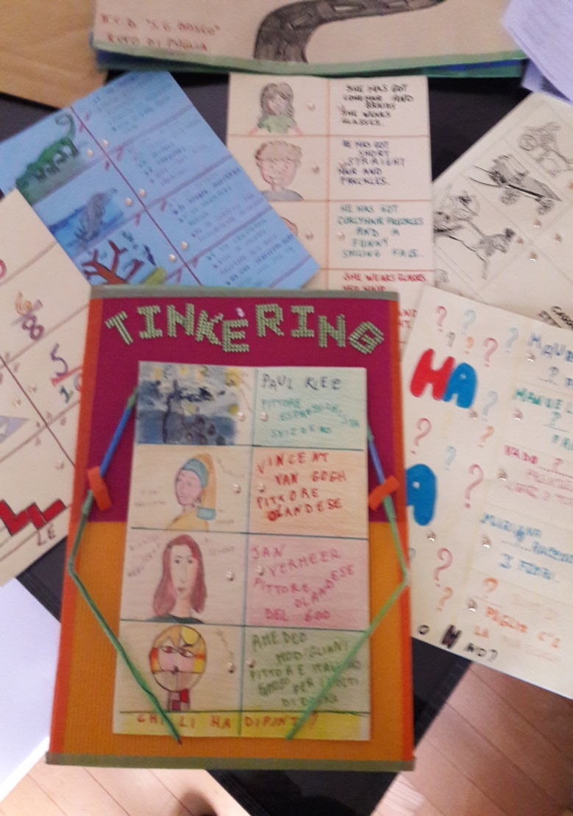
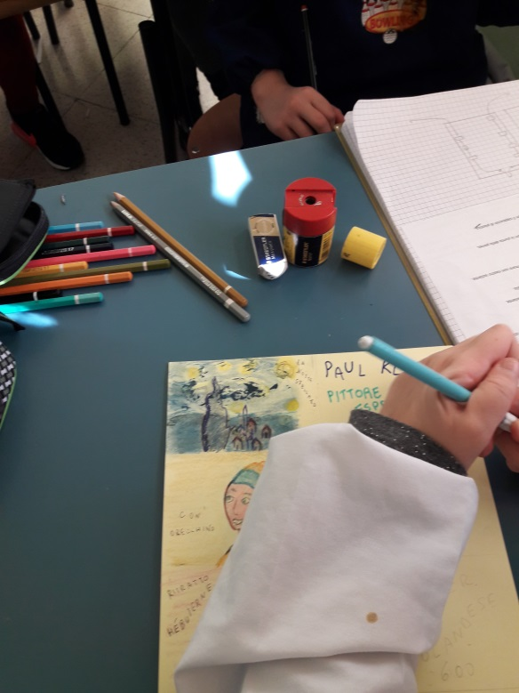
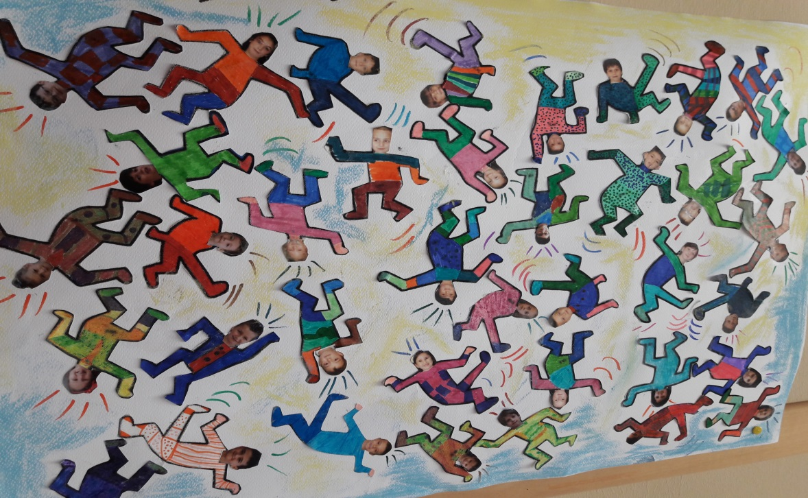
Done and signed!
ENJOY IT!

