Slide 1
The famous Polish people
Artists and discoverers

Slide 2
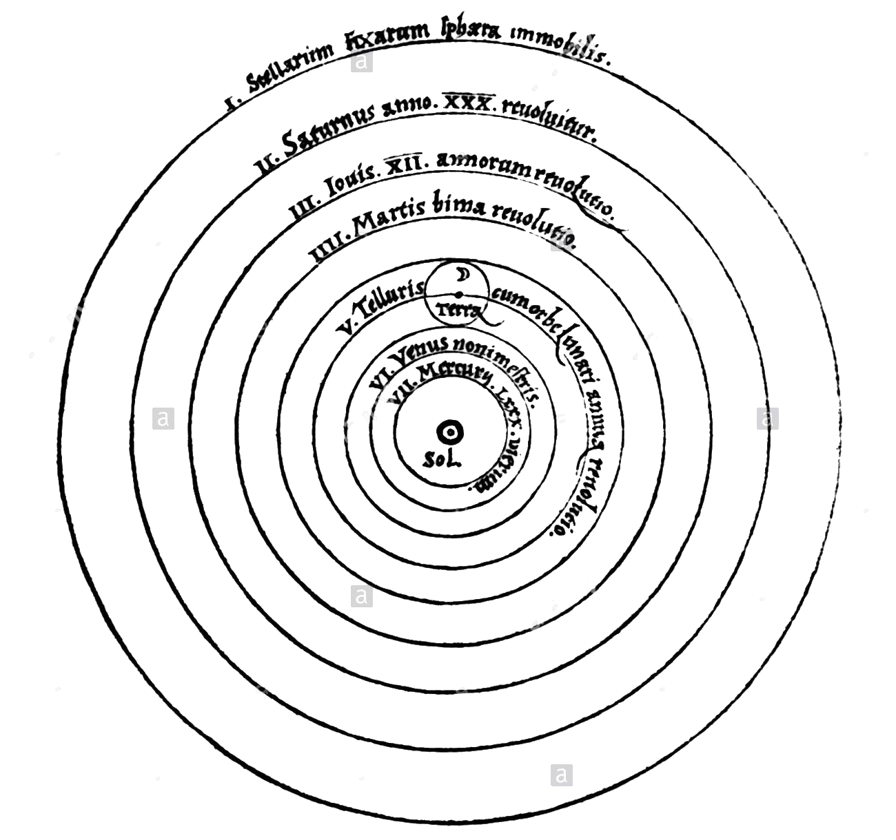
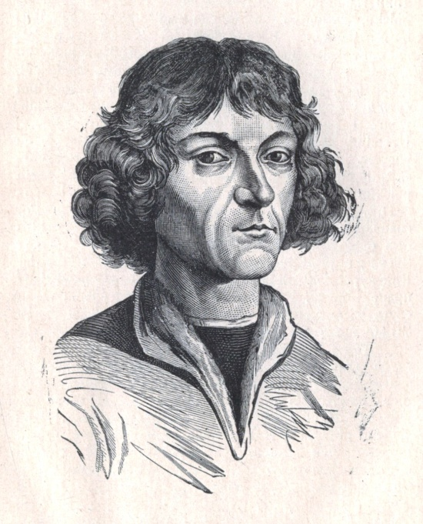
Mikołaj Kopernik
Polish astronomer, author of the work
„O obrotach sfer niebieskich” (De revolutionibus orbium coelestium).
This is what the following line says about him:
„He stopped the Sun, the Earth moved
The tribe gave him Polish…”
He lived in years 1473 – 1543.

Slide 3
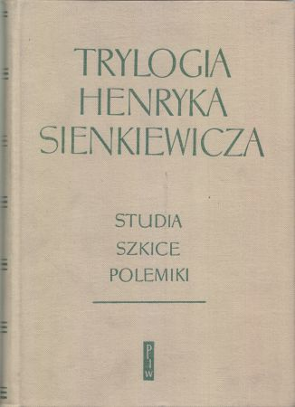
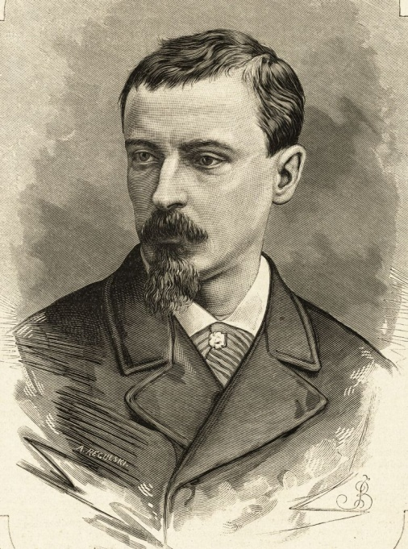
Henryk Sienkiewicz
Polish novelist, novelist and publicist.
In 1905, he was awarded the Nobel Prize in the field of literature for lifetime achievement.
He is one of the most popular Polish writers at the turn of the 19th and 20th centuries.
He wrote, among others "W pustyni i w puszczy" or "Trylogia" ...
He lived in years 1846 – 1916.

Slide 4
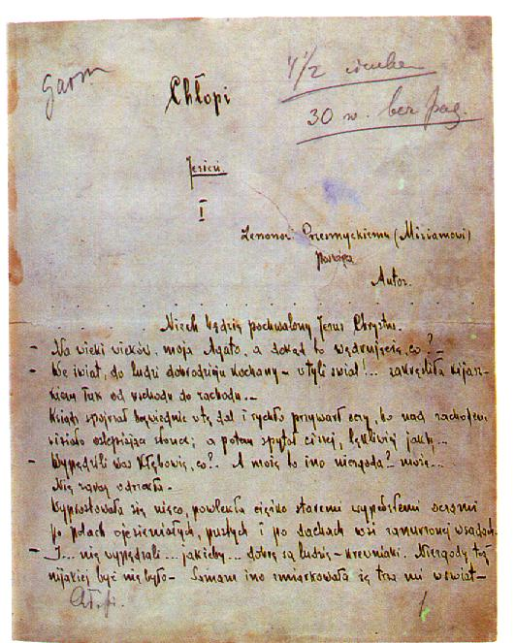
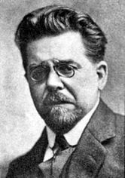
Władysław Reymont
Polish writer, prose writer and novelist.
Author of many novels, including the „Chłopi” epic, for which he received the Nobel Prize in 1924.
He lived in years 1867 – 1925.

Slide 5
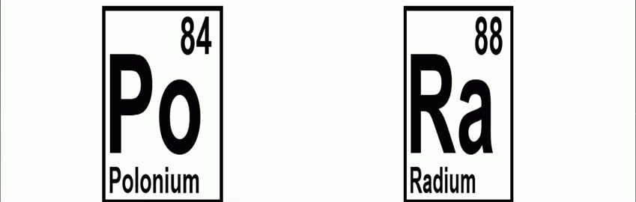
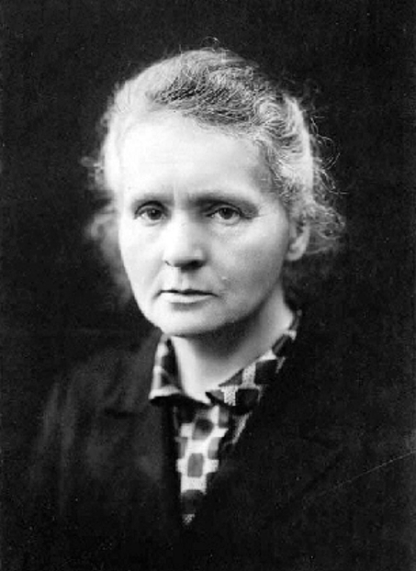
Maria Skłodowska - Curie
Polish physicist and chemist.
In 1898, she discovered two elements: Polon and Rad.
In 1903 and 1911 she was awarded the Nobel Prize.
She lived in years 1867 – 1925.

Slide 6
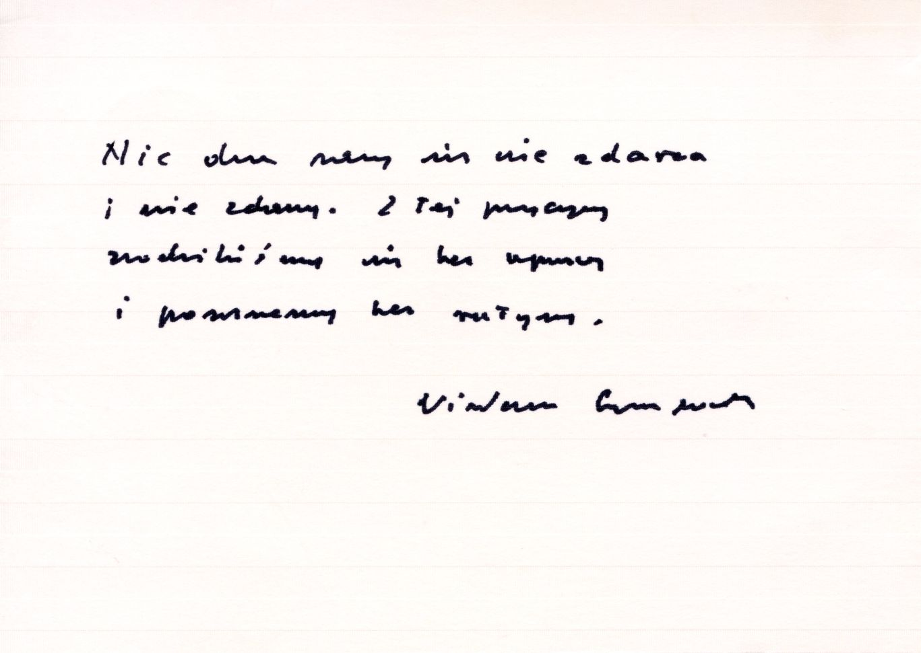
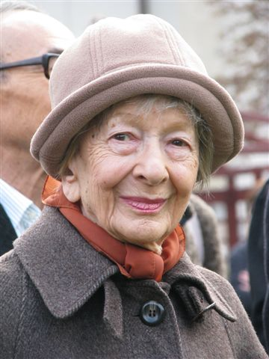
Wisława Szymborska
Polish poet, essayist, critic, translator, columnist. In 1996 she received the Nobel Prize field of literature .
In 1989, she founded the Polish Writers' Association.
In 1995 she became a member of the Polish Academy of Arts and Sciences, and in 2011 received the award of the Order of the White Eagle.
She lived in years 1923 – 2012.

Slide 7
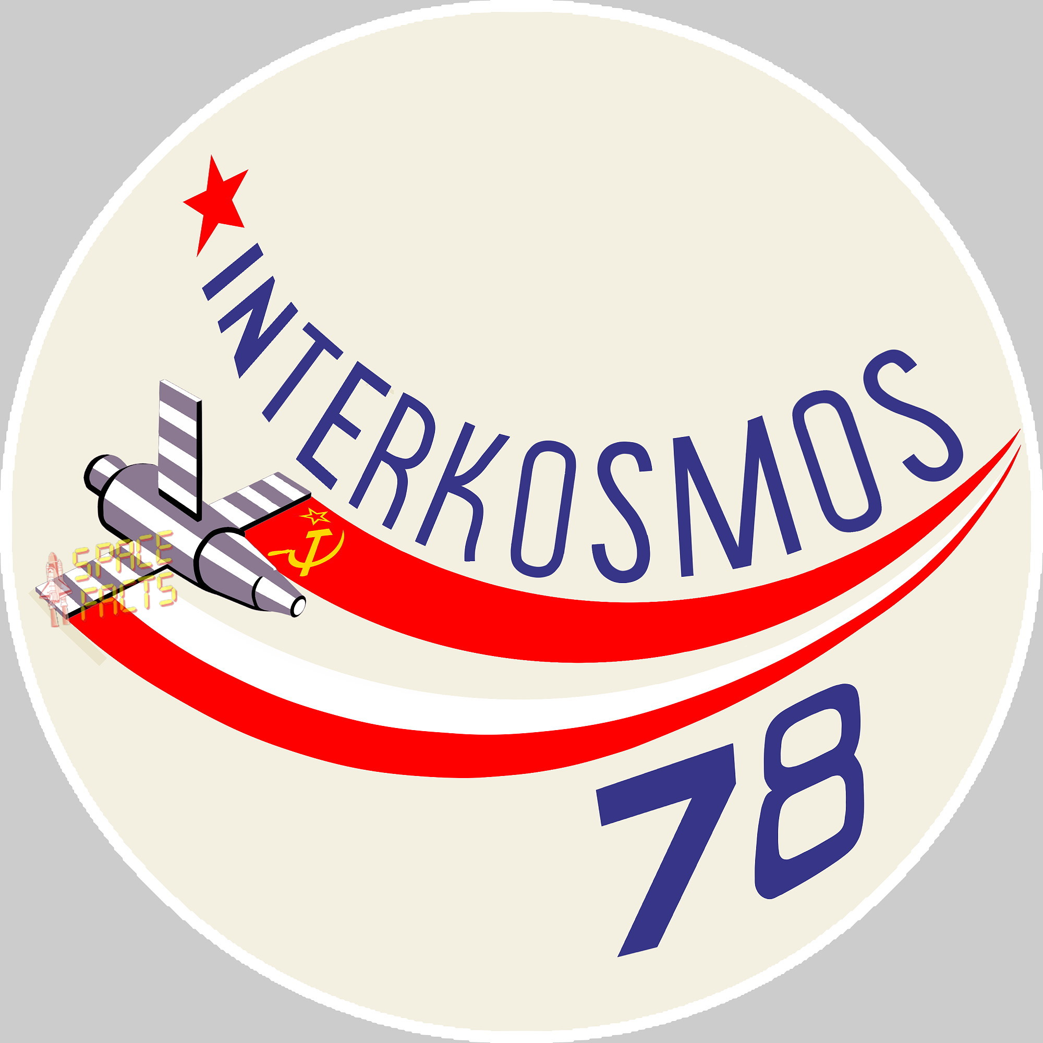
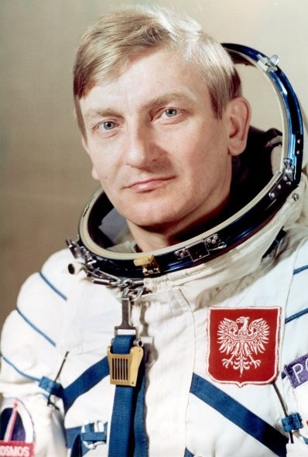
Mirosław Hermaszewski
Polish pilot and astronaut, Brigadier General, Polish Army pilot.
As the first and only Pole so far, he took a flight into space.
He started on June 27, 1978, aboard the Soyuz30 spacecraft.
He spent eight days in space.
He was born in 1941.

