Slide 1
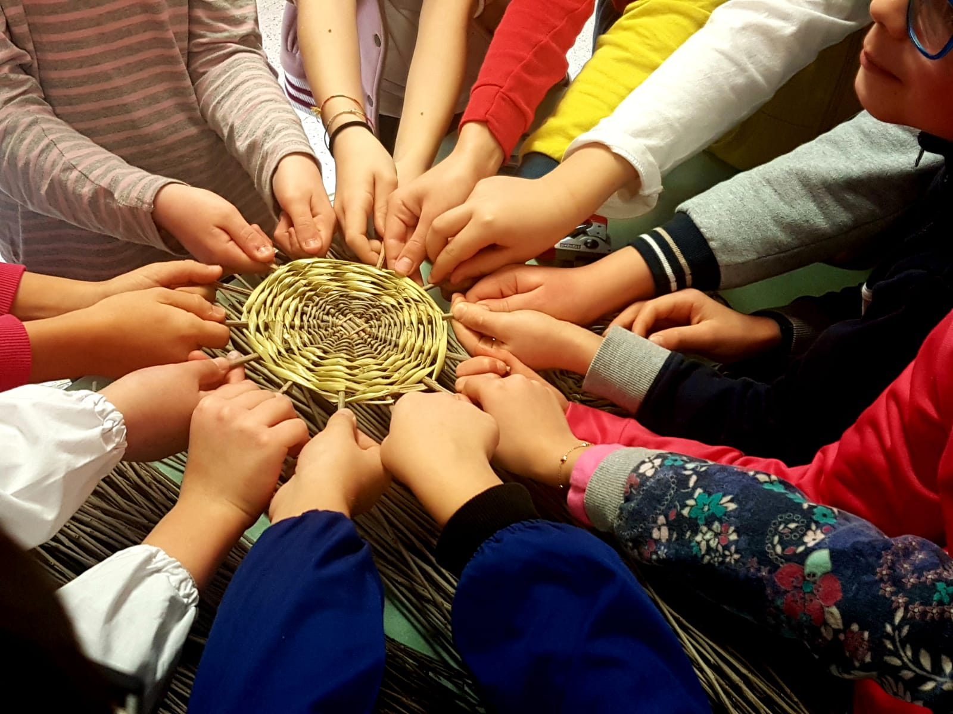
TINKERLAB: HOW TO MAKE BASKETS OUT OF OLIVE BRANCHES, AN OLD KNOWHOW OF OUR GREATGRANDFATHERS

Slide 2
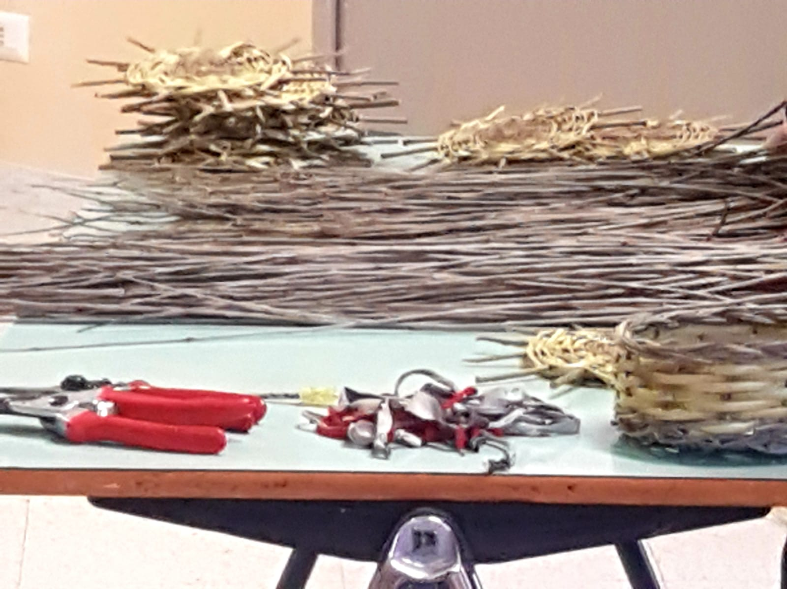
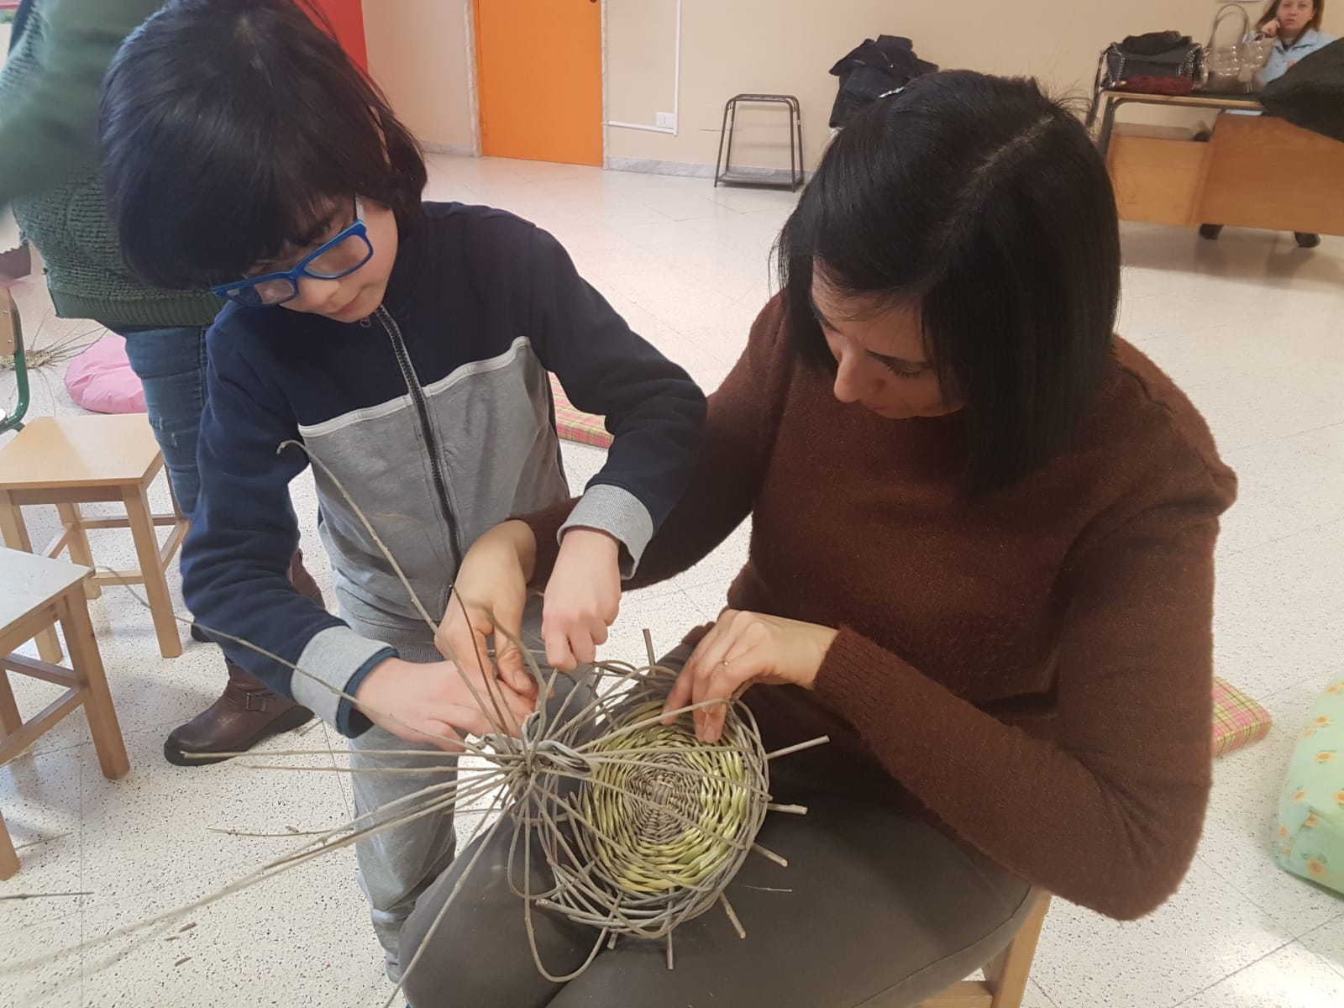
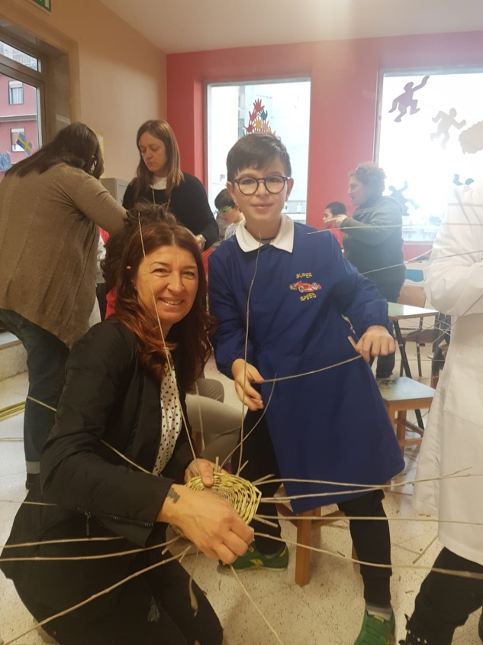
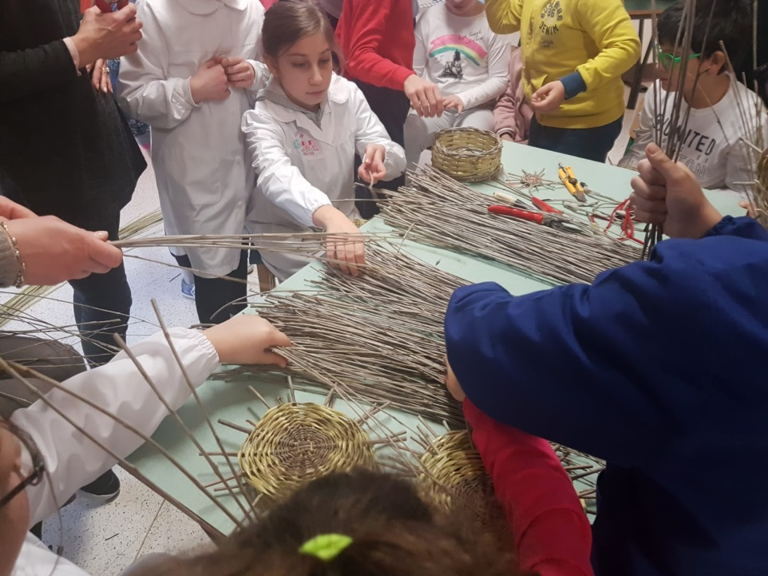

Slide 3
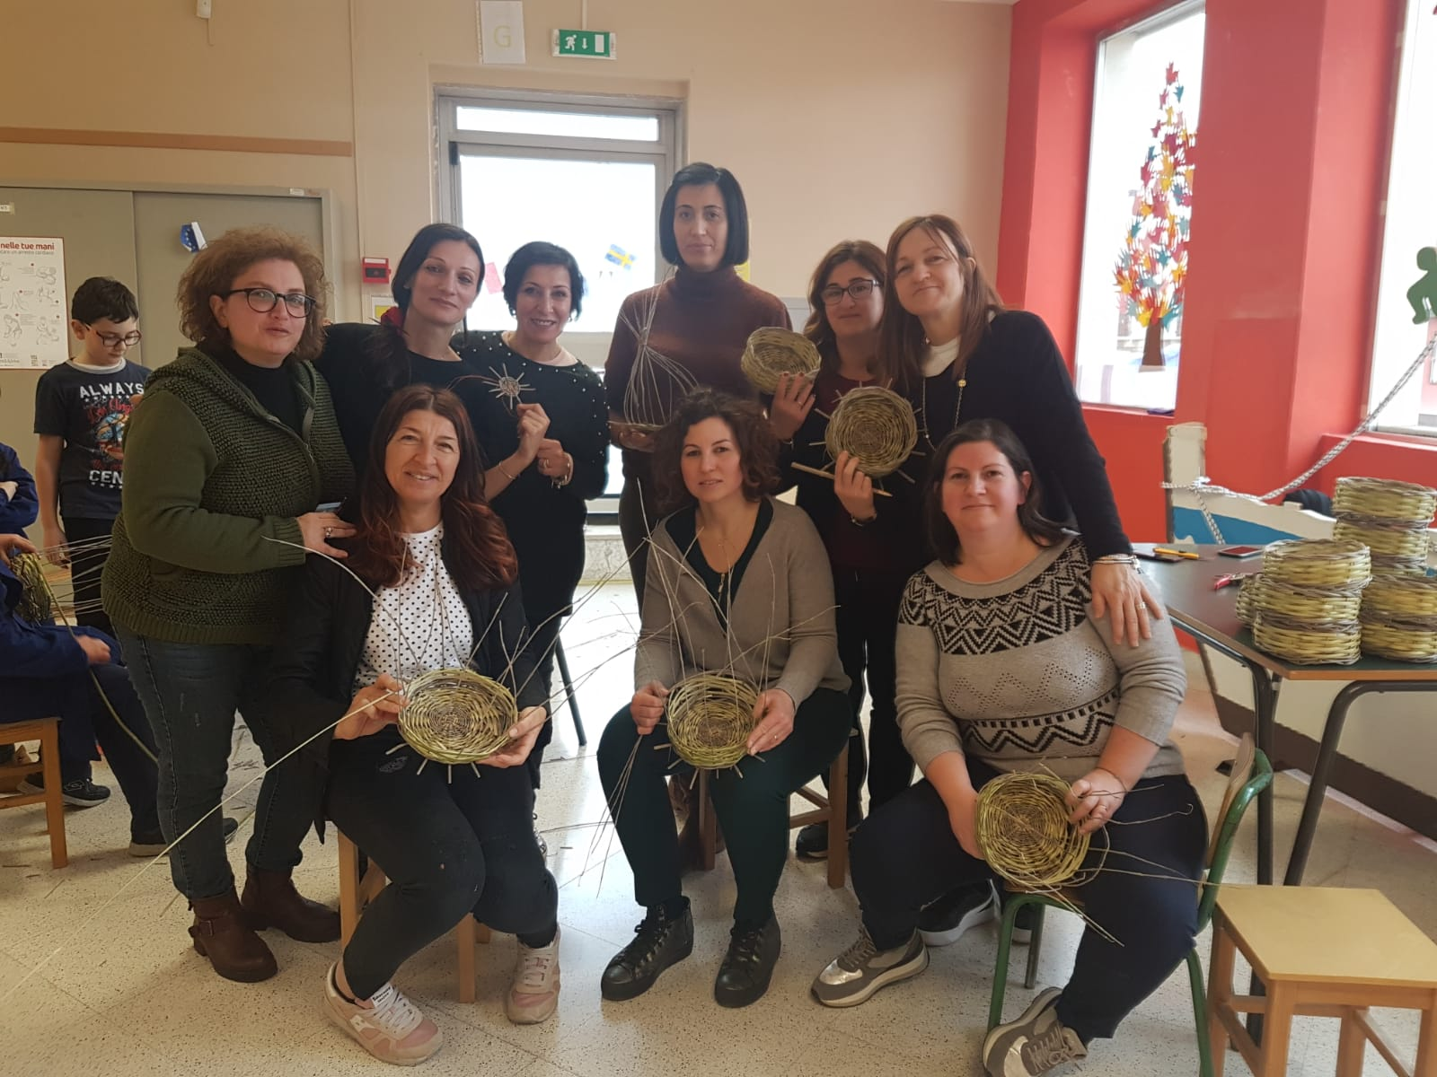
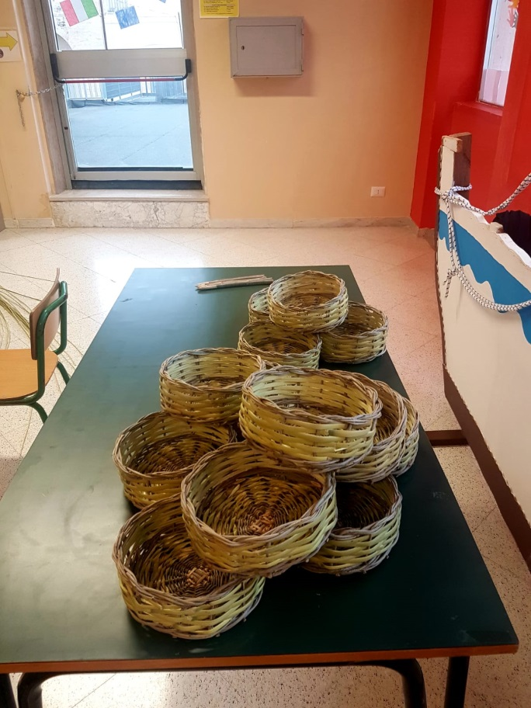
WITH A LITTLE HELP FROM AN EXPERT
OUR MUMS AND TEACHERS.

