Slide 1
CODY ROBY IN ITALY WITH ERASMUS+
CLASSI 5^ A-B-C
SCUOLA PRIMARIA S.G. BOSCO
A.S. 2018/19

Slide 2
CODY ROBY IN ITALY WITH ERASMUS+
Welcome to Italy. We are in Ruvo, in the south-east of Italy, in a region called Puglia.
Ruvo is a small town near Bari. It has 25,000 (twenty-five thousand) inhabitants. It is nice, relaxed and rich in history and culture: it has numerous monuments of the past. We hope you can spend a pleasant and interesting week in our school and our town.

Slide 3
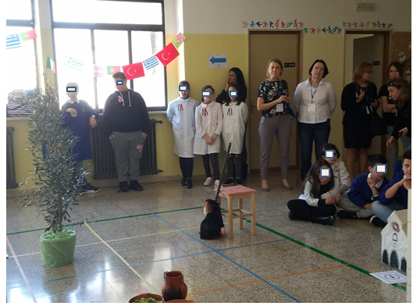
On the chessboard there are the most representative symbols of our city.

Slide 4
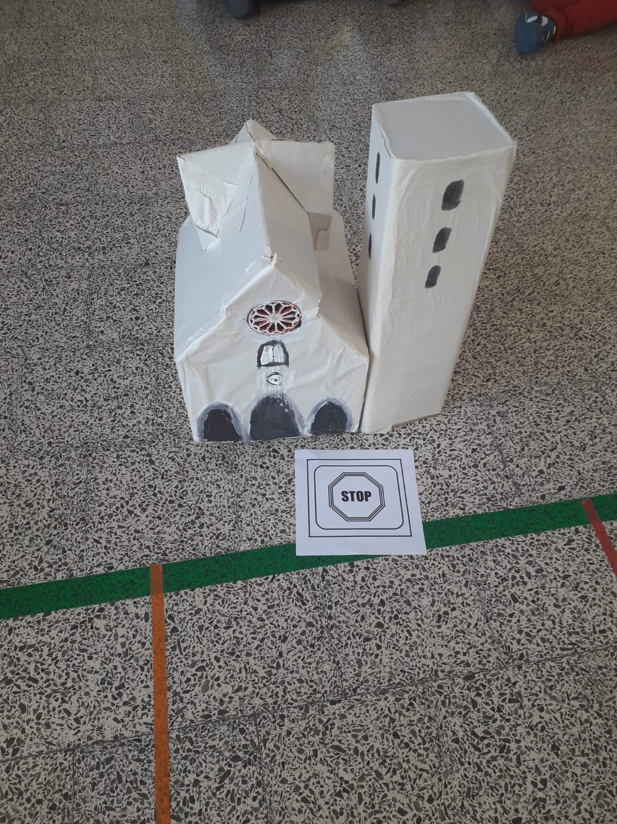
CODY ROBY IN ITALY WITH ERASMUS+
You can visit our romanesque cathedral. It was built in the eleventh century.

Slide 5
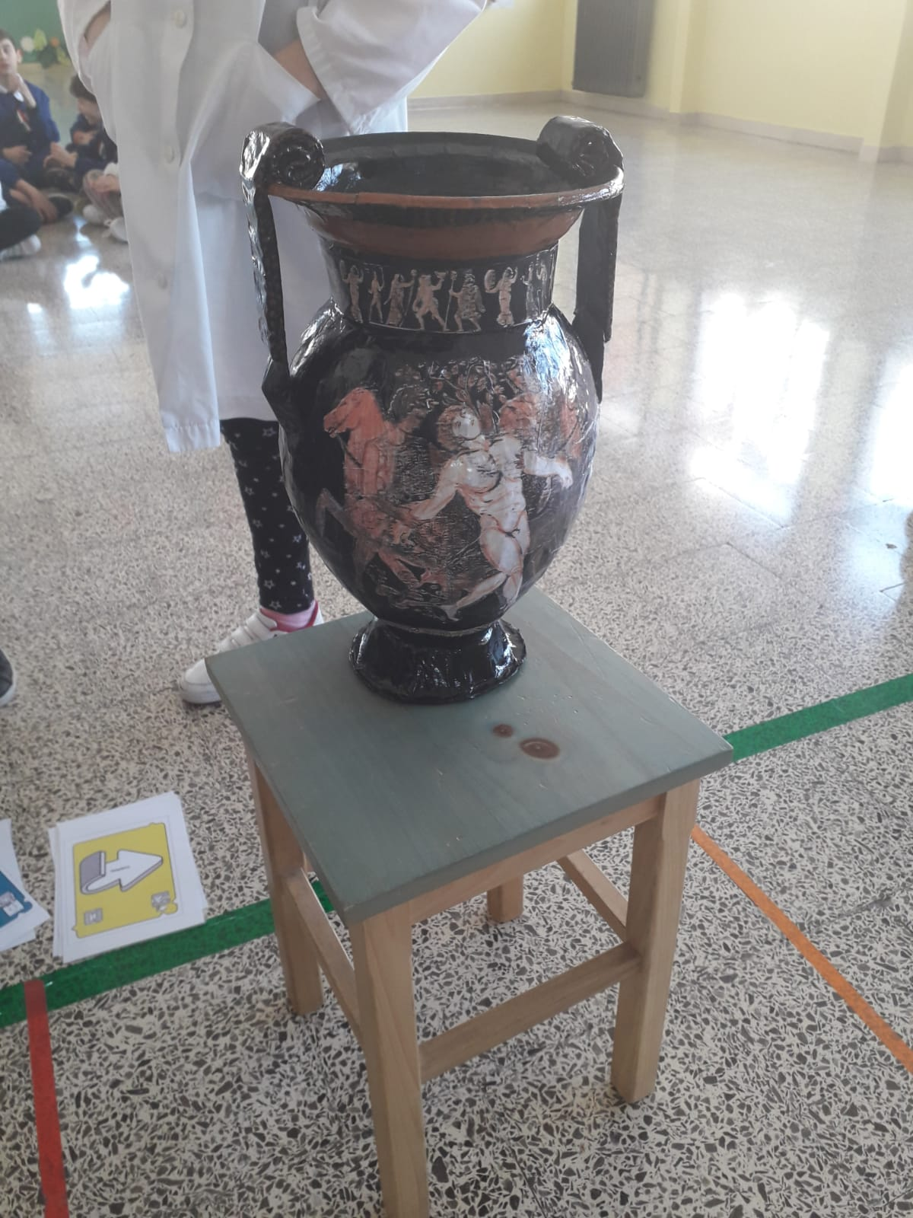
Jatta museum is famous for its Greek handcrafts. You can admire the vase of Talos, dating back to the 5th century BC (before Christ) which represents the Argonauts killing a giant.

Slide 6
The olive tree is the symbol of our Puglia, a great oil producer.

Slide 7
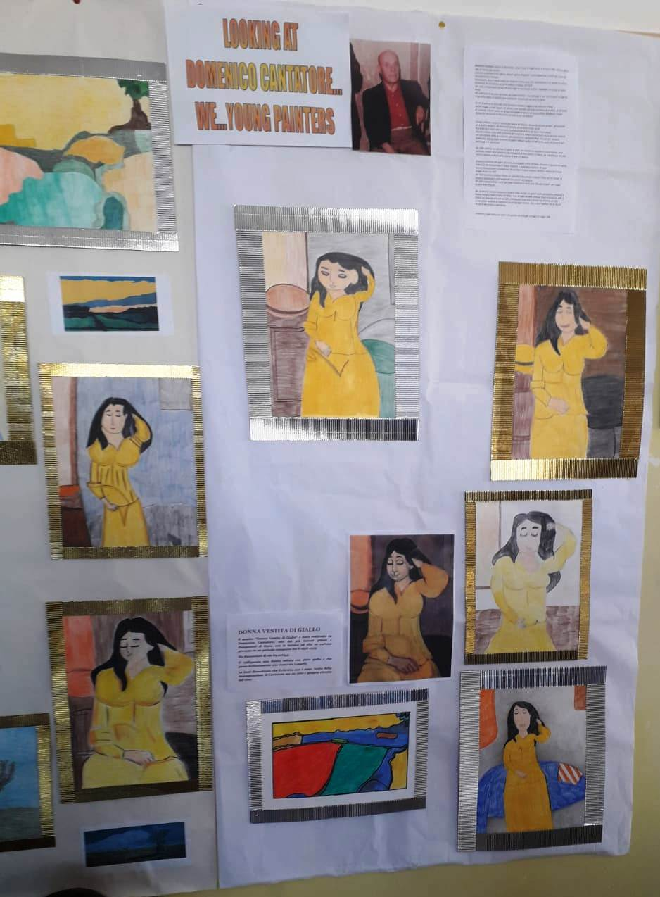
OUR STUDENTS HAVE DRAWN THE MOST FAMOUS PAINTINGS BY CANTATORE
Domenico Cantatore was a great painter who was born in Ruvo. Here are some famous paintings, preserved in the gallery.

Slide 8
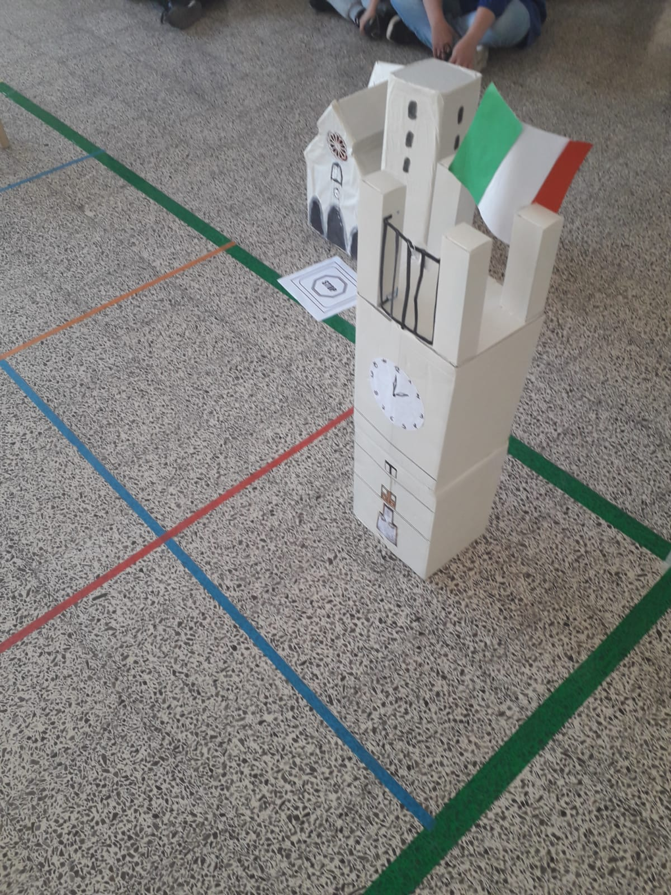
The Clock Tower is a public building. It marks the passing of time every quarter of an hour with the tolling of the bells. There is an important epigraph that recalls the greatness of the Roman Rubi.

Slide 9
Orecchiette (little ears) with turnips are our typical dish.
The quarantana is a puppet that is hung on the street during Lent.

Slide 10
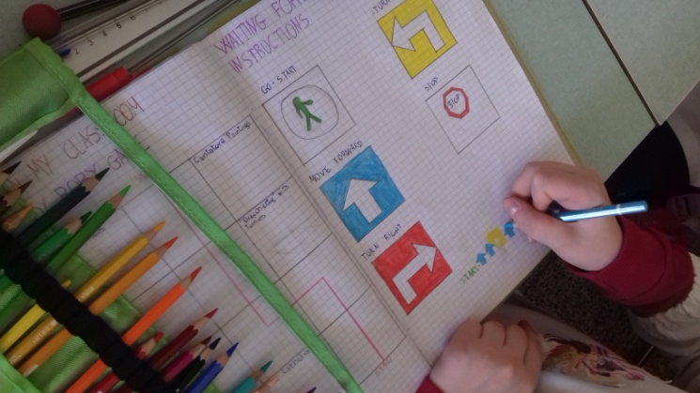
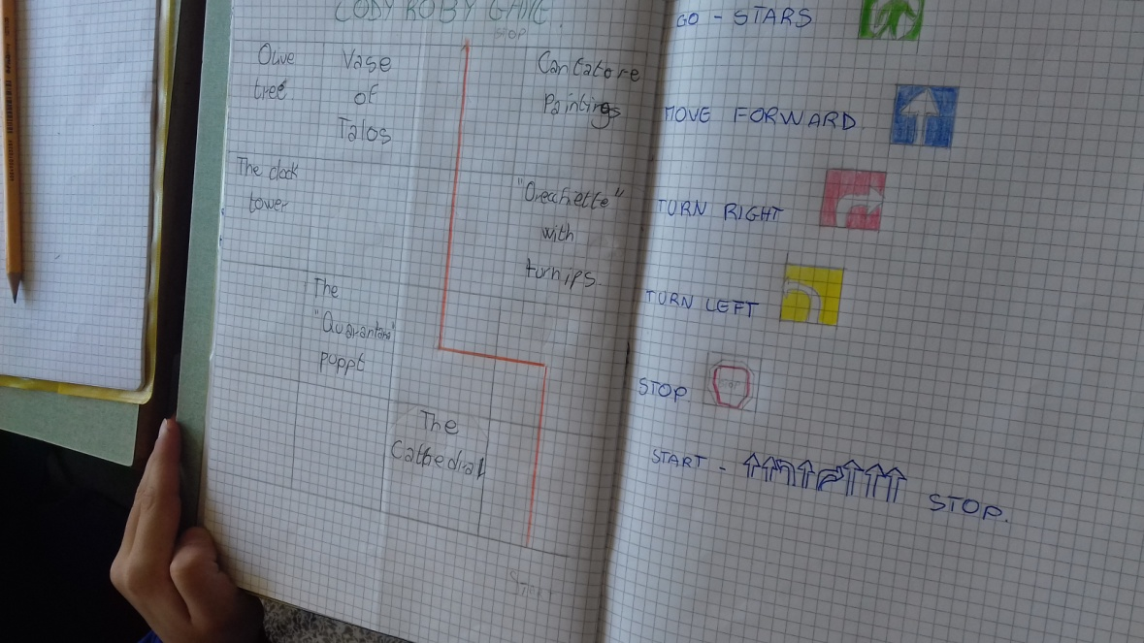
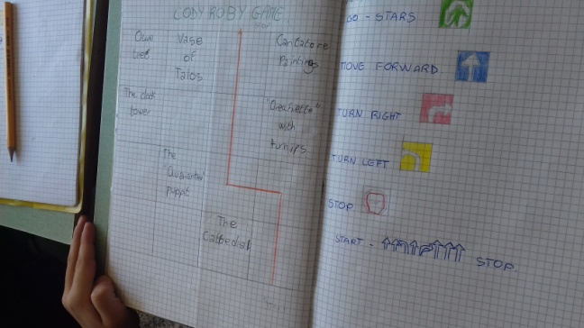
CODY ROBY
Cody roby is a new method to play unplugged games.
Roby is a robot who executes instructions.
Cody is a coder who provides instructions.

Slide 11
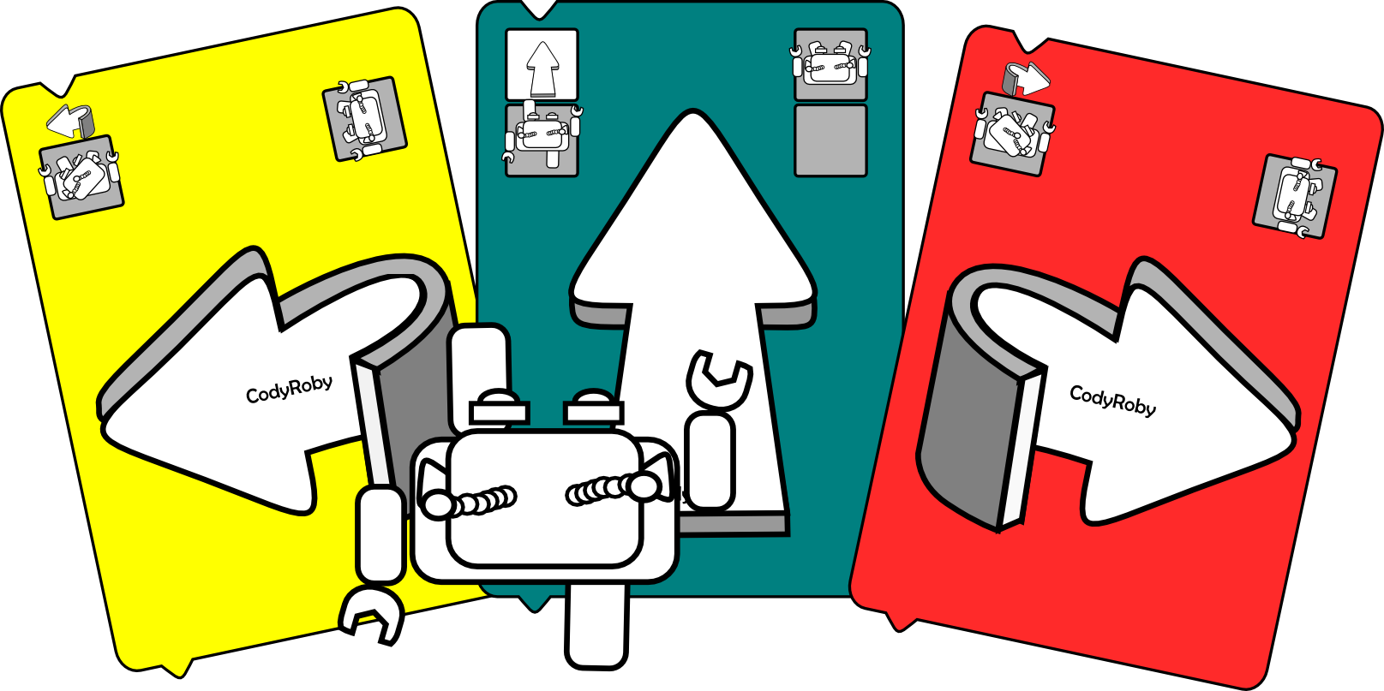
There are 40 cards and a giant chessboard.
The instructions are:
GO
MOVE FORWARD
TURN LEFT
TURN RIGHT
STOP
The instructions are drawn on a cards by an arrow.

Slide 12
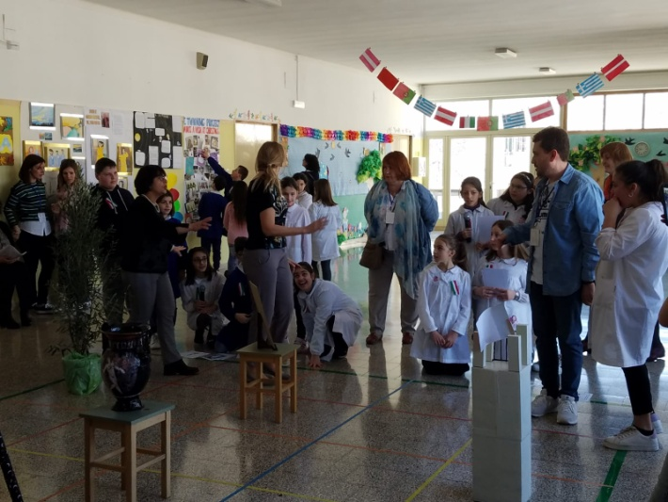
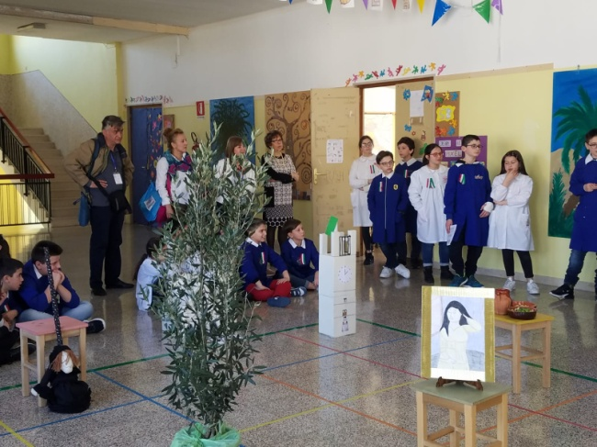
We play THE TOURIST.
A TOURIST wants to visit our city. There are two teams.
The teams A and B play at the same time. They will take the tourist to visit the chosen monument with the cody cards.
The teams take only the cards they need from the decks. They put the cards one under the others. The top card is the first instruction (move).
The team delivers the instructions to the tourist who performs them. If the instructions are right, the team wins. If the instructions are incorrect or there are unused cards the team loses.

Slide 13
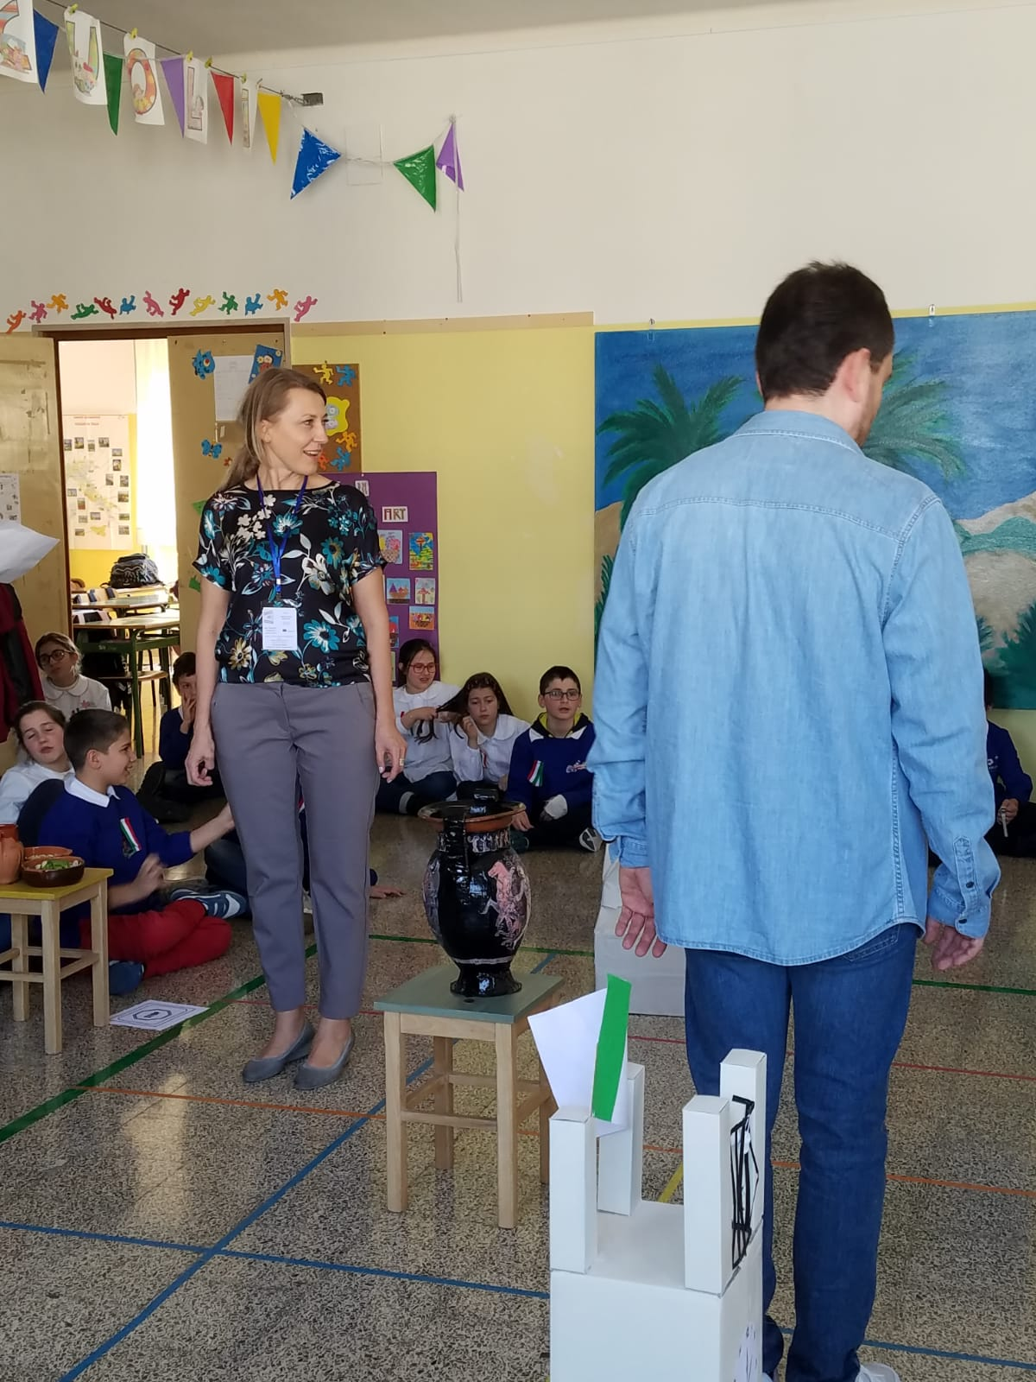
We play the duel
.
The duel is a cody roby card game for two teams.
The teams use the cody roby cards to move their robots on the chessboard in the attempt of catching each other.
The teams place their “roby” on two squares at the opposite corners of the board. The cards are on the floor.
The duel can start.
At each turn a team takes five cards from the top of the deck. The team evaluates the five cards in hand and use one or more of them to move its roby on board.
The winner is the team which moves its roby into a square already occupied by the other teams’ robot.

