Slide 1
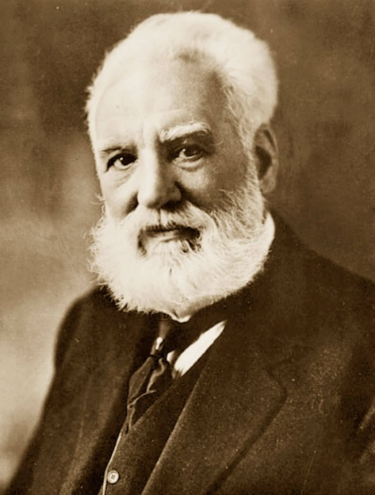
Antonio Meucci
Authors: Gattullo Lucia, Lobosco Giorgia ,Magrone Mattia

Slide 2
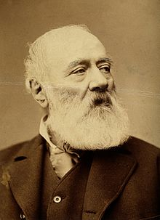
Antonio Meucci, was born Antonio Santi Giuseppe Meucci (Florence, 13 April 1808 - New York, 18 October 1889), he was an Italian inventor, famous for the development of a voice communication device accredited by various sources such as the first telephone, the so-called telephony.

Slide 3
BIOGRAPHY
Antonio Santi Giuseppe Meucci (Italian: [anˈtɔːnjo meˈuttʃi]; 13 April 1808 – 18 October 1889) was an Italian inventor and an associate of Giuseppe Garibaldi (a major political figure in the history of Italy).Meucci is best known for developing the first telephone.
Meucci set up a form of voice-communication link in his Staten Island, New York, home that connected the second-floor bedroom to his laboratory. He submitted a patent caveat for his telephonic device to the U.S. Patent Office in 1871, but there was no mention of electromagnetic transmission of vocal sound in his caveat. In 1876, Alexander Graham Bell was granted a patent for the electromagnetic transmission of vocal sound by undulatory electric current.[5] Despite the longstanding general crediting of Bell with the accomplishment, the Italian government[specify] later honored Meucci[when?] with the title "Inventore ufficiale del telefono" or "Official inventor of the telephone".[how?] The U.S. House of Representatives also honored Meucci in a resolution in 2002 for having had some role in the development of the telephone (although the U.S. Senate did not join the resolution and the interpretation of the resolution is disputed).

Slide 4
The telettrophone
On 12 December 1871, Meucci founded the Telephonic Company [24] with three Italians, whose goal was to carry out all the necessary experiments for the realization of the Telophone. The contract also envisaged extending the company's activities in every state of Europe and the world, in which the Telettronica Company proposed to obtain patents, to form affiliated companies and to grant licenses. My company is dissolved within a year, failed the previous attempt of 1860 to promote the sponsorship of the invention to some Italian entrepreneur, December 28, 1871 Antonio Meucci deposited at the US Patent Office, Washington, the caveat n. 3335 entitled Sound Telegraph in which he described his invention, waiting to find the $ 250 to file a regular patent.
I

Slide 5
n the summer of 1872, Antonio Meucci addressed the Vice President Mr. Edward B. Grant of the American District Telegraph Co. of New York, whose consultants were Alexander Graham Bell and Elisha Gray, to be allowed to experiment with his telephone in the telegraph lines of that company. Thanks Grant, after having promised his help, he was hesitating with various pretexts, after two years he asked for the restitution of the materials and drawings delivered, but he was told that they had been lost. In December 1874, Antonio could no longer find someone to lend the $ 10 needed to pay the annual maintenance fee for his caveat and therefore, as declined on December 28, 1874, according to the provisions of the then US patent law. However, some critics have questioned the aspect of the story, as Meucci was able to patent other inventions (35 years) 1872, 1875, 1875 and 1876. Freemason, awarded the 33rd degree of the ancient and accepted Scottish Rite, the August 8, 1888 he presided in New York, by delegation of the Grand Master of the Grand Orient of Italy Adriano Lemmi, the initiation at sight of an Italian diplomat.
The plaque of Antonio Meucci
On Friday 18 October 1889 at 9:40 am, Antonio Meucci died at his home in Clifton, Isola Staten, just before the company Globe Telephone Company presented his sentence, still confident in full recognition of his invention. His ashes are found at the Garibaldi-Meucci Museum in New York, along with the tomb of his wife Ester.

Slide 6
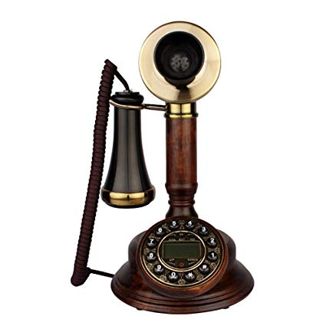
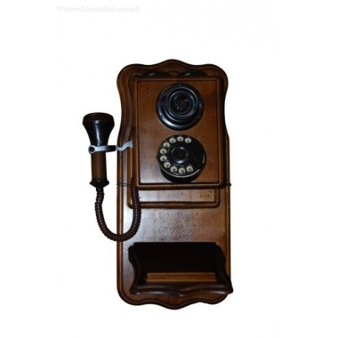
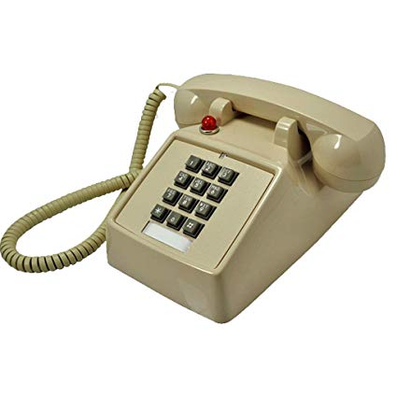
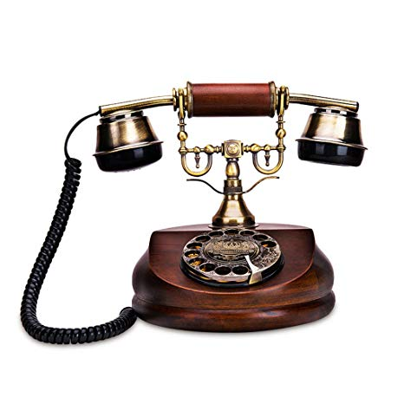
The end
Thank you for seeing it

