Slide 1
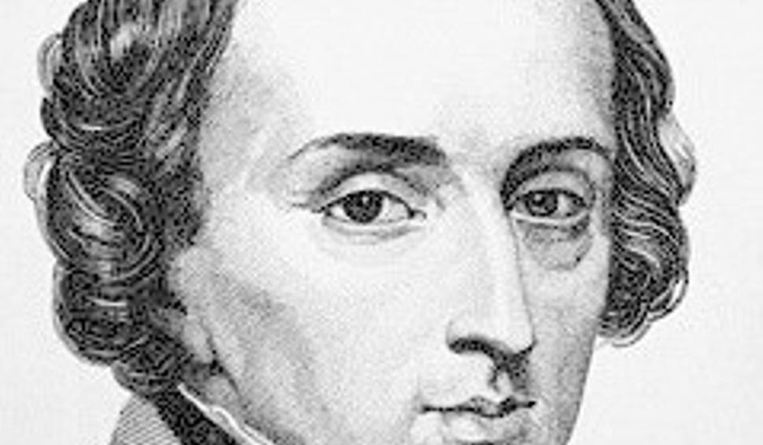
Fryderyk Chopin
biography

Slide 2
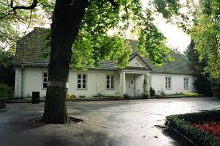
Fryderyk Chopin was one of the gratest Polish composer and pianist.
He was born First March 1810 in Żelazowa Wola.
His father Mikołaj Chopin was French, and his mother Justyna Krzyżanowska was Polish.
Fryderyk had three sisters : Ludwika, Izabella and Emilia.

Slide 3
He started to play the piano when he was 4 years old.
He composed his first Polonaise B flat minor when he was 7 years old.
He had his first public concert at the age of 8 years.

Slide 4
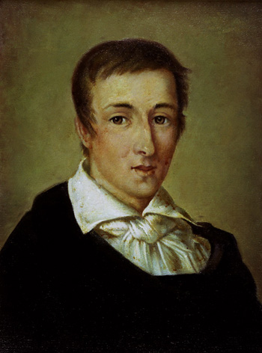
When Fryderyk was a teenanger he studied in Warsaw Liceum.
In 1826 he attended the Warsaw High School of Music. His teacher was a famoust composer Józef Elsner.

Slide 5
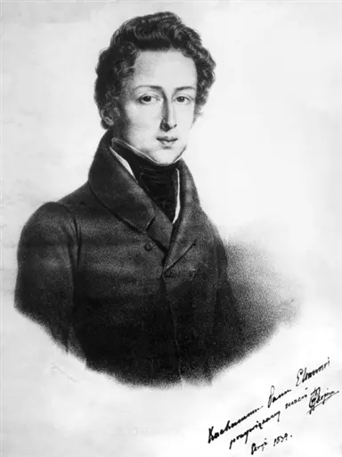
In 1830 he left Poland. He went to Paris, where he met many famous people.
In 1832 he gave his first concert in Paris and became a famoust pianist.

Slide 6
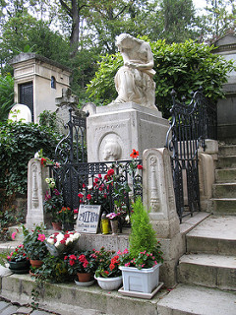
Chopin never married and never returned to Poland.
He died at age 39 in Paris.

Slide 7
Bibliography
https://życiorys.info/fryderyk_chopin
https:/pl.wikipedia.org/wiki/Fryderyk _Chopin
https:/culture .pl/pl/tworca/fryderyk-chopin
pl.chopin. Nifc.pl
https:/poranny.pl/
https:/czas dzieci.pl/

