Slide 1
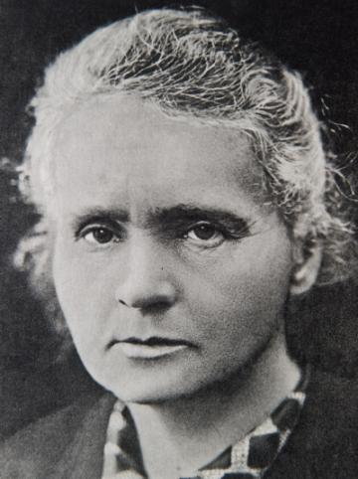
Maria Skłodowska-Curie
and her life
Work prepared by:
Anna Jagiełło
&
Weronika Rudnik
Szkoła Podstawowa nr 7 w Wołominie
class 6a

Slide 2
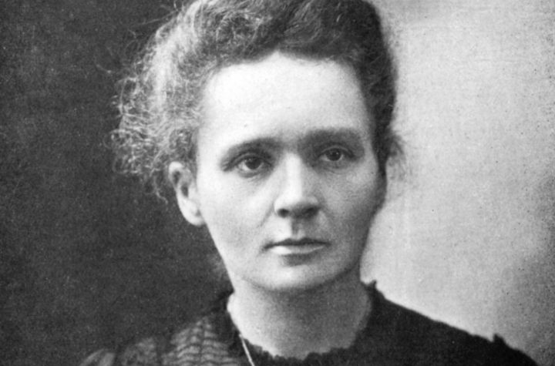
Maria Skłodowska-Curie was born on the 7th of November , 1867 in Warsaw. She was the first woman who won two Nobel Prizes.

Slide 3
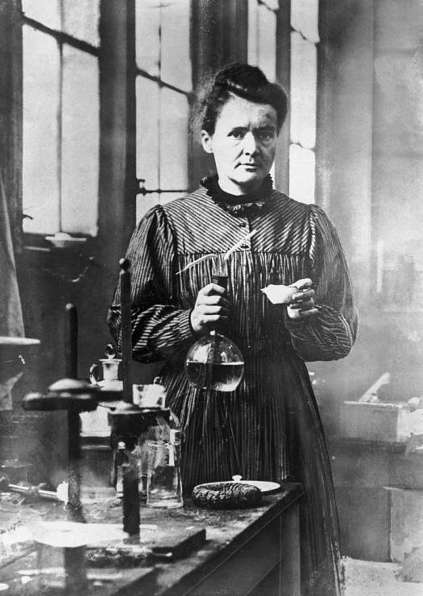
She won the first Nobel Prize in the field of chemistry ,
the second in the field of physics. She discovered the elements of Rad and Polon. Polon was named in honour of Poland.

Slide 4
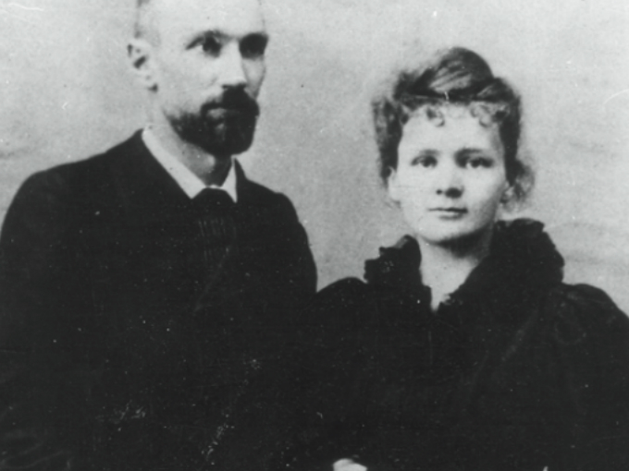
Her marriage to Pierre Curie lasted from 1895 to 1906. In the meantime, she gave birth to two daughters. Irene Joliot Curie and Eve Curie.

Slide 5
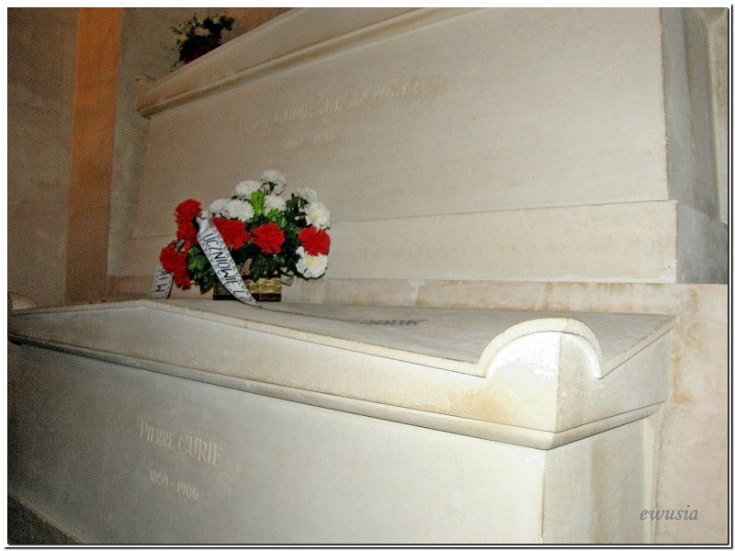
Maria Skłodowska Curie died on the 4th of July, 1934 in Passy. She was buried in the Pantheon.

Slide 6
Maria Skłodowska Curie is a great historical figure, we Polish people are pround of her.

Slide 7
Bibliography:
https://pl.wikipedia.org/wiki/Maria_Skłodowska-Curie
https://www.bing.com/images/search?q=maria+sk%c5%82odowska+curie+zdj%c4%99cia&FORM=HDRSC2

Slide 8
The End

