Slide 1
HERON OF ALEXANDRIA
Ο αλεξανδρευσ

Slide 2
Hero of Alexandria ( Ἀλεξανδρεύς) also known as Heron, was a mathematician and engineer who was active in his native city of Alexandria, Roman Egypt. He is considered the greatest experimenter of ancient times and his work is representative of the Hellenistic scientific tradition.Heron’s most important geometric work, Metrica, was lost in 1896. It is a compendium, in three books, of geometric rules and formulas that Heron gathered from a variety of sources, some of them going back to ancient Babylon, on areas and volumes of plane and solid figures..

Slide 3
HIS MOST FAMOYS INVENTION “AEOLIPILE”
Hero published a well-recognized description of a steam-powered device called an aeolipile sometimes called a "Hero engine". Among his most famous inventions was a windwheel, constituting the earliest instance of wind harnessing on land.He is said to have been a follower of the atomists. Some of his ideas were derived from the works of Ctesibius

Slide 4
HIS WRITINGS
Book I enumerates means of finding the area of various plane figures and the surface areas of common solids. Included is a derivation of Heron’s formula for the area A of a triangle,
A = √s(s−a)(s−b)(s−c)
in which a, b, and c are the lengths of the sides of the triangle, and s is one-half the triangle’s perimeter. Book I also contains an iterative method known by the Babylonians for approximating the square root of a number to arbitrary accuracy. A variation on such an iterative method is frequently employed by computers today. Book II gives methods for computing volumes of various solids, including the five regular Platonic solids. Book III treats the division of various plane and solid figures into parts according to some given ratio.

Slide 5
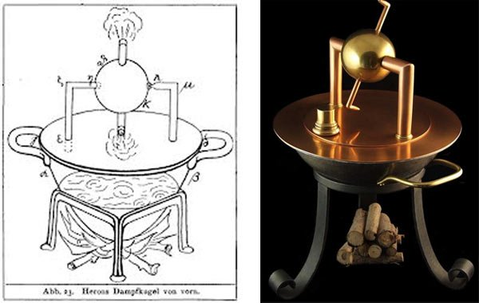
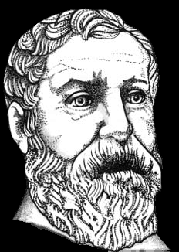
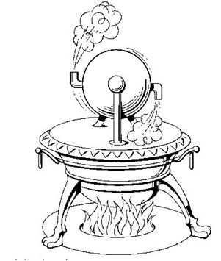
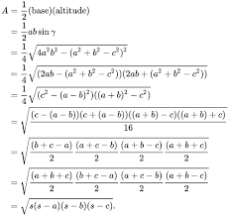

Slide 6
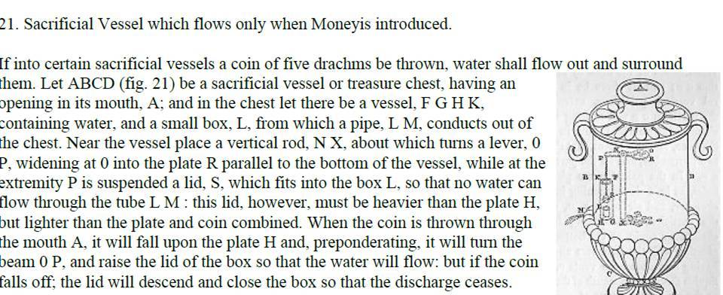
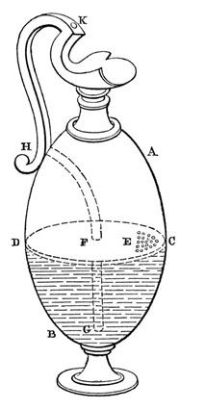
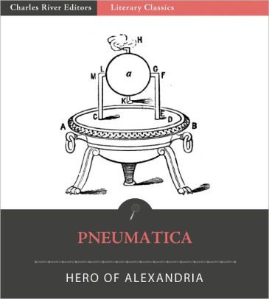
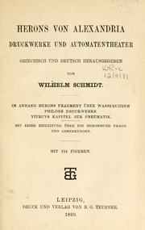

Slide 7
THANK YOU FOR YOUR ATTENTION
TULIN BIBER
ELPIDA ASLANIDOU
ANASTASIA SERNISLIDOU
ALEXANDROS ZOSIMIDIS

