Slide 1
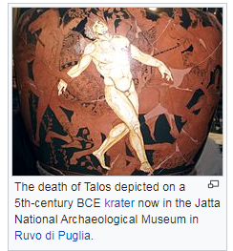
THE MYTH OF TALOS a show made by our pupils
In Greek mythology, Talos was a giant automaton made of bronze to protect Europa in Crete from pirates and invaders. He circled the island's shores three times daily.

Slide 2
