Slide 1
STUDYING THE HUMAN BODY
STEAM
S LIKE SCIENCE

Slide 2
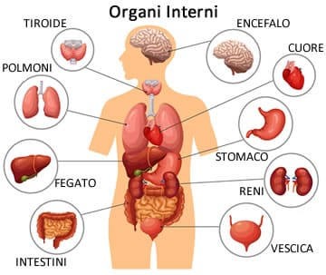
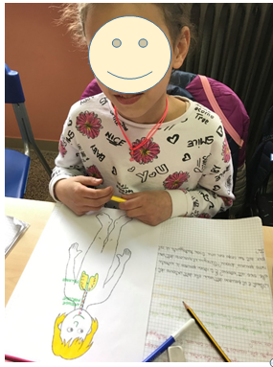
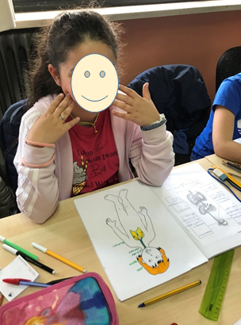

Slide 3
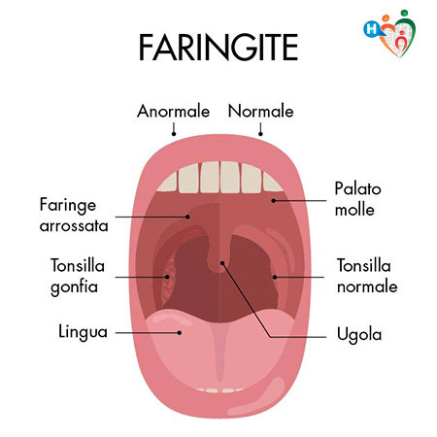
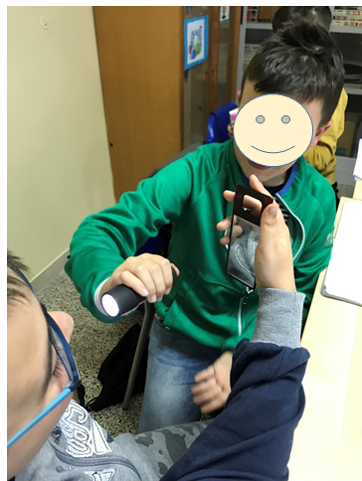
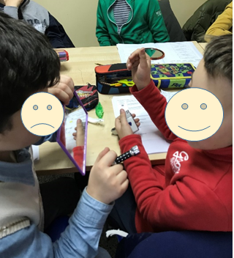
WE OBSERVE OUR FRIEND’S PHARYNX

Slide 4
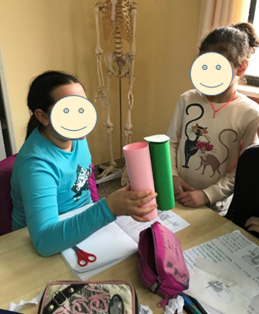
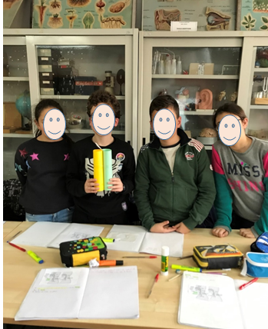
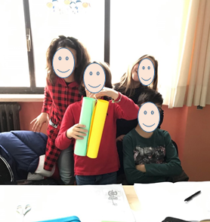
WE BUILD A MODEL OF LARYNX AND ESOPHAGUS WITH EPIGLOTTIS

Slide 5
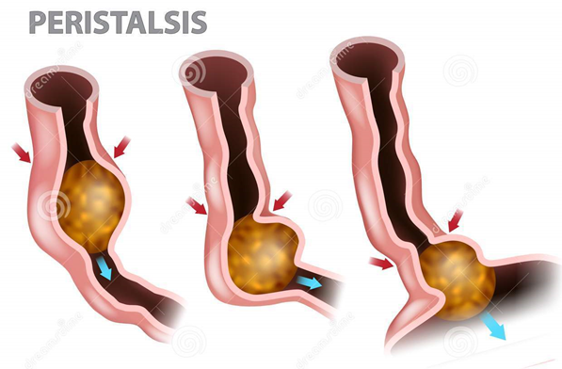
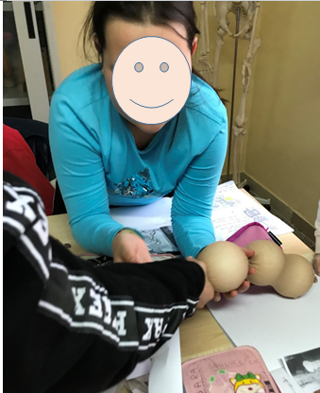
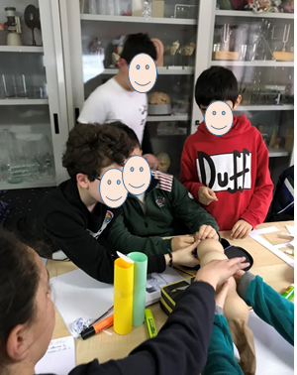
WITH A SOCK AND POLYSTYRENE BALLS SIMULATE THE MOVEMENT OF THE PERISTALSIS.

Slide 6
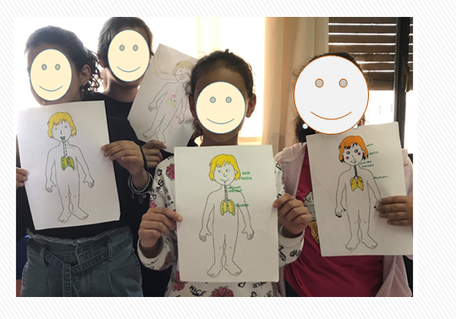
MY IDEA ABOUT THE ROUTE OF THE AIR

Slide 7
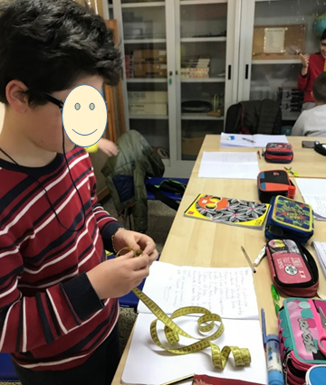
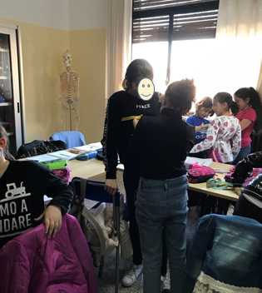
WE USE THE CENTIMETER
TO MEASURE THE WIDTH OF MY CHEST DURING THE INSPIRATION

