Slide 1
Leonardo Da Vinci and his inventions
Work of Lucia Gattullo, Mattia Magrone and Giorgia Lobosco
Class 5°D
school : Bartolo di Terlizzi

Slide 2
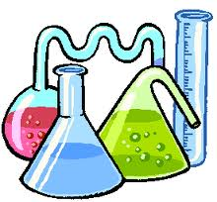
One scientist best italian
Leonardo Da Vinci was a big artist and scientist

Slide 3
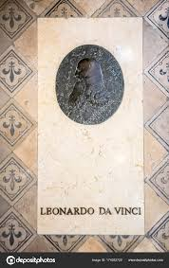
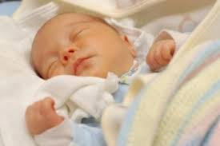
Leonardo da vinci’ s life
He was born the 15 TH april 1452 to Anchiano
He was deade the 2 ND may 1519 to Amboise

Slide 4
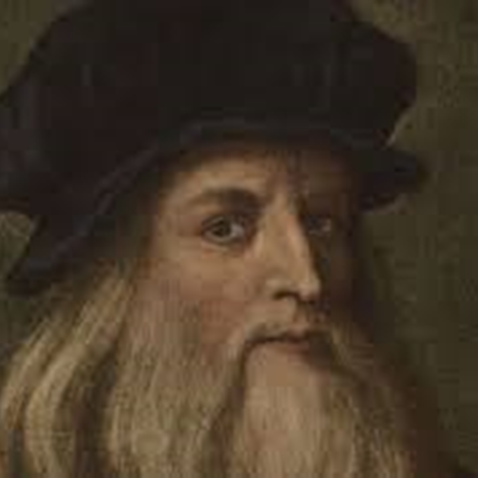
biography
On 23 April 1519 he wrote his will before the notary Guglielmo Boreau, in the presence of five witnesses and of the inseparable Francesco Melzi: he wished to be buried in the church of San Fiorentino, with a funeral ceremony accompanied by chaplains and minor friars, as well as from sixty poor, each holding a torch; he requested the celebration of three solemn masses, with deacon and subdeacon, and of thirty "low" masses, in San Gregorio, in Saint-Denis and in the church of the Franciscans.

Slide 5
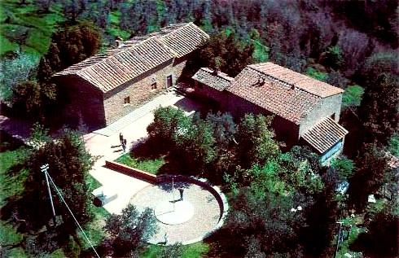
He lived in the time of the Renaissance. He is famous for his paintings, but he was also a scientist, mathematician, engineer, inventor, anatomist, sculptor, architect, botanist, musician, and a writer. Leonardo wanted to know everything about nature. He wanted to know how everything worked. He was very good at studying, designing and making all sorts of interesting things.

Slide 6
Many people think that Leonardo was one of the greatest painters of all time. Other people think that he was the most talented person ever to have lived. The art historian Helen Gardner said that no-one has ever been quite like him because he was interested in so many things that he seems to have had the mind of a giant, and yet what he was like as a person is still a mystery.
Leonardo was born at Vinci which is a small town near Florence, Italy. He was trained to be an artist by the sculptor and painter Verrocchio. He spent most of his life working for rich Italian noblemen. In his last years, he lived in a beautiful home given to him by the King of France.

Slide 7
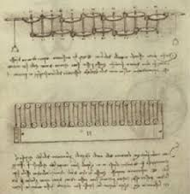
Two of his pictures are among the best-known paintings in the world: the Mona Lisa and The Last Supper. He did many drawings. The best-known drawing is Vitruvian Man. Leonardo was often thinking of new inventions. He kept notebooks with notes and drawings of these ideas. Most of his inventions were never made. Some of his ideas were a helicopter, a tank, a calculator, a parachute, a robot, a telephone, evolution, and solar power.

Slide 8
The best paintings

Slide 9
The best inventions

Slide 10
The end
thanks for watching

