Slide 1
Wolomin
The most important landmarks of Wolomin

Slide 2
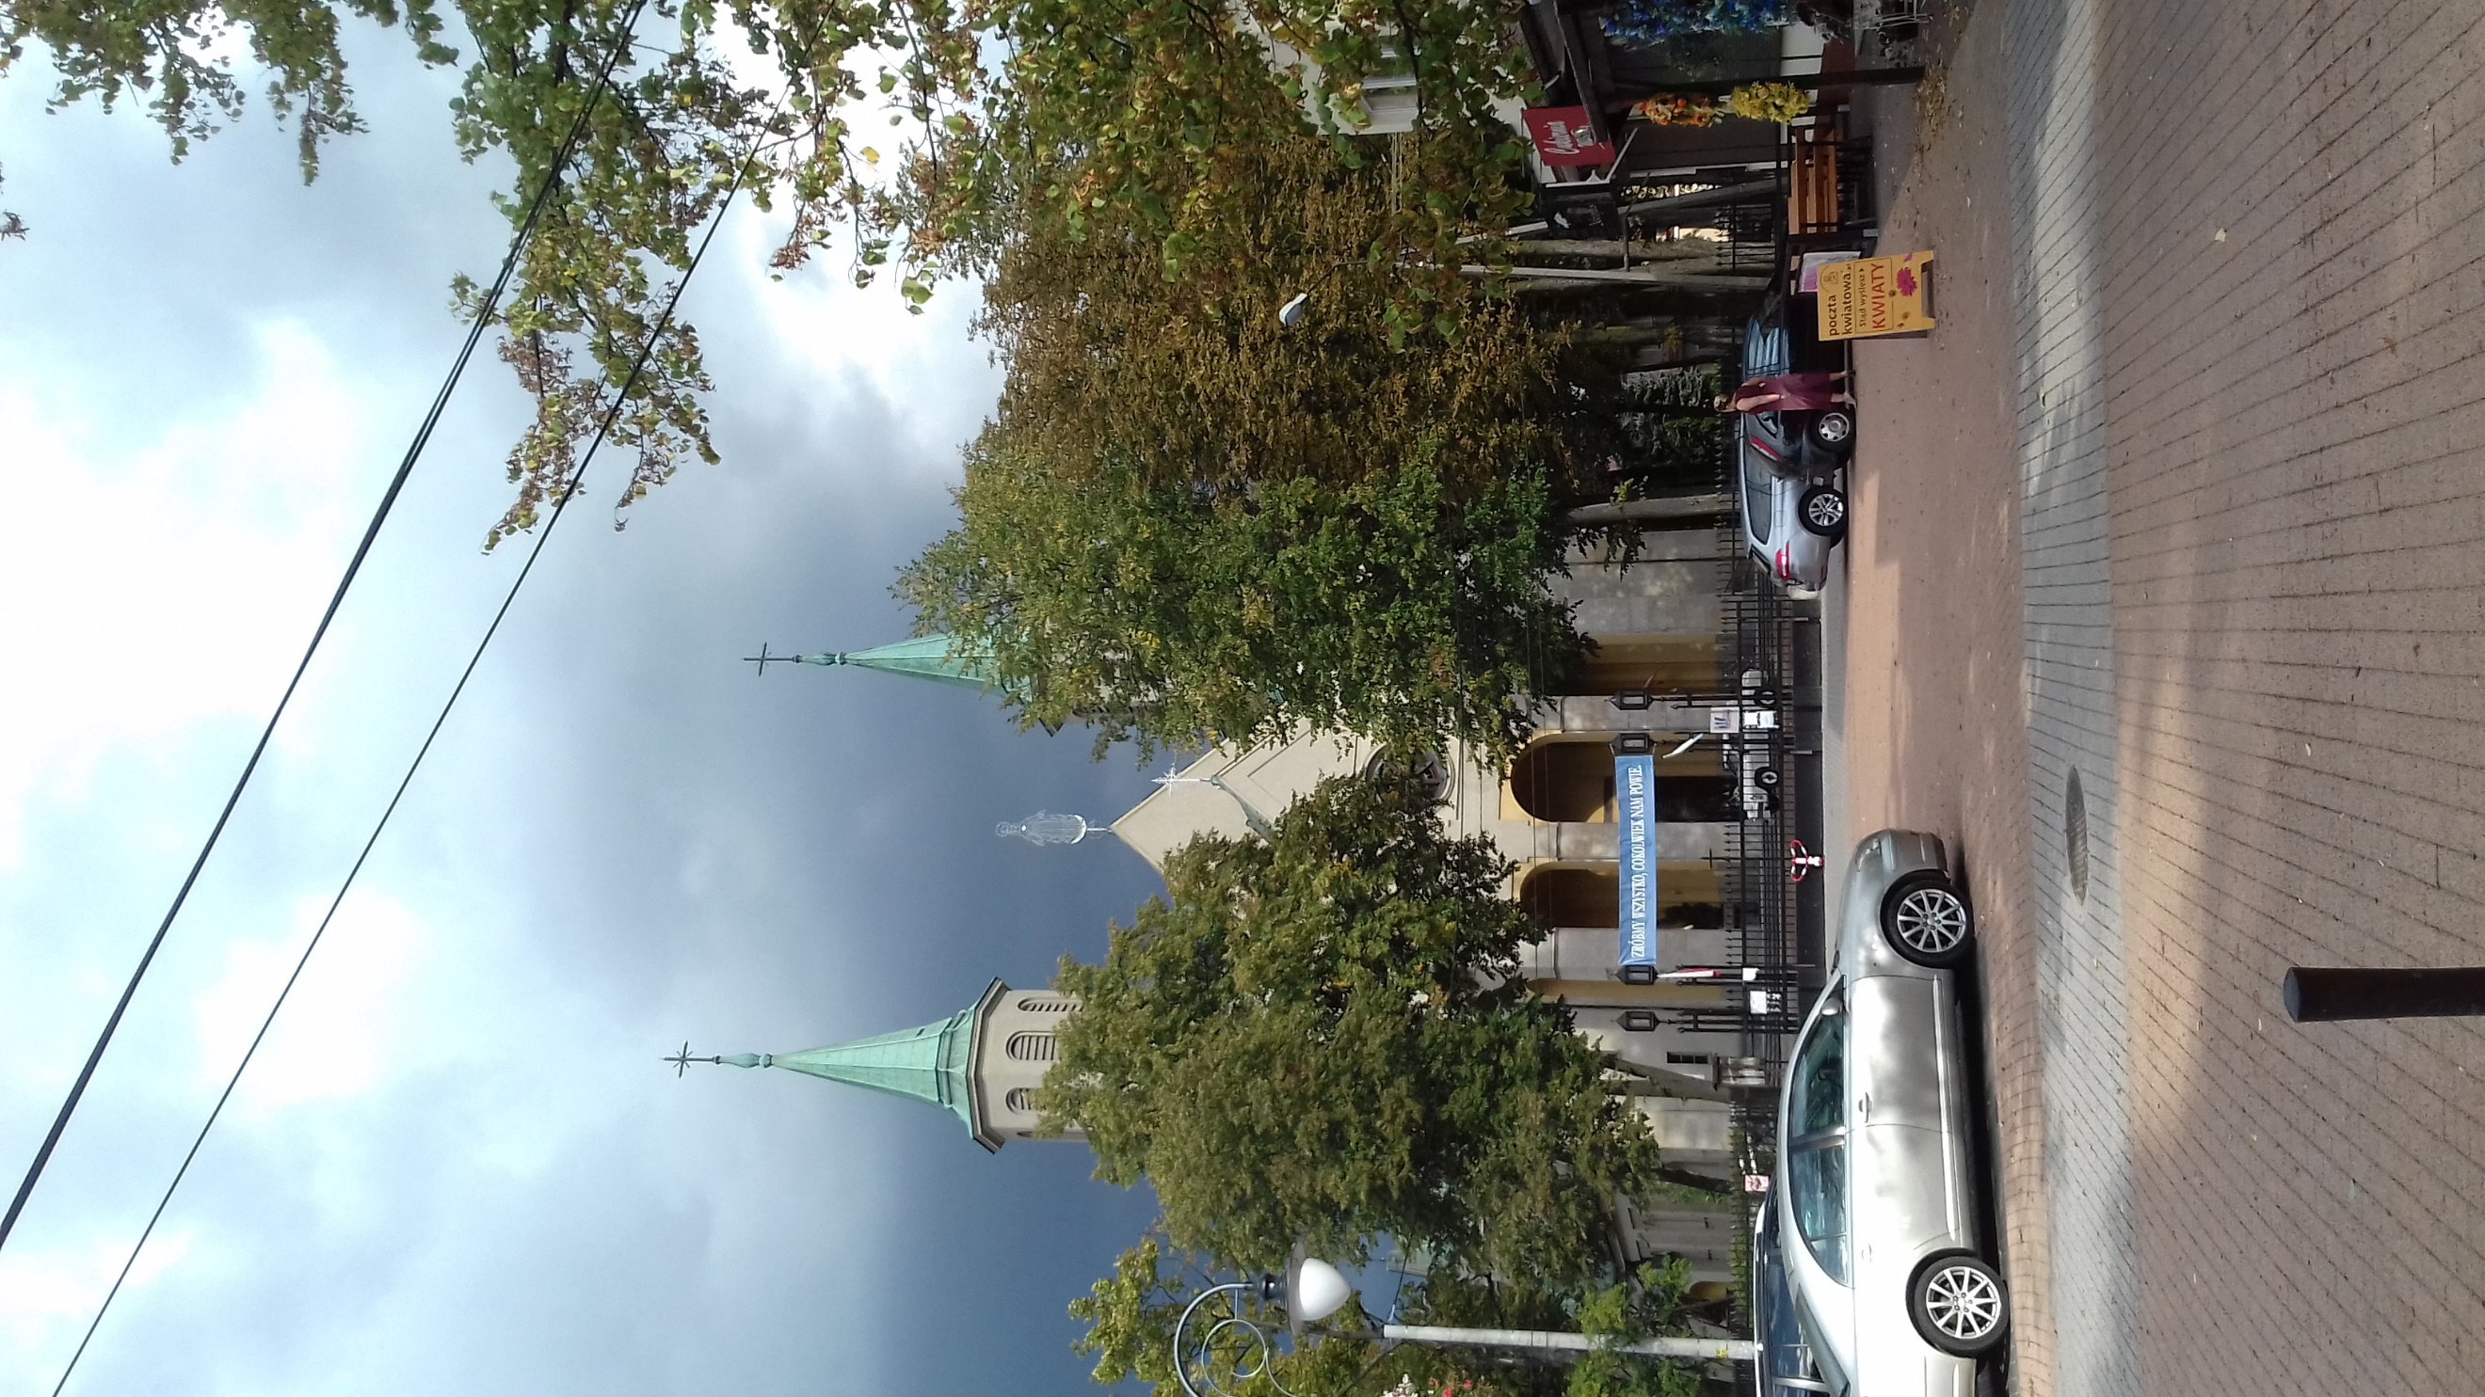
Church, Kościelna str.
This is the oldest church in Wolomin.

Slide 3
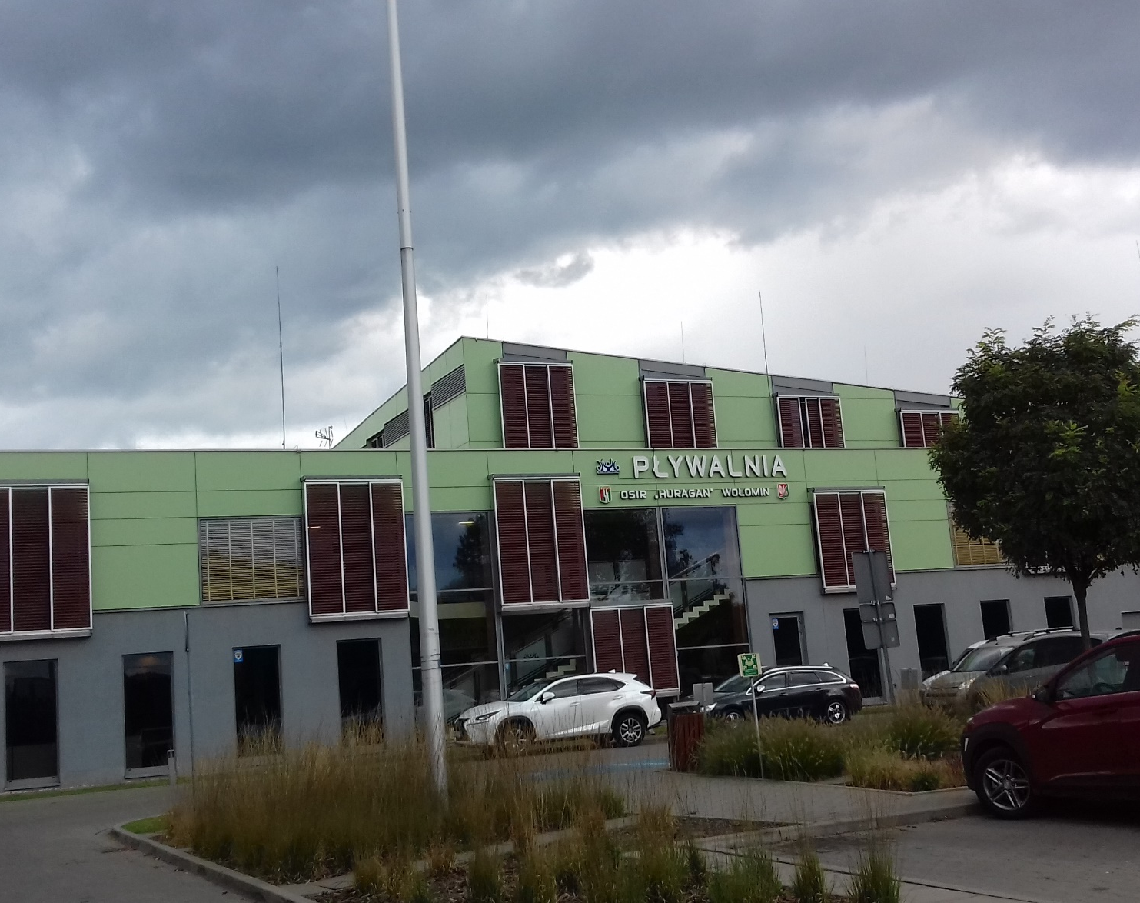
Swimingpool,
1 Maja str.
This is the place where you can swim, play with your friends and train.

Slide 4
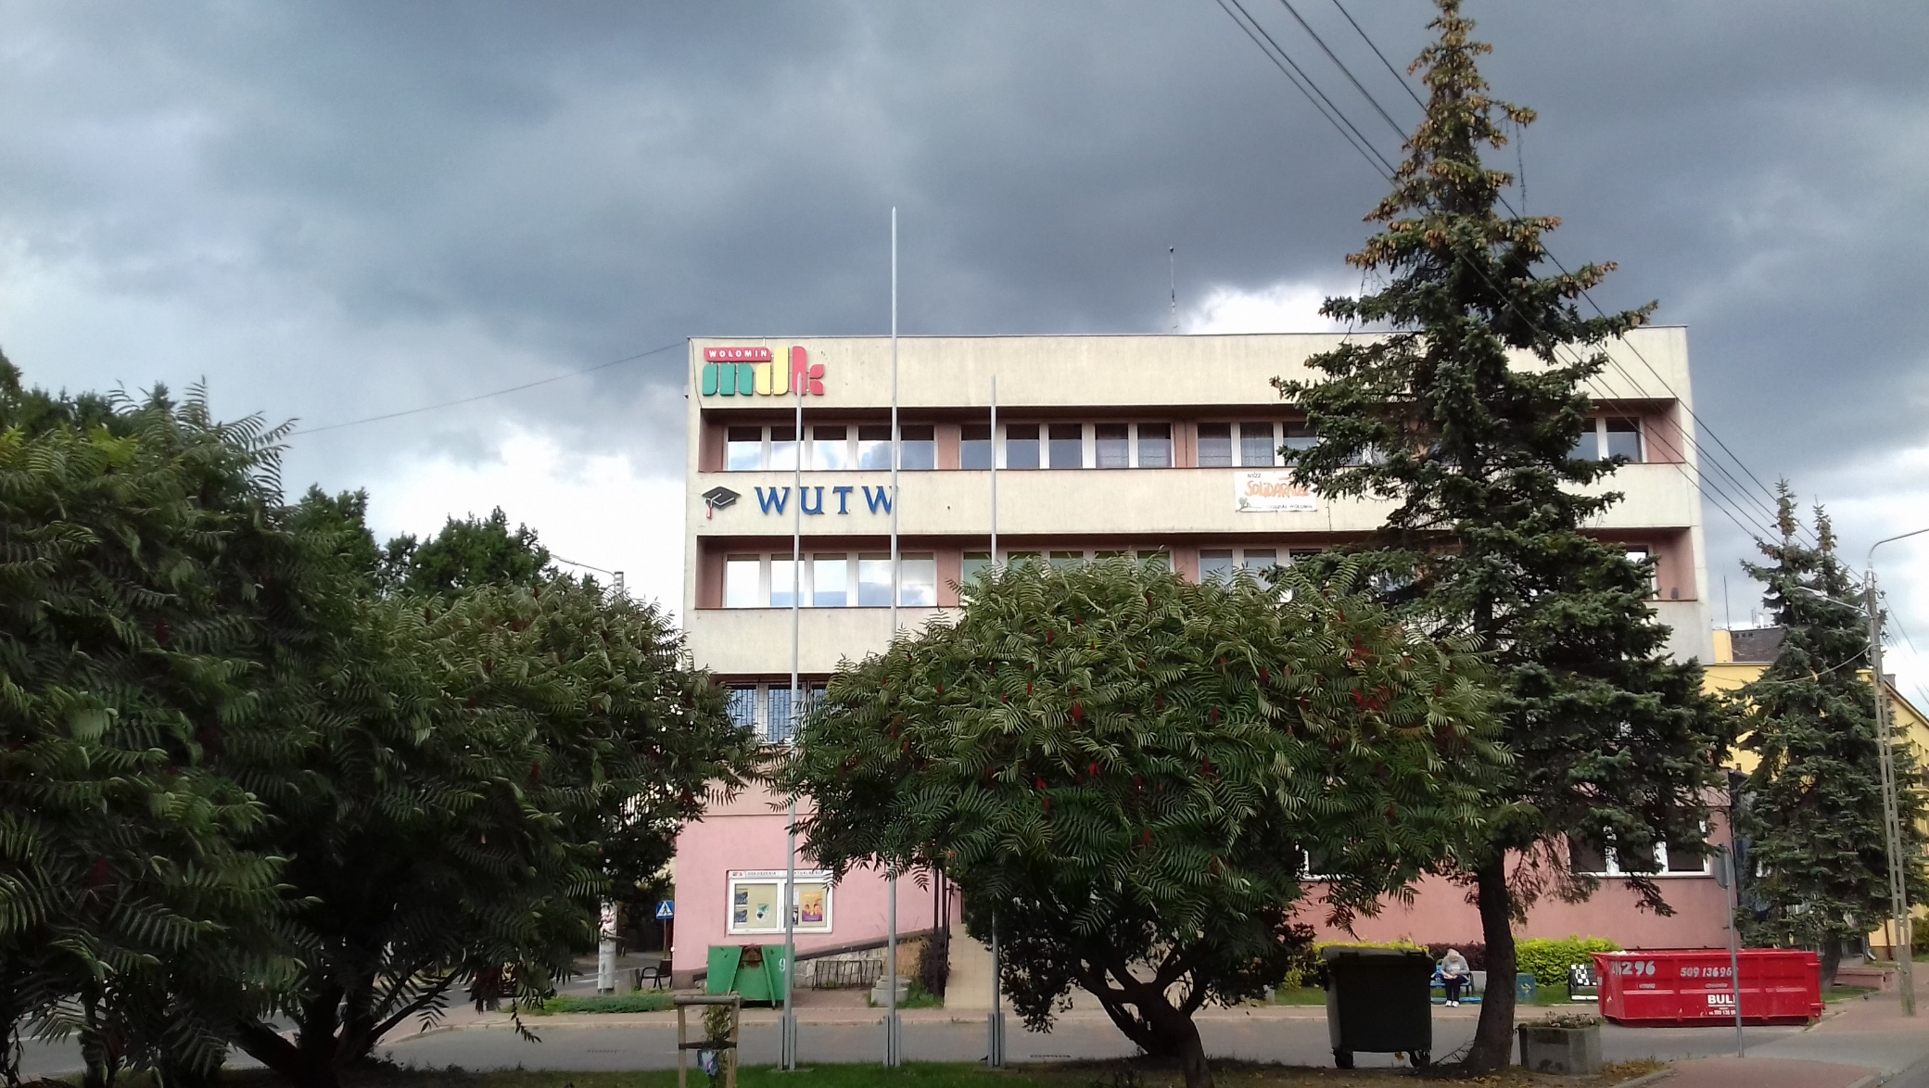
House of Culture, Mariańska str.
This is a big city house of culture. You can learn how to dance, sing, play the guitar there.

Slide 5
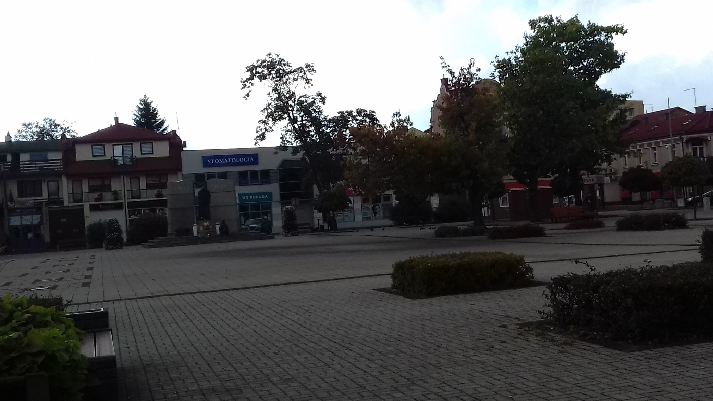
3 Maja Square
This is the main square in Wolomin. Important events take place there.

Slide 6
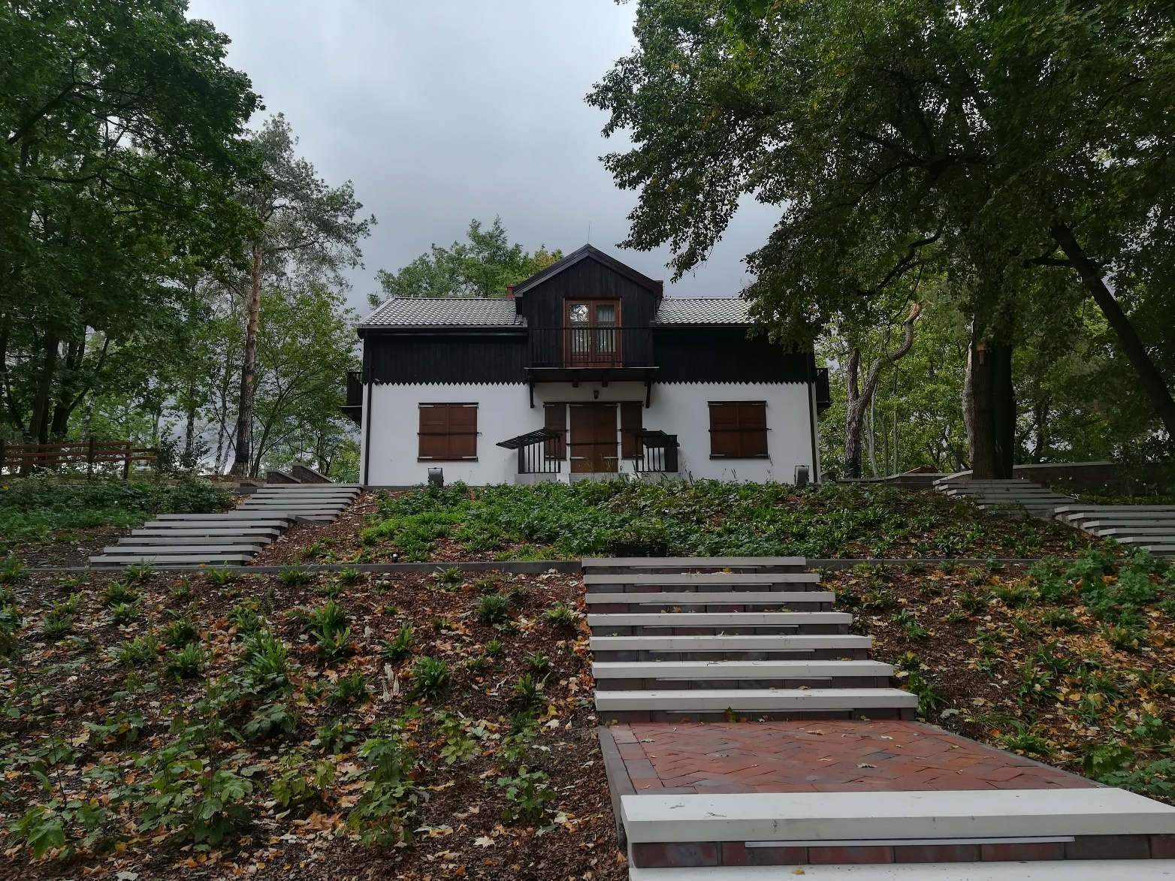
,,House above the meadows”, 1 Maja str.
This is a museum of Zofia and Wacław Nałkowski’s, ”House above the meadows”
.

Slide 7
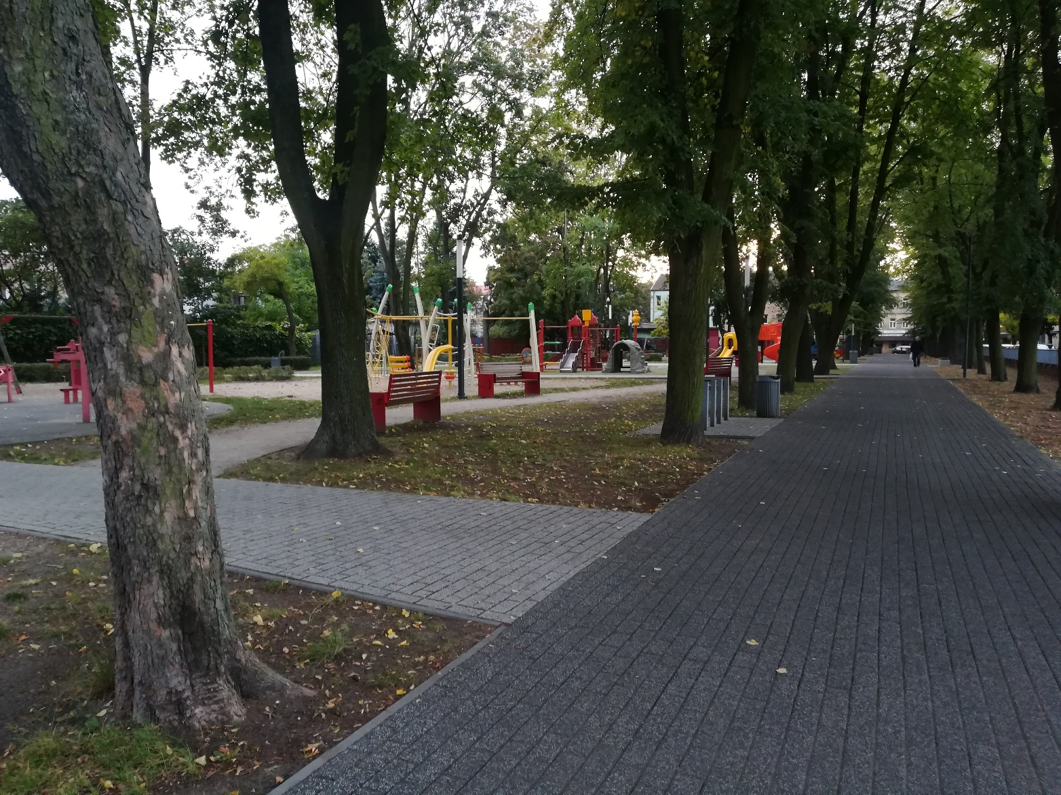
Park Wodiczki, Moniuszki str.
This is a park with a playground of name’s Bohdan Wodiczka.

Slide 8
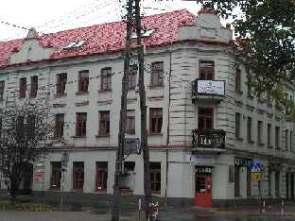
Public library, Wileńska str.
You can take and read books there.

Slide 9
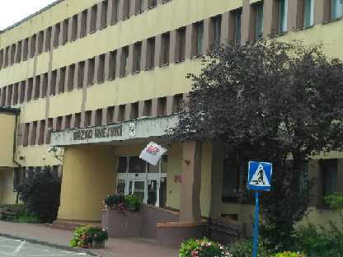
Town hall, Ogrodowa str.
This is a town hall.

Slide 10
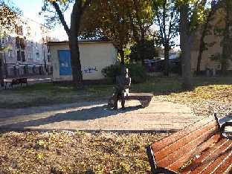
The bench of the Wolomin founder, Ogrodowa str.
The founder of Wolomin was Henryk Konstanty Woyciechowski.

Slide 11
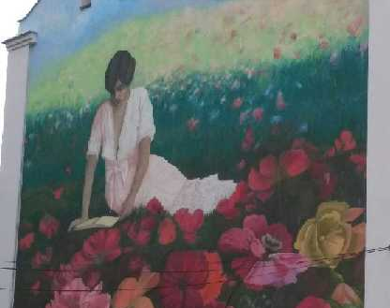
Graffiti
Graffiti is a Wolomin’s decoration.

Slide 12
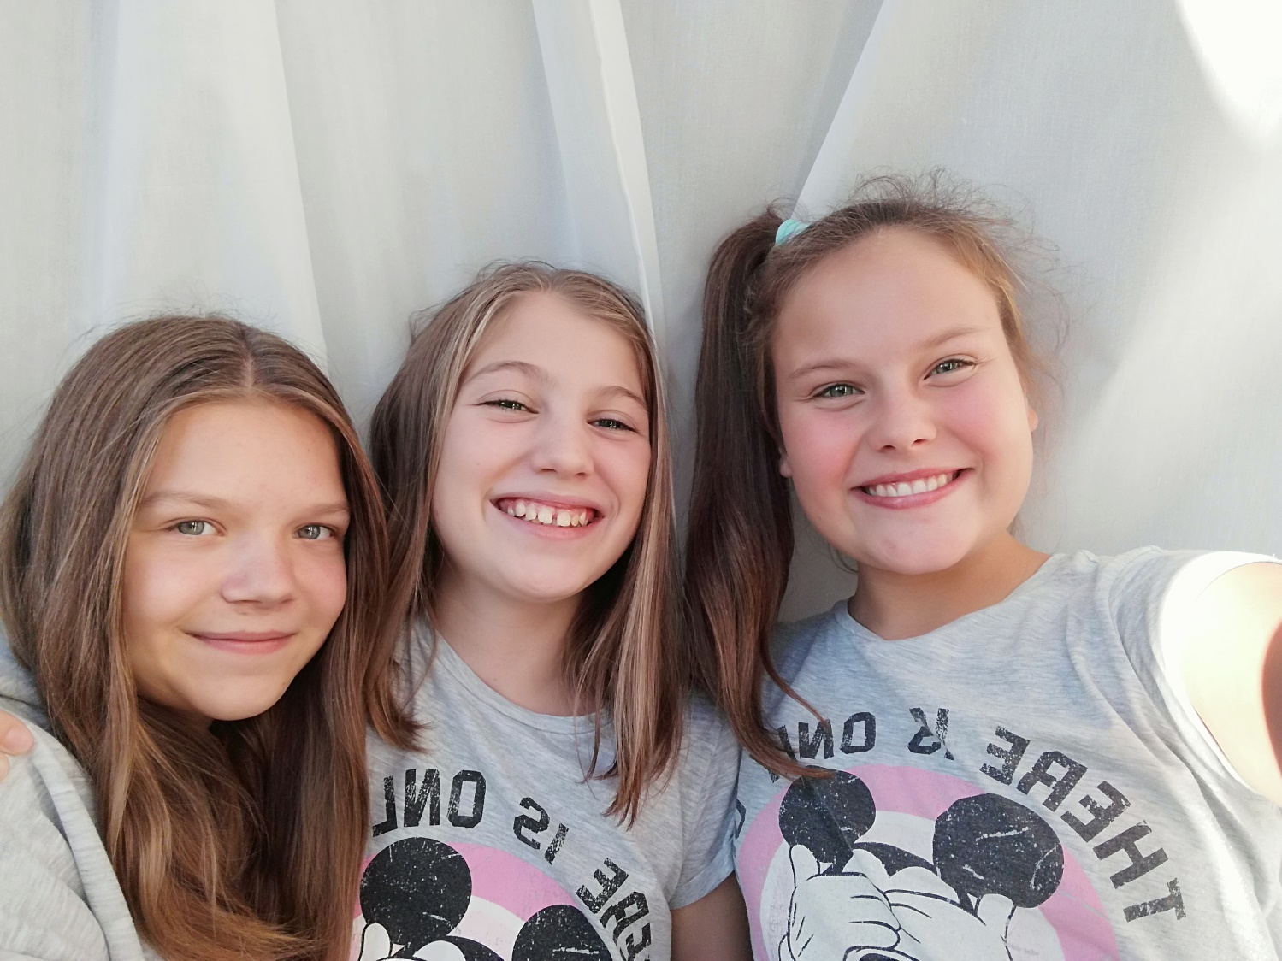
Thank you for watching!
Michalina Szczepaniak, 6s
Weronika Staniak, 6s
Kinga Kupiec, 6s

