Slide 1
Mikołaj Kopernik
Astronom, lekarz ,ekonomista

Slide 2
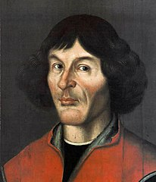
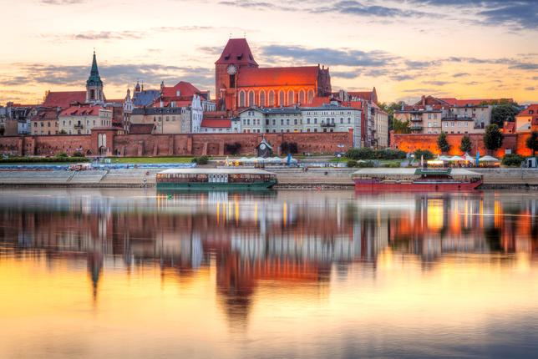
When he was born?
He was born on 19th of February 1473. He died in 1543 . He was born in Toruń, he died in Frombork.
The cause of his death was brain stroke.

Slide 3
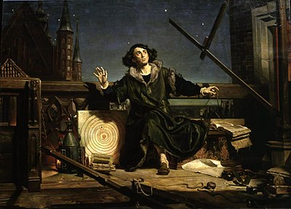
Who was he?
He was a Renaissance polymath , in addition to astronomy he also dealt with mathematics, law , economics , military strategy, , he was also a doctor and a translator.
His work with astronomy started with the fact that he liked to look at stars.

Slide 4
What did he create?
Until the 16th century , everyone trought that the Sun and other planets orbited the Earth , and the Earth stood still, but Kopernik discovered and proved to everyone that the Sun stands in its place,and the Earth and orther planets revolve around the Sun and ist own axis.
Writer of the „On the Revolutions of the Celestial Spheres”

Slide 5
family
The merchant's family of Mikołaj and Barbara from the Watzenrode (she died after 1495). He had three older siblings: brother Andrzej (born about 1465), sister Barbara (born around 1469) and Katarzyna (born around 1471) .

Slide 6
o the Revolutions of the Heavenly Spheres
De revolutionibus orbium coelestium (on the rotation of the celestial spheres) - the work of Nicolaus Copernicus, which contains the lecture on the heliocentric and heliostatic construction of the universe. At that time, it was an revolution in science and the world view. It was published in Nuremberg in 1543. It consists of six books.

