Slide 1
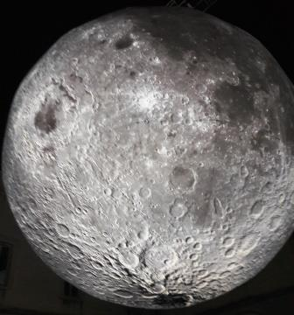
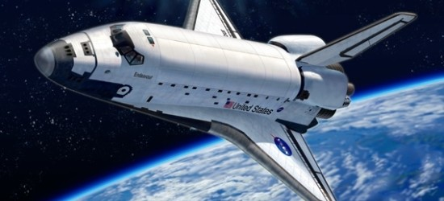
50 YEARS FROM THE LANDING ON THE MOON

Slide 2
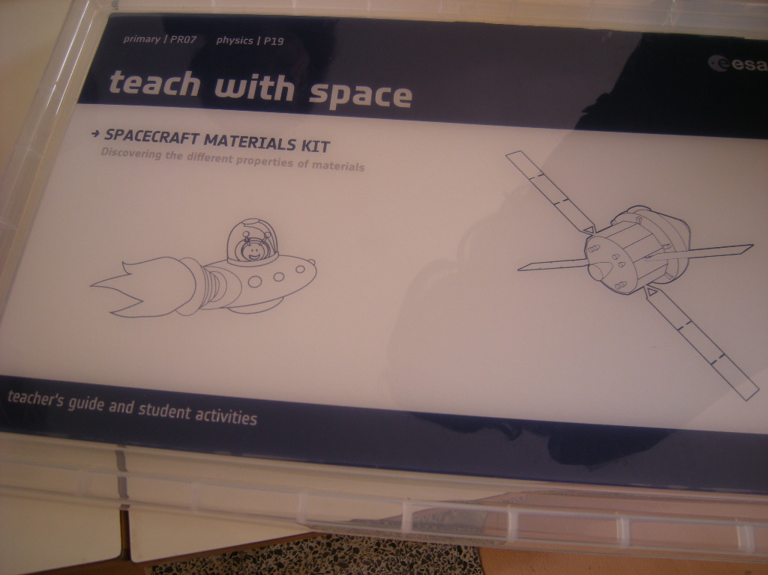
THE COURSE WILL BE EXTENDED TO PUPILS.
THE TEACHERS OF OUR SCHOOL TOOK PART TO A COURSE AIMED AT LEARNING HOW TO BUILD A SPACE SHIP. THE MATERIAL WAS PROVIDED BY EUROPEAN SPACE AGENCY

Slide 3
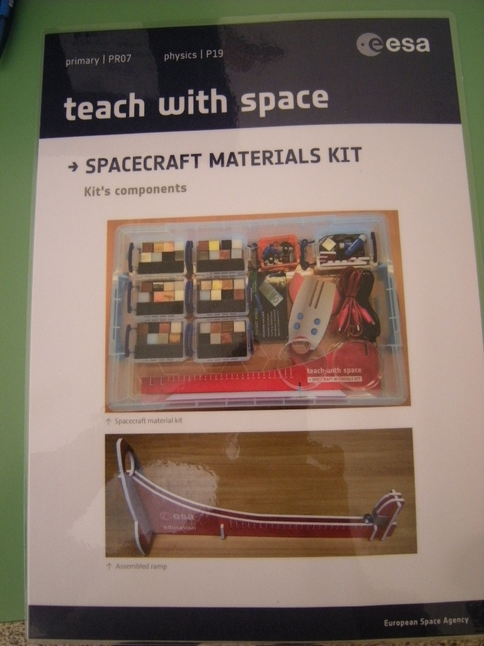

Slide 4
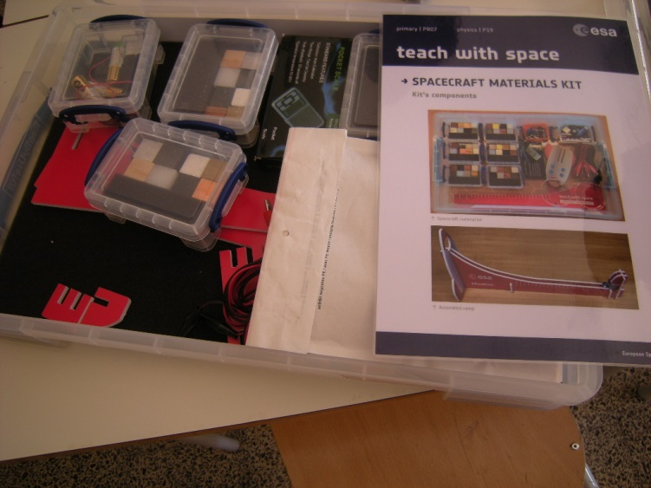
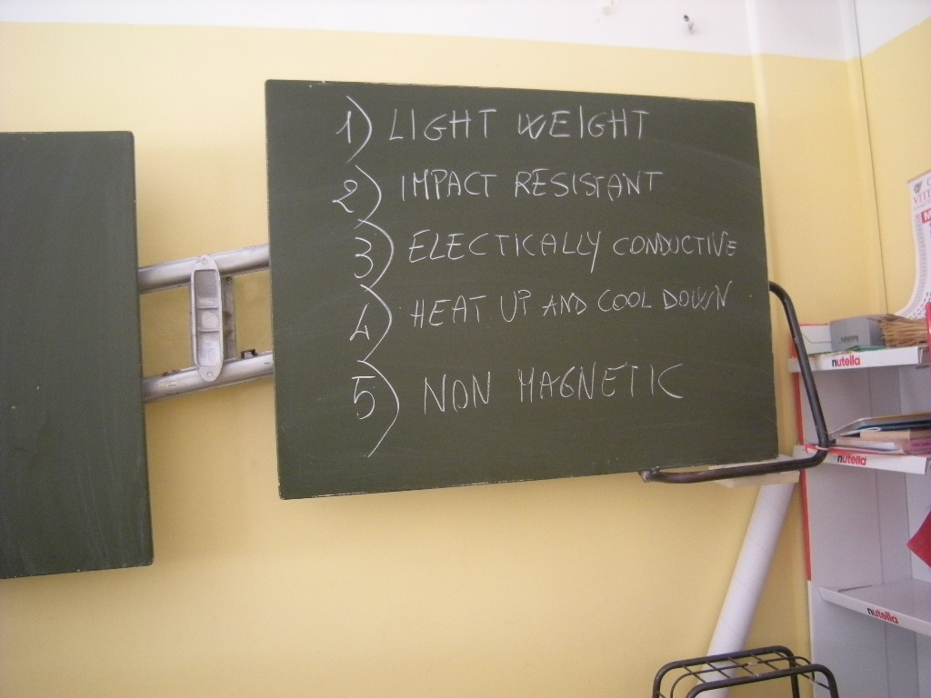
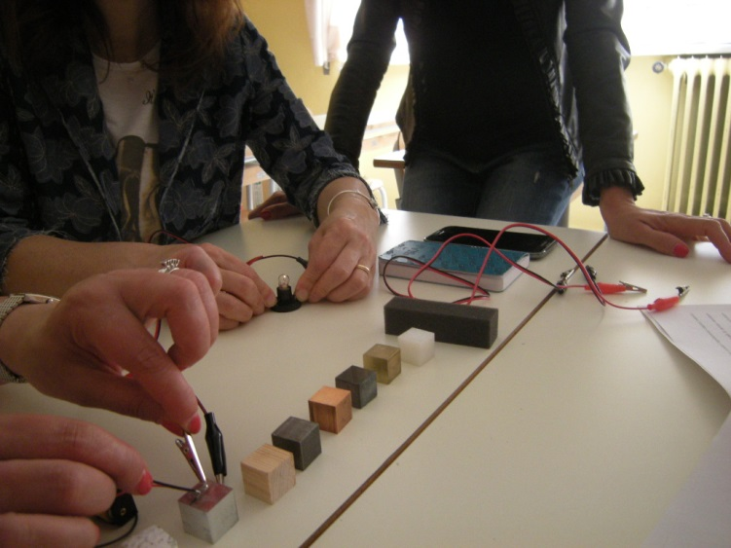
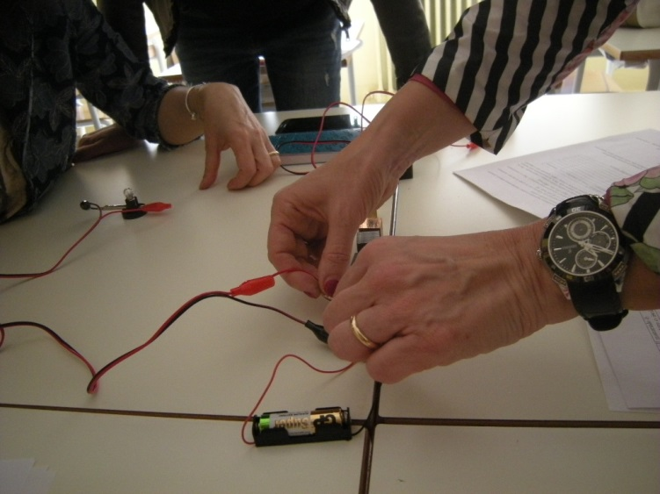
THESE CHARACTERISTICS ARE NECESSARY TO BUILD A SPACE SHIP
WHAT IS THE BEST CONDUCTOR?

Slide 5
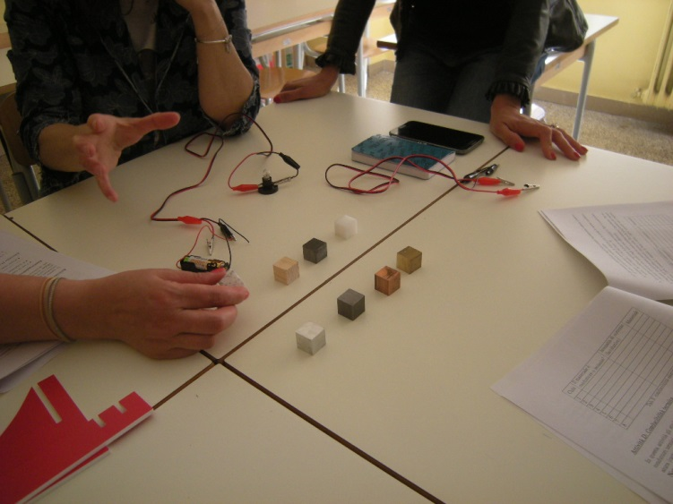
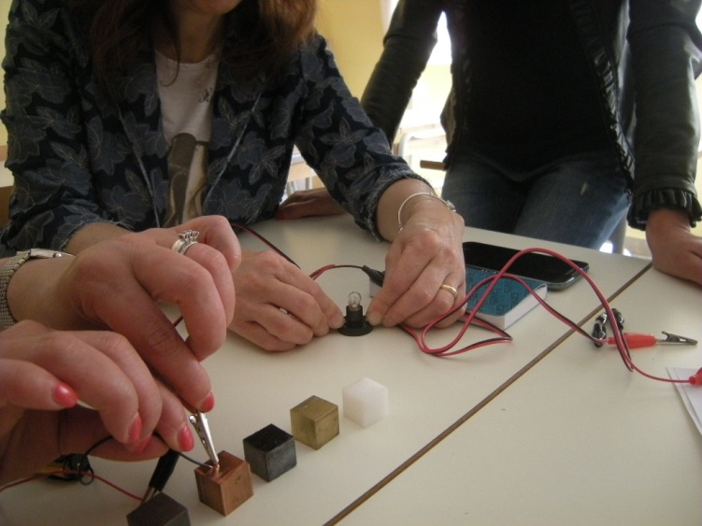
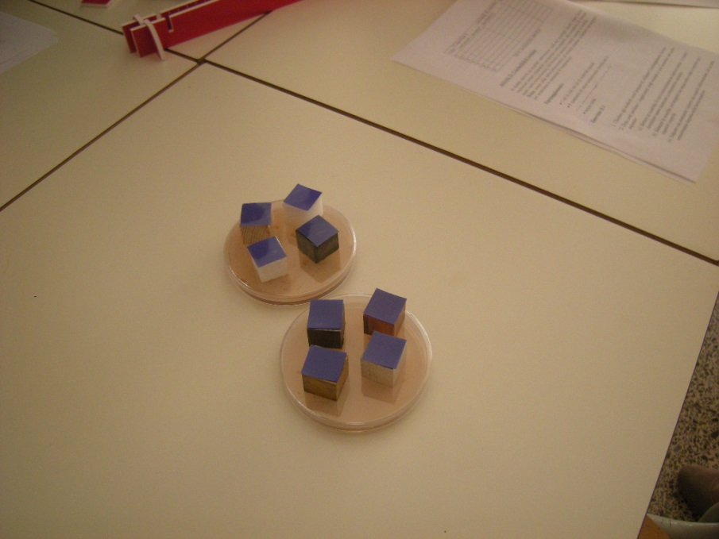
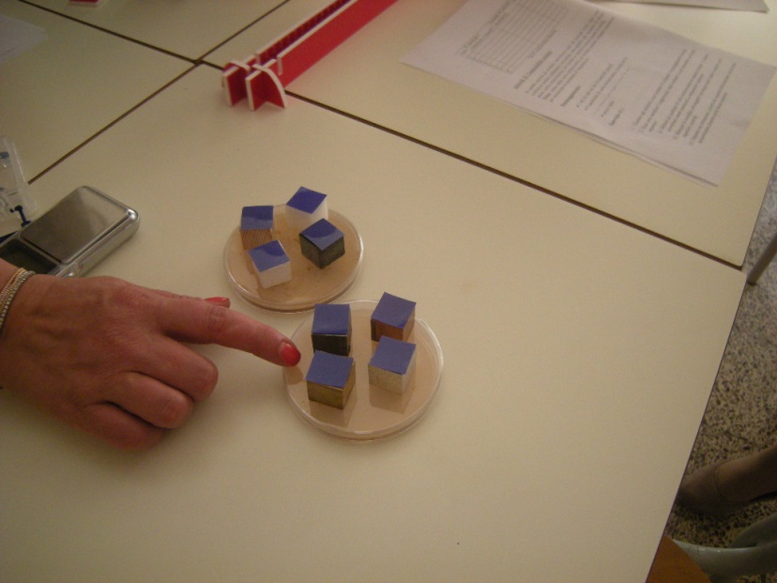
3 DO NOT HAVE THE REQUIRED CHARACTERISTICS
WHICH ONE COOLS DOWN VERY FAST?
WE USE THESE TINY PIECES OF SPECIAL PAPER TO FIND IT OUT.

Slide 6
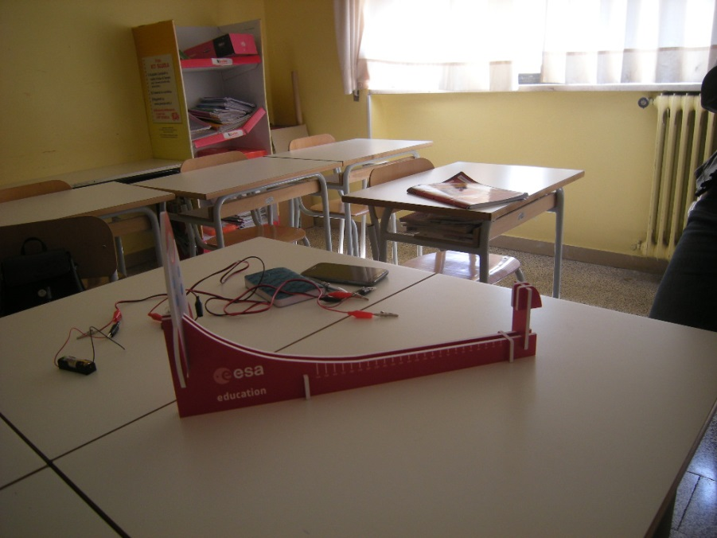
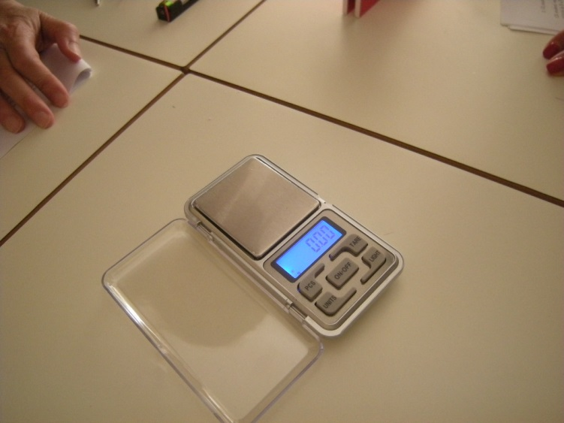
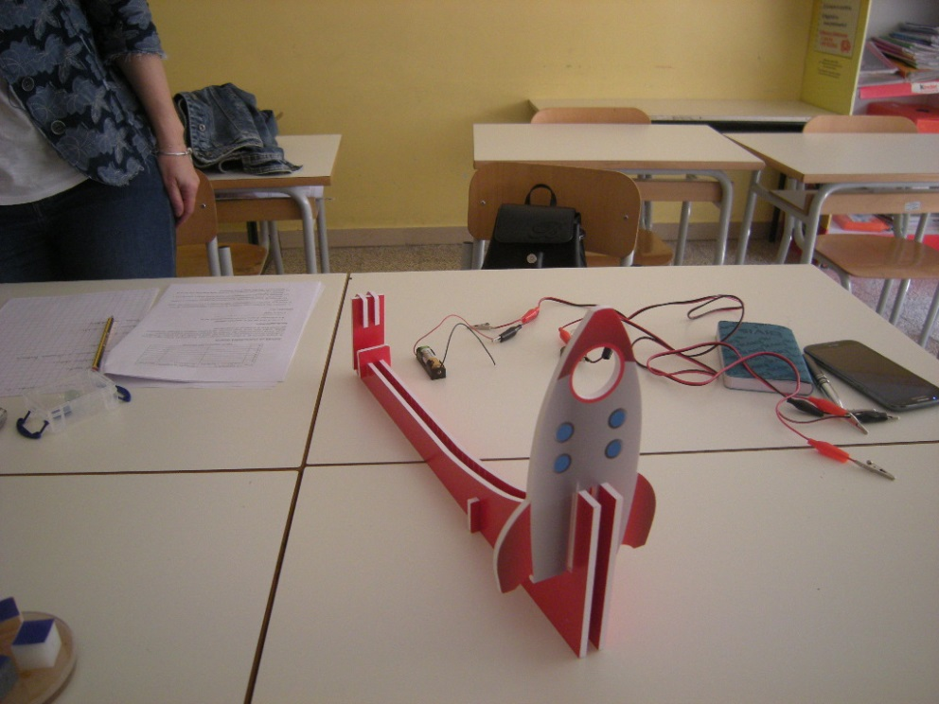
THIS IS TO VERIFY WHICH MATERIAL IS MORE RESISTENT TO AN IMPCT.
WHICH ONE IS LIGHT ENOUGH?

Slide 7
TO LEARN MORE VIEW: https://www.youtube.com/watch?v=FQx3_ds73So

