Slide 1
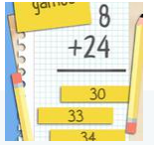
MATH QUIZ DAY
ON THE 28.05.2019
THE PUPILS OF OUR COUNTRIES MET ON LIN TO PLAY MATH QUIZZES TOGETHER

Slide 2
MATH QUIZ FROM ITALY
Mary goes to the market and buys 6 cabbages.
Compare the prices of 3 shops:
1,00 euro every cabbage
1,50 euro every cabbage
3 cabbages at the price of 2 cabbages
SHOP 1 SHOP 2 SHOP 3
1,20 euro every cabbage
4 cabbages at the price of 3 cabbages
Is there a shop where the prices of the cabbages are more convenient if Mary buys 6 of them?
Explain your answer and say how you have found out the price of 6 cabbages at each shop.
Latvia’s Math Quiz
John is a gardener who grows 2 types of plants- there are plants with only 5 leaves or plants with 2 leaves and 1 flower.
All together plants have 6 flowers and 32 leaves.
How many plants are there in John’s garden?
A-10 plants
B-12 plants
C-13 plants
D-15 plants
E-16 plants
Answer: ?

Slide 3
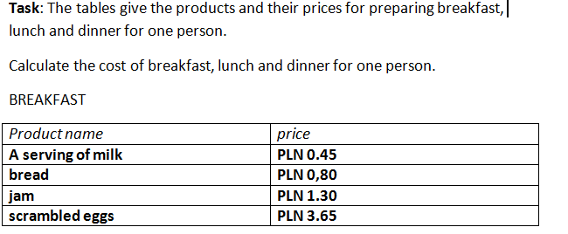
MATH
QUIZ FROM POLAND

Slide 4
MATH QUIZ FROM TURKEY
Metehan and his father go to shopping center. While parking the car, his father wants Metehan to look out the window and asks: “ How many wheels are there in the garage.” Metehen counts and finds: 4 cars and 2 motorbikes. They park their car and enter the shopping the center. In front of the door of shopping center, his father asks again: “ Tell me please again How many wheels are there in the garage ?”
MATH QUIZ FROM GREECE
What is 150 divided by 5?
2. What is 222 + 83?
3. What is 50% of 500?
4. What is the square root of 9?
5. What is 11 x 11?
6. What is 100 – 151?
7. What number must you add to 66 to make the sum of 121?
8. How many degrees are there in a right angle?
9. What is 0.33 as a percentage?
10. If you divide a cake into 10 equal slices and remove 5 of the slices, as a fraction, how much of the cake is remaining? (Please give your answer as the lowest possible fraction)

Slide 5
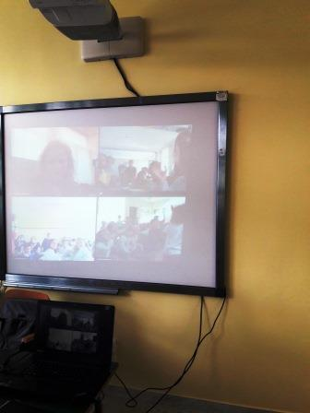
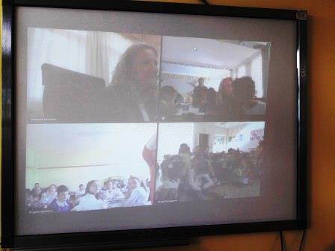
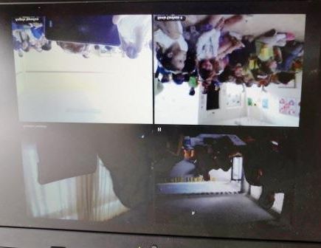

Slide 6
