Slide 1
ITALIAN SCHOOL DIARY
To let all families know all about our Erasmus project we have edited a school diary given for free to all the pupils of our school.

Slide 2
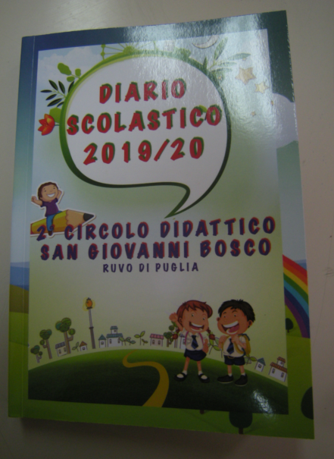
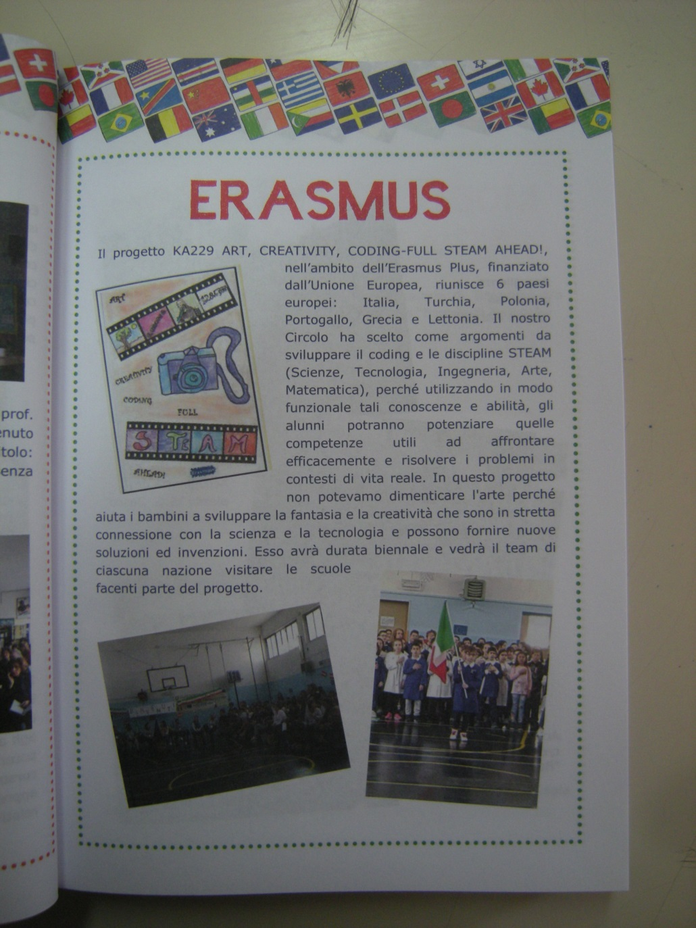

Slide 3
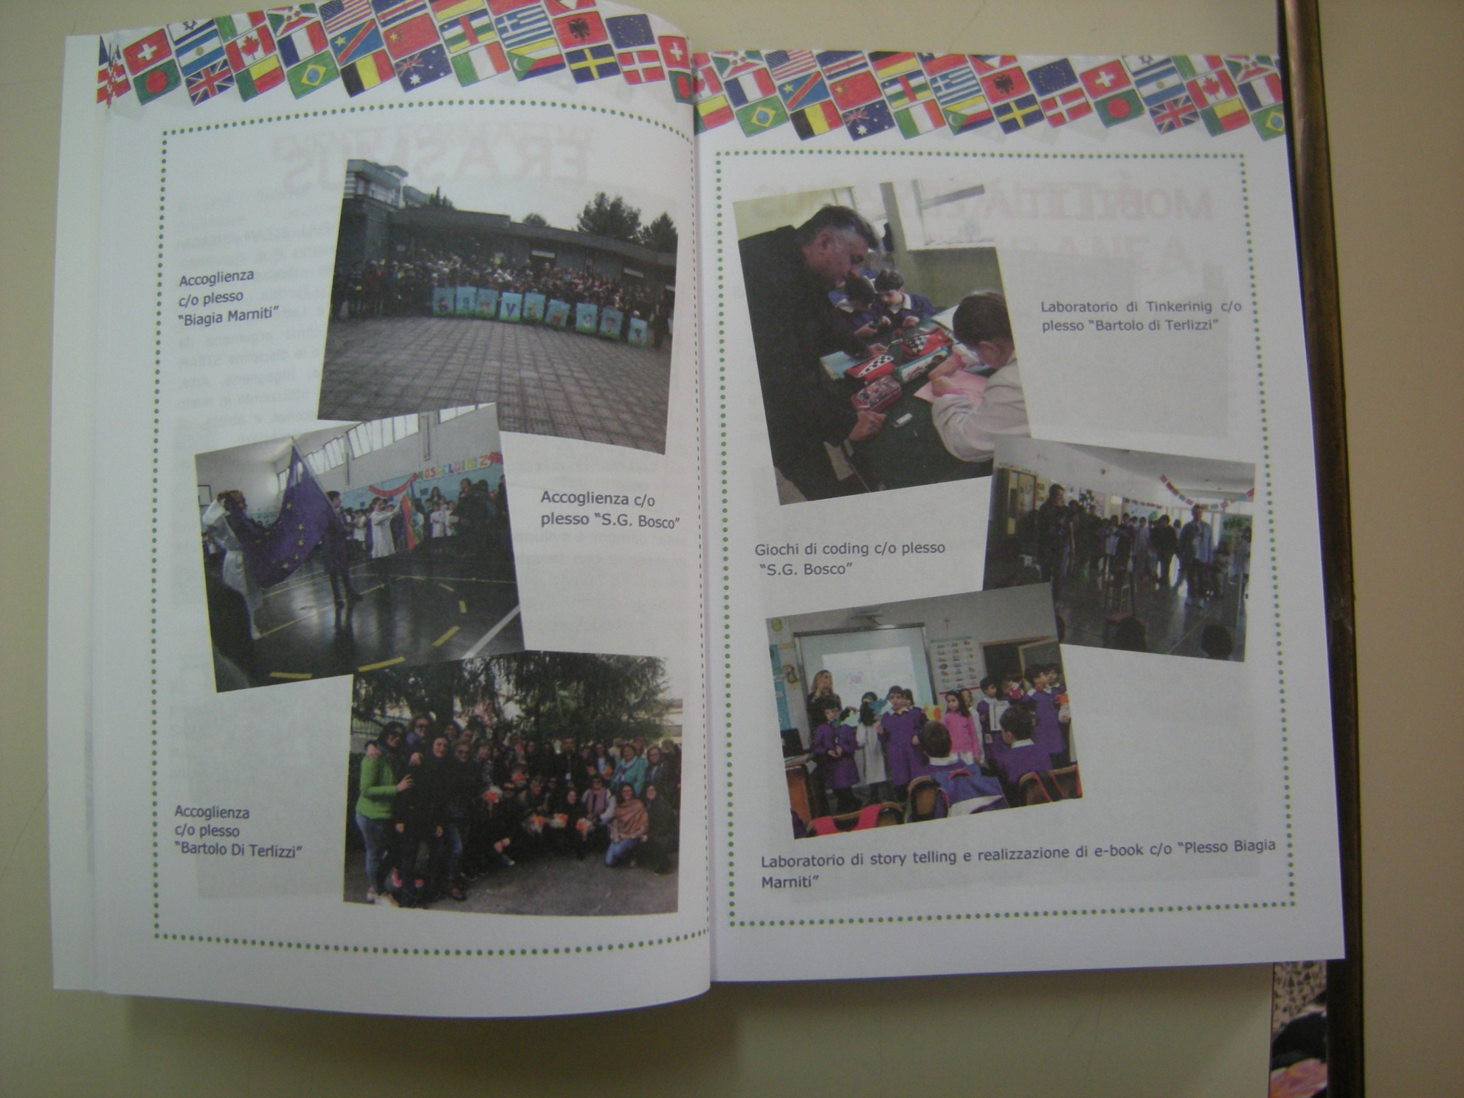

Slide 4
