Slide 1
THE JOURNEY OF THE FOOD
SCHOOL OF INQUIRY DELL’ANISN - PUGLIA
TEACHING AND LEARNING SCIENCES WITH IBSE
DOCENTE: VOLPE GRAZIA
CLASSI COINVOLTE: 5^ A-B
Scuola primaria S. G. Bosco- Ruvo di Puglia

Slide 2
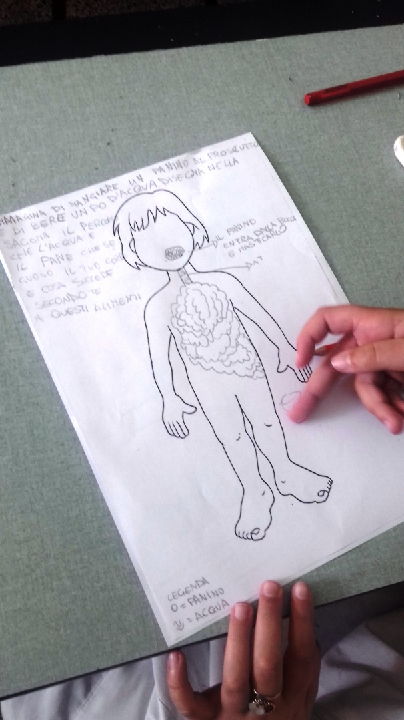
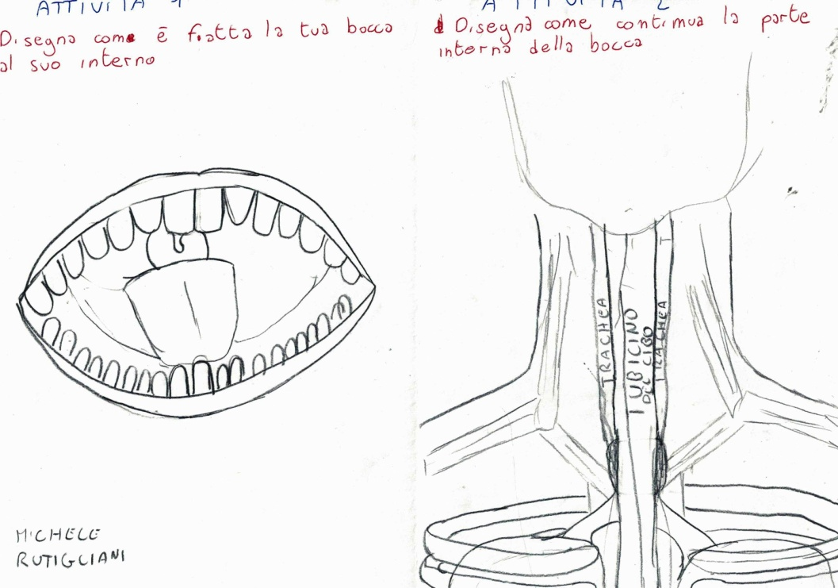
ENGAGEMENT (1) Individual work: Draw how your mouth

Slide 3
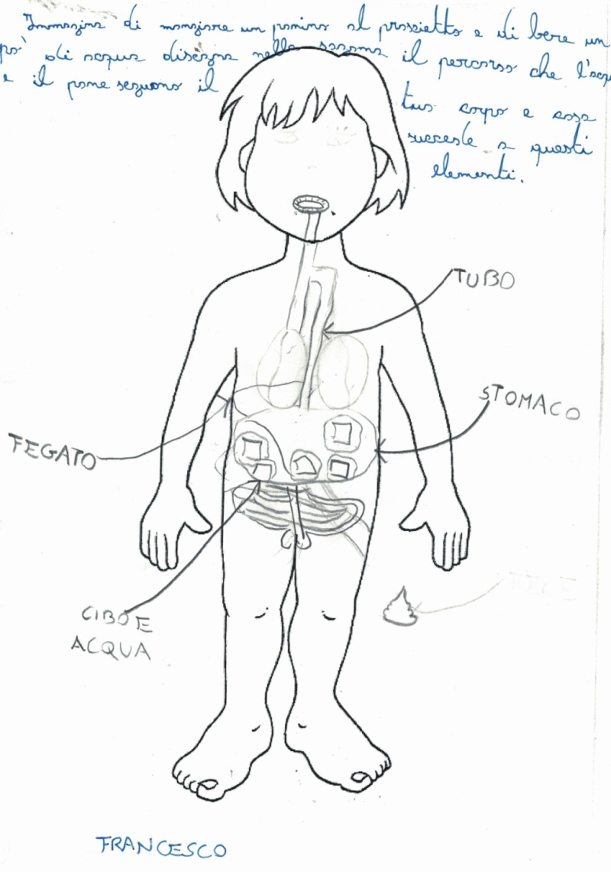
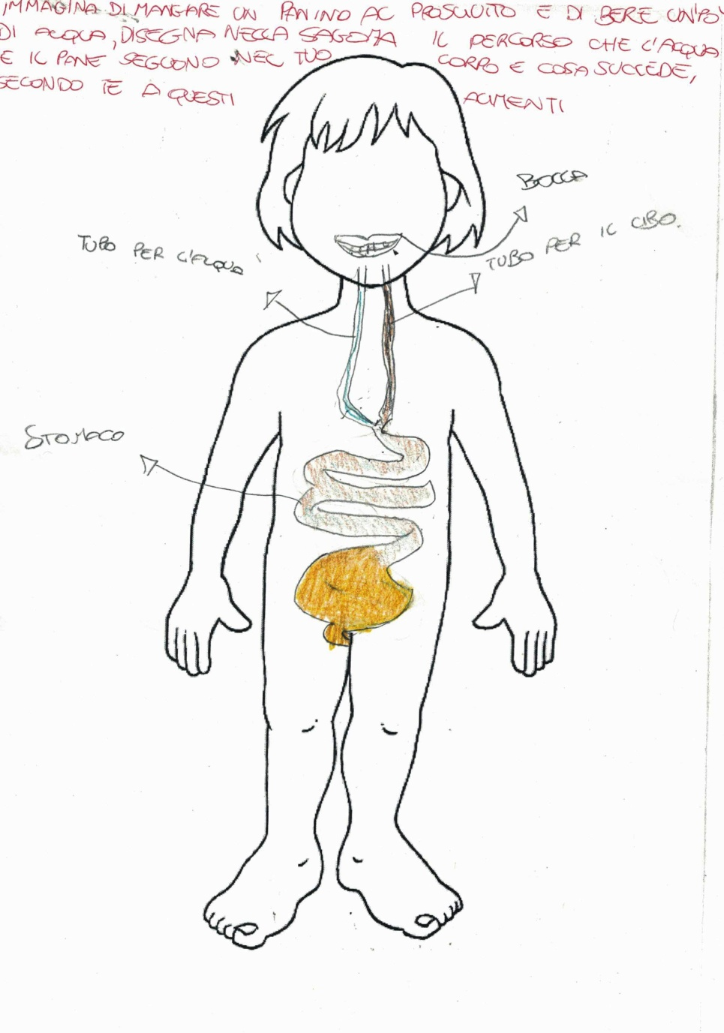
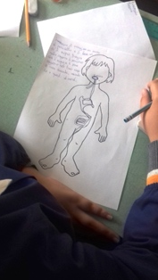
ENGAGEMENT (2)
In what part of your body is the bread you have eaten and the water you have drunk?

Slide 5
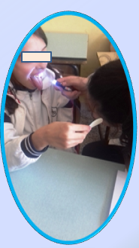
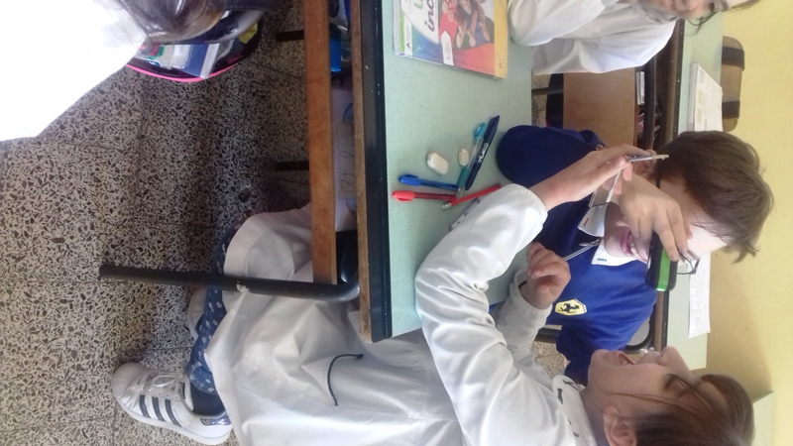
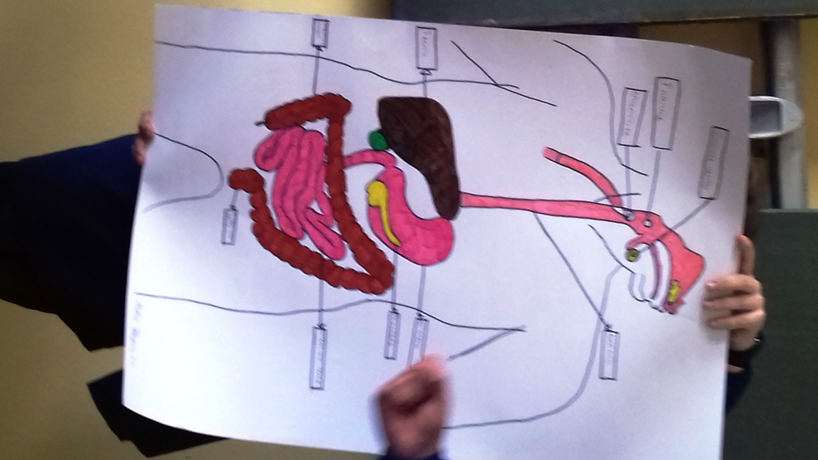
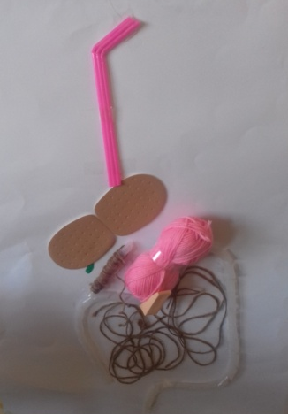
EXPLANATION
VISION OF MOVIES
DIRECT INVESTIGATION EXPERIENCES ON THE BODY AND MANIPULATION OF MODELS
INVESTIGATIONS ON BOOKS
OBSERVATIONS

Slide 6
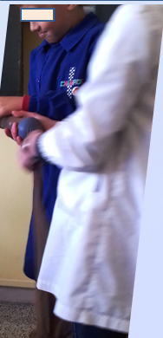
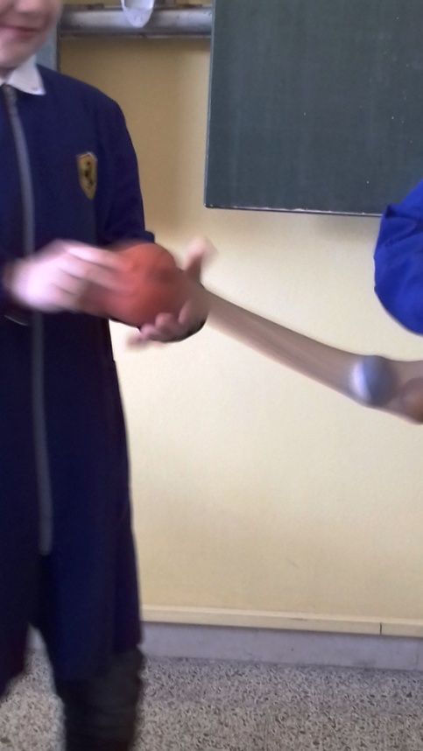
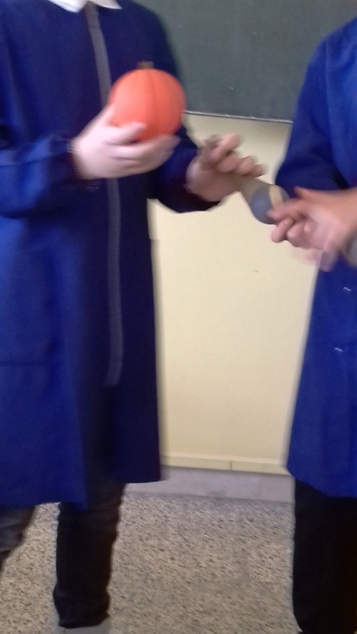
Our simulations

Slide 7
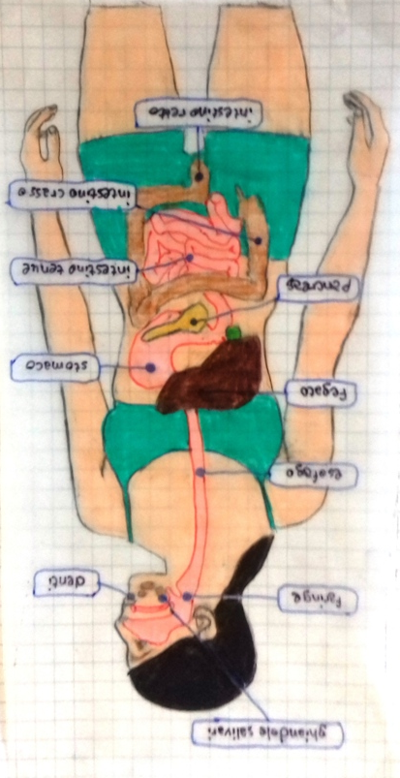
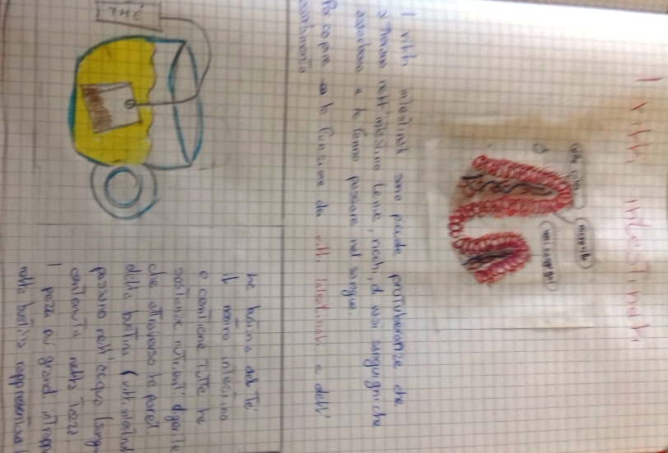
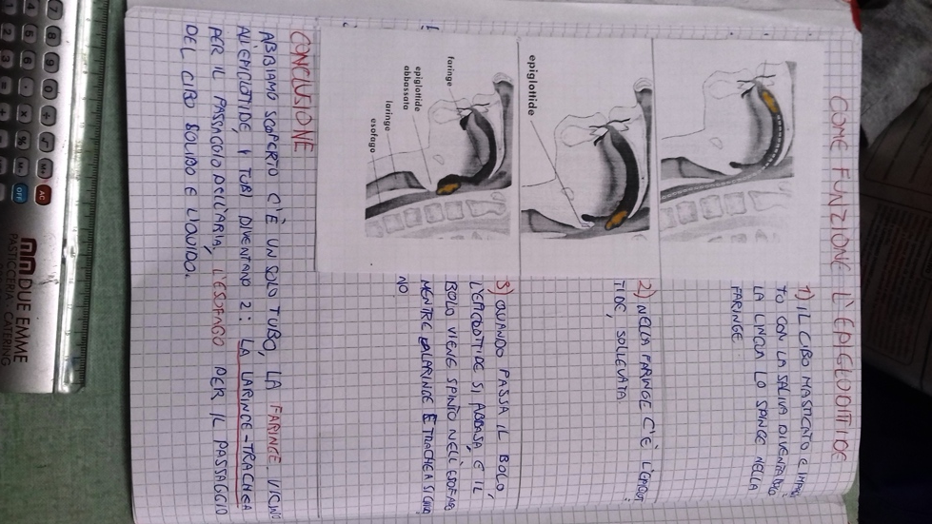
EXPLANATION Investigations on books - Observations

Slide 8
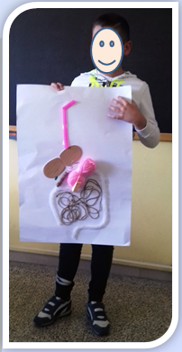
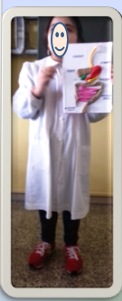
COMUNICATION We tell about the path of the food

Slide 9
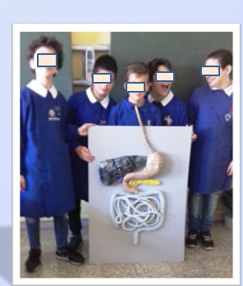
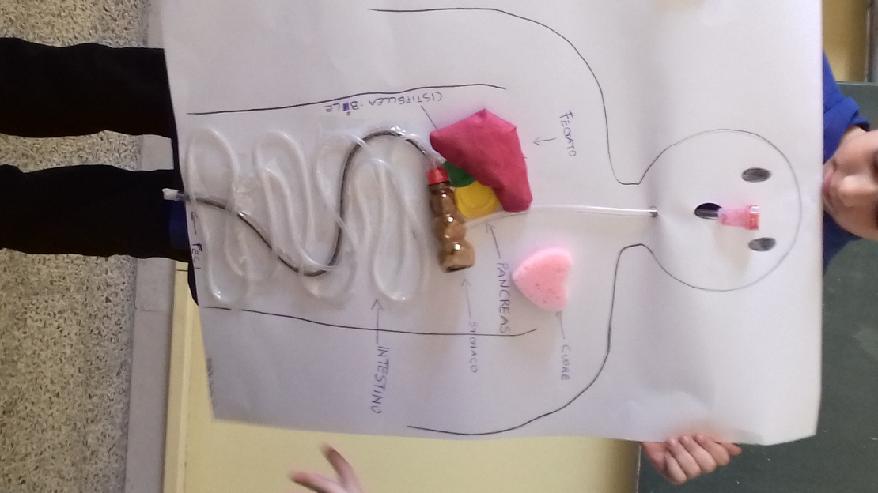
Our working sample

Slide 10
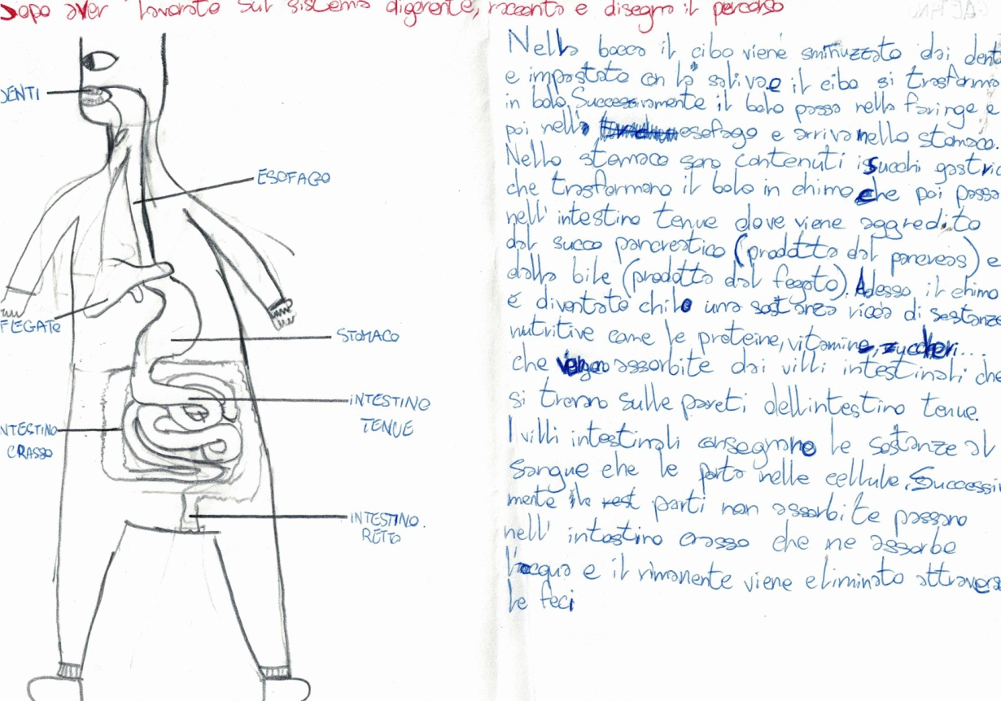
EVALUATION
WHERE WAS I WRONG and why? We check the drawings made during the engagement and we find out the errors

Slide 11
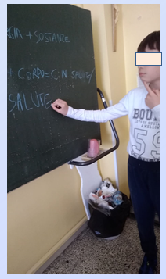
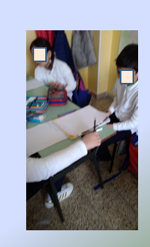
Do you think the food you eat is healthy?
COMUNICATION AND ANALYSIS:
During the discussion we identified and recorded our:
Questionable solutions
Good solutions

Slide 12
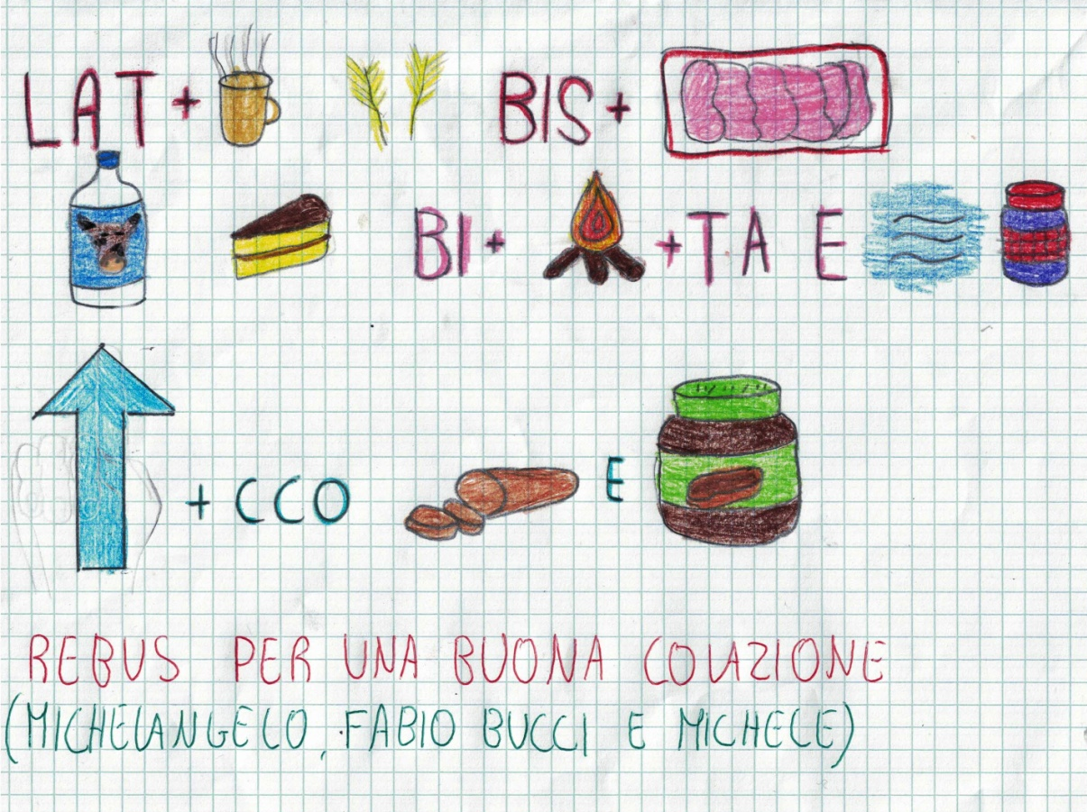
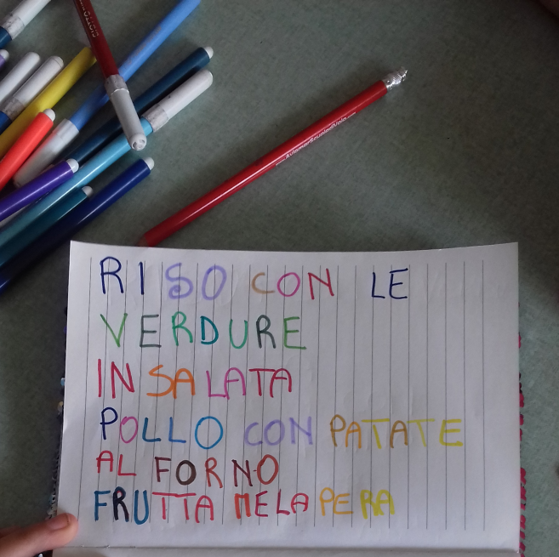
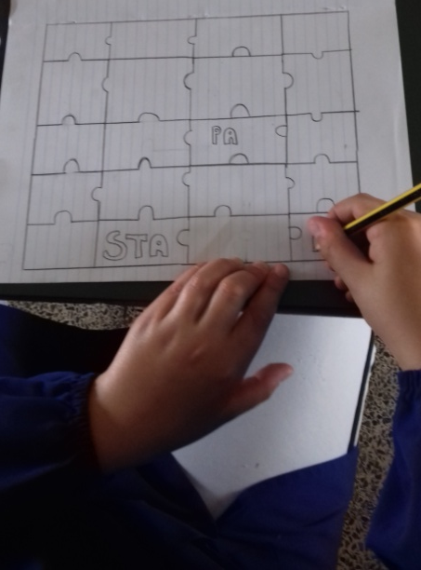
GAMES ABOUT FOOD

Slide 13
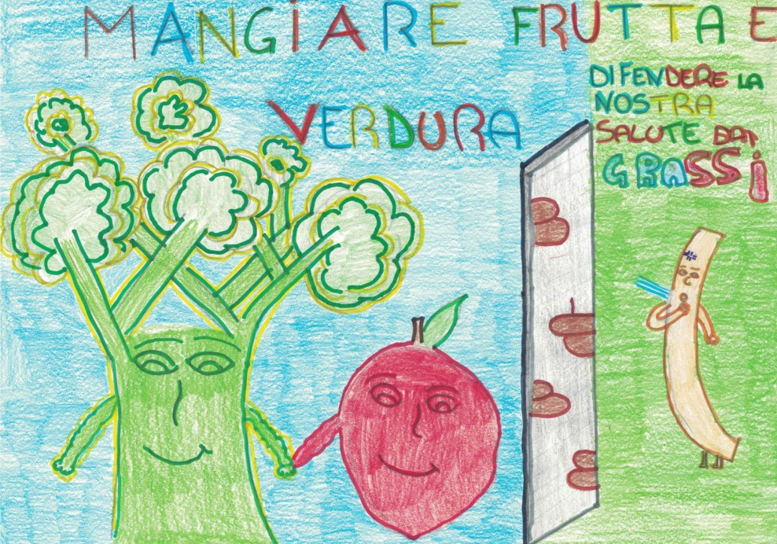
Do you think the food you eat is healthy?
APPLICATION:
CREATE ADVERTISING SLOGAN TO PROMOTE HEALTHY FEEDING

Slide 14
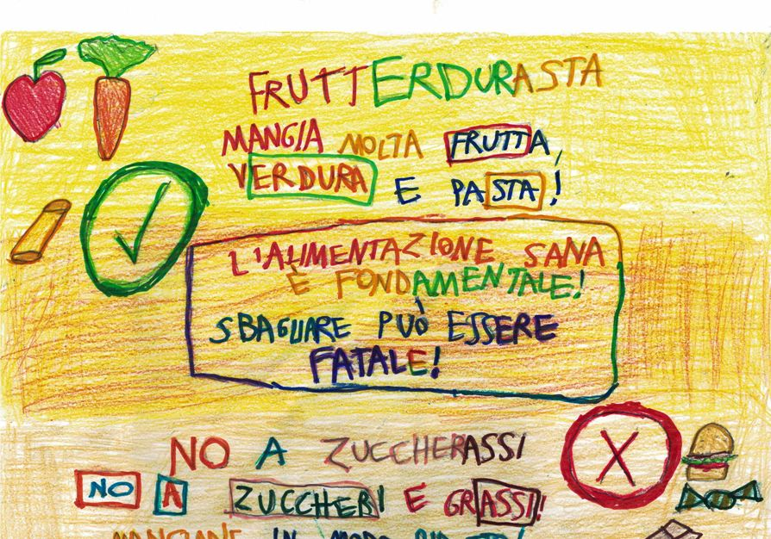
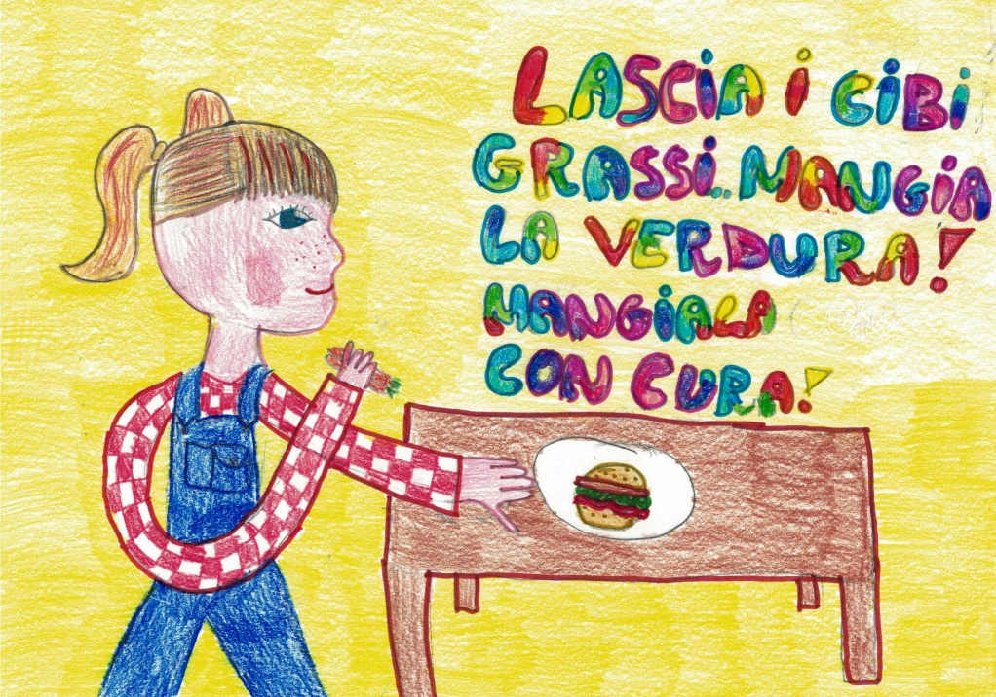
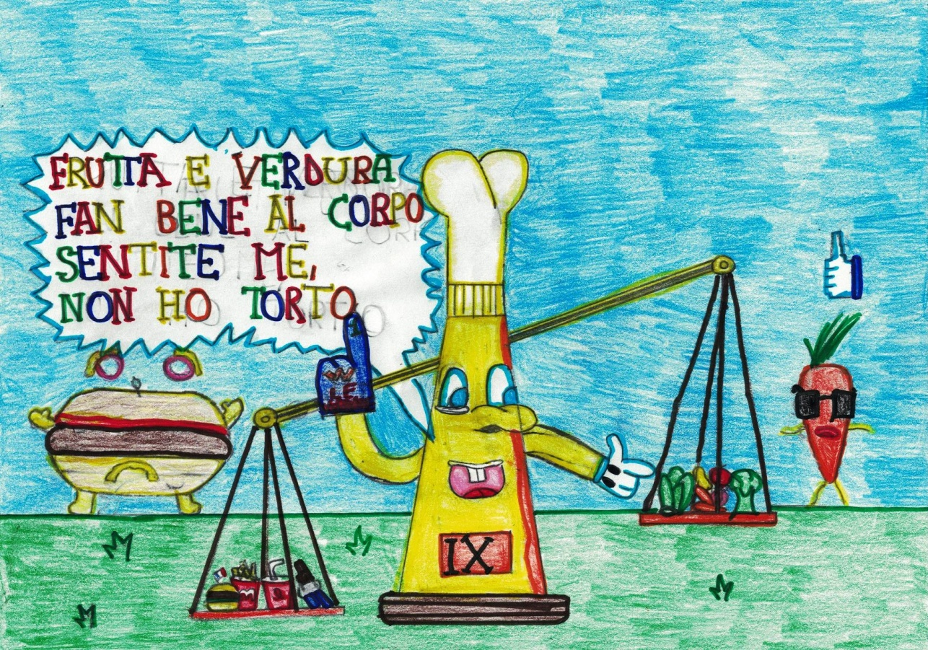
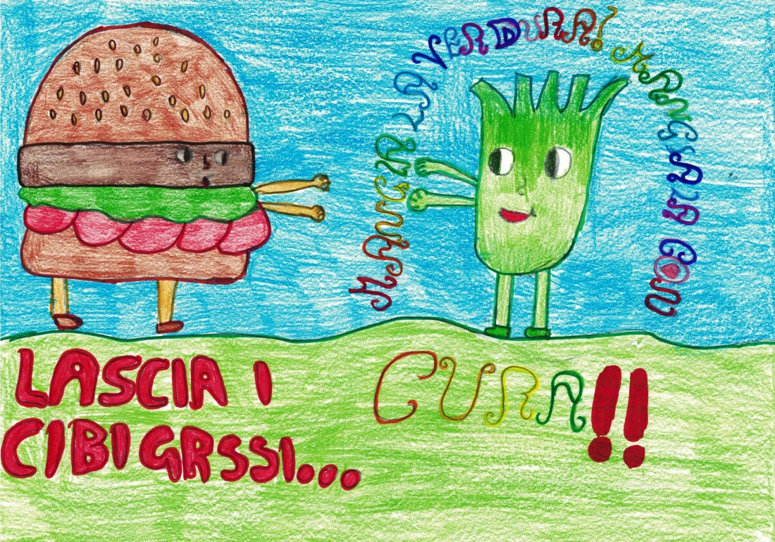

Slide 15
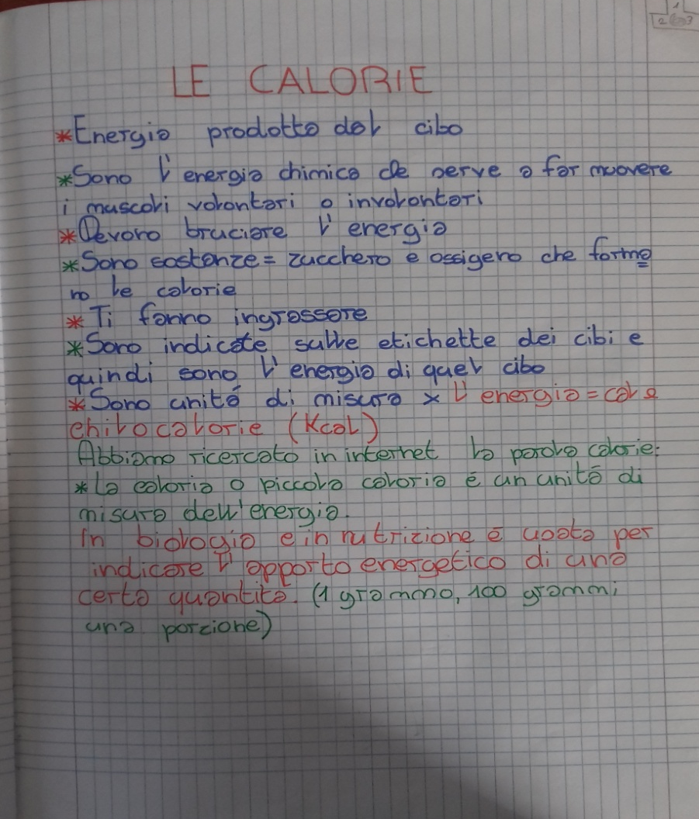
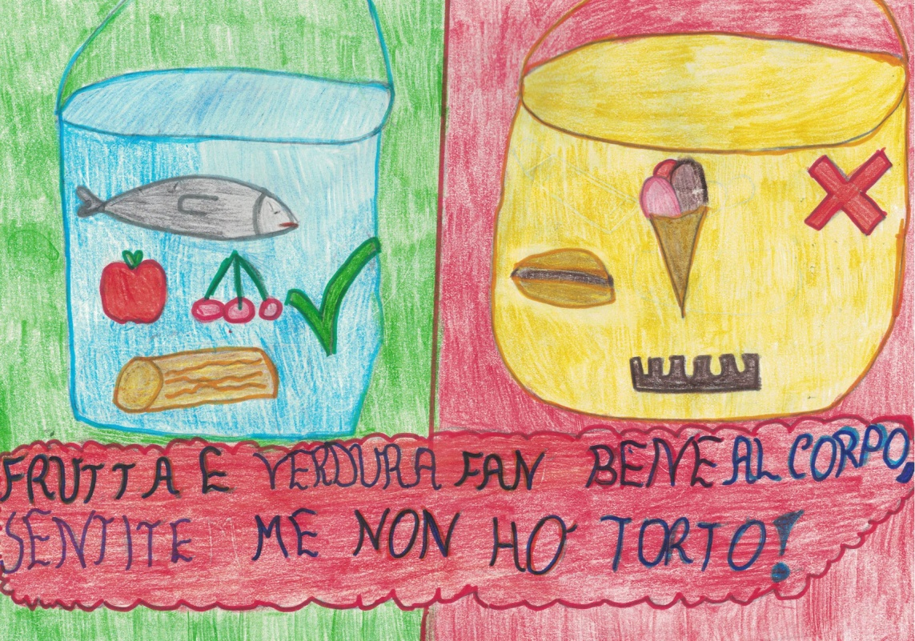
HOW DOES THE FOOD CHANGE IN OUR BODY?
HOW CAN WE CALCULATE THE CALORIES? One student remembered that there were calorie tables on biscuit packages; so we took the cookies, the juice ... and we observed them...
EXPERIENCE WHAT ARE THE CALORIES?

Slide 16
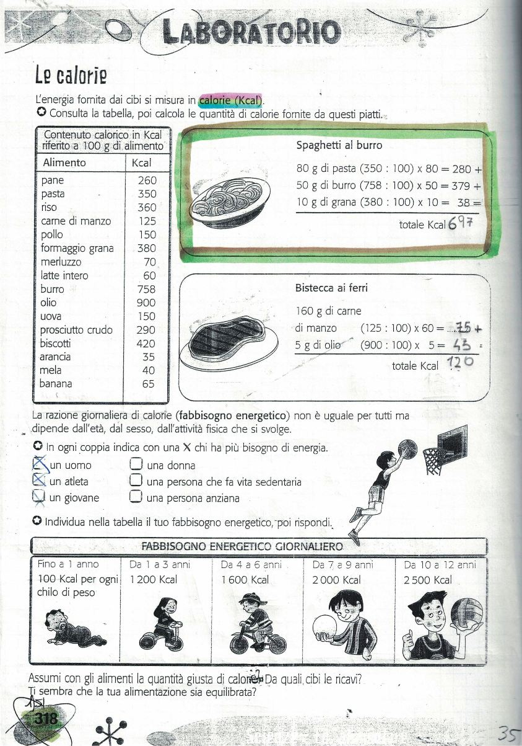
HOW DOES THE FOOD CHANGE IN OUR BODY?
THE FOOD IN OUR BODY BECOMES
ENERGY
EXPERIENCE

Slide 17
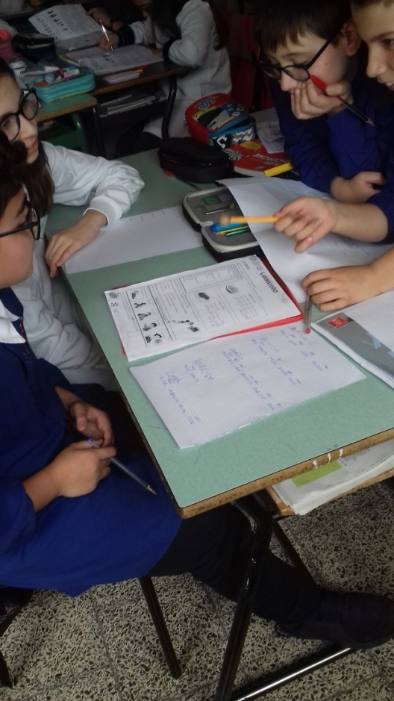
HOW DOES THE FOOD CHANGE IN OUR BODY?
EXPERIENCE

Slide 18
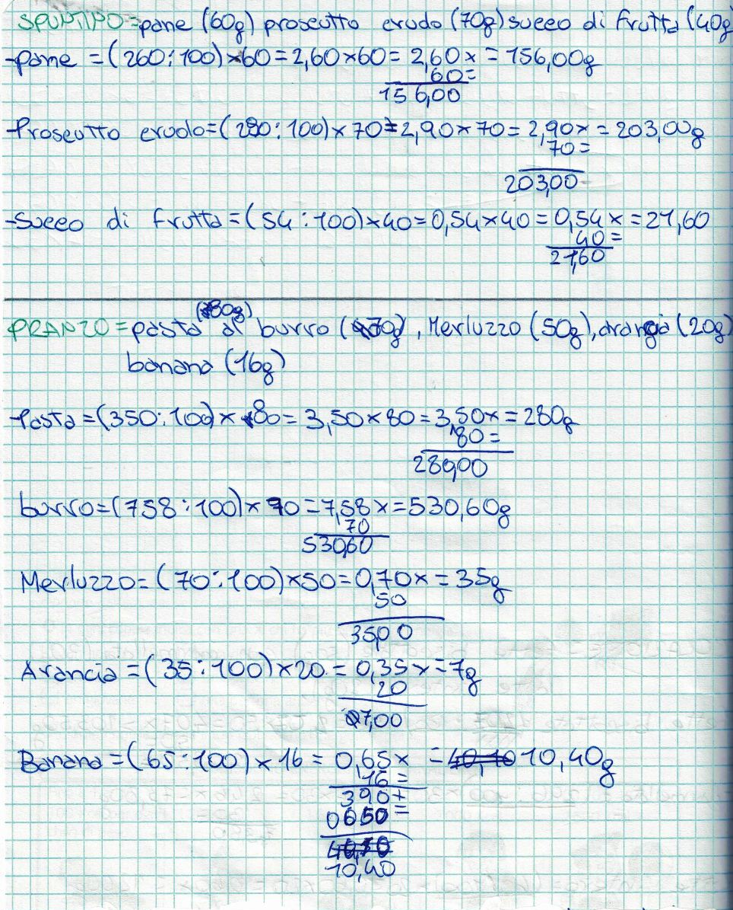
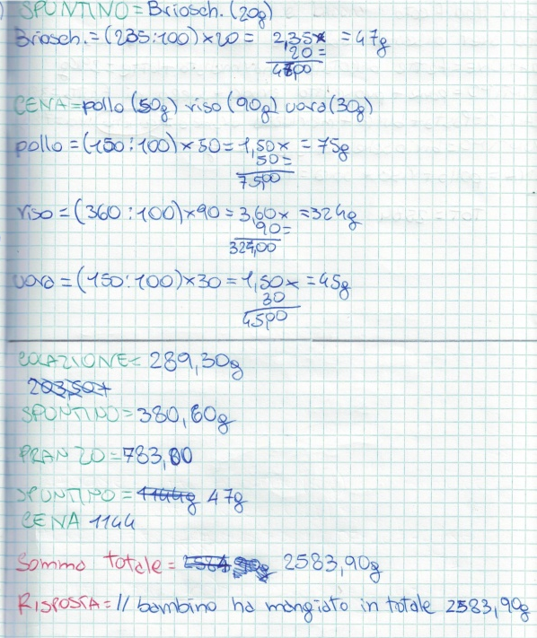
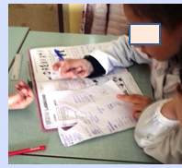
MATHEMATICAL-SCIENTIFIC LABORATORY
WE CALCULATED THE CALORIES OBSERVING THE TABLE AND WE HAVE TRIED TO WRITE A MENU THAT RESPECTED THE ENERGY REQUIREMENT OF THE CONSIDERED PERSON.
MENU FOR ONE STUDENT
MENU' MODIFIED

Slide 19
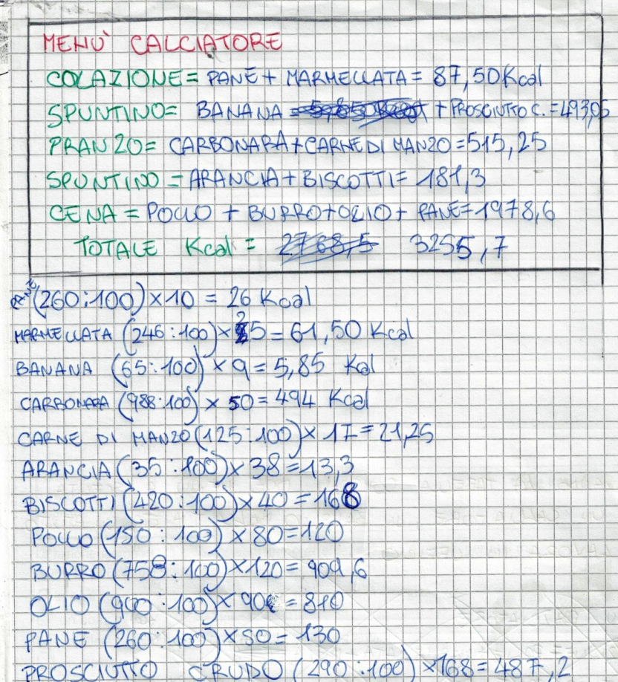
MATHEMATICAL-SCIENTIFIC LABORATORY
IN THE GREAT GROUP, THE MENU HAS BEEN DISCUSSED AND EVALUATED .
IT WAS MODIFIED IF IT WAS NOT CONSIDERED AS GOOD.
MENU FOR A SOCCER PLAYER
MODIFIED MENU

Slide 20
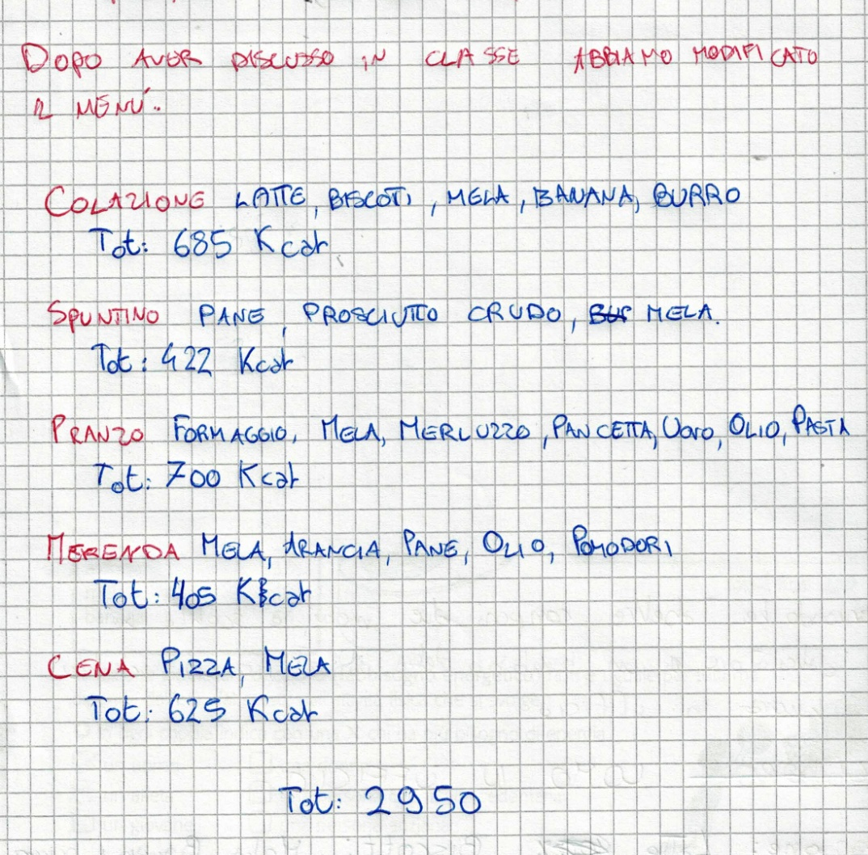
MATHEMATICAL-SCIENTIFIC LABORATORY
MENU’ MODIFICATO
MENU’ PER UN UOMO CHE LAVORA IN UFFICIO

Slide 21
Strengths of the experience
PUPILS WERE STRONGLY MOTIVATED
SIGNIFICANT AND NOT MECHANICAL LEARNING
OVERCOMING THE FEAR OF BEING WRONG
BECAUSE YOU ARE WORKING IN THE GROUP
HEALTHY COMPETITION AMONG THE GROUPS.

