Slide 1
Erasmus +
Refugees and Frontiers:
Keep Europe United

Slide 2
Day 1
Sunday, 1-10-2017
11:20 The Netherlands. The Dutch arrive in Athens(reception: Ntara M. and the hostingparents).
15:50 Denmark . The Danish team arrives in Athens(reception: Dodou M. and the hostingparents).
18:00 Turkey. Turkish team arrives in Athens(reception: Panopoulou C and the hostingparents).
19:30 Dinner near the seaside at the Restaurant“Ellados Eikones”
22:50 Italy. Italian team arrives in Athens.(reception:Giatra A. + hosting parents).

Slide 3
Day 2
Monday, 2-10-2017
First morning in Athens on Monday, the 2nd of October students and teachers from all countries met for the first time in the courtyard of the 4th Lykeion of Alimos.

Slide 4
After having their tour around the school, the students entered the school’s ICT labs for the 1st workshop which was prepared by the Italian team. The students searched the internet for refugee/immigrant cases in Italy and found details about some of refugees/immigrants and their stories.

Slide 5
Presentations on REFRO in Theater 'Karolos Koun' (11:00-14:30)
Italy
The Netherlands
Greece
Denmark
https://prezi.com/view/nkezUkGc7Yl2ddfCSXTT/

Slide 6
14:30-16:30 Lunch
17:00-18:30 Alimos shelter/ NGO '' Save the children '' / Interviews on REFRO
19:00-21:30 In the evening the students gave a performance on refugee- immigration's history, Narrative events, they danced to modern and traditional music.

Slide 7
The Program
19:00 Tzivaeri , Nyfes , Modern Dancing Performance on immigration Theme by H. Panopoulou & Erasmus+' students.Choreography Anna Rossolatou.
19:30 Monologues Across the Aegean Sea, Narrative event by H. Panopoulou & Erasmus+' students.Guest Star Seniors Marina Kalogirou & Lydia Mpagiorgou.
20:00 Documentary on Refugees' Theme by Theofany Pyrza & Vasiliki Karagiorga.
20:30 Music Performance , Project's Song by 4th's Lykeion band " Face Of Oblivion" by Angeliki Tsatsi.
21:00 Greek Traditional Dances by Ourania MakriICT: Boukorou K. , Kasimatis A. , Psaroulis S. , Pyrza T.

Slide 8
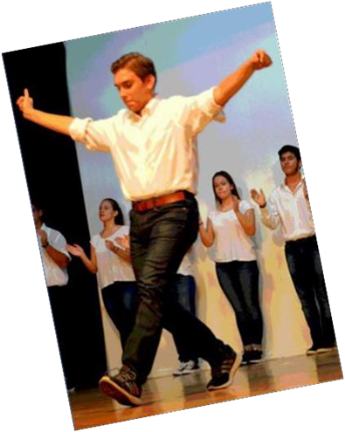
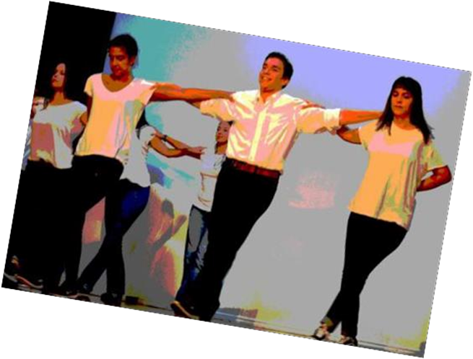
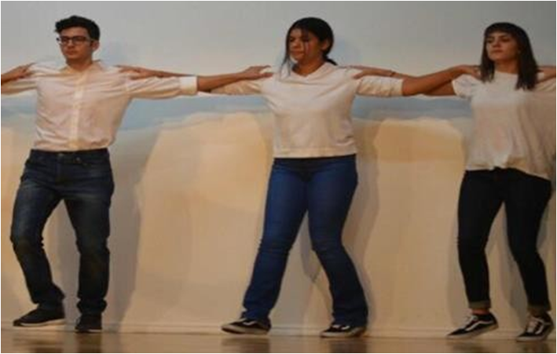
Modern Dance
Monologues across the Aegean sea
Traditional Dances

Slide 9
2nd Transanational Meeting
Greek Refugee Council
Announcement by Mr S. Tzouanopoulos on Council's actions and future perspectives.
Shelters for Unaccompanied Children in Greece
NGO "Save the Children"Announcement by Mrs YIva van den Berg, Child Protection Manager-S5 Greece.

Slide 10
2nd Transnational Meeting Gallery

Slide 11
Day 3
Tuesday, 3-10-2017
First half of the day (8:00-15:00)
08:00 Meeting in Alimos Metro Station
08:45 Arriving in Acropolis
place, Dionysos' Ancient Theatre Guide
10:00 Visiting the Acropolis Museum Tour

Slide 12
At noon the Lip Dub took place in Dionysiou Aeropagitou street under Acropolis place.

Slide 13
Second half of the day (16:00 – 19:30)
Lunch at Plaka
Sightseeing in the City Center
Free time for the students until 19:00 when everyone met at the Acropolis' Metro Station
19:30 Arrival in Alimos

Slide 14
2nd Transnational Meeting
TROPICAL HOTEL / lounge
5:30 PM Hotel Lounge
18:00 Hellenic Foundation for European and Foreign Policy/ Europe Direct ELIAMEP/presentation on REFRO by Mrs Vasilaki R.
18:15 NGO "Metadrasi" / presentation on REFRO by Mrs Grillaki E.
18:30 Ex Principal / 2nd Gymnasium of Intercultural Education Elliniko Mrs Mpanti M. / presentation on Refugee Students inclusion
19:00 Project's Evaluation and further planning
20:00 Dinner

Slide 15
Day 4
Wednesday, 4-10-2017
NAFPLIO
08:00 School
08:00-20:00 All day trip at Nafplio
10:30 Arrival at Mycenes and guided tour
12:00 Arrival at Nafplio (the first Greek capital) sightseeing through the city and then visiting the Palamidi Castle

Slide 16
13:00 Lunch at local restaurant free time for students and teachers
18:00 Departure for Athens 20:30 Arrival
In the evening, walk around town and the sea side

Slide 17
Day 5
Thursday, 5-10-2017
First day in Chios
At 4 am the Erasmus team met at the school in order to depart for Athens Airport
5:30 am flight to Chios
The Erasmus students arrive at Chios and have breakfast near the airport, then settle at their hotel and prepare for the upcoming activities

Slide 18
The erasmus team then visited the Town Hall , met the Mayor and had an interview on REFRO
After that, the Erasmus team went to the Mastic's Museum and then had lunch at Megas Limionas , ''Angyra'' Restaurant

Slide 19
After the break the kids went sightseeing.. (Southern Island)
Kampos
Mesta , The medieval village
Pyrgi
Mavra Volia
Agia Fotia
And the seaside…

Slide 20
Day 6
Friday, 6-10-2017
Second day in Chios
Around 8:30 the erasmus team had breafast and at 10 they visited the 2nd Lyceum of Chios where a presentation on immigration by Greek students took place.
And then they visited Northern Chios

Slide 21
Volissos School
Visit

Slide 22
Break for lunch and then some sightseeing..
Nea moni
Byzantine Monastery
Anavatos
And some seaside…

Slide 23
The Erasmus team then visited the refugee's shelter in Chios/VGO metaDRASI

Slide 24
Day 7 Saturday, 7-10-2017
05:00 -> Departure of the Greek and Danish for Chios' airport
06:30 -> Flight to Athens
07:10 -> Arrival of the teams and free time for them
10:00 -> For the rest of the teams departure from hotels and walk at Chios' city
11:00 -> Departure for the airport
12:40 -> Flight to Athens
20:00 -> Goodbye party at 1st elementary' s school salle
13:10 -> Arrival
14:00-20:00 -> Free
time for the teams
DEPARTURE of the Italy team from Athens Airport
DEPARTURE of the Turkey team by boat from Chios

Slide 25
Goodbye Party

Slide 26
Day 8
Sunday, 8-10-2017
09:00 School
All day trip to Athens North-East Suburbs
Cape Sounion
Ancient temple of Poseidon sight seeing
Lavrion/Lunch
Sight seeing free time 20:00 Arrival back rest...seaside...
12:05 DEPARTURE / The Netherlands

Slide 27
Day 9
Monday, 9-10-2017
Departures:
Denmark : 16:35 (Dodou M. + hosting parents) Italy : 14:10 (Giatra A.+ hosting parents)

Slide 28
Presentation created by:
Aggeliki Papageorgiou
Jovana Pietri
Nikoleta Plevraki
Rodokleia Kakouri

