Slide 1
THE SITUATION IN GREECE(2016-2019) :
EUROPEAN ACTIONS

Slide 2
Migration Flows Arrivals to Europe (2016-2019)
Source : IOM (International Organization for Migration) Office in Greece

Slide 3
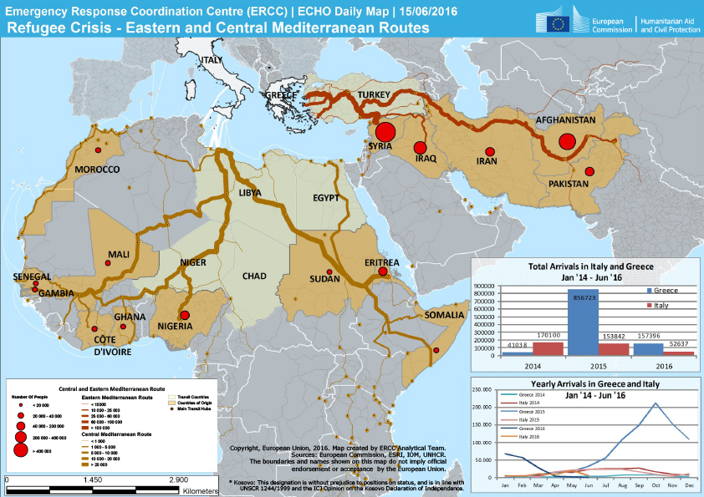

Slide 4
Refugee’s Relocation
Hotspots in Italy and Greece
Eu Civil Protection Mechanism
How Europe helped The Situation
Frontex Reinforcement
Humanitarian Funding
Europe – Turkey
Agreement

Slide 6
The Agreement between Turkey and Europe
As far as refugees and migrants are concerned
All new irregular migrants crossing Turkey into Greek Islands will be returned to Turkey
For every Syrian being returned to Turkey from Greek Islands , another Syrian will be resettled from Turkey to the EU
Turkey will take any necessary measures to prevent new sea or land routes for illegal migration opening from Turkey to the EU
Presence of Turkish officials on Greek islands and Greek officials in Turkey to ensure liaison
-March 18 2016
Source : Council of the EU

