Slide 1
the social situation about the refugees in Greece since 2016 until 2019.

Slide 2
How many refugees have arrived in Greece in 2016-2019?
2016
2017
2018
176.906
35.052
50.215
2019
6.844

Slide 3
Where and how many refugees live in Greece?
More than 20,000 refugees are hosted today in hot spots and hosting structures across Greece.
Lesvos, Samos, Chios and Leros
Nea Kavala Kilkis
Shisto /
Pireaus
Hersonos Kilkis
Elaionas / Elliniko
Diavata

Slide 4
Refugee groups have recently found a refuge in old wagons that have been decommissioned for a long time in West Thessaloniki and only hundreds meters away from the city's train station.

Slide 5
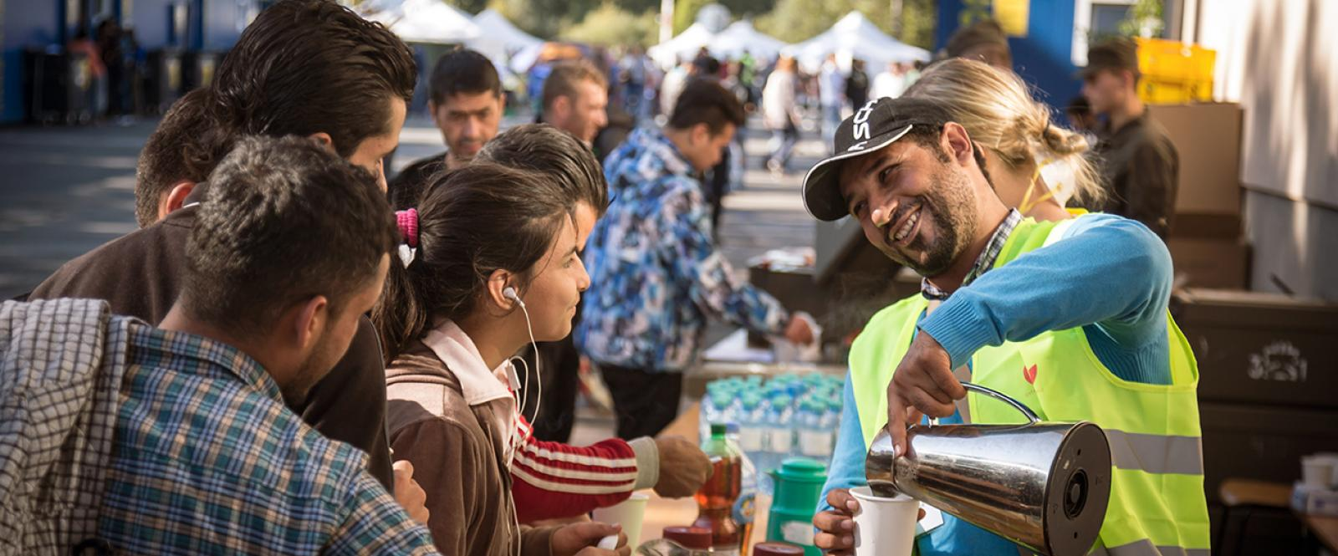
WAYS TO HELP REFUGEES / MIGRANTS

Slide 6
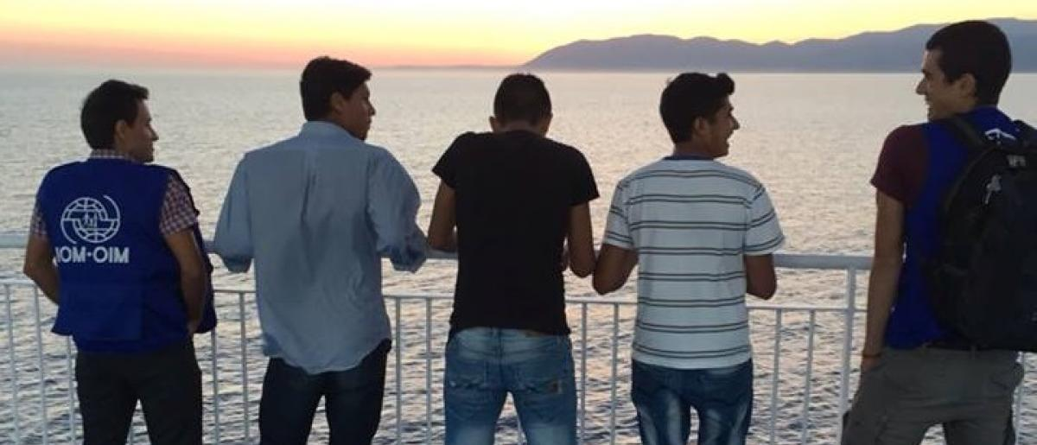
Reception schools
HELIOS pilot project
Assisted Voluntary Return and Reintegration Programs (AVRR)
Preventing sexual and gender-based violence against refugees / migrants and strengthening support to victims
Psychological and Social support for Syrian citizens affected by the humanitarian crisis in Greece
Protecting children in the context of the Refugee and Migrant Crisis in Europe

Slide 7
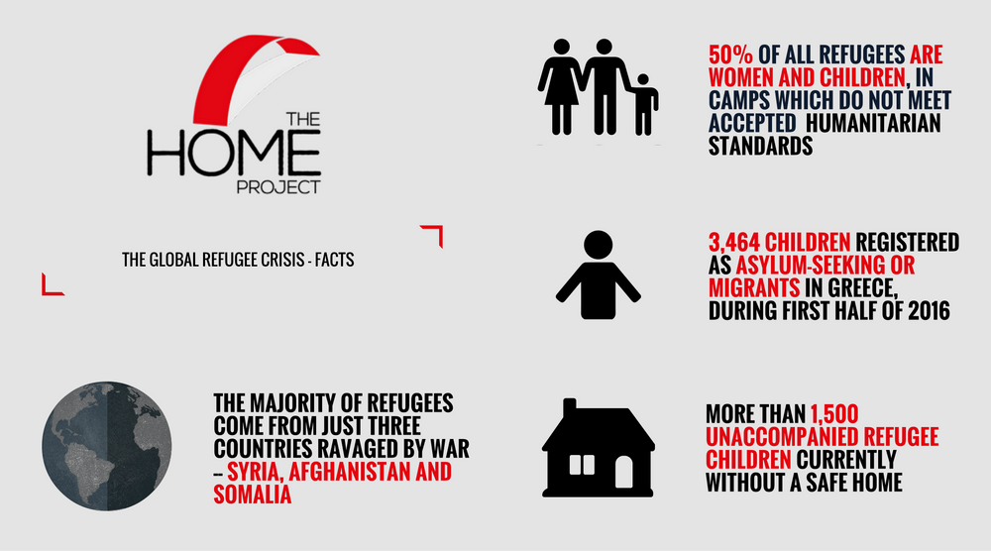
THE HOME PROJECT
They work in residential construction and accompany these damaged children from refugee camps, police stations and detention centers, security protected shelters where they receive care and attention. They also help meet the needs of the mental health and well-being of refugees, with a view to achieving treatment and social inclusion. Our teams are active in camps and refugee assemblies to provide support, protection and empowerment opportunities, and also raise awareness of education and employment skills.

Slide 8
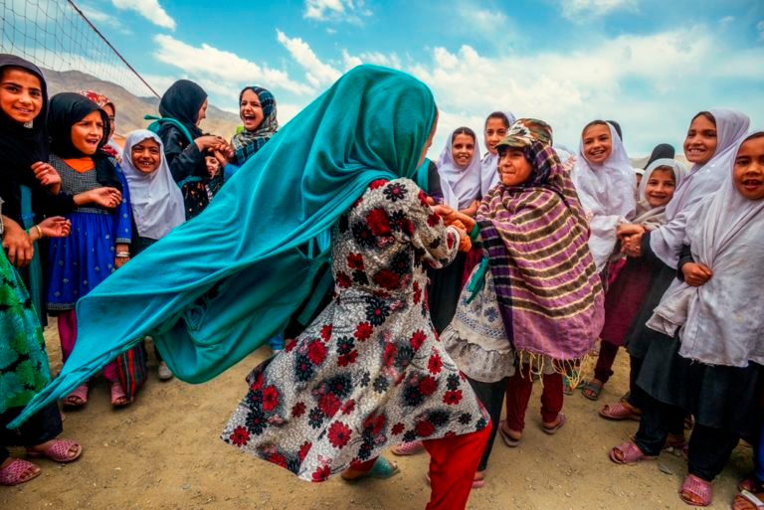
The story of inad.
‘My name is Inad, I am 16 years old, from Egypt. I love my homeland
and the pyramids. In my country, we did what we wanted with my
friends. We would go on walks in the evening, we liked going to the
sea and tease the girls. I love Greece. But sometimes I do not love anything in my life ... I see dreams often. A dream I see is that I have been walking for too long in the desert and the sun has exhausted me. My journey is very difficult. At some point I meet a dog dying of thirst. I take off my shoe, I fill it with water and I give it to him. Some time after I find people hanging out with me. I keep going along with someone and find a cart that was dragged by donkeys. We climb up the cart and we carried on with our journey. Then we meet two people who they were fighting. We separated them, took them with us and got them here. I dream of going to Italy to find my brother. I also dream to rejoin my family again in Egypt’.

