Slide 1
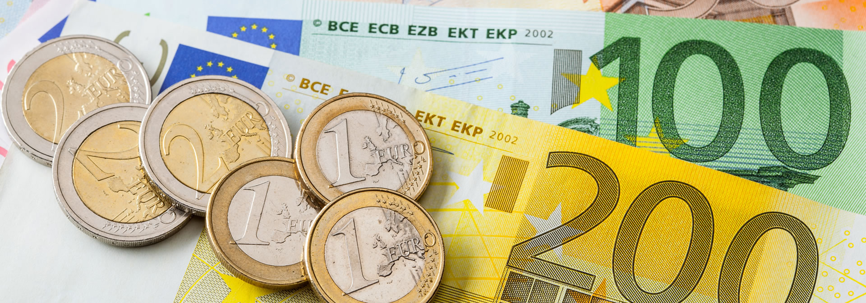
The economic situation in Greece in relation with the refugee aid. (2016-2019)

Slide 2
People that have arrived in Greece in 2016-2019
2016
176.906​
2017
35.052​
2018
50.215​
2019
6.844

Slide 3
The funds that were delivered to Greece from the E.U
In total,the European Union has allocated aproximately 1,69 billion euros in response to the refugee situation in Greece.

Slide 4
HOW WERE THE FUNDS USED?
This Photo by Unknown author is licensed under CC BY-NC-ND.

Slide 5
Out of 1,69 billion euros:
Greek Authorities: 794 million euros
UNHCR: 506,67 million euros
IOM: 119 million euros
EASO: 26 million euros
Various international NGO ( partners of the European Commission): 201 million euros
Other international organizations or NGO: 44,6 million euros

Slide 6
Some of the things that have been done
The iReturn programme​
The "FILOXENIA" programme
The Reception and Identification Service

Slide 7
Reception and Identification Service: Its mission is the effective management of third country nationals who cross the Hellenic borders without legal documents and/or procedures, under conditions that respect their dignity, by placing them in first reception procedures. The iReturn programme: A process which gives the ability to refugees and immigrants to re-engage in the social, economic, political and cultural life of their country. The "FILOXENIA" programme: <<We offer independent and safe accommodation for refugees waiting for relocation in Europe. Each apartment has two bedrooms, a bathroom, living room, kitchen and balcony. Elevator and wheelchair-accessible apartments are available for families with disabilities.>>

