Slide 1
Save the Children Shelters for Unaccompanied Children in Greece October 2017 Ylva van den Berg Child Protection Manager - SC Greece Response

Slide 2
Background information
In 2015, Greece has been the main entry point into Europe for more than one million refugees and migrants seeking safety for themselves and their families.
Until March 2016, migrants and refugees arriving on the islands would move to the mainland and continue to transit to other European countries.
On March 8 2016 , the Greek border with FYROM finally closed.
On March 18 2016, EU and Turkey reached an agreement under which all new ‘irregular’ migrants crossing from Turkey to the Greek Islands as of 20 March 2016 will be returned to Turkey.
Since the official border closures and the EU-Turkey Statement came into force in March 2016, there are currently an estimated 62,000 refugees and migrants stranded on mainland Greece and on the islands.
The number of arrivals from Turkey to Greece has significantly decreased since the EU-Turkey Statement.

Slide 3
Save the Children - Greece Response
Save the Children has been providing assistance to children and families across Greece since August 2015.
Programmes have been implemented in Greece: on the islands of Lesvos, Chios, Samos, Leros and Kos, and on the mainland in the Attika region and in Northern Greece. At the moment SC is handing over to national actors, and determining strategy for 2018.
Our programs include child protection, health and nutrition and education, and have reached almost 500,000 children and adults.
Child Protection: individual case management support by multi disciplinary teams, group based psychosocial support through Child Friendly Spaces, shelters for unaccompanied children
Advocacy (integration/ access to quality education, ending of unlawful detention of children, durable legal options and efficient access to the asylum procedures.
Training

Slide 4
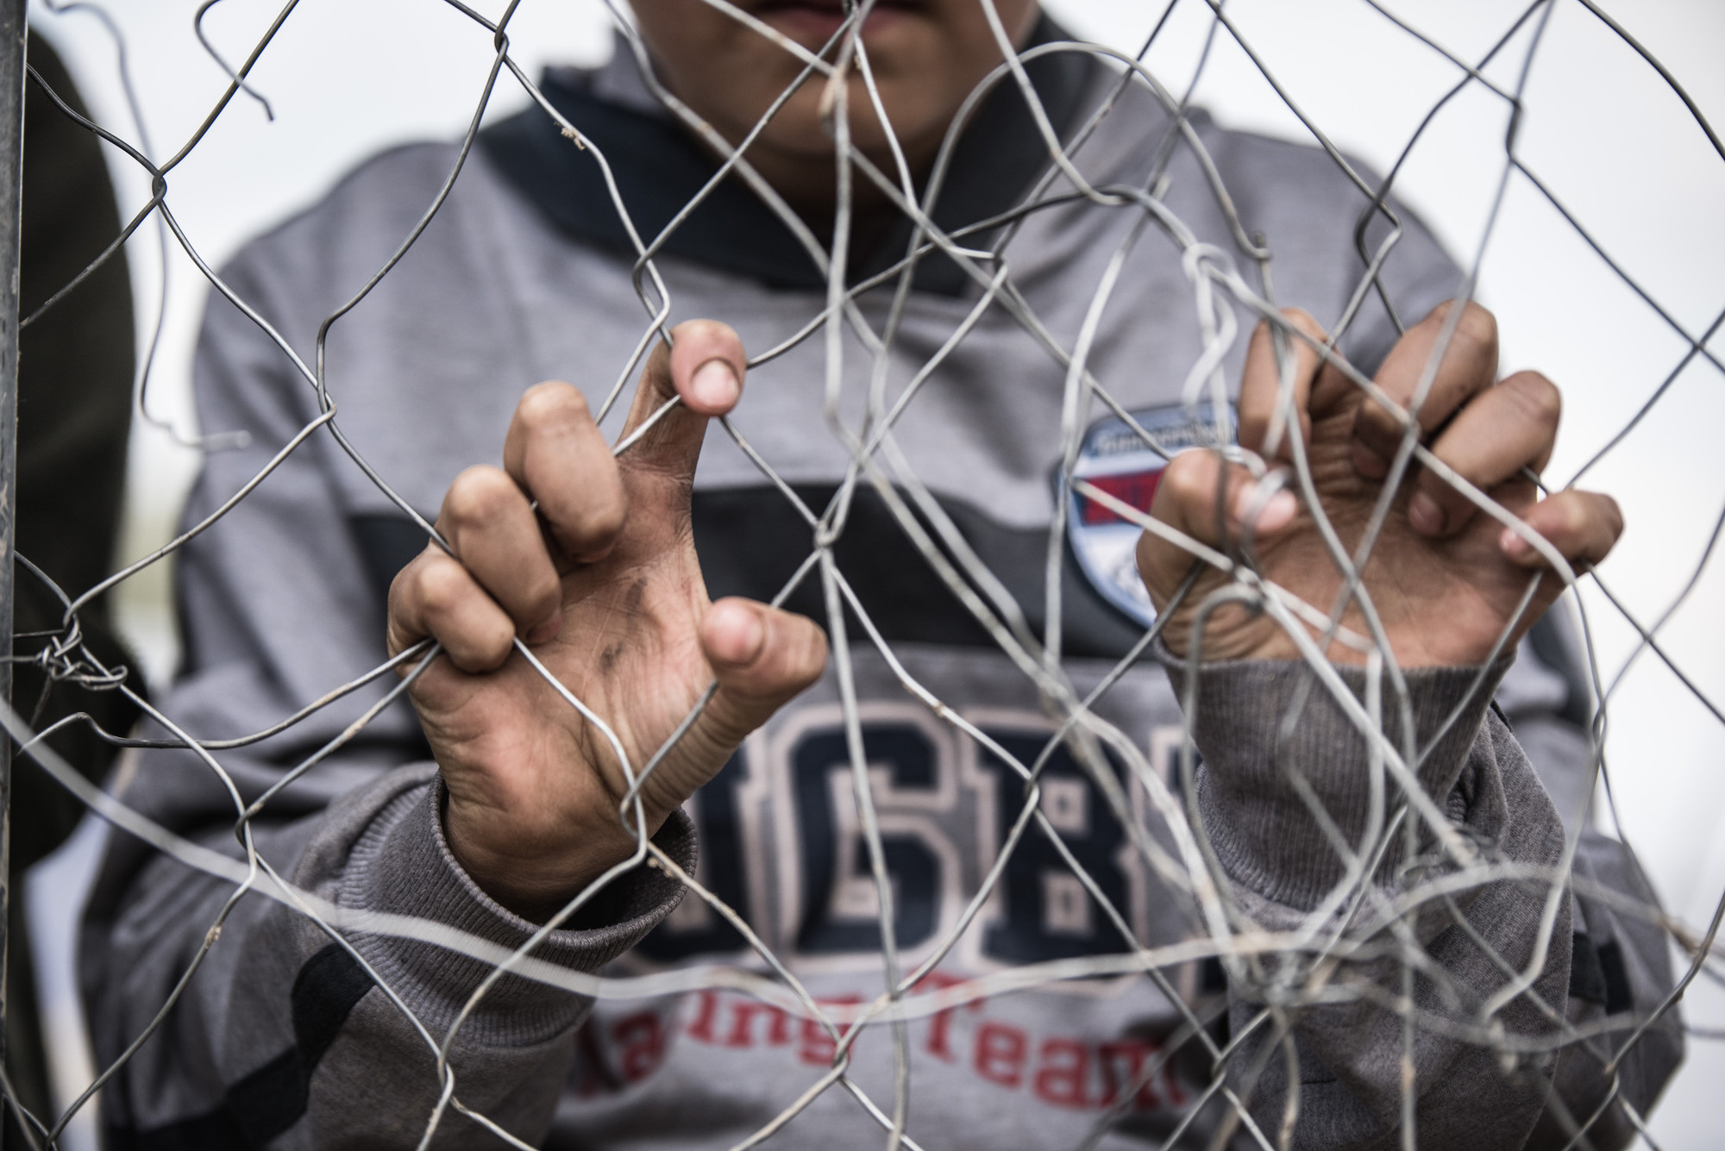
Unaccompanied children in Greece
Unaccompanied children are particularly at increased and heightened risk of abuse, violence and exploitation, including sexual abuse and child labour, in order to meet their survival needs
Unaccompanied children in Greece remain in urgent need of safe, care, protection, and basic services and adequate and accessible information on their legal rights, services and viable options, including about their right to seek asylum and the EU Family Reunification process.

Slide 5
Unaccompanied Children– Shelters for UAC
According to the National Centre for Social Solidarity (EKKA), there are an estimated total of 2,450 unaccompanied children in Greece.
Approximately 1183 unaccompanied children are placed in care in shelters (52 shelters).
1,473 total number of UAC on the waiting list for shelters. They lack any form of appropriate care, due to a lack of appropriate care facilities in Greece.
On the mainland they stay in open sites and urban areas, including on the streets or in squats, while numbers of unaccompanied children held in police custody, pre-removal centres or other detention facilities is increasing again.
An estimated 400 unaccompanied children are held in closed or semi-closed facilities in the hotspots on the islands and in Evros (Northern Greece at the Turkey border).
Currently around 180 places in Safe Zone (filled) – temporary spaces in sites with 24/7 care for children in detention and other vulnerable children
Placements in shelters through referrals to EKKA8,419 total number of referrals to E.K.K.A between January 2016 and August 2017 (93% boys, 7 % girls, 6 % below 14 years old)

Slide 6
Save the Children – Kalamaki shelter
Operational since October 2016 – 72 UAC stayed in the shelter
Placements 25 (previously 32 but decrease due to high number with MHPSS needs) – male between 13 and 18 years old
UAC leave shelter: “absconding”, family reunification, relocation, and turning 18
Different nationalities: Afghan, Syrian, Pakistani, Iraqi, Kurdisch, Egyptian, Algeria, Somalia
Placement in shelter through E.K.K.A; SCI no involvement
Prior to arrival in the shelter medical checks and documentation
Legal Guardianship under the Public Prosecutor (PP); PP needs to stay informed and has to give approval for important decisions (e.g. travels outside Athens, surgery, moving to another shelter, etc.)

Slide 7
Save the Children – Staffing Shelter
Shelter provides 24/7 care and therefore we need a large team:
Shelter Manager E.K.K.A
Child Protection Manager SCI
Case Management Unit, consisting of Child Protection Officer, 2 social workers, 1 psychologist, 1 lawyer
Shelter Coordinator
15 Caregivers
6 Cultural Mediator
2 teachers (NFE) – due to long waiting lists formal education
2 guards

Slide 8
Case Management
Each child case file with care plan – weekly case review meetings
Overall care, including medical, nutrition, clothing, education, recreation, sports etc.
Ensure durable legal options such as relocation and family reunification or asylum in Greece
UAC waiting for prolonged periods of time for legal ways of family reunification, which continues to lead children choosing irregular and unsafe ways of migration, putting them at high risk
Long term stay, but also many boys “abscond” (out of 75 boys 29). Reporting after 24 hours to the police. Different reasons: leaving Greece through smugglers, difficulty to follow rules and structure in the shelter etc.

Slide 9
Legal Options – International Protection
Family Reunification: 10
- 6 boys from Syria
- 3 boys from Afghanistan
- 1 boy from Pakistan
Relocation: 13
- 13 boys from Syria
Asylum approved: 7
- 3 boys from Syria
- 2 boys from Afghanistan
- 1 boy from Pakistan
- 1 boy from Somalia

Slide 10
Challenges
Psychosocial distress and mental health issues due to on-going difficult circumstances, insecurity, uncertainty about the future and legal limbo they face.
Negative coping mechanisms (e.g. self harm, drugs, alcohol etc.)
Age assessment (adults registered as minors and visa versa)
Violence and Aggression by boys as a result of frustration, anxiety, distress etc.– limitations to respond – PP’s order to move them from shelter – no appropriate place to move them to – deficiency CP system
Lengthy asylum procedures; sometimes appointment in 1 year – uncertain future perspective
Access to formal education
Lack of appropriate care facilities and spaces available for UAC
Sexual exploitation – survival sex
=> Reporting to the Children’s Ombudsman

