Slide 1
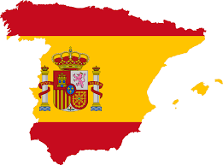
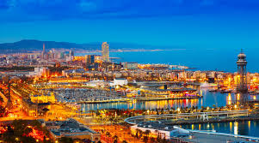
SPAIN

Slide 2
Spain, the third largest European country, takes up most of the Iberian Peninsula, Balearic Islands in the Mediterranean, the Canary Islands in the Atlantic and two small enclaves on the Moroccan coast of Africa. The furthest the southernmost point adjacent through the Straits of Gibraltar from Morocco, as the bridgehead of a bridge between two continents.

Slide 3
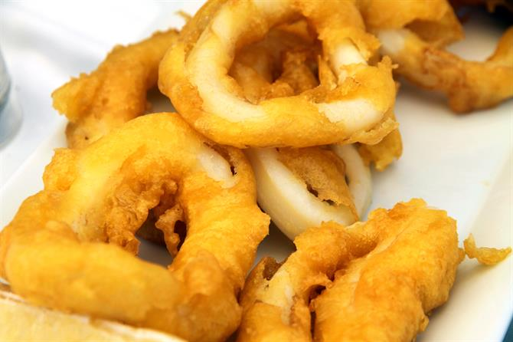
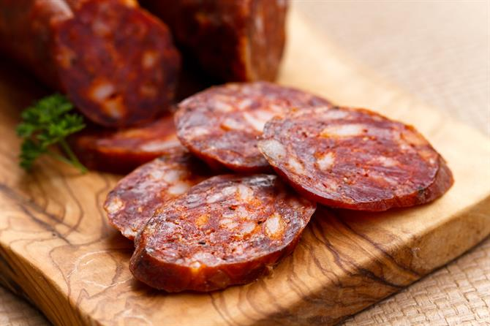
I LIKE FOOD IN SPAIN

Slide 4
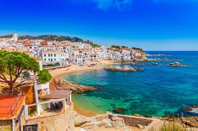
LANDSCAPE

Slide 5
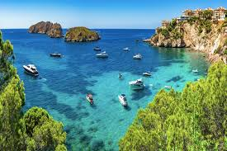
SEA

Slide 6
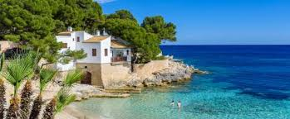
SUNNY WEATHER

