Slide 1
The good and bad food habits
©Karolina Michalik and Michał Siedloczek
Notes:
Sprawdzić słowo ,,nawyk”

Slide 2
The good food habbits
Eat 5 meals daily
Eat regular
Eat 5 portions fruit and vegetables daily
Drink at least a liter of water daily

Slide 3
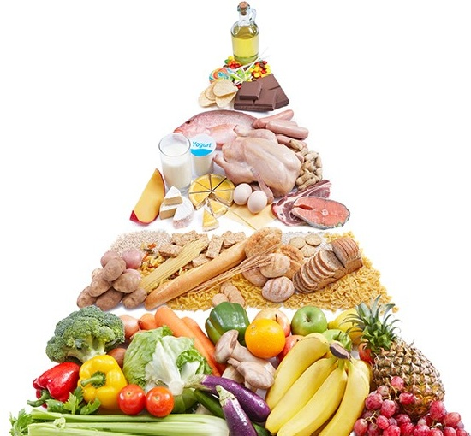
The healthy eating pyramid
Dairy products, fish and meat products
Fats
Dairy products, fish and meat
grain products
Fruits and vegetables

Slide 4
How read healthy eating pyramid?
Eat fruits and vegetables 5 times on a day
limit fat intake

Slide 5

physical activity is also needed for health

Slide 7
Sources: https://drosed.pl/wp-content/uploads/2018/04/warto-wiedziec__image-5.jpg,
Notes:
Źródła:

