Slide 1
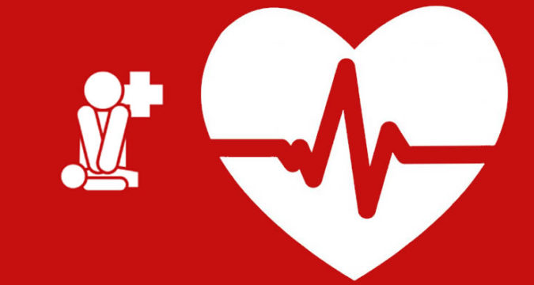
Istituto Comprensivo «Beniamino Gigli»
Recanati
BLS COURSE (Basic Life Support)
Meeting with a doctor and some Red Cross volunteers

Slide 2
In class with the teachers the students studied the anatomy and physiology of the human body.
In the meeting with doctors and Red Cross volunteers the students learned:
the numbers and symbols of the emergency services;
- the phases of first aid: assessment of the state of consciousness and
breathing, lateral safety position of the unconscious patient who
breathes;
cardiopulmonary resuscitation: execution of external cardiac massage, performing artificial respiration (mouth-mouth and mouth-nose ventilations) through the use of mannequins;
early defibrillation: recognition of the AED symbol, knowledge of the
operation of the AED and the purpose of defibrillation, knowledge of the BLS
algorithm (Basic Life Support - Basic support for vital functions).

Slide 3
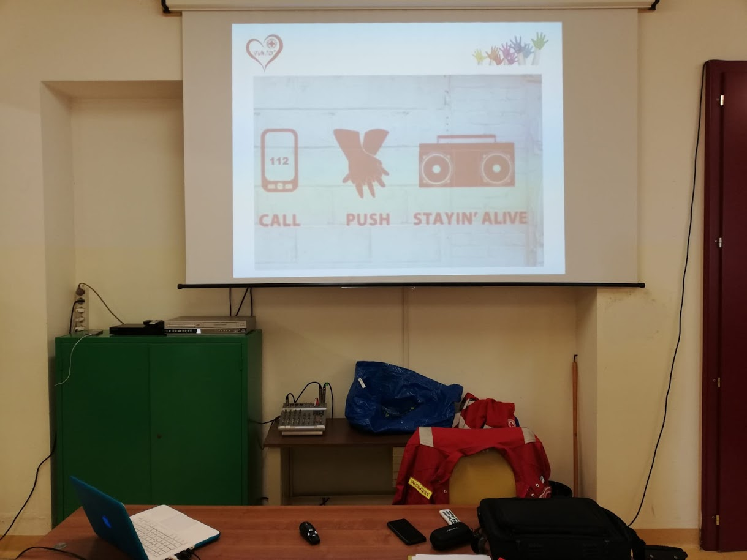

Slide 4
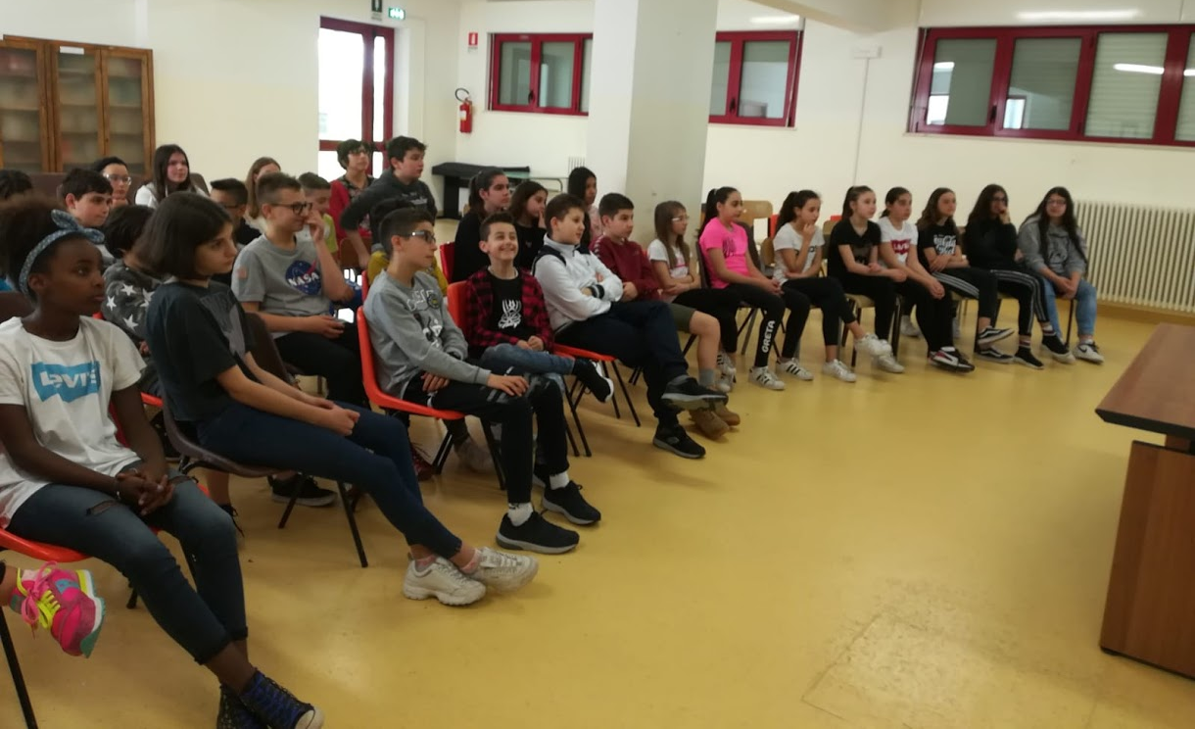

Slide 5
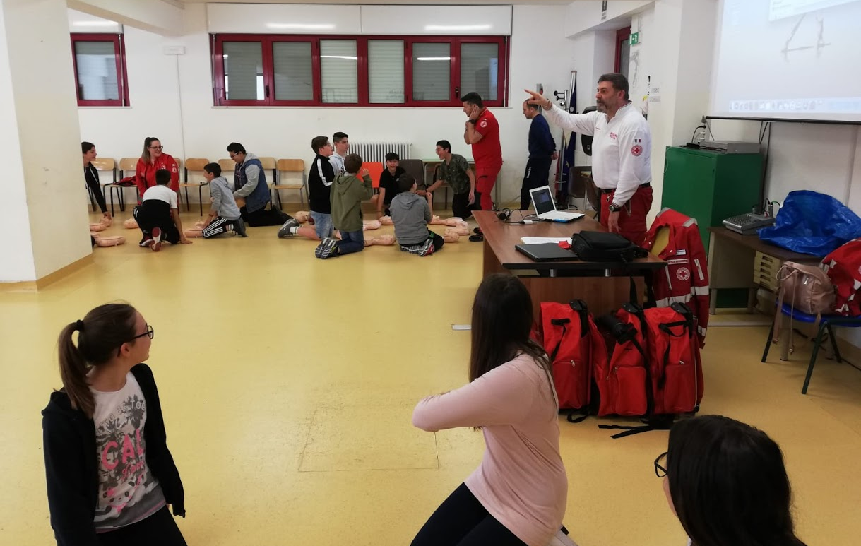

Slide 6
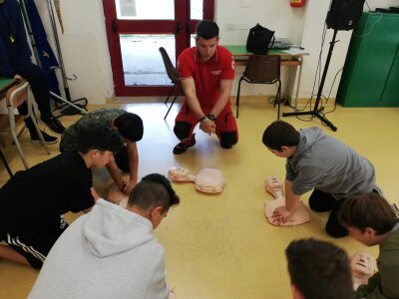

Slide 7
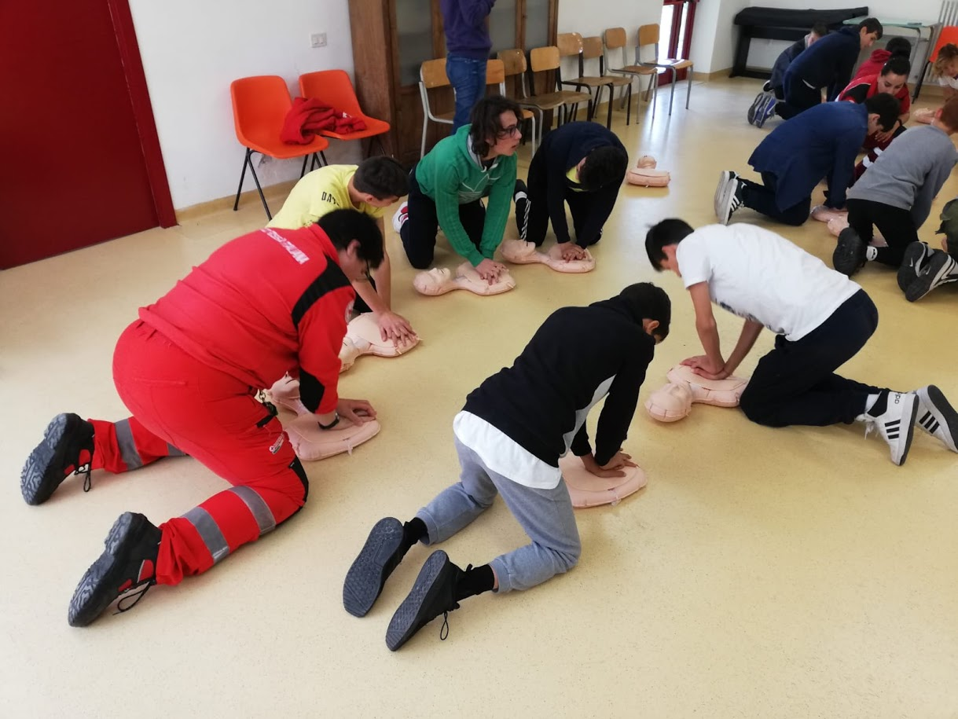

Slide 8
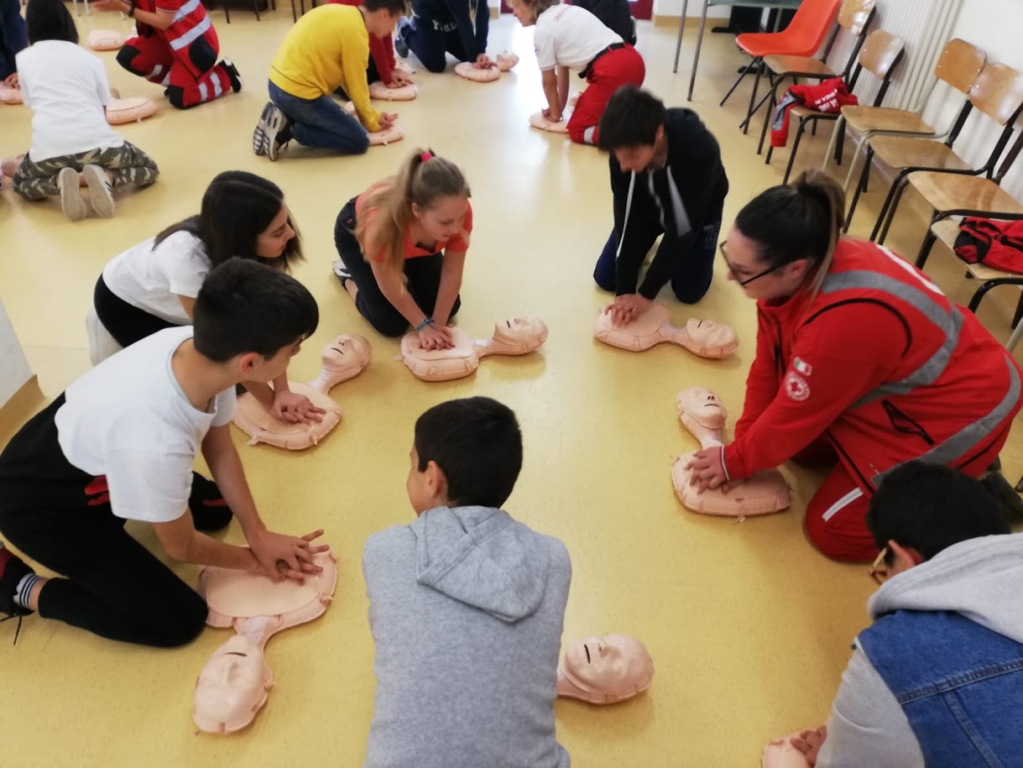

Slide 9
