Slide 1
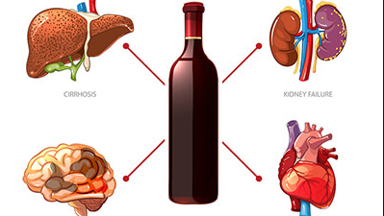
The impact of alcohol on a person's body

Slide 2
In 1975 the Organization of the Worldly Health admited alcohol to be the drug
It is worth mentioning that alcohol is one of the mostly – spread substances causing adiction.
According to the statistical reseaches the use of alcohol becomes the reason of the death of one fourth of the young people aged from 15-29 in Europe. Moreover, 55000 young people died because of alcohol in 1999. Therefore, alcohol is considered to be dangerous due to its threatening influence on the people of all over the world.

Slide 3
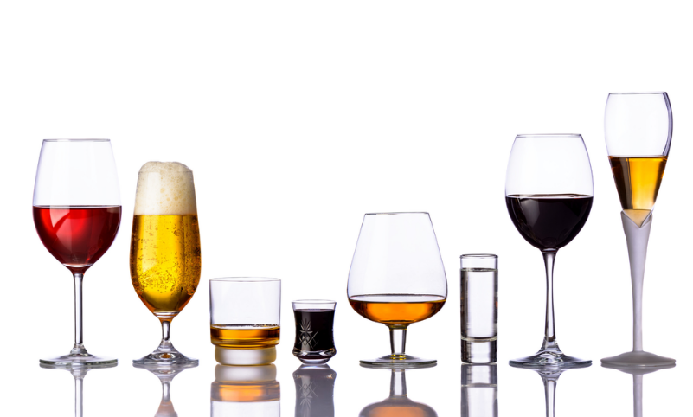
Harm caused by alcohol in Lithuania
70% of all the suicides;
1000 deaths;
436 deathly poisonings;
1100 persons harmed in the accidents;
21% of all the crimes;
20% of teenagers committed crimes being not in a sober condition.

Slide 4
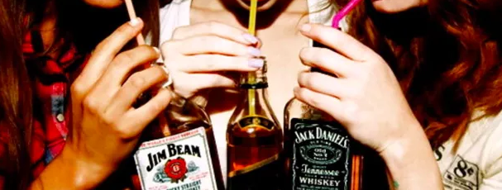
Alcohol causes harm on a teenager's body
If a teenager starts drinking alcohol being younger than 13, then the tolerance of his body for alcohol is slight. Later (after 1,5 – 2 years) the tolerance can achieve the highest point rapidly. A teenager can become addicted.

Slide 5
Effects of Alcohol

Slide 6
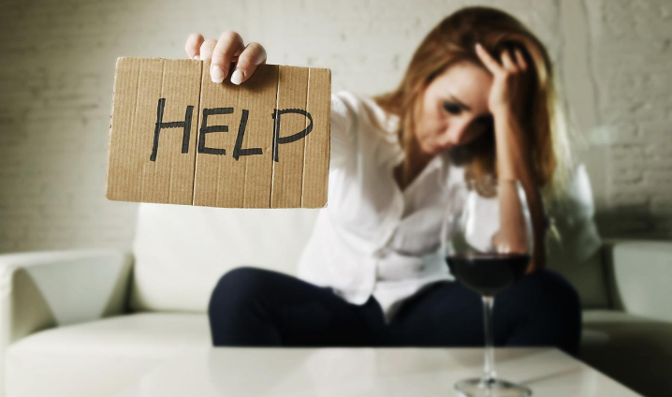
Effects of Alcohol
When the absorvation of vitamins gets wrong, the skin of all body loses its flexibility, gets wrinkled in a very young age.
A person loses his teeth, nails get weakened, even can break down, a person loses his hair, tuberculosis starts developing, immunitative system gets weakened, even loses its function.

Slide 7
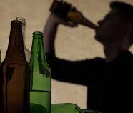
Physical dependance
Physical dependance of alcohol is formed when a person starts using alcohol for 3 or 6 months.
The diseases, caused by alcohol among young people, start developing rapidly.
The earlier a young person starts using alcohol the greater risk can be developed.

Slide 8
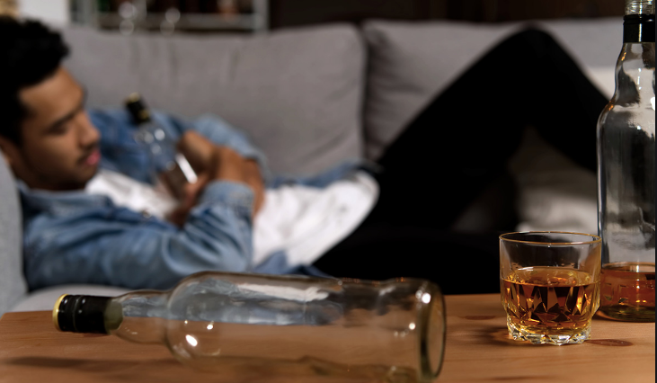
Psychological dependance
Psychological dependance is caused by the understanding, that a person can not stop drinking alcohol in spite of a lot of obvious harmful consequences.

Slide 9
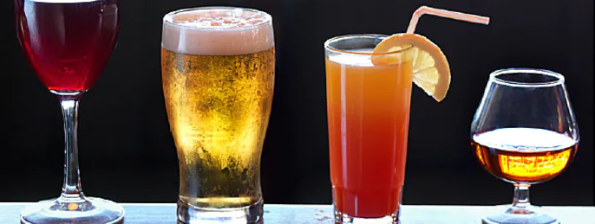
Conclusions
No matter, what amount (even the least) of alcohol is used, it is always harmful because of cousing negative consequences.
Alcohol always does harm or even destroys the certain amount of cells of brains, liver or any part of a body.

Slide 10
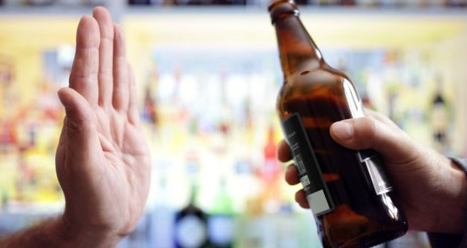
How to say "No!"
How to behave when someone offers you to drink alcohol, to do something, what you don't want at all.
If you get into any situation, which can be quite complicated and involving, no matter, you must lean how to say "NO!"
At the same time it is important not to lose your friends. Also it is even more important to understand, that your friends must learn how to respect your point of view

Slide 11
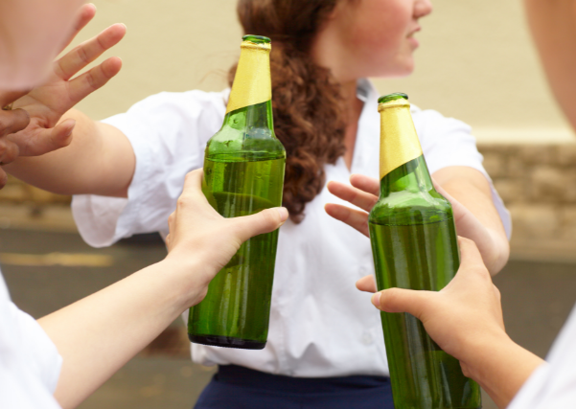
How to say "NO!"
These kinds of advice are very useful in this situation:
Be strong. Your decision is right.
Do not delay. Say "No!" the quicklier, the better.
Say "No!" loudly, clearly, in a strong voice.
While saying "No!" look at your friend's eyes straightly.
Don't say, that you are sorry. Don't explain, why you say "No!"
Repeat your statement one more time "NO!"

