Slide 1
Poland
Prepared by Kasia Wrzesień, Kasia Tomera and Marta Pałyska

Slide 2
Where is Poland?
Poland is in the central Europe.
Our neighbours
are Germany,
the Czech Republic, Slovakia, Ukraine, Belarus, Lithuania and Russia.

Slide 3
Our flag
Our flag is white and red. White colour symbolizes purity and red symbolizes blood.

Slide 4
Our emblem
There is a white eagle with a crown on a red background on our emblem. This refers to the legend of the creation of Poland.

Slide 5
Our anthem
Our anthem was
written by Józef
Wybicki.
It's called "Mazurek Dąbrowskiego".
https://www.youtube.com/watch?v=DebhiaQH3ps

Slide 6
Our capital
Our capital city is Warsaw.

Slide 7
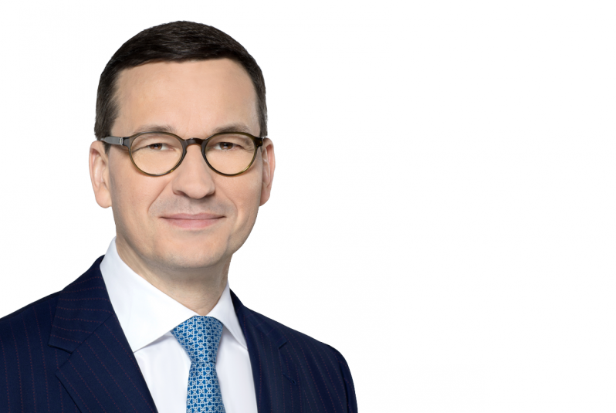
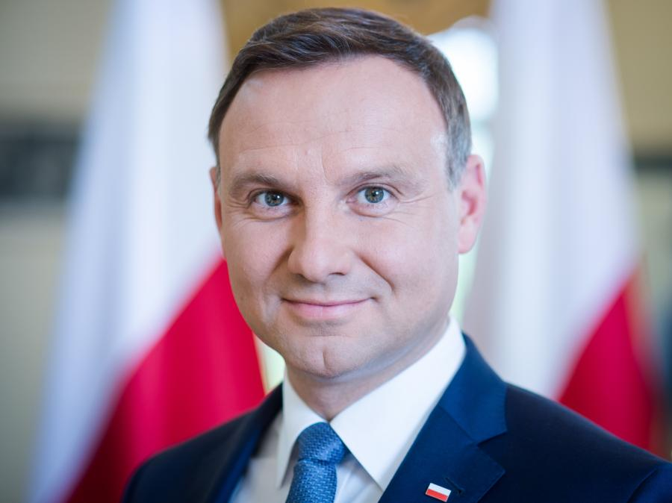
Polish government
Andrzej Duda is the Polish President.
Mateusz Morawiecki is the Polish Prime Minister.

Slide 8
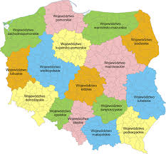
Silesia
Here it is ☺

Slide 9
Coal mines
Silesia is an area famous for its coal mines.

Slide 10
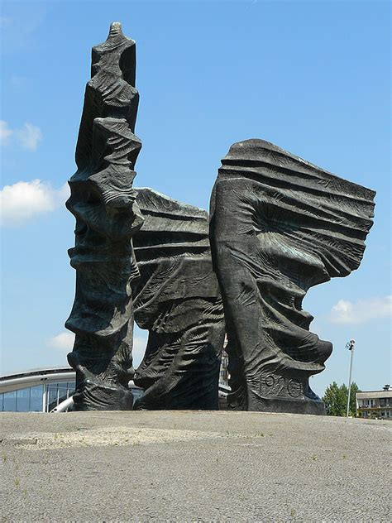
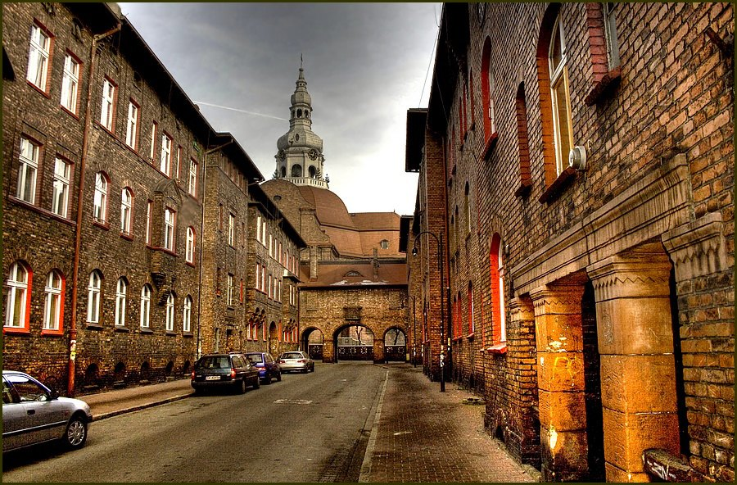
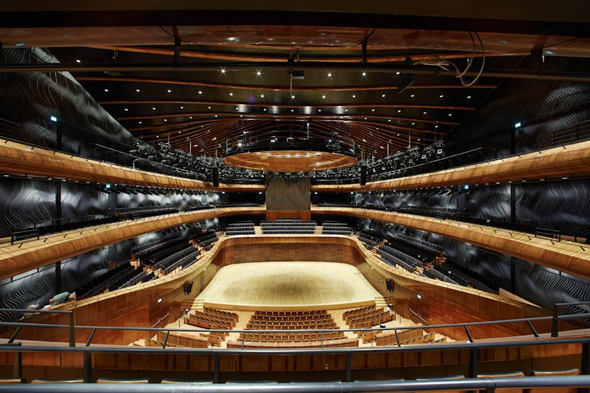
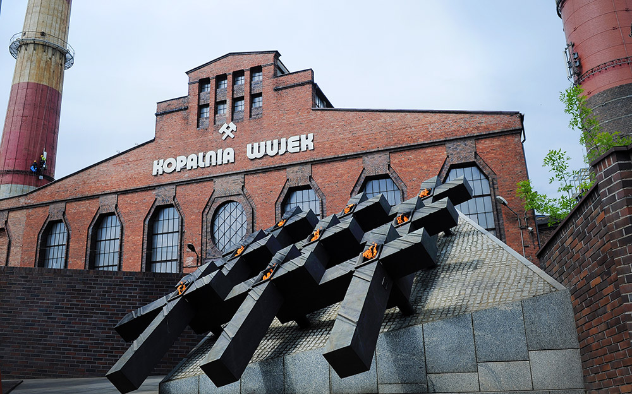
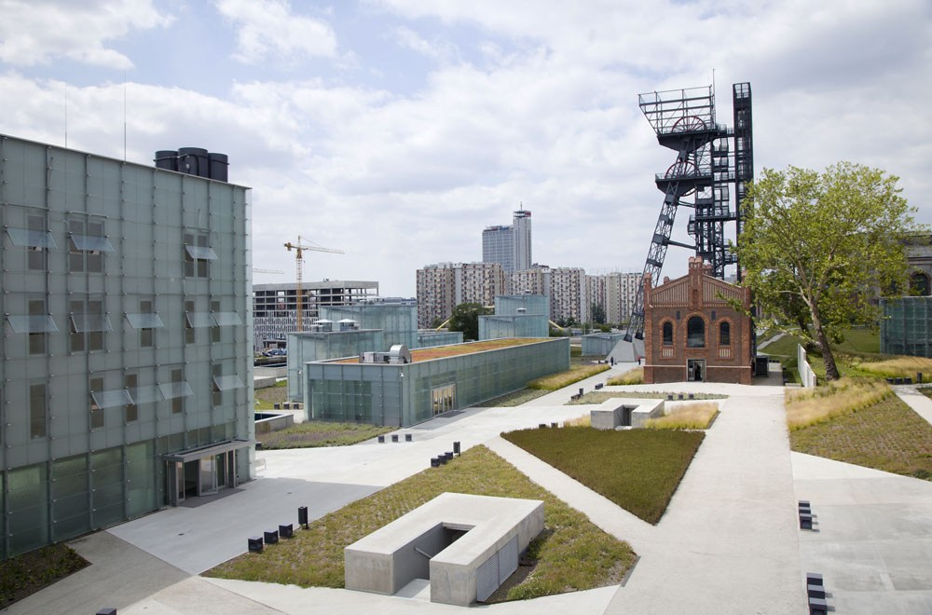
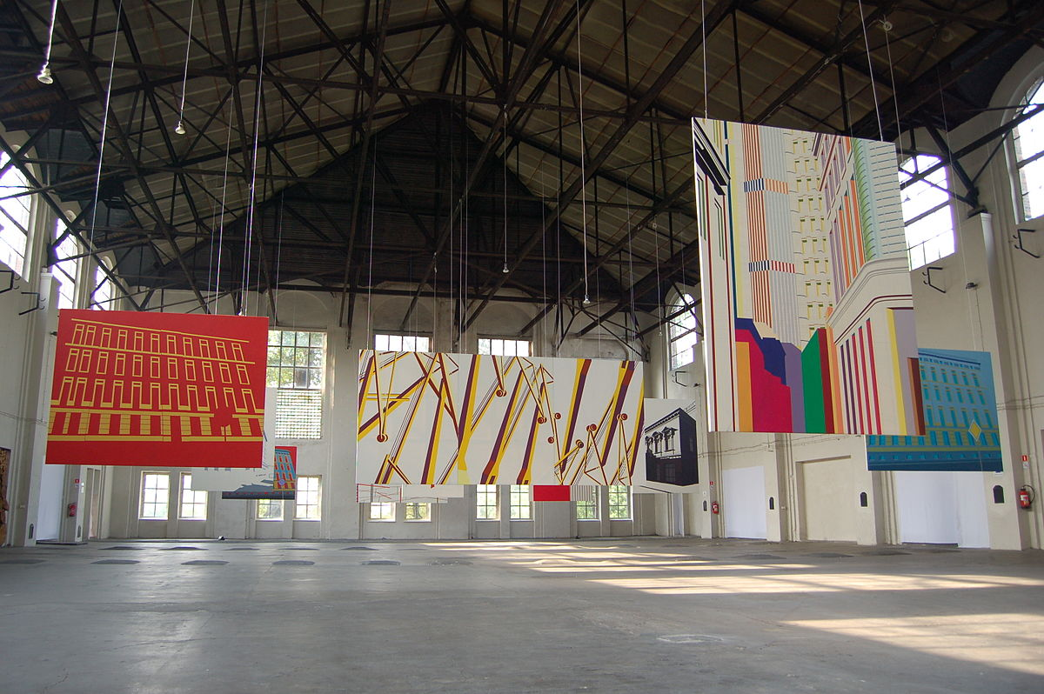
Famous places in Katowice
The most famous places in Katowice are: Spodek, Wujek Mine, Silesian Museum, NOSPR (National Polish Radio Symphony Orchestra), Nikiszowiec, Szyb Wilson Gallery and Silesian Insurgents' Monument.

Slide 11
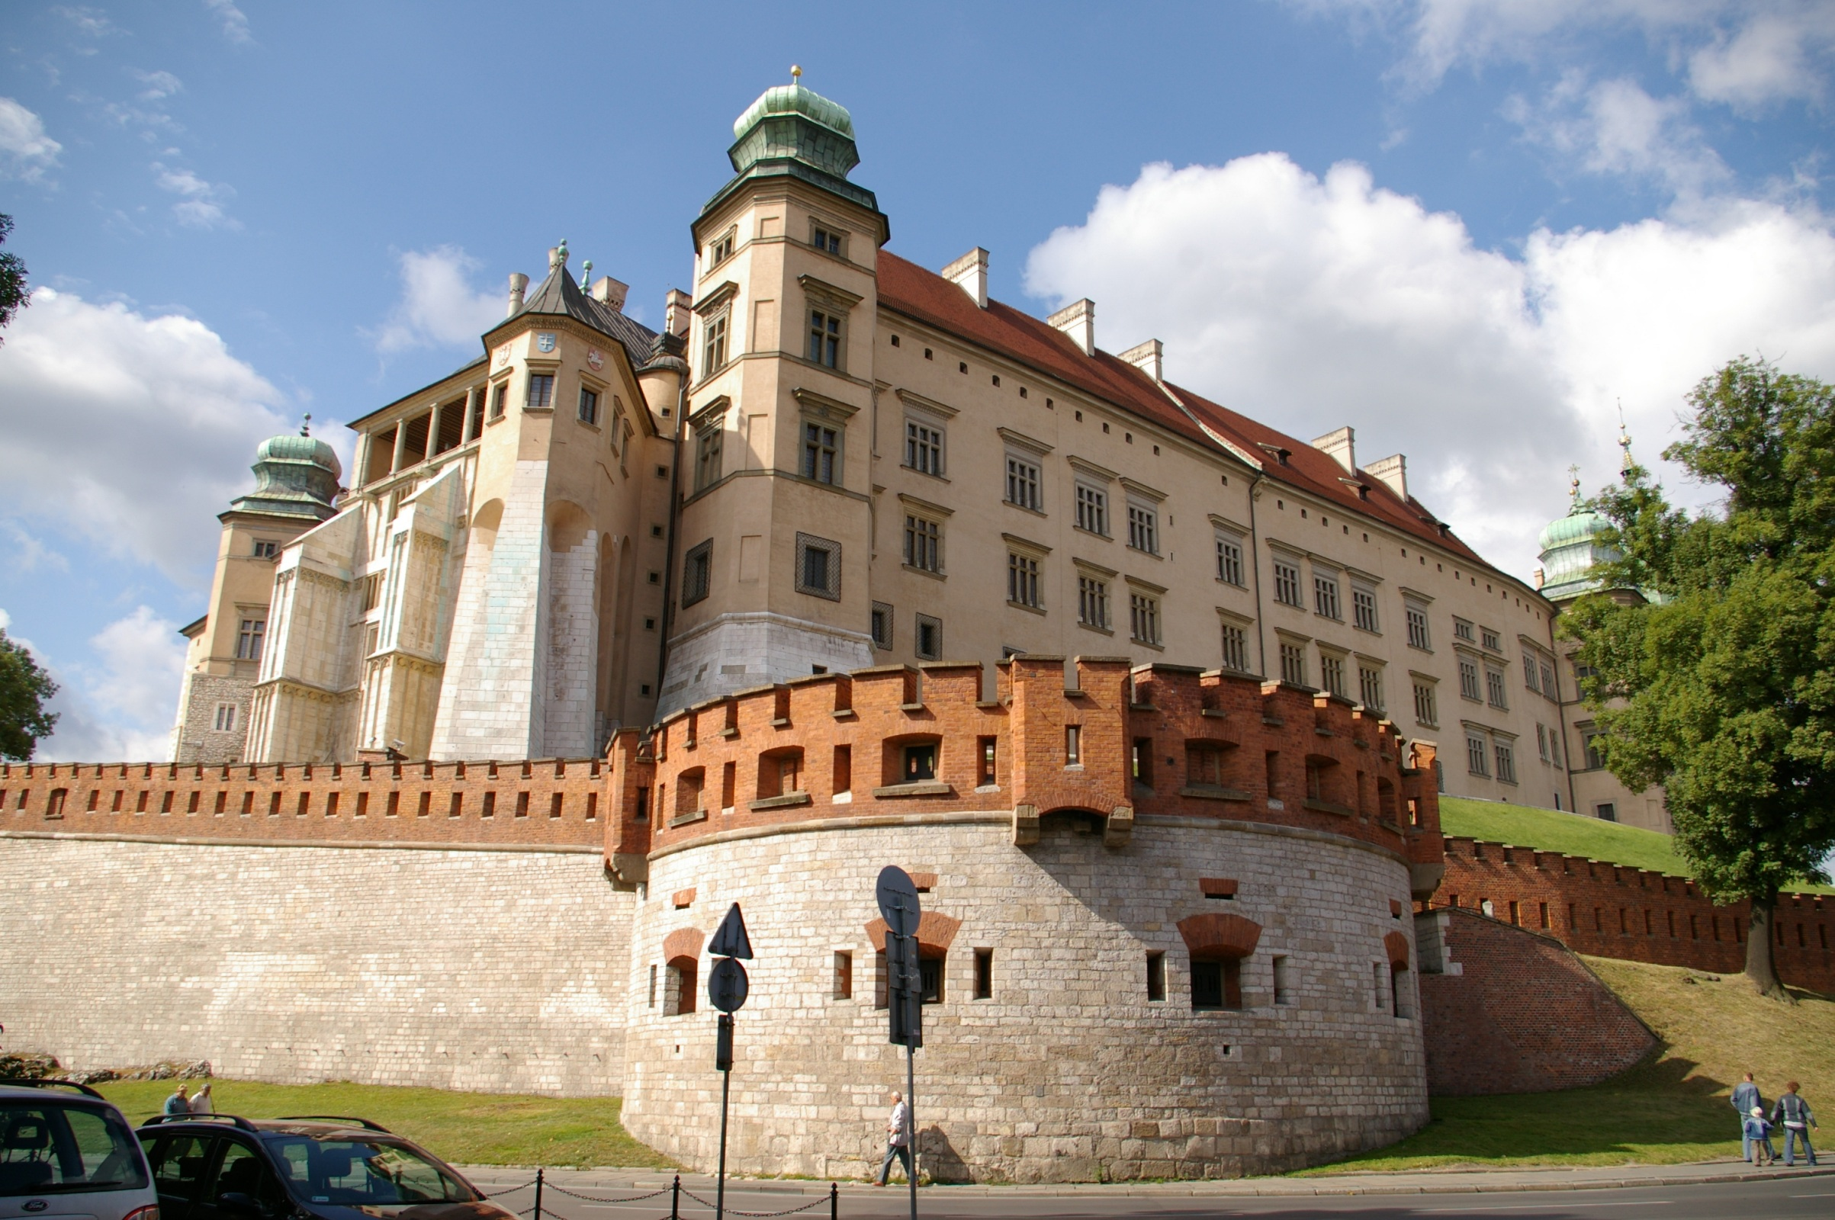
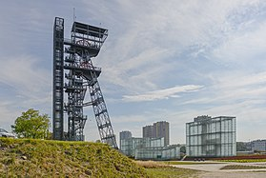
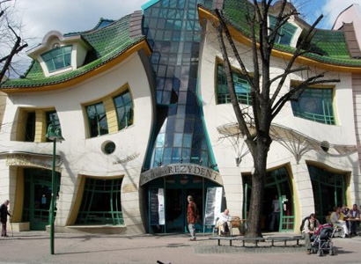
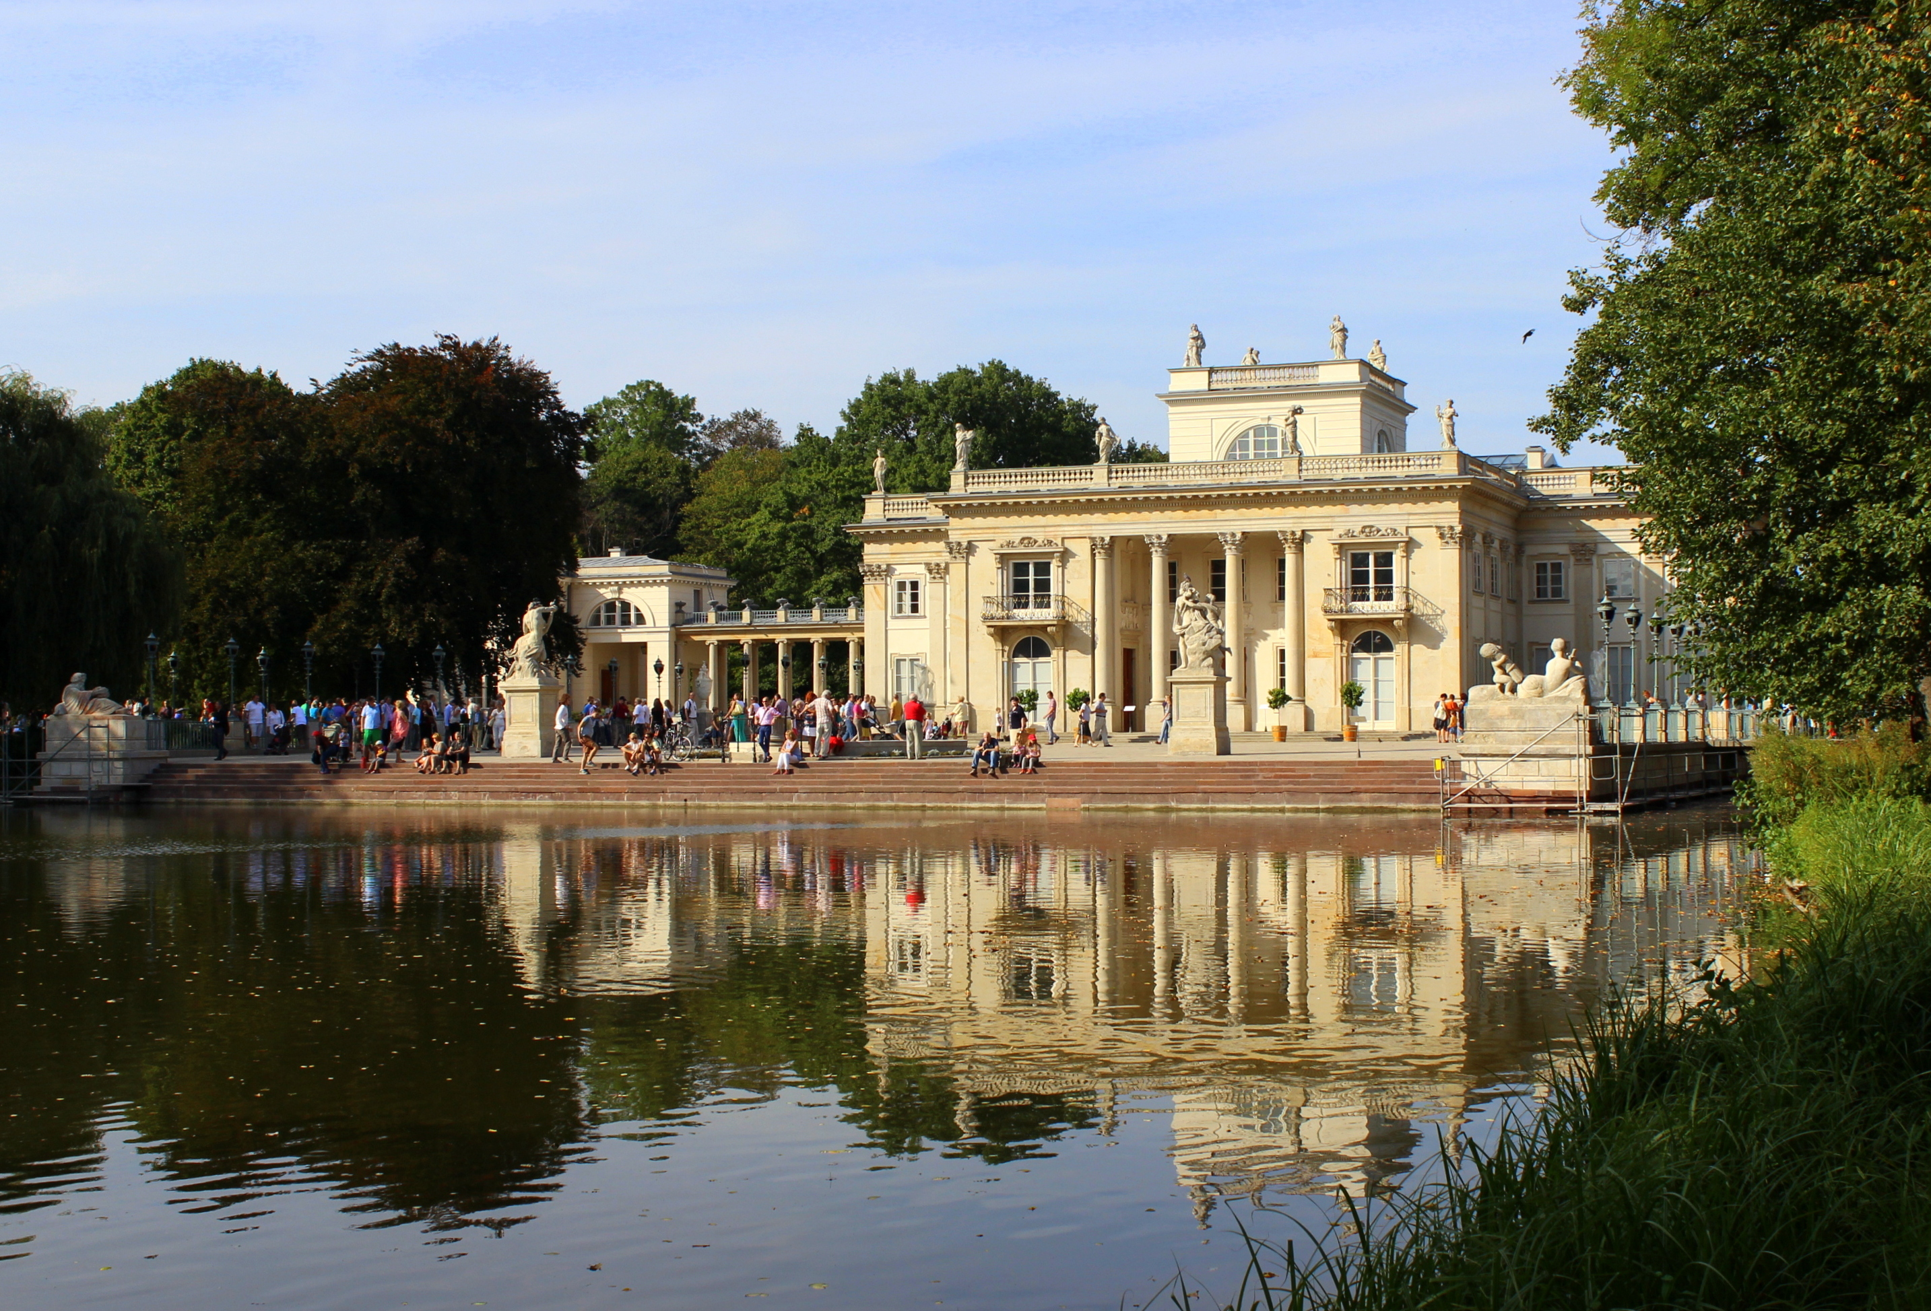
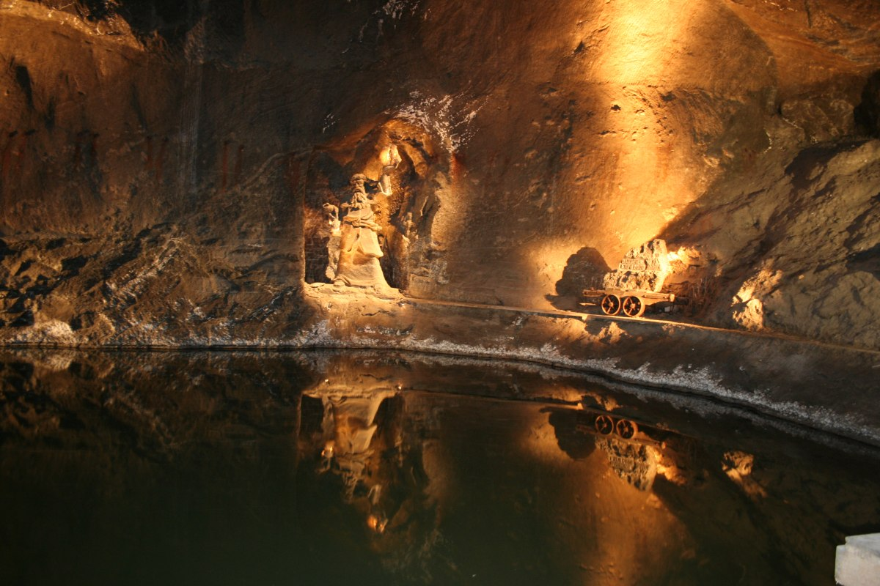
Polish famous places
The most famous places in Poland are: the Royal Castle in Warsaw, Wieliczka Salt Mine, Łazienki Królewskie, Wawel Castle in Krakow, Crooked House in Sopot and the Silesian Museum in Katowice

Slide 12
Vistula
Vistula is the longest river in Poland. Its length is 1047 kilometers.

Slide 13
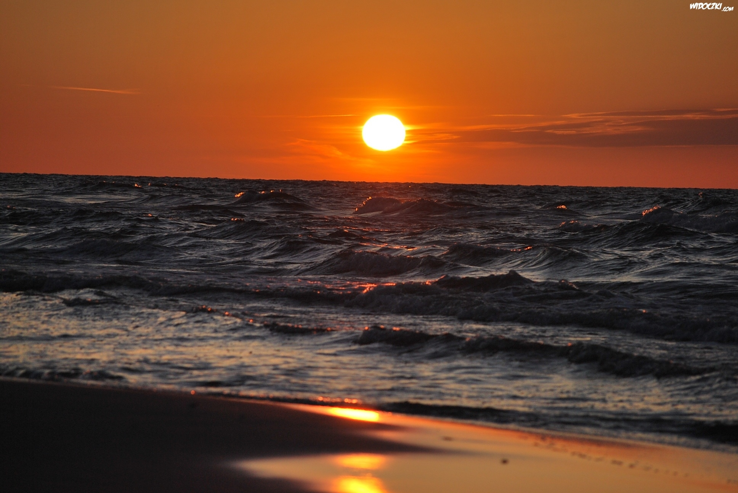
Baltic sea
Poland has access to the Baltic Sea. All beaches are sandy. The sea is beautiful although quite cold.

Slide 14
Polish food

Slide 15
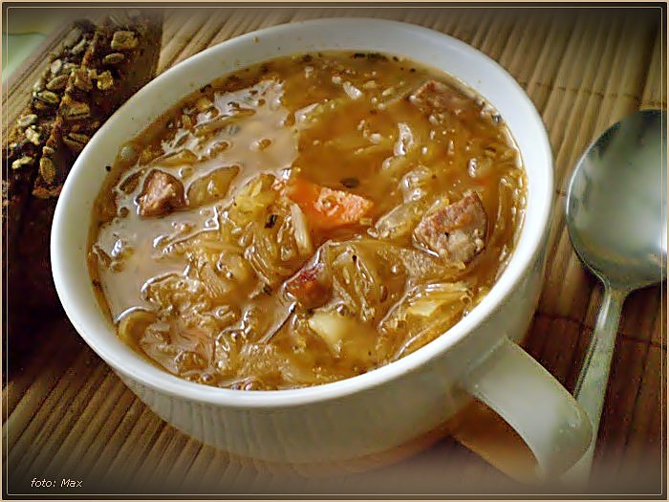
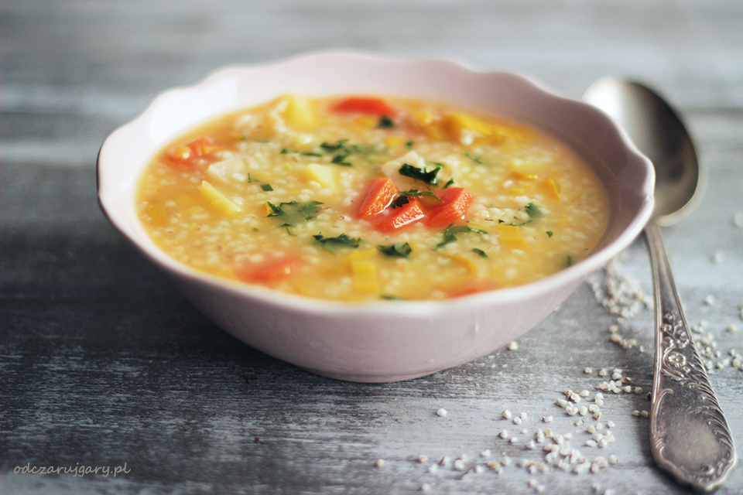
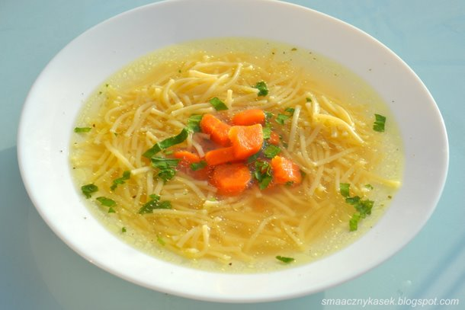
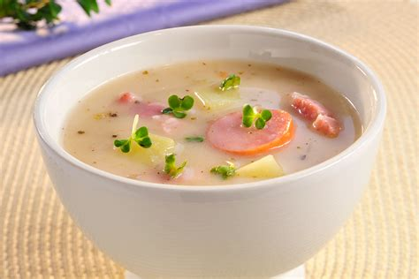
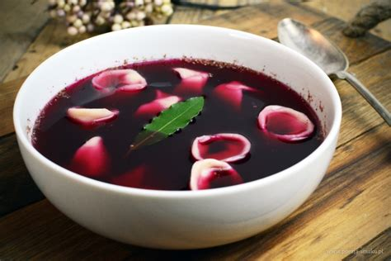
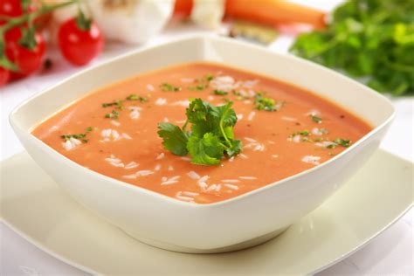
Soups
The most famous
Polish soups are
cucumber soup, tomato
soup, sauermehlsuppe,
borscht, cabbage soup,
krupnik and chicken soup.

Slide 16
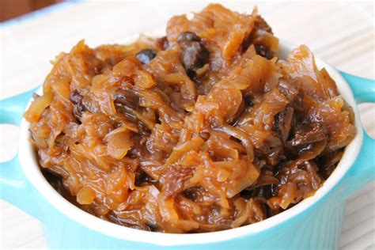
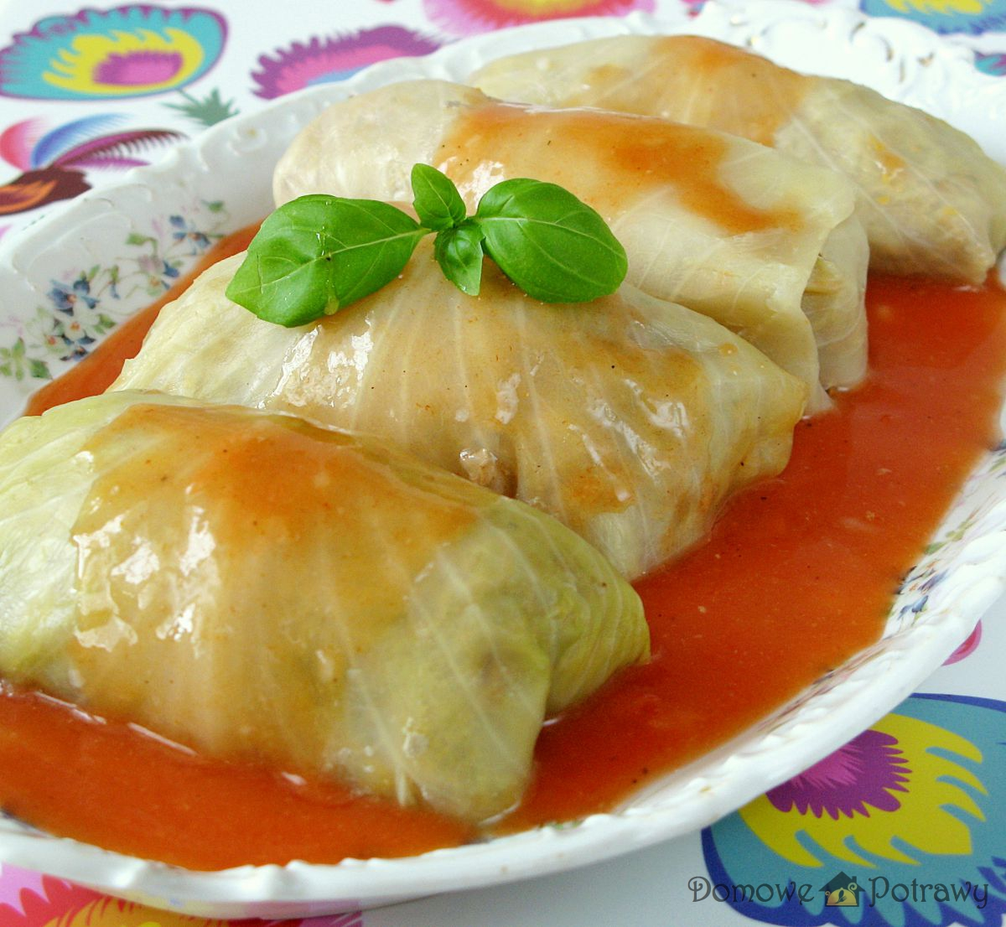
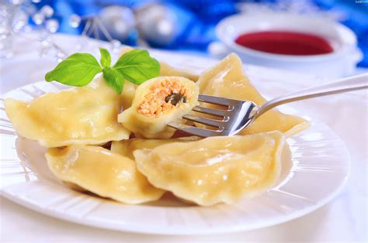
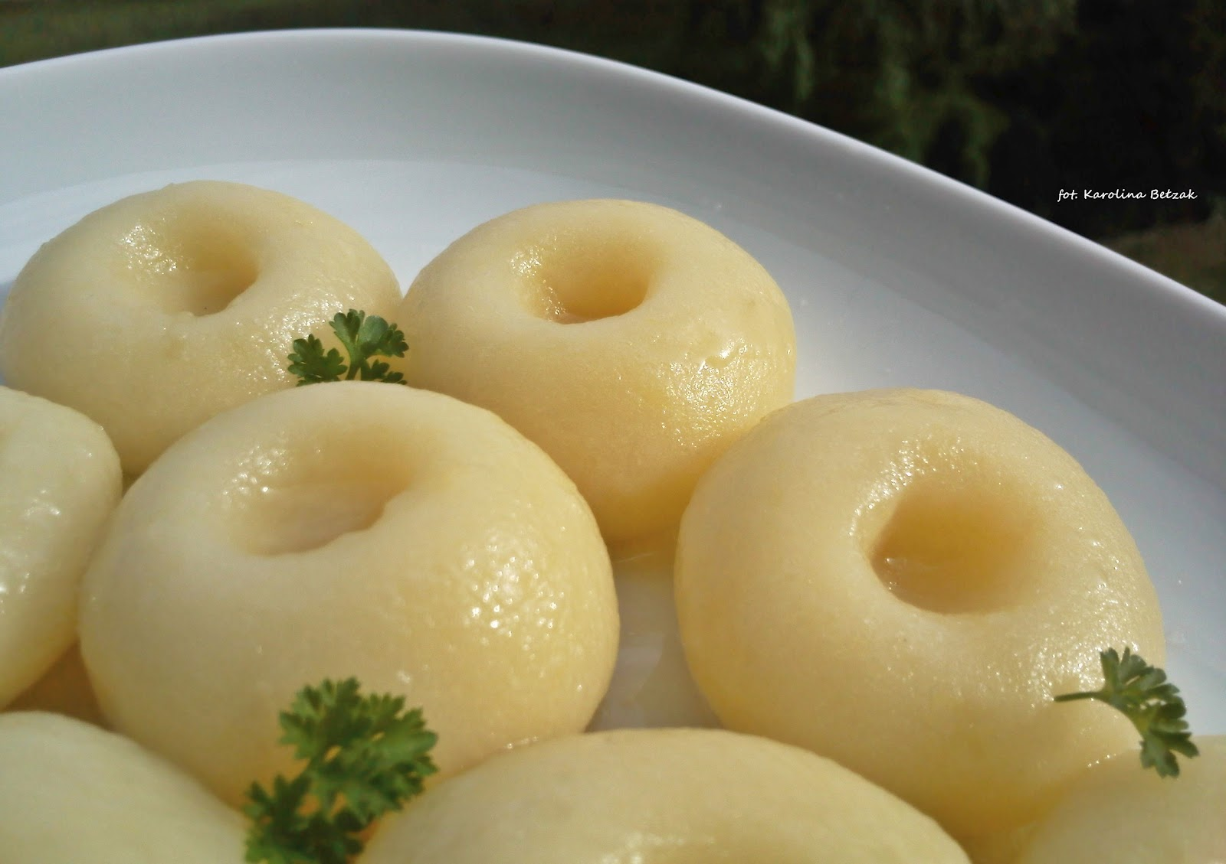
Main course
The most famous Polish second dishes are: pork chop, cabbage rolls, dumplings, noodles and hunter's stew.

Slide 17
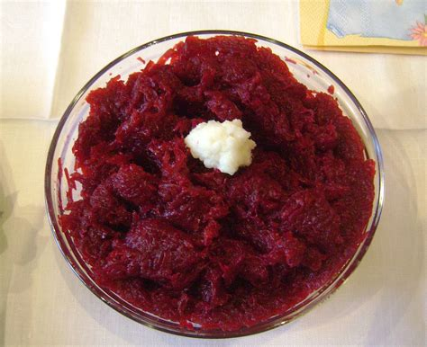
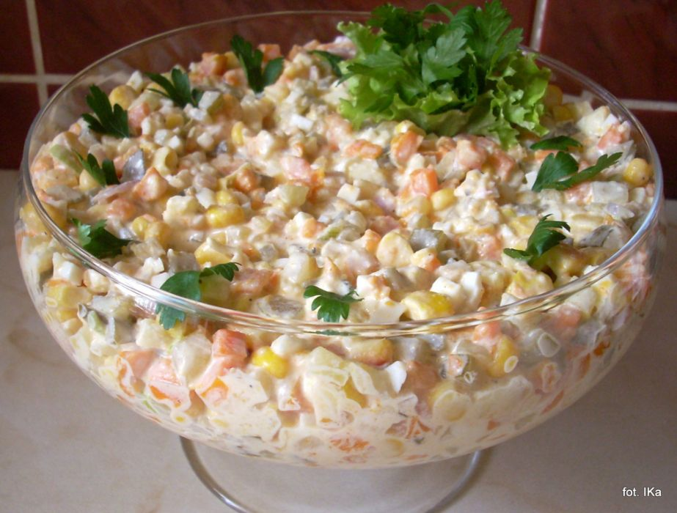
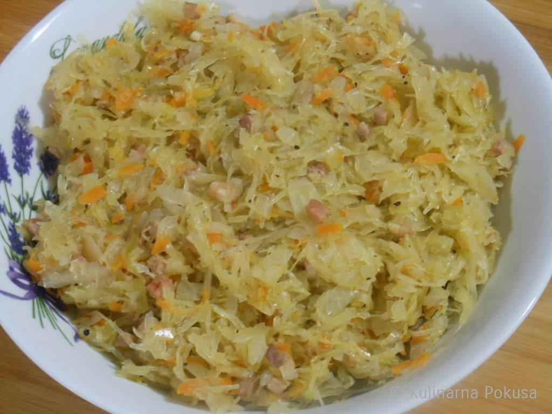
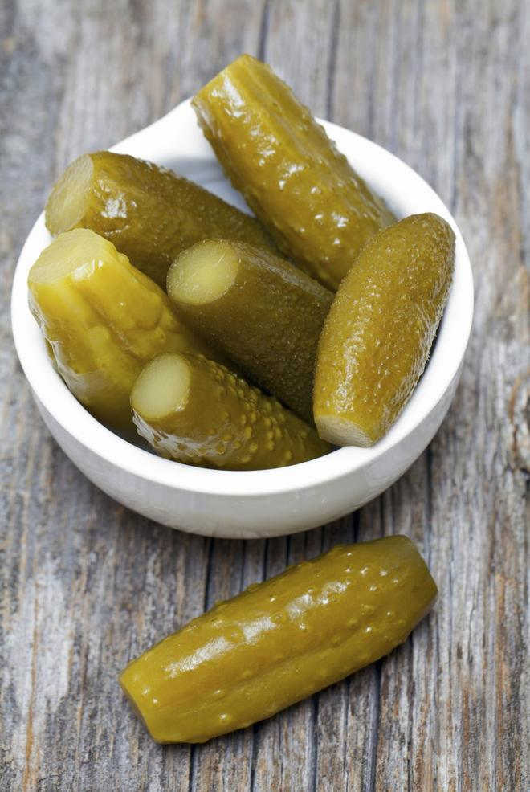
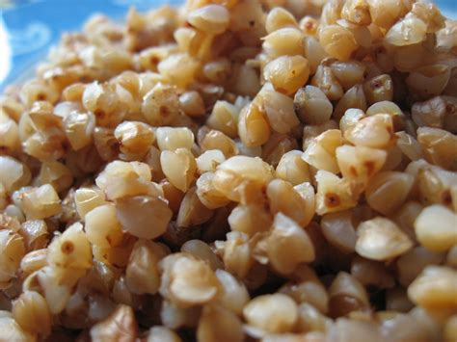
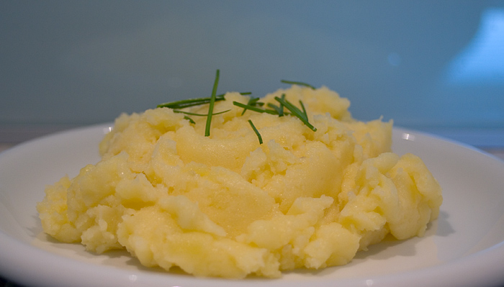
Side dishes
The main dish often includes: potatoes, groats, pickled cucumbers, beetroots, sauerkraut or salad.

Slide 18
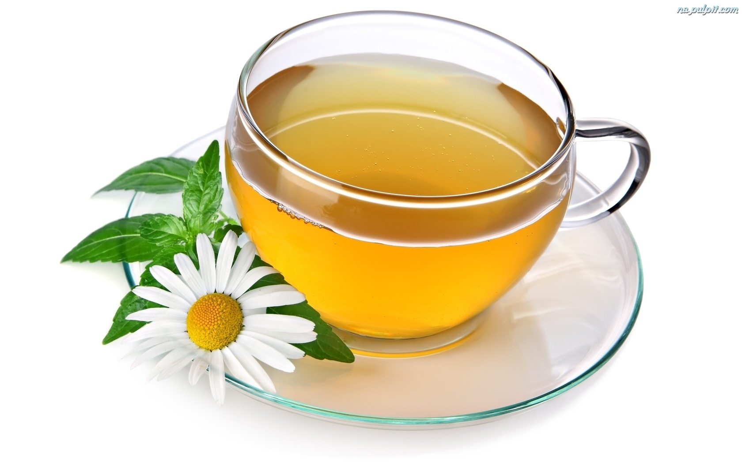
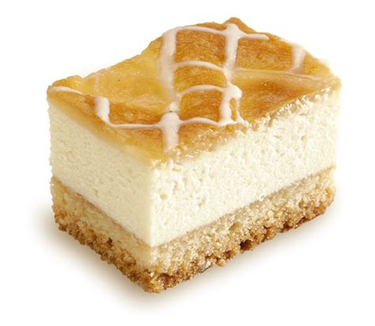
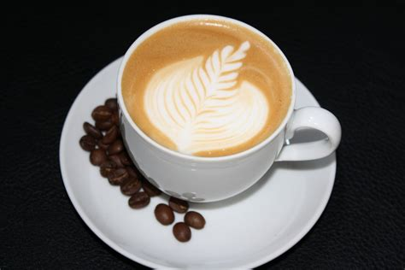
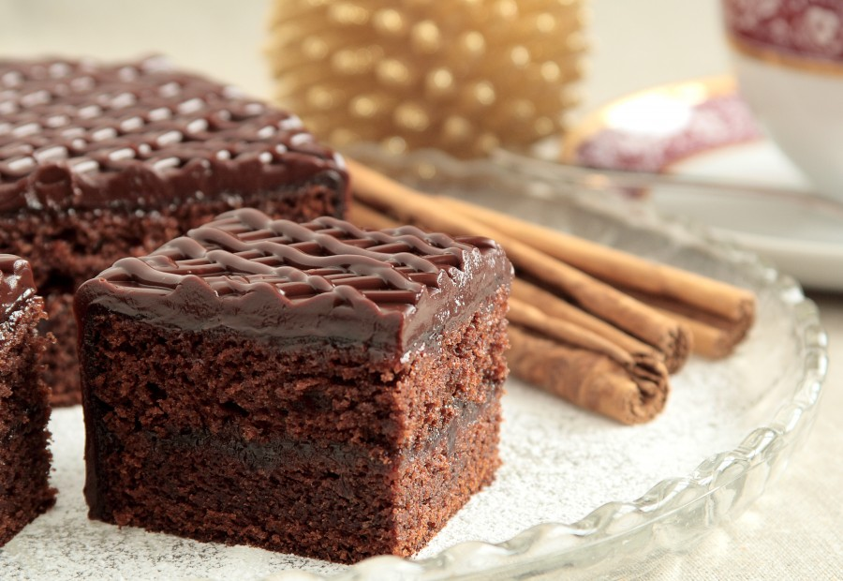
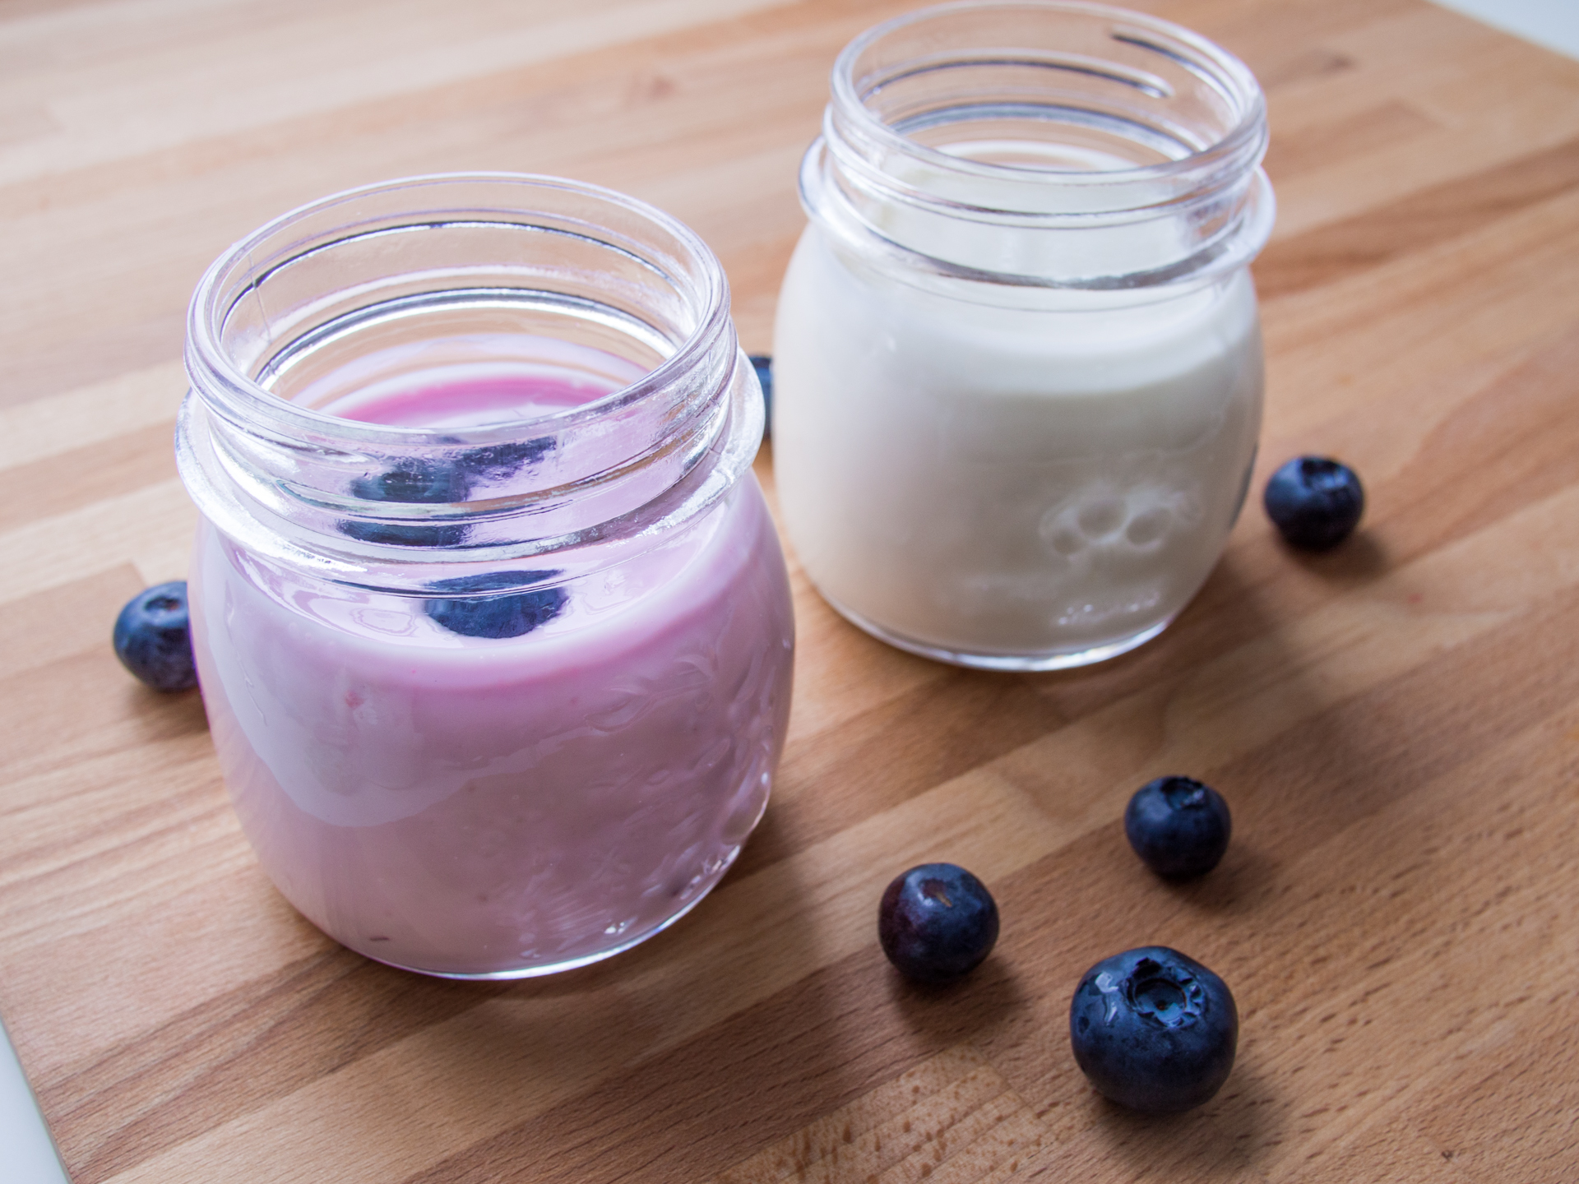
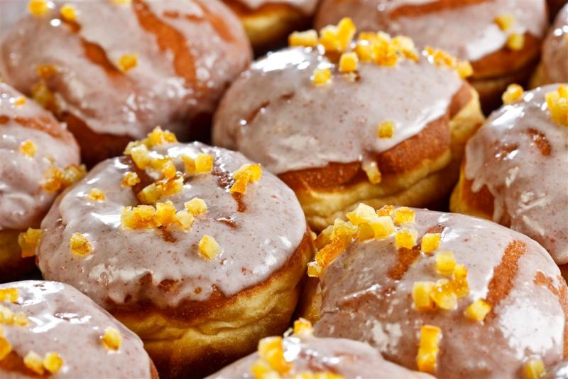
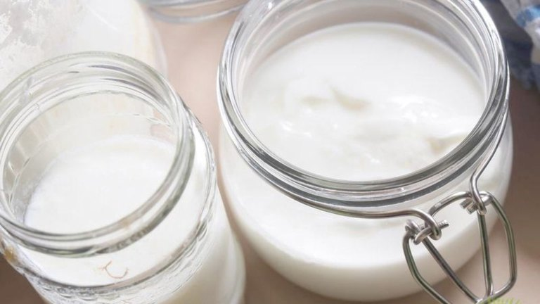
Afternoon snack
For an afternoon snack we usually eat apple pie, cheesecake, gingerbread or donuts. We often drink tea, coffee or juice.

Slide 19
Seasons in Poland

Slide 20
Spring
Spring is warm and rainy.
Flowers are growing
and blooming.

Slide 21
Summer
Summer is hot and sunny. We don't go to school.

Slide 22
Autumn
Autumn is rainy and
gloomy. Leaves
fall from the trees.

Slide 23
Winter
Winter is cold and freezing. It's always snowing.

Slide 24
The Tatras
The Tatras Mountains are the highest and one of the most beautiful mountains in Poland.

Slide 25
Rysy peak
Rysy is the highest Polish peak. It is 2499 meters above the sea level.

Slide 26
Polish currency
In Poland we pay with Zloty. We also believe that finding one penny brings happiness.

Slide 27
Famous Poles

Slide 28
Mikołaj Kopernik
Mikolaj Kopernik was born in Toruń. He proved the heliocentric theory.

Slide 29
Fryderyk Chopin
Fryderyk Chopin was a famous Polish composer. He played for the kings and other famous persons.

Slide 30
Pope John Paul II
John Paul II was the pope. He did a lot of good and was passionate about travelling.

Slide 31
Maria Sklodowska-Curie
This woman was
a chemist. She
discovered the
elements of
polonium and
radium.

Slide 32
Polish language zone

Slide 33
Polish alphabet
In our alphabet
there are
32 letters.
l

Slide 34
Tongue twisters
Kiedy muchy latają za muchami,
wówczas za muchami latają muchy.
When flies fly behind flies, flies fly around flies.
Dziesięć kudłatych kóz idzie do zoo,
do zoo idzie dziesięć kudłatych kóz.
Ten shaggy goats go to the zoo,
ten shaggy goats go to the zoo.

Slide 35
Tongue twisters
W Szczebrzeszynie chrząszcz brzmi w trzcinie,
więc Szczebrzeszyn z tego słynie,
że tam właśnie chrząszcz brzmi w trzcinie.
In Szczebrzeszyn, the beetle sounds in a reed,
so Szczebrzeszyn is famous for the fact
that there the beetle sounds in a reed.
Ta tapeta tu, tamta tapeta tam.
This wallpaper here, that wallpaper there.

Slide 36
Phrase book
Hello! - Cześć! Good morning! - Dzień dobry! I'm sorry! - Przepraszam! Bye! - Pa! What's your name? - Jak się nazywasz? How old are you? - Ile masz lat? My name is … - Nazywam się ....

Slide 37
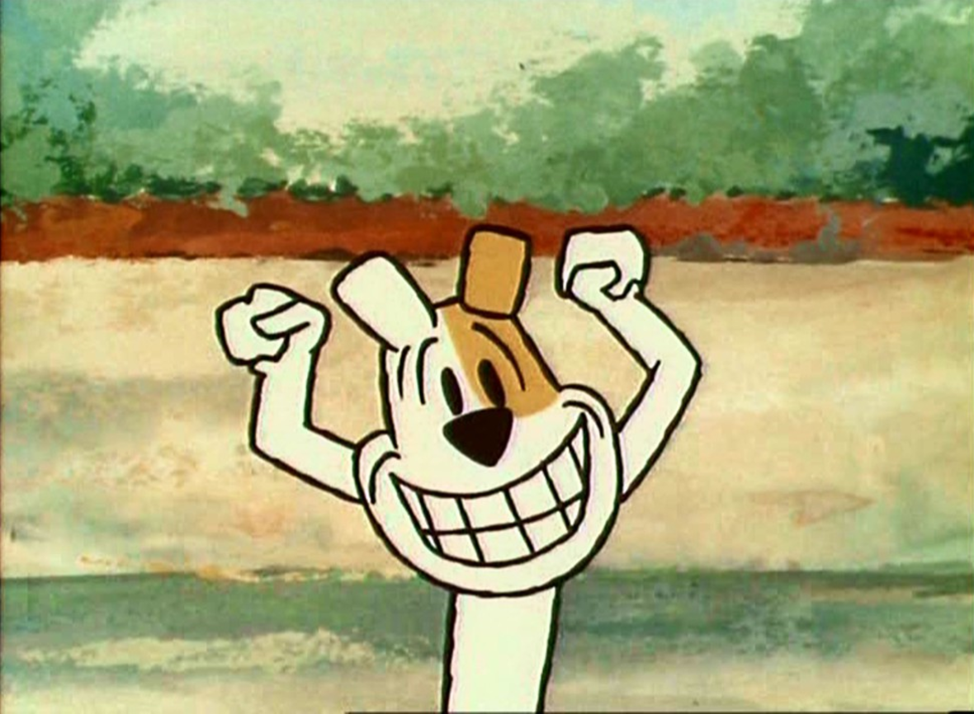
Thank you for your attention

Slide 38
QUIZ!

Slide 39
Which city is our capital?
A) Warsaw B) Katowice C) Gniezno

Slide 40
Which sea is "our" sea?
A) Black Sea B) Baltic Sea C) Red Sea

Slide 41
How high is the Rysy peak?
A) 2499 meters above the sea level B) 1082 meters above the sea level C) 3809 meters above the sea level

Slide 42
Who is our President?
A) Mateusz Morawiecki B) Andrzej Duda C) Bronisław Komorowski

