Slide 1
Klaipeda Tauralaukis Progymnasium, Lithuania “NewS - New Skills New Schools” 2017-2019
Water

Slide 3
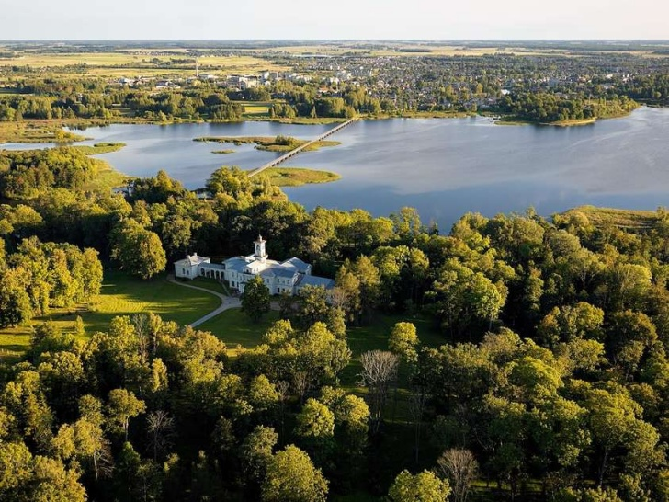

Slide 4
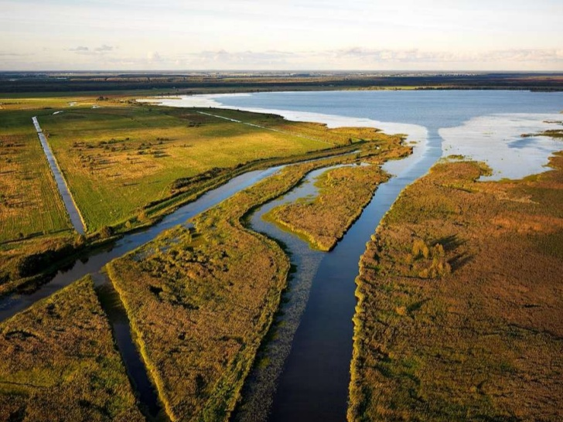

Slide 8
2b grades students wrote about the Baltic sea
What is the Baltic Sea?
The Baltic Sea is in the Atlantic Ocean basin in the north-east of Europe. On the one hand, it is surrounded by the Scandinavian Peninsula, on the other, the countries of Eastern and Central Europe and the Danish islands. The inhabitants of the western outskirts of the Baltic Sea call the Baltic Sea the Eastern Sea. Among them, the name of the sea was taken over by the Finns, although they are, like the estates, the western sea. The Baltic Sea is referred to as the Baltic Sea by the people of the other Baltic Sea.

Slide 9
What is the size of the Baltic Sea?
The Baltic Sea is about 1600 km long, an average of 193 km wide and an average of 50 m deep. The maximum depth is 459 m. Area: 386 thousand. Km The length of the coast is about 8000 km. The color of the water is cloudy green, its color depends on the phytoplankton. Water is less clear than the Atlantic Ocean.

Slide 10
Which countries are bordered by the Baltic Sea?
The following countries border the Baltic Sea: Sweden Finland Russia Estonia Latvia Lithuania Poland Germany Denmark

Slide 11
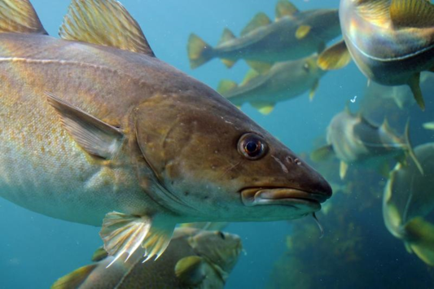
The wildlife of the Baltic Sea
There are 50 species of fish and seagrass in Lithuania's marine waters, of which 28 species are marine, 10 - passersby fish species (those living in the sea but spawning in the rivers and vice versa), and 12 - fresh waters entering the sea from lagoon or rivers. The most important marine commercial fish are the subspecies typical for the Baltic Sea: insect and cod. The coastal area is dominated by salmon, brush, flounder.

Slide 12
About 50 years ago, Nida and Sventoji fishermen often saw storms in the dunes during storms. Sometimes they entered the Curonian Lagoon or the Nemunas. 1923 The dead seal was found in Lampėdžiai near Kaunas. The most frequent seas in the Lithuanian seaport are the more turvy seals. They are grown in the Marine Museum to increase their numbers, while the young Chicks are released.

Slide 13
Large marine mammals - whales and dolphins do not live in the Baltics, only climb through migration and sometimes reach the eastern edges. 1911 Between Sharkuva and Rasytė, a 8-meter long lighthouse was thrown onto the shore - this could have been the biggest hurricane of the dolphin that arrived here. Often there are dolphins called sea pigs on the eastern end of the sea. 2001 In July, about 22 kg of a porpoise pig was hid in the net at Melnrage.

Slide 14
Questionnaire
What countries are bordered by the Baltic Sea?
a) Sweden, Finland, Russia, Estonia, Latvia, Lithuania, Poland,
Germany, Denmark
b) Sweden, Russia, Poland
c) Lithuania Latvia Estonia

Slide 15
4b grade students make fish from paper

Slide 16
Lithuanian tap water is among the cleanest in Europe and is perfectly drinkable. This is because 100% of it is taken from abundant underground sources sheltered from human interference.

Slide 17
88% of all homes now have access to municipal water (75% to hot water) and 85% have sewerage. The remainder is mainly old wooden village homes that use wells for water and outdoor.

Slide 18
Experiments with water

Slide 19
Students with teacher performed a flowering bush experiment. The purpose of the experiment was to find out if the water colored with various materials affects the bushes blossom colour.

Slide 20
The students were divided into three groups and each group received a different bush. In the first jar was simple water, in another water with ink and in another water with potassium permanganate. The teacher wrote the students' guesses what color will be flowers bloom. After three weeks, the results were discussed. There we saw flowers bushes with the same colour.

Slide 21
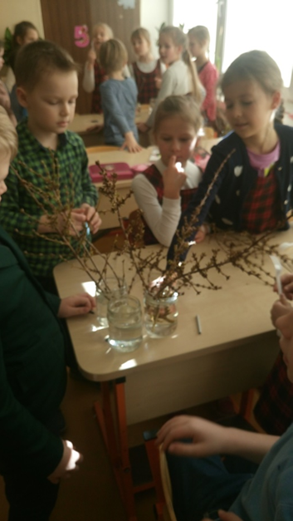

Slide 22
Krūmo pavadinimas, žiedų spalva | Name of the brow, color of the flowers | Water | Water with ink | Water with potassium permanganate
Ornamental shrub forzite, yellow flowers | Hypothesis | Yellow | Blue, red | Purple, red
 | The result | Yellow | Yellow | Brown
 | Conclusions: Water with ink did not affect the color of the flowers, water with potassium permanganate twigs and rings was colored brown. Everything needed to replenish water with ink and potassium permanganate.
Shrub naked, flowers are gray-yellow | Hypothesis | Grey yellow | Dark blue purple | Light purple, light pink
 | The result | Grey yellow | Grey | Brown
 | Conclusions: Water with ink did not affect the color of the flowers, water with potassium permanganate twigs and rings was colored brown. Everything needed to replenish water with ink and potassium permanganate.
Wicker is inhaled (agriculturized carbide), flowers are yellow | Hypothesis | Yellow | Blue, red | Violetinė, raudona
 | The result | Yellow | Yellow | Yellow
 | Conclusions: Water with ink, potassium permanganate did not affect the color of the flowers. Everything needed to replenish water with ink and potassium permanganate.
Investigation "Blooming Bushes"

Slide 23
Third-formers have been told that water is magical: it can become a cloud, rain, dew-fall, fog, snow, ice and hail. We have been finding out that water is very strong: it can break the toughest rocks, turning them into sand.

Slide 24
Kids were familiarized with water's state during winter, understood important ecological problems, connected to the pollution of water, necesserity of preserving and cleaning of it.

Slide 25
You can travel using the water, it is needed for water-mills, to grind flour, water spins electrical turbines, that provide electricity, because of that we have light, we can listen to a radio, watch TV. Water essential when putting out fires.

Slide 26
Experiment 1: "Water is made out of particles"
Requirements: water, cocktail straw, a paper sheet.
Water is made out of particles. It is not a solid object. Kids put drops of water on the paper, and blowwed at it from Start to Finish.

Slide 27
While blowing they realized, that water molecules are able to divide and fuse together. Even the tiniest drops can be split into even more tiny drops.

Slide 28
Experiment 2: "The taste of water"
Requirements: a few glasses of water.
Five kids go out of the class, while the others decide to say that water in one glass is sweet, while in the other - tasteless.

Slide 29
Some kids of our class admitted that they tasted the sweetness of the water. You can try this out and see if your kids are susceptible to the power of suggestion.

Slide 30
Experiment 3
Requirements: glasses of water, and a glass of dishwasher and capsules of ink.
Before the experiment, kids are asked which of these two liquids will dye faster. After pouring the ink in, we see, that water dyes itself faster.

Slide 31
We listen to kids' opinions, why that happened.
In experiments we witnessed waters' pranks, its colorfulness, mood, speach.

Slide 38
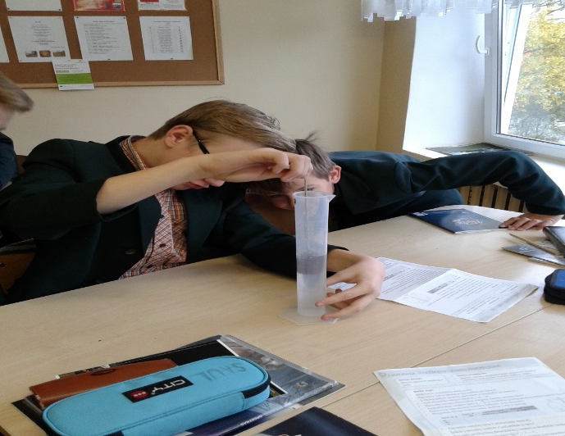
Experiments with water in the physics lesson
Students in the 8th grade put irregularly shaped
bodies in the water and calculate
the volume of the immersed body according
to the increased water level.

Slide 39
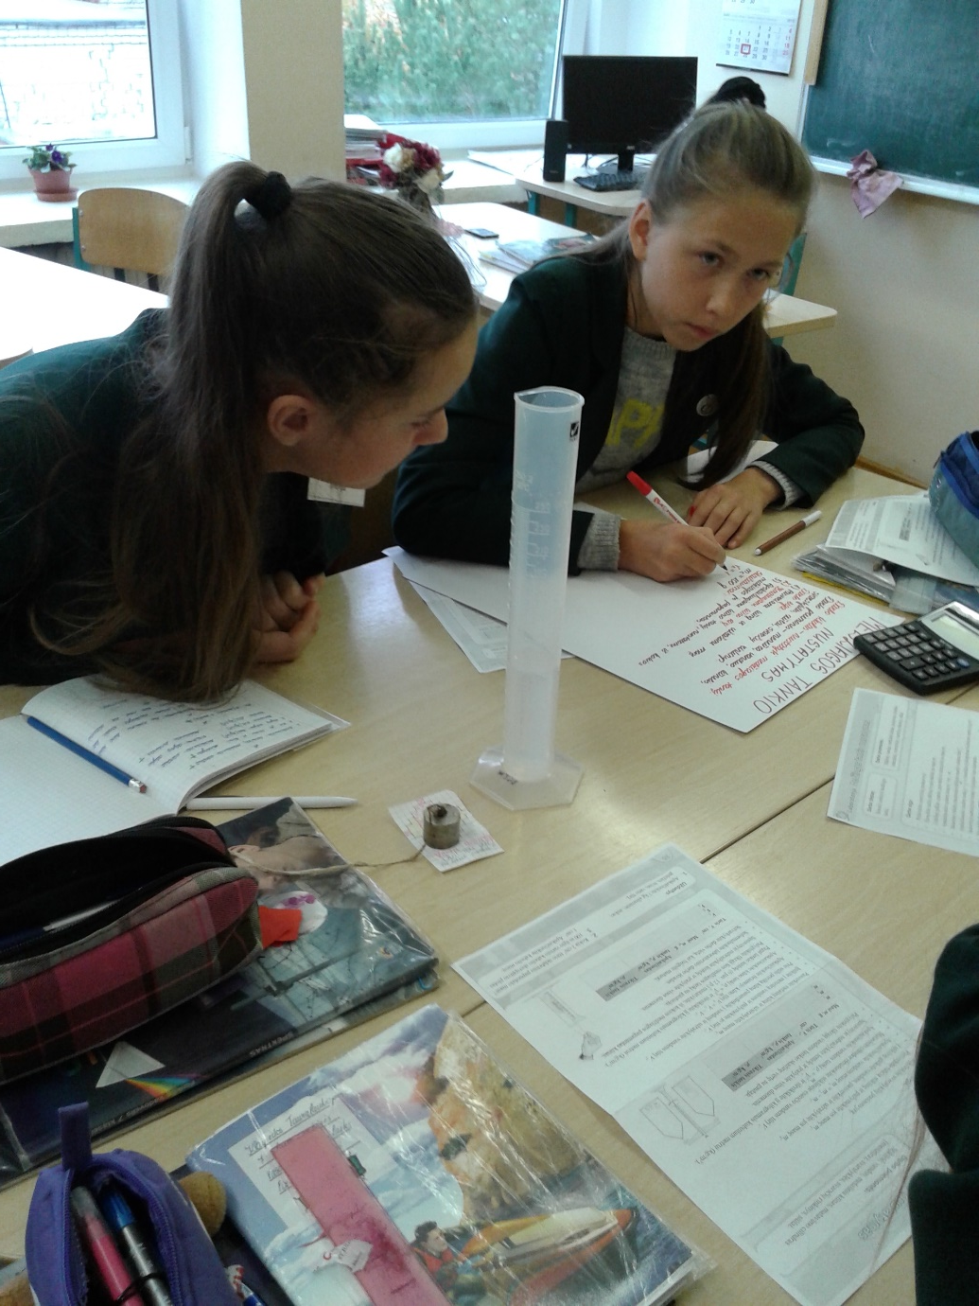
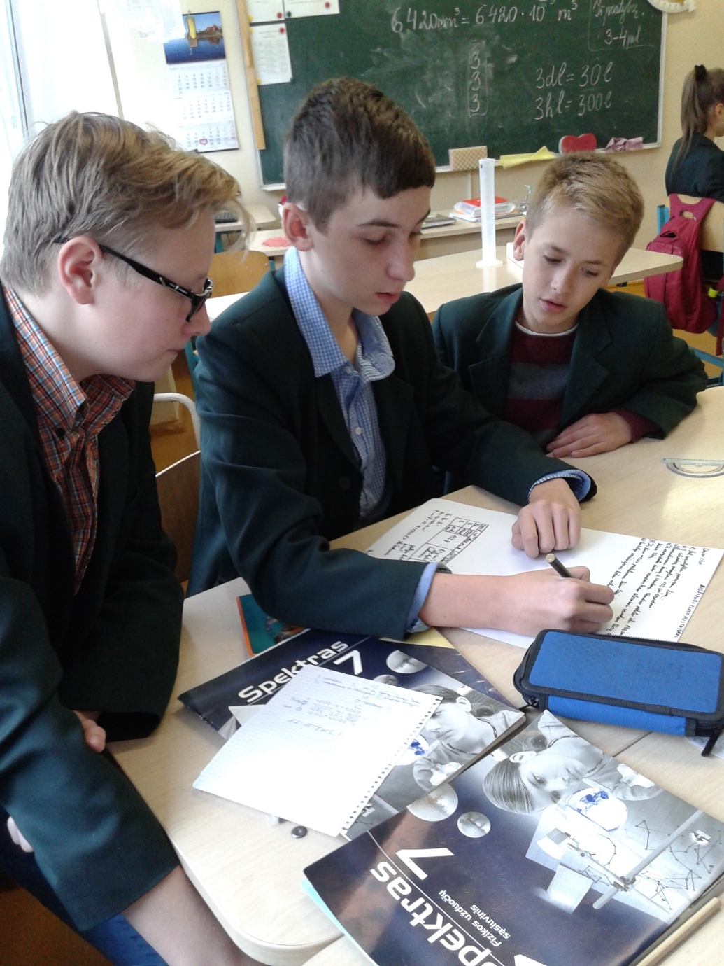

Slide 40
8 grade students information collected on special water feature

Slide 41
If you've been climbing in a lake or other water
in the summer, you probably noticed
that the water in the bottom is coolder than
ever before. Why ?

Slide 42
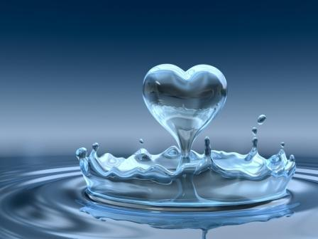
An anomaly in the water – what is it?
Most of the materials when are heated expands and shrinks when are frozen. However, there are exceptions. For example, water "behave" differently — mini expands (from a certain temperature). This unusual feature is called the anomaly of water.

Slide 43
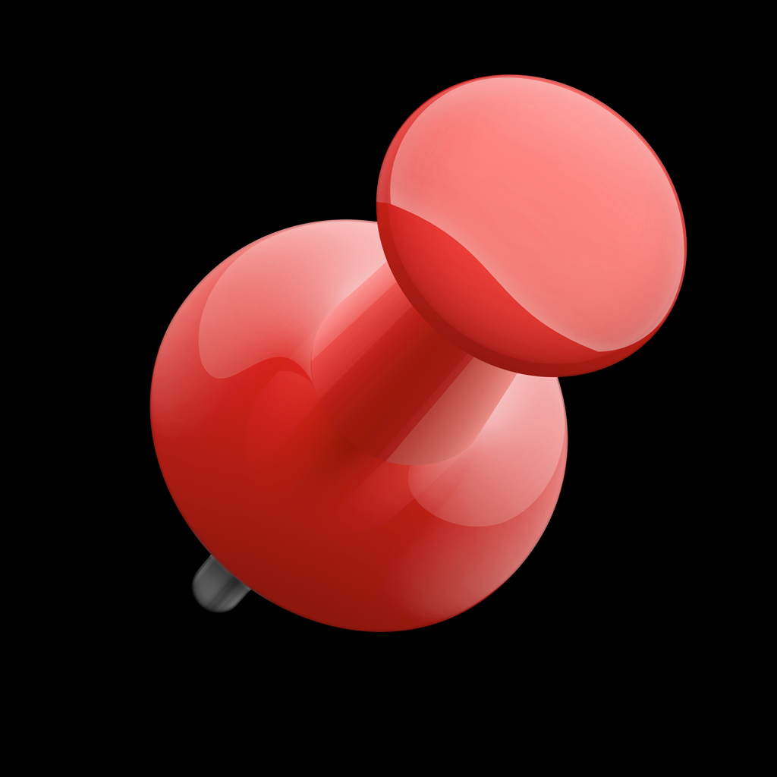
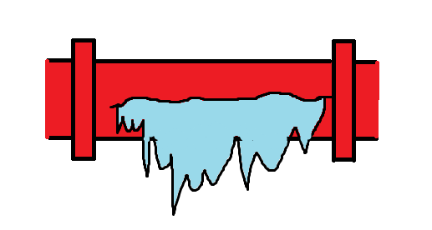
Torned tubes.
The effects of water anomalies
Developing water can rip metal pipes. Therefore, in the fall the parks off fountains, gardens, water from the irrigation system is released. In winter is also necessary to keep them empty.

Slide 44
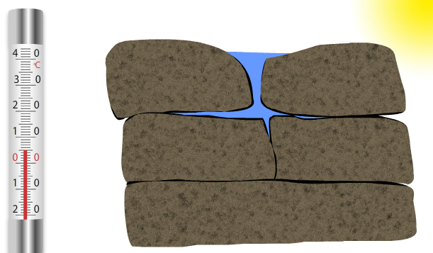
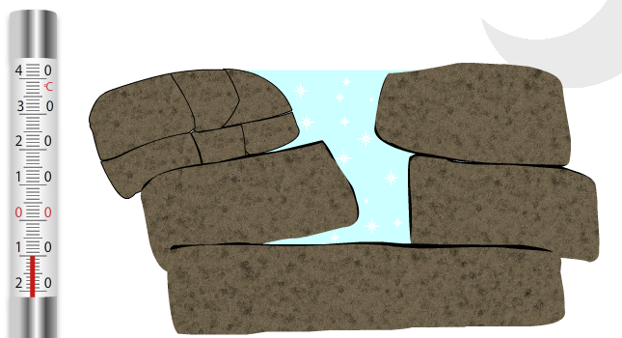
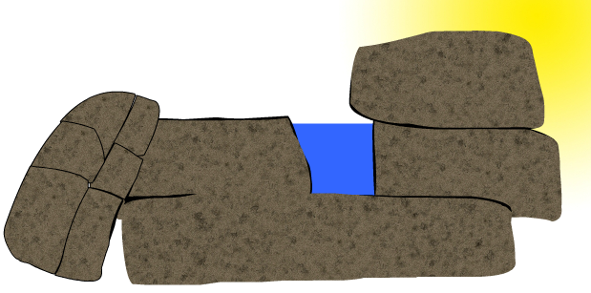
What is fragmentation of rocks?
The ever-expanding water disruption can be seen and in the mountains. The cliffs have the small cracks that penetrate the rain water. When water bocomes colder it expands and enhances these cracks. In the long run from deep and wide cracks in the rock fragment. Split-off pieces of rock falls from the mountain and rocks.

Slide 45
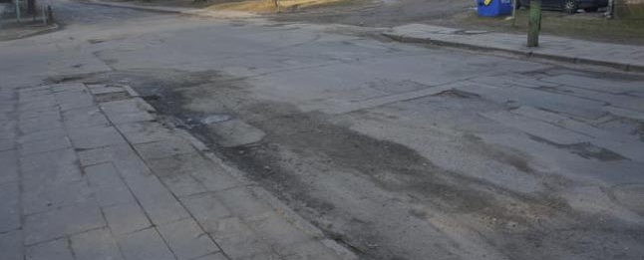
Pits in the Asphalt
Asphalt pit appears much like the water degrades rocks. Rain water penetrates into the small cracks in the asphalt. When water become colder it expands and damage the road surface. Ice dissolved, asphalt remains in the cavity. Car wheels damage the roads.

Slide 46
Why frog overwinter is resting in the water?
In September when there is colder weather, the frogs are massively jumping to lakes, rivers or other bodies of water. October is already visible: diving into the water in the bottom of the plant and goes away between the period before the spring. Frog- is cold blood animal. Negative temperature it lethal. If they would be on the ground in winter they will die. Under these conditions, the frog can successfully live in the water.

Slide 47
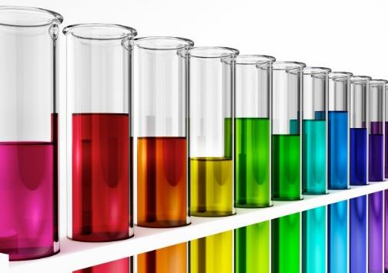
Students experiment with freezing water

Slide 48
The aim of the test
To see how does the anomaly of water exist.

Slide 49
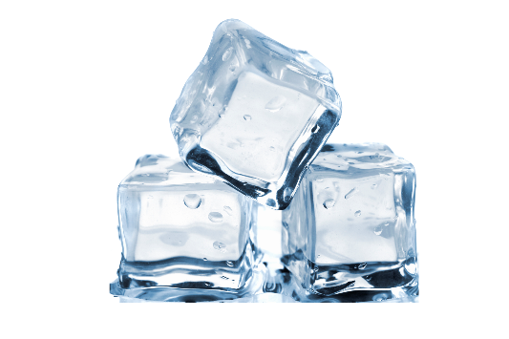
Hypothesis
I think that froozen in the ice water will be more than 100 ml.

Slide 50
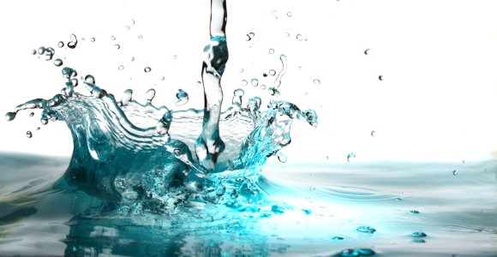
Methods of work
Filming
Test execution
Generalization

Slide 51
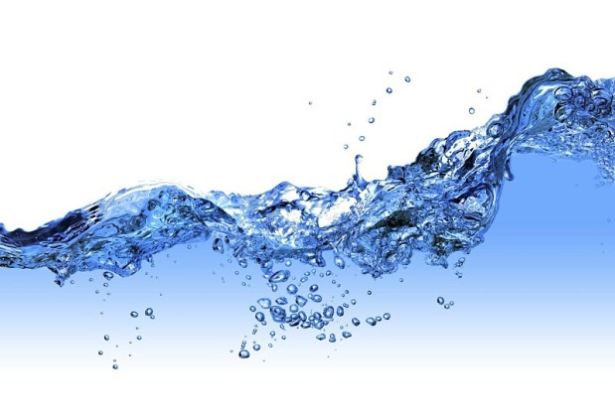
The workflow
- Do the test
Short it
Upload the video of this presentation

Slide 52
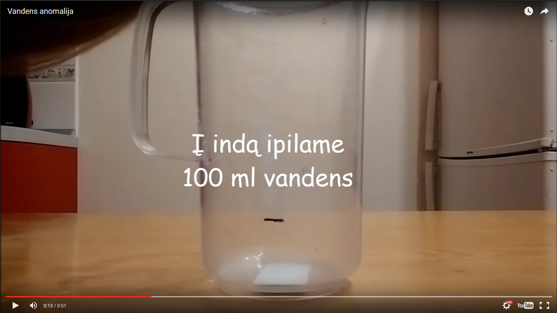
Test
https://youtu.be/lakFo6RDMqY

Slide 53
Result and hypothesis denial or confirmation
My hypothesis proved: frozen water was
more than 100 ml.

Slide 54
IN THE MATH LESSON HAD THE EXERCISE
Condition:
1 litre container is full of water at room temperature (20 ° c). We know that a change in the volume of 10 l of water's temperature rises by 10 ° c is 21ml. as far as his running of the vessel, if the water become warmer to 1000C?

Slide 55
Doing the exercises
Solution: you need to calculate how much of the capacity increase in the volume of water 1 l: 20ml: 10 = 2, an increase in the volume of water at 100 c 1mlTačiau, and 800C (1000C = 800C-20 ° c), which is 8 times as much. Thus, the 800C, the water's temperature rises by an increase of the volume: 2 ml 1 ml * 8 = 16.8 (both in the water and running) a: water running 16.8.

Slide 56
Creating animation in the LOGO team

