Slide 1
Project eTwinning
Portugal
Spain
Germany
28/04/2021

Slide 2
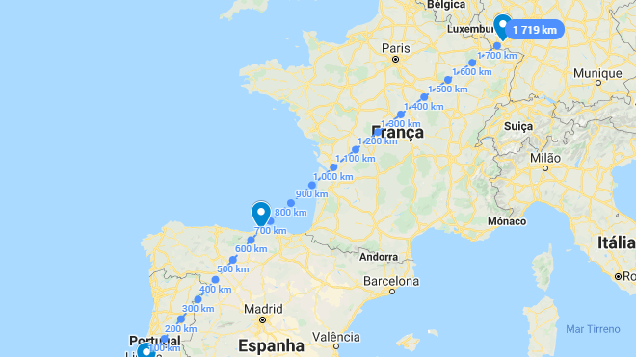

Slide 3
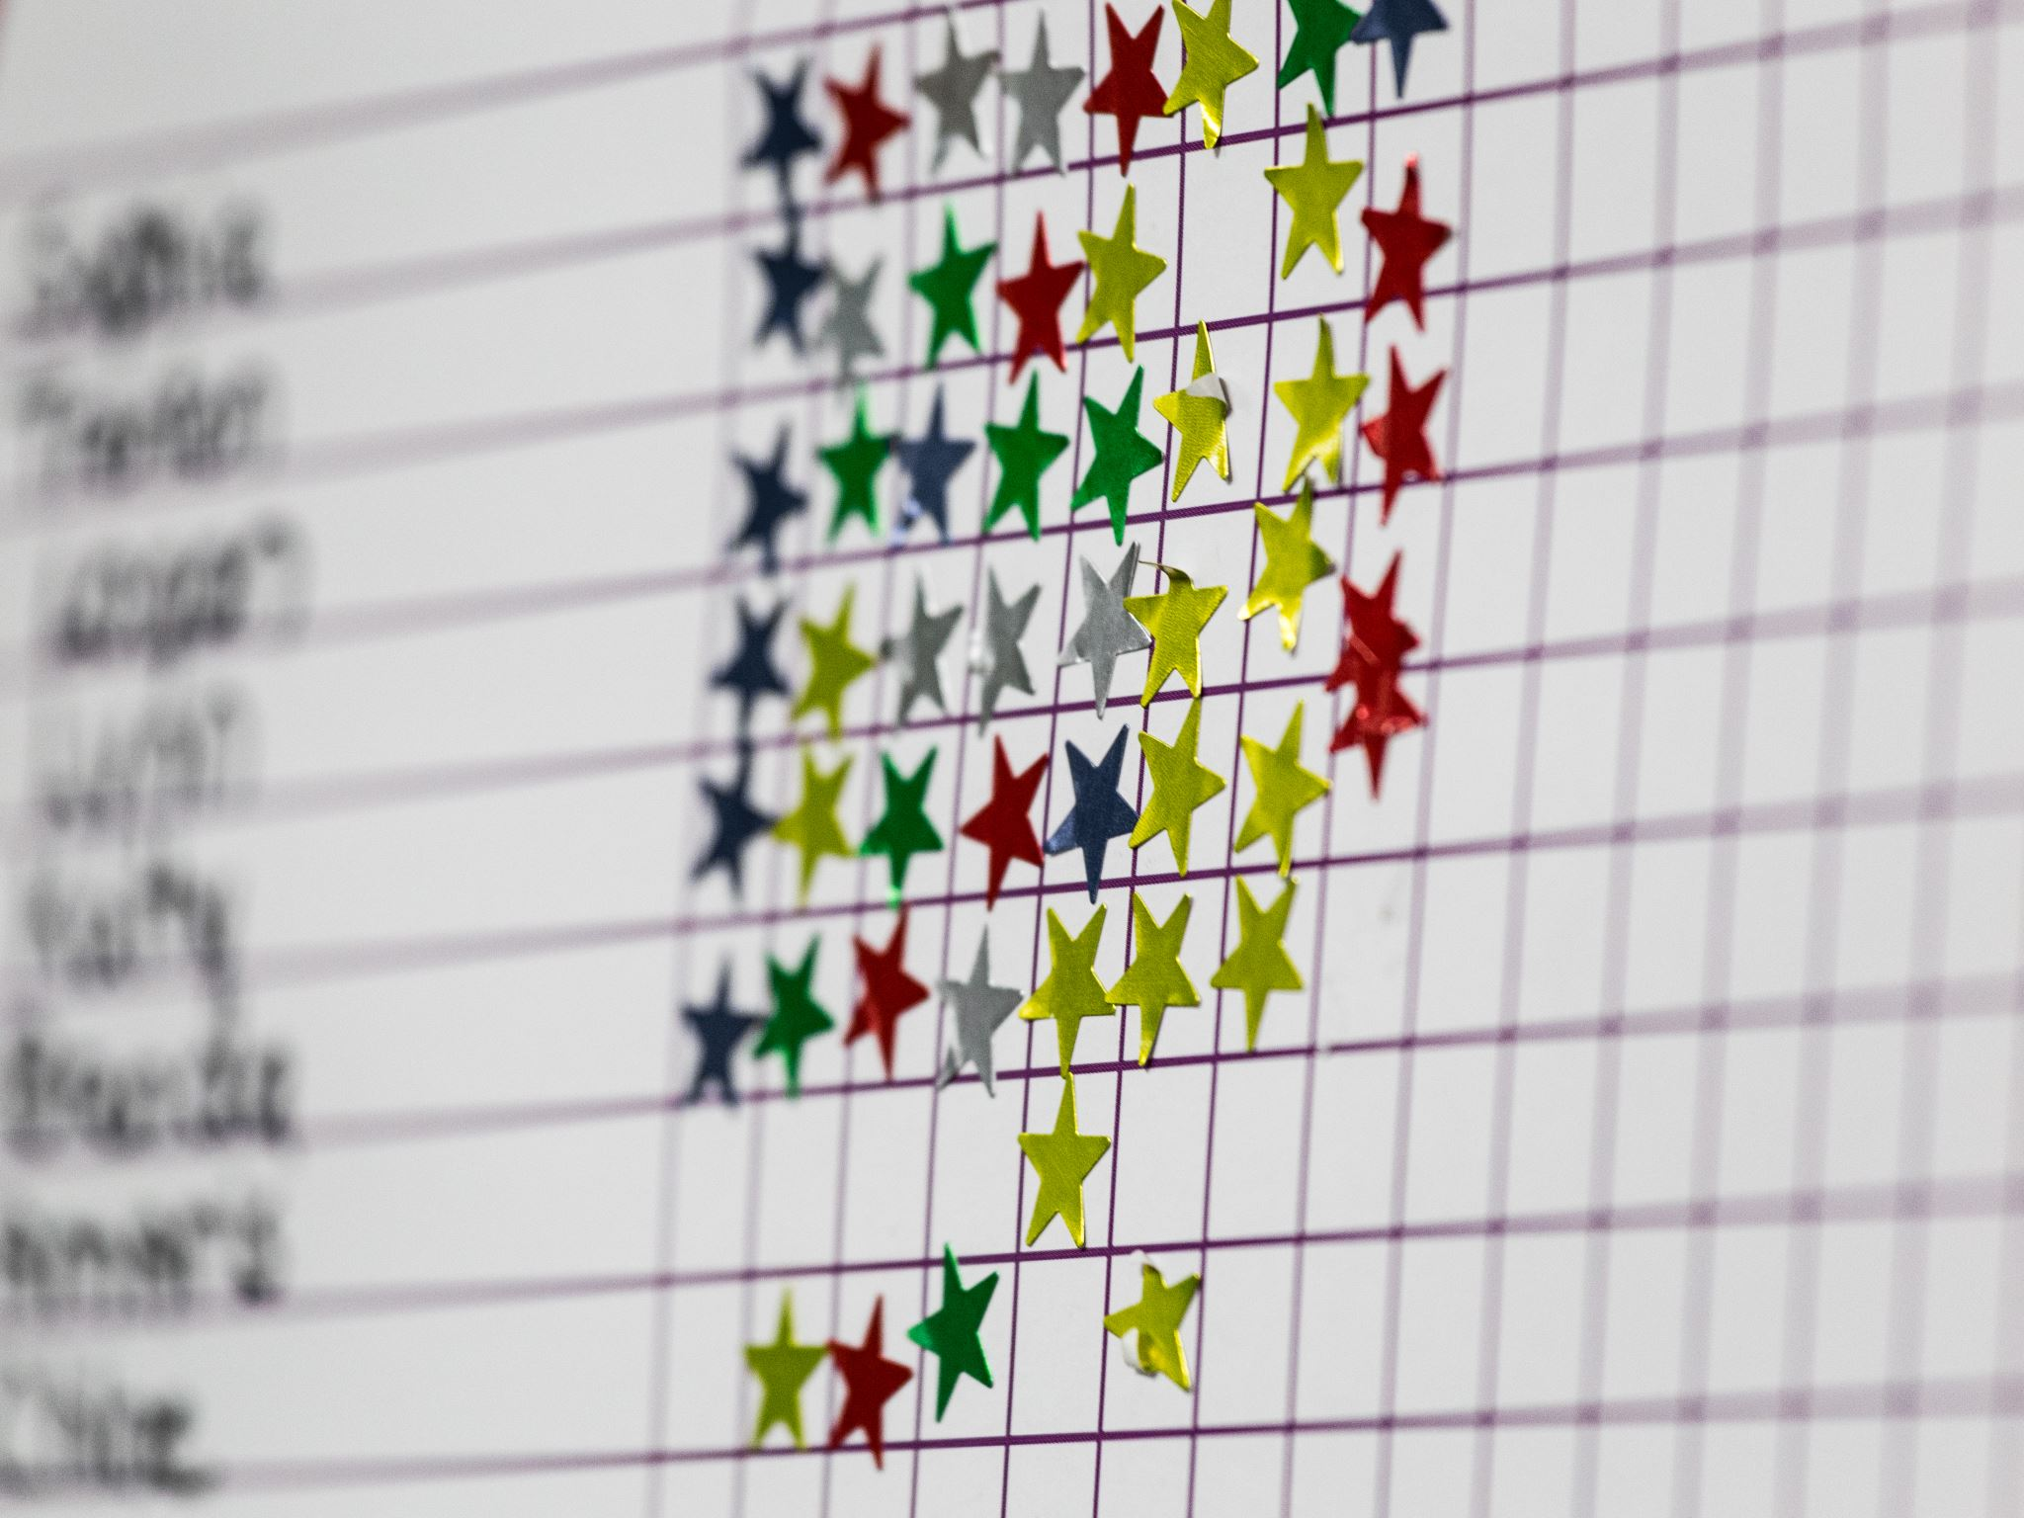
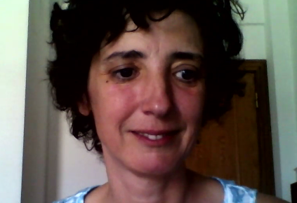
I'm teacher Sónia Barbosa Teacher - 8ºC

Slide 4
TasK 1:
You must introduce yourself to the other students:
For example, you can say something about your age, your family, your hobbies, your favorite subject at school, and so on…

Slide 5
Group 5
Eva González 2°B (Spain)
Hugo Vélez 2°B (Spain)
Luca Conrath 7°2 (Germany)
Daniel Danneker 7°2 (Germany)
Elisa Stein 7°2 (Germany)
Victoria Schmitt 7°2 (Germany)
Inês Ribeiro 8ºE (Portugal)
Gonçalo Marques 8ºE (Portugal)
Guilherme Alves 8ºE (Portugal)
Joaquim Ferreira 8ºC (Portugal)
Eduardo Rego 8ºC (Portugal)

Slide 6
Group 6
Eric Velez, 2ºB (Spain)
Lucia De Obeso, 2ºB (Spain)
Sofía Jaramillo, 2ºB (Spain)
Sophie Omlor 7°1k (Germany)
Franziska Pohl 7°1k (Germany)
Emily-Louisa Marzlin 7°1k (Germany)
Matilde Ribeiro 8ºE (Portugal)
Ângela Romão 8ºE (Portugal)
Beatriz Santos 8ºE (Portugal)
Tiago Pires 8ºE (Portugal)
Inês Martins 8ºC (Portugal)
Lúcia Silva 8ºC (Portugal)
Luís Bomfim 8ºC (Portugal)

Slide 7
Task 2
So, You have to talk about the tasks you have created in your group and, together, choose your four favorites.
Don't forget to fill in etwinning
“Discuss
Which exercises were selected by each group?”

Slide 8
Each Group in each country chooses 4 exercises and places it in the eTwinning discussion space.

Slide 9
Group 5
https://docs.google.com/presentation/d/1dUvxtOM-wEskdjW_7mQPLdAF93Kb19e6wQvk-8vh5Uc/edit#slide=id.ga85fa577ff_0_20
Group 6
https://docs.google.com/presentation/d/1T3Qerl2IFvGGDJWhmrhFcAyM7QD-lkiCCQDLFg_b8NM/edit#slide=id.ga85fa577ff_0_20

Slide 10
Stay safe

