Slide 1
Endemic Fauna Under Protection of Manisa/Turkey

Slide 2
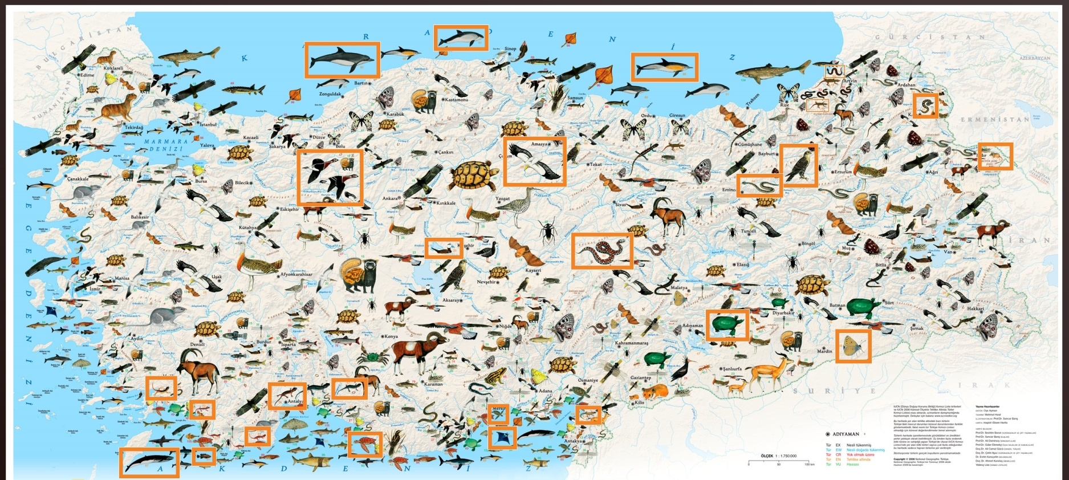
What is Endemic Species?
Endemic species are plants and animals that exist only in one geographic region.

Slide 3
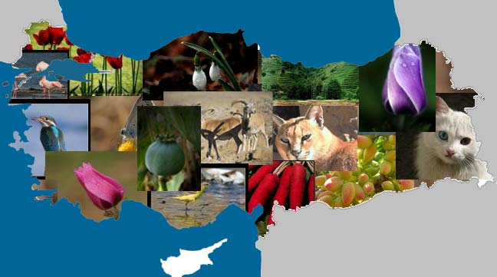
Endemic Fauna of Turkey
Turkey is a place with splendid beauty, has excellent flora and fauna. The geographical location of Turkey along with its favorable climate has made Turkey very rich about flora and fauna.

Slide 4
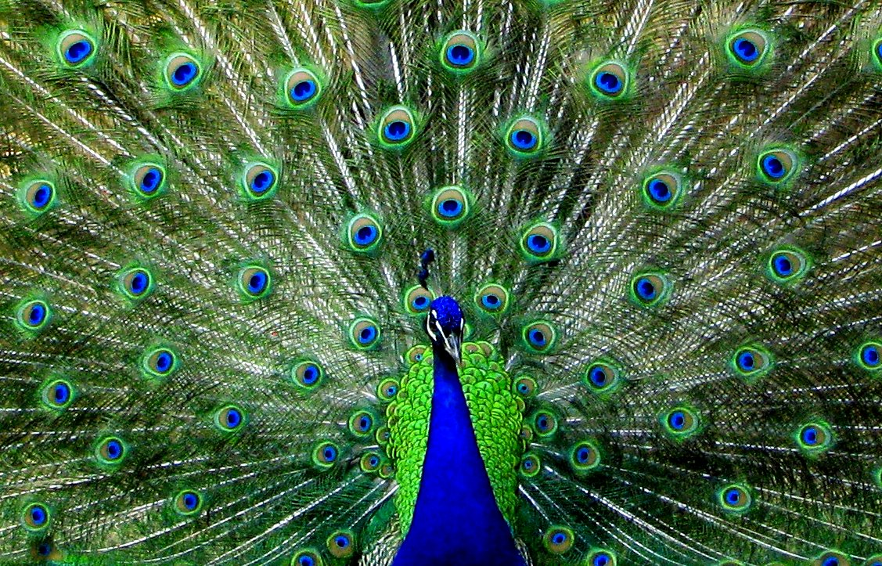
Turkey's fauna is so rich, different types of animals, beautiful birds, fish. 40.000 animal species found in Turkey are estimated to be over 80% of the ones found in the whole continent of Europe.

Slide 5
Which Species Live in Our Region?
Turkey's Aegean and Mediterranean shores provide a refuge for monk seals and loggerhead turtles, while is wetlands house colonies of numerous endangered species, such as the Dalmation pelican, flamingoes, wild ducks and geese.

Slide 6
Endemic Species of Turkey
There are some endemic species of Turkey such as:
Angora rabbit
Kangal Shepherd Dog
Turkish Angora
Turkish Van
Angora Goat
Anatolian Leopard

Slide 7
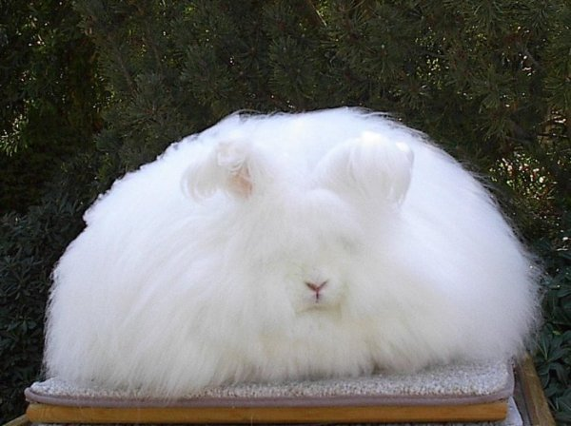
Endemic Species of Turkey:
Angora rabbit
This rabbits were most popular pets in Europe during 18th century.

Slide 8
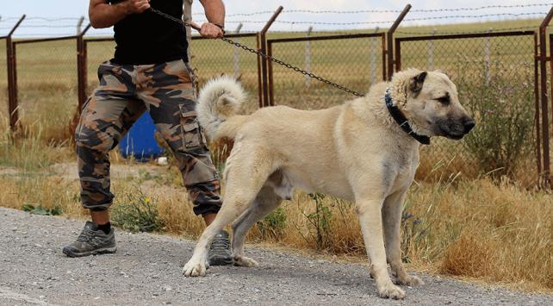
Endemic Species of Turkey:
Kangal Shepherd Dog
This dogs are very popular in Turkey and the name of district where dogs live is also Kangal.

Slide 9
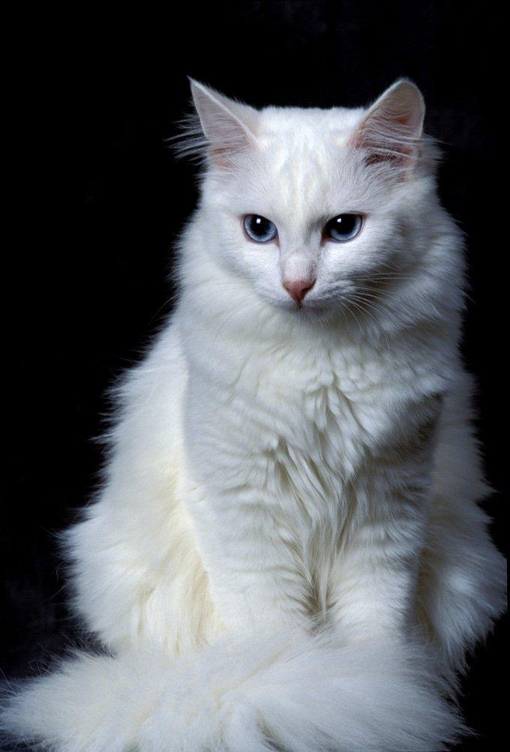
Endemic Species of Turkey:
Turkish Angora
More than half of the white Ankara Cats are deaf.

Slide 10
Endemic Species of Turkey:
Turkish Van
Turkish Van cats can swim. You can see a cat in Van Lake.

Slide 11
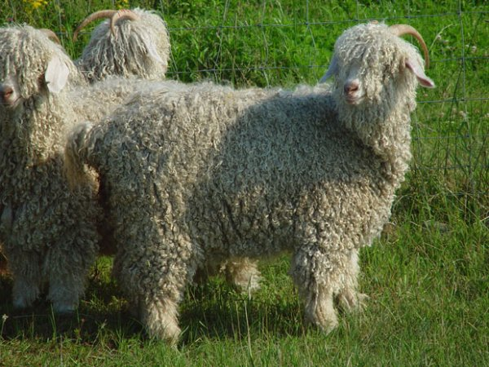
Endemic Species of Turkey:
Angora Goat
The fleece taken from an Angora goat is called mohair and it is used in textile very much.

Slide 12
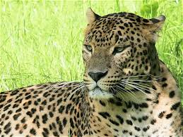
Endemic Species of Turkey:
Anatolian Leopard
Before November 2013, it was accepted that the last leopard was shot in 1974 in Beypazarı.

