Slide 1
Endemic Flora Under Protection of Manisa/Turkey

Slide 2
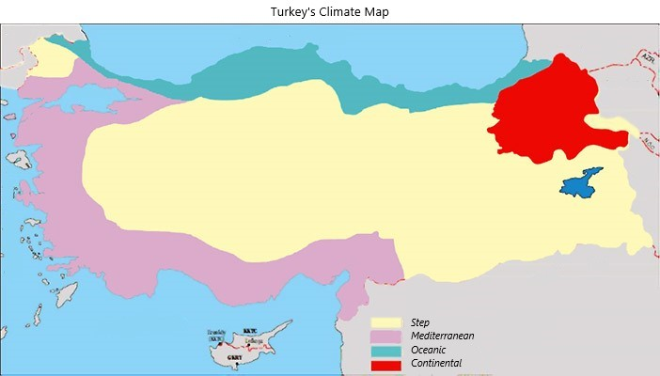
Turkey is a country which contains different climates such as mild Mediterranean climate, Continental climate, Oceanic climate.

Slide 3
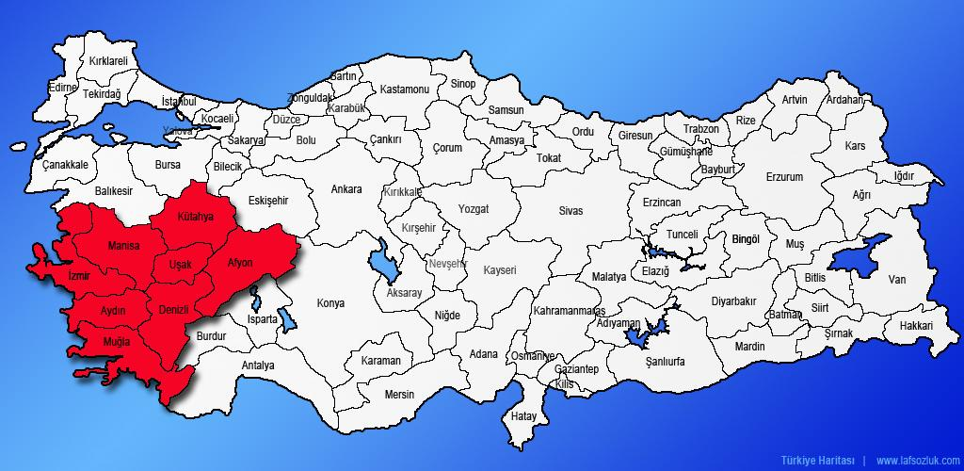
Eagen Region is a region which you can see many endemic spieces.

Slide 4
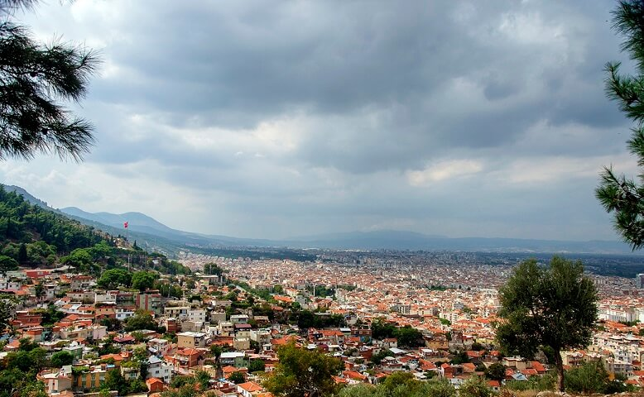
Our province Manisa is a quite big province with nearly 1.4 million people. It gets bigger day by day and turns into a thread to living beings.

Slide 5
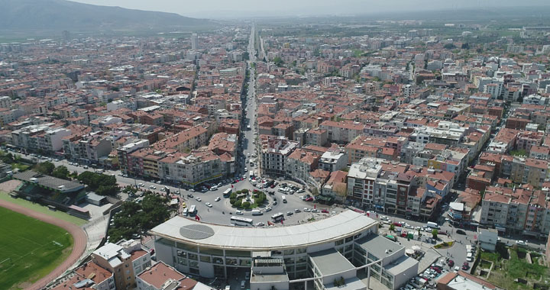
Akhisar is a district nearly 50 kilometers away from Manisa. Our school is in Akhisar.

Slide 6
What does “Endemic” mean ?
Endemic species are plants and animals that exist only in one geographic region. Species can be endemic to large or small areas of the earth: some are endemic to a particular continent, some to part of a continent, and others to a single island.

Slide 7
Flora of Turkey
The rich Turkish flora includes more than 9.000 varieties of plants. About 3.000 of them are endemic to Turkey and grow in nature nowhere else in the world. Turkey is the only country in the world under the influence of 3 botanical geographical regions. Also famous bioclimatists concurred that Turkey is the only country in the world subject to three main climates.

Slide 8
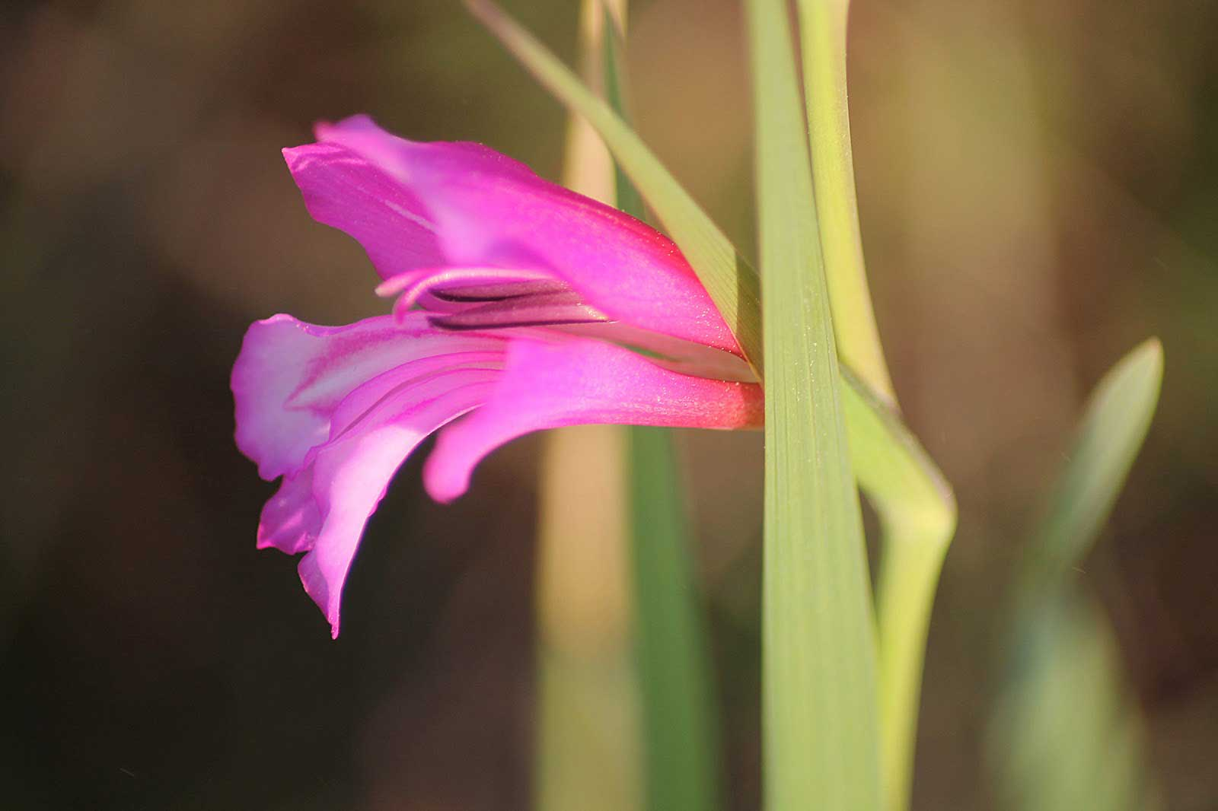
Anatolia Glaiol

Slide 9
Upside down Tulips of Van(!)
This plants grow naturally only in Van province of Turkey.

Slide 10
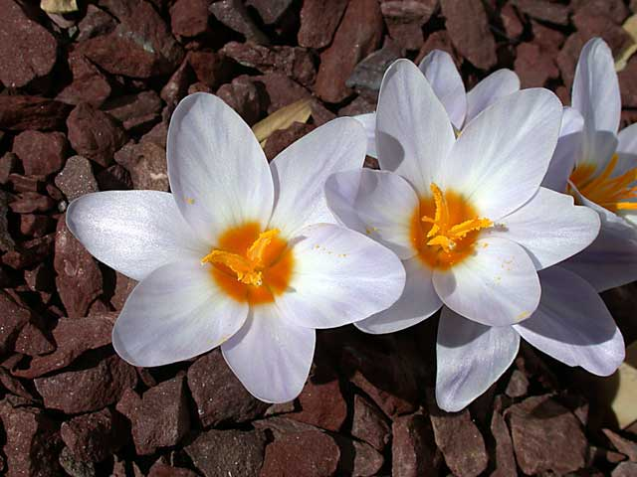
Crocus of Antalya
You can find this plants only in Antalya province of Turkey.

Slide 11
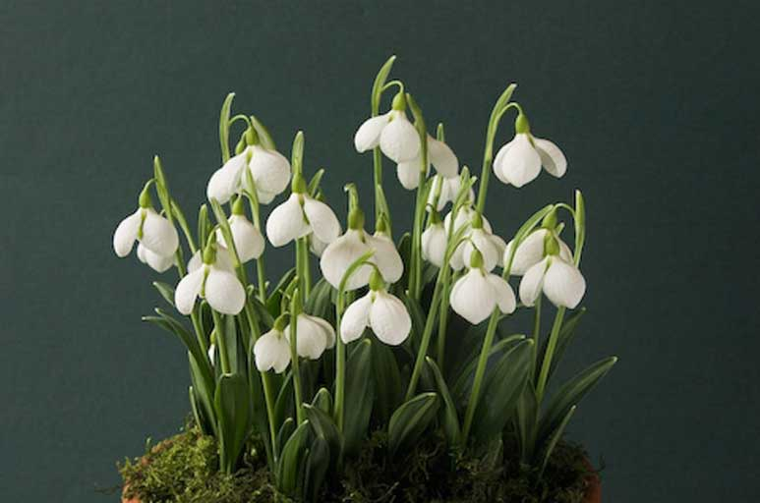
Snowdrop of Istanbul
This plants grow naturally only in Istanbul province of Turkey.

Slide 12
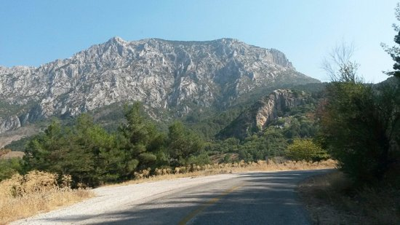
Where can we see Endemic Spieces in Manisa ?
Manisa is settled next to Mountain Spil. Spil has It’s own conditions so we can see some endemic plants there.

Slide 13
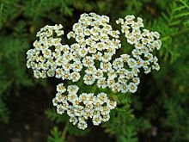
Achillea nobilis subsp (Kabefesleğeni)

Slide 14
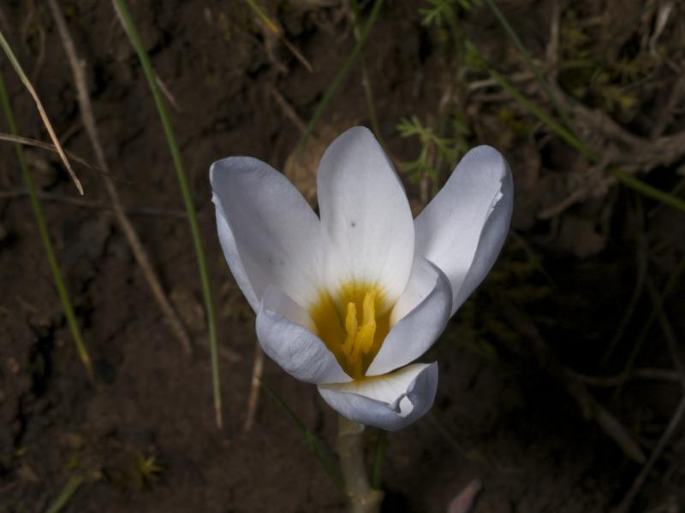
Arenaria sipylea (Tulip of Spil)

Slide 15
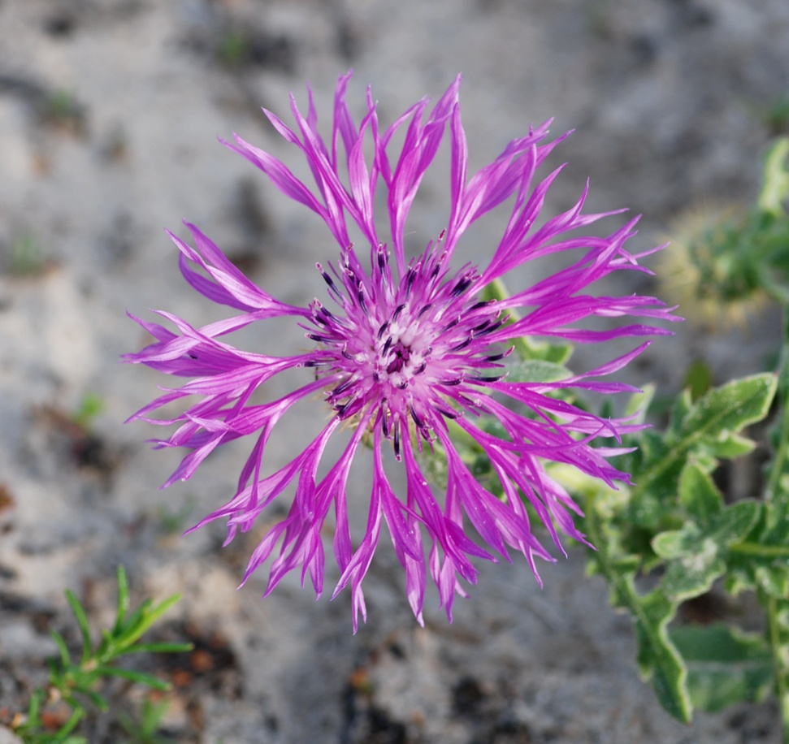
Centaurea sipylea (Cornflower of Spil Mountain)

Slide 16
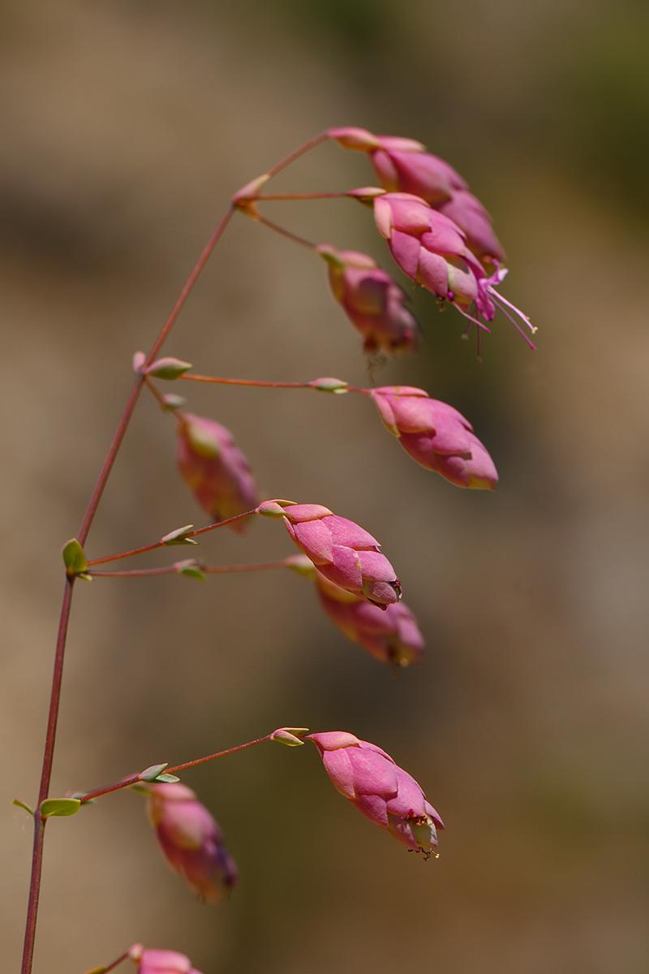
Origanum sipyleum (Mor Mercan)

Slide 17
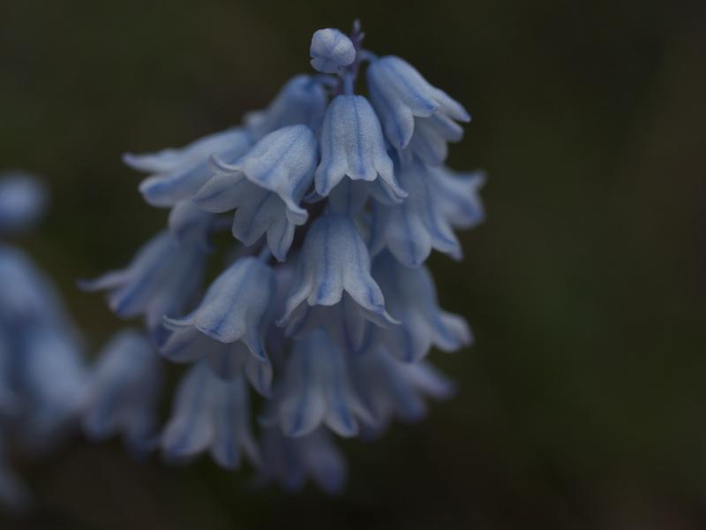
Satureja parnassica subsp sipylea (Also an endangered spiece) (Arı Kekiği)

Slide 18
Mesir Paste
Mesir paste tradition (Mesir Macunu in Turkish) is a very old tradition in the history of Manisa, an Anatolian city in the Aegan Region, dating back to almost 500 years. Mesir paste was started as a medicine invention during the Ottoman period but later on it became an important part of local festivy in this city. Mesir is made from many kinds of plants which known for their use as medicine.

Slide 19
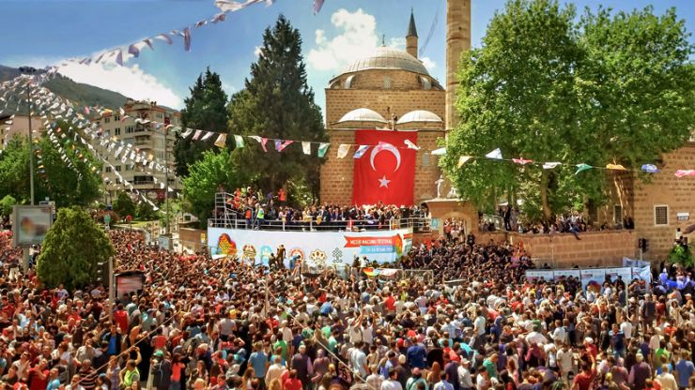
Mesir Fest

Slide 20
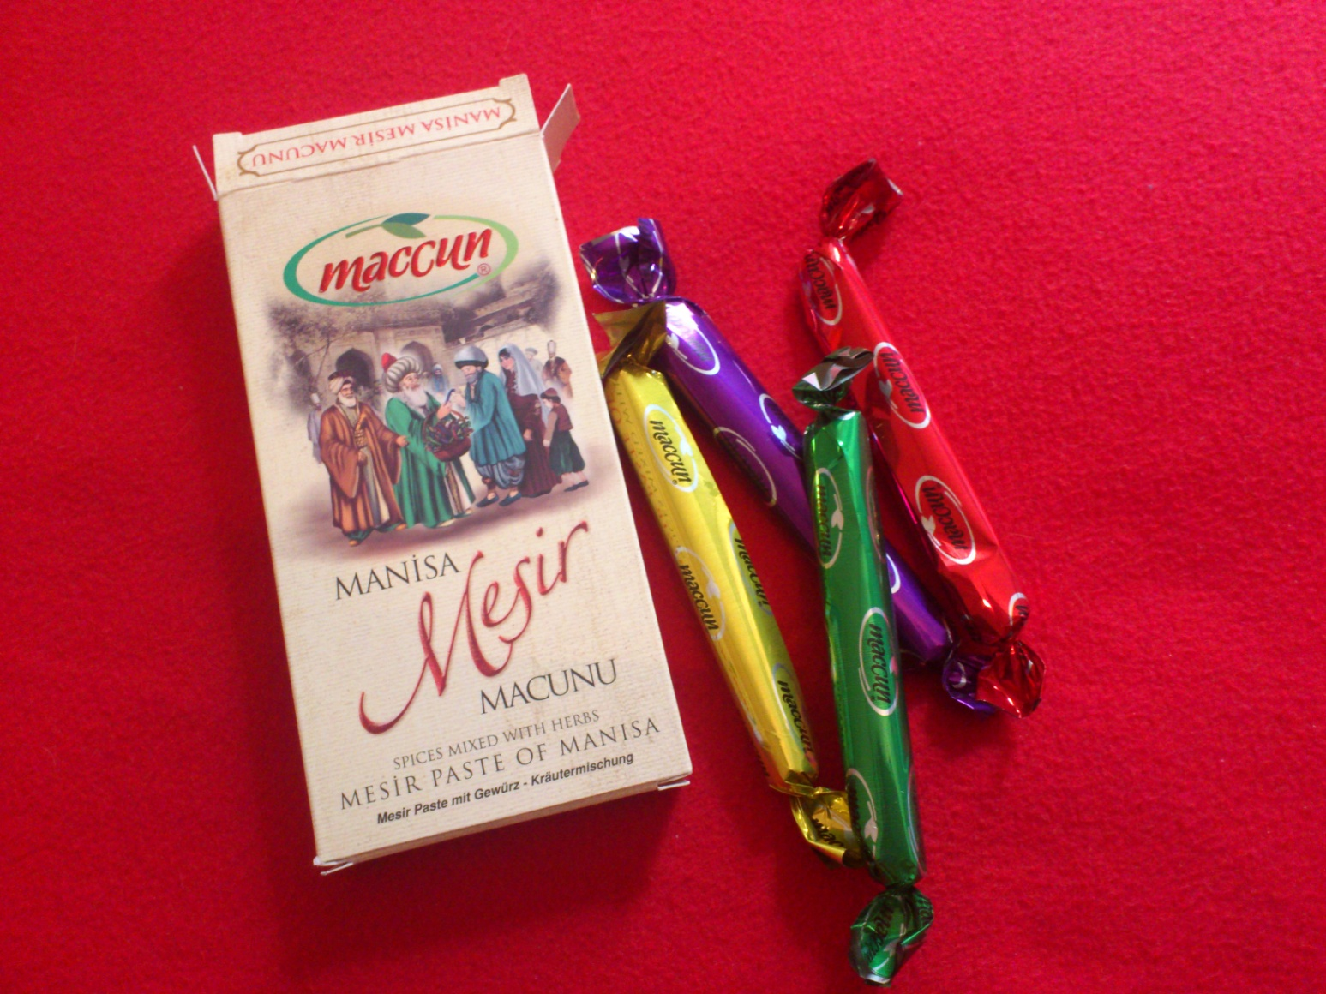
Manisa is famous for its Mesir Paste.

Slide 21
Plants which are used to produce Mesir Paste (Nearly 40 Spieces)
Allspice (Yeni bahar) (Pimenta dioica)
Alpina officinarum root (Havlican koku)
Anise (Anason) (Anisum vulgare)
Black cumin (Corek otu) (Nigella sativa)
Black myrobalan (Kara halile) (Terminalia nigra)
Black pepper (Karabiber) (Piper nigrum)
Buckthorn (Topalak or Akdiken) (Nerprun alaterne)
Cardamon (Kakule) (Elettaria cardamomum)
Cassia (Hiyarsenbe) (Cassia)
Chebulic myrobalan (Kara halile) (Terminalia chebula)
China root (Cop-i cini) (Smilax china)
Cinnamon (Tarcin) (Cinnamomum verum)
Cloves (Karanfil) (Syzygium aromaticum)
Coconut (Hindistan cevizi) (Cocos nucifera)
Coriander (Kisnis) (Coriandum sativum)
Cubeb (Kebabe) (Cubebae fructus)
Cumin (Kimyon) (Cuminum cyminum)
Dried orange blossom (Portakal cicegi)
Fennel (Rezene) (Foeniculum vulgare)
India blossom (Hindistan cicegi)
Galingale (Havlican) (Alpinia officinarum)
Ginger (Zencefil) (Zingibar officinalis)
Iksir sugar (Iksir sekeri)
India blossom (Hindistan cicegi)
Java pepper (Kuyruklu biber) (Piper cubeba)
Licorice extract (Meyan bali) (Glycyrrhiza uralensis fisch)
Licorice root (Meyan koku) (Glycyrrhiza glabra)
Mastic (Cam sakizi) (Mastichum)
Millet (Hintdarisi) (Pennisetum glaucum)
Myrrh (Murrusafi) (Commiphora Molmol)
Muskroot (Sumbul) (Adoxa moschatellina)
Mustard seed (Hardal tohumu) (Brassica nigra)
Orange peel (Portakal kabugu)
Rhubarb (Ravend) (Rheum Palmatum)
Saffron (Safran) (Crocus Orientalis)
Citric acid (Limon tuzu)
Senna (Sinameki) (Cassia senna)
Turmeric (Zerdecal) (Curcuma domestica)
Udulkahr (Udulkahir)
Vanilla (Vanilya) (Vanilla planifolia)
Woad (Civit) (Isatis)
Yellow myrobalan (Sari halile) (Fructus myrobalani)

