Slide 1
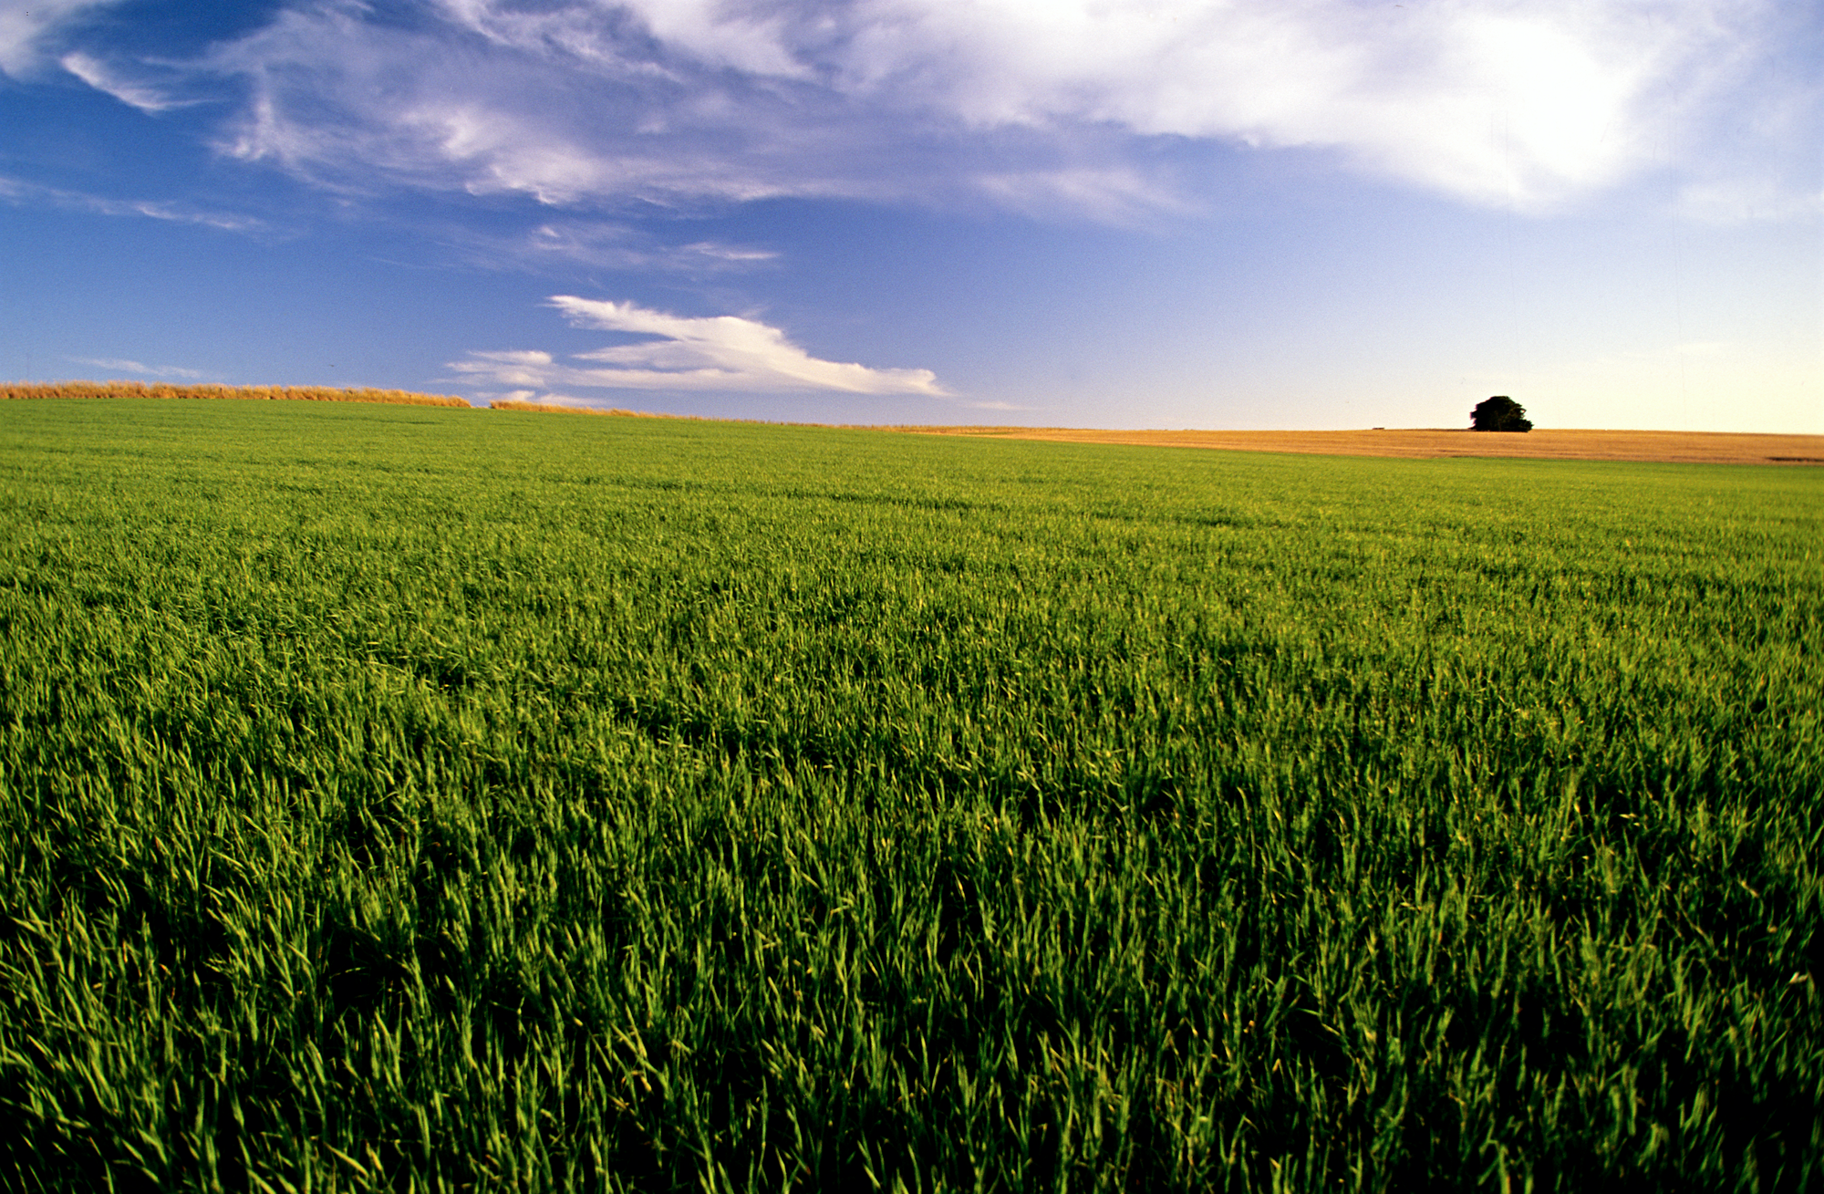
How does the earth shape people’s culture
In The Terms Of Eating/Farming

Slide 2
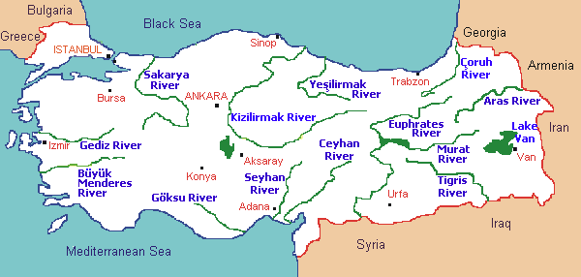
Base Of Farming: Water Sources
Water sources are the most important factor in farming. During the history, Anatolia always had plenty of water sources.
(Map of natural water sources in Turkey.)

Slide 3
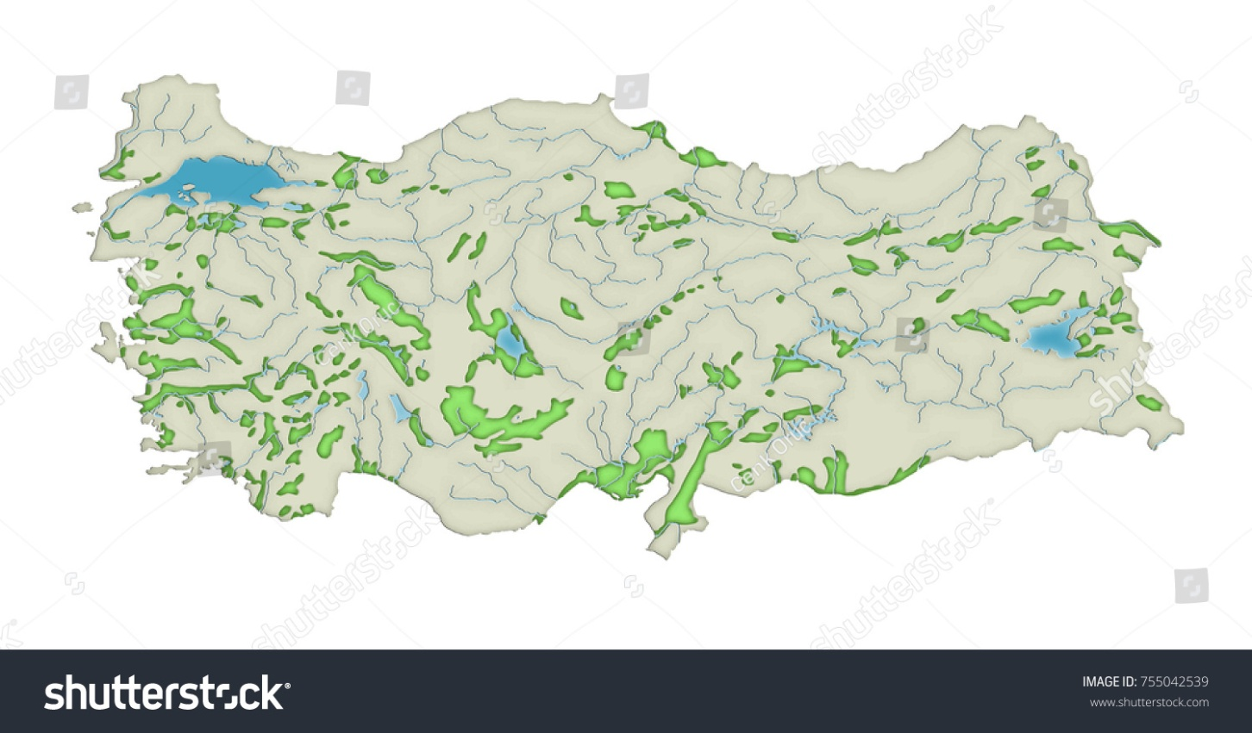
Plains Of Turkey
Delta Plains: Delta plains are the plains which occured in time because of rivers. Rivers carry some materials and that materials make the soil much more efficient.
(Map of plains in Turkey)

Slide 4
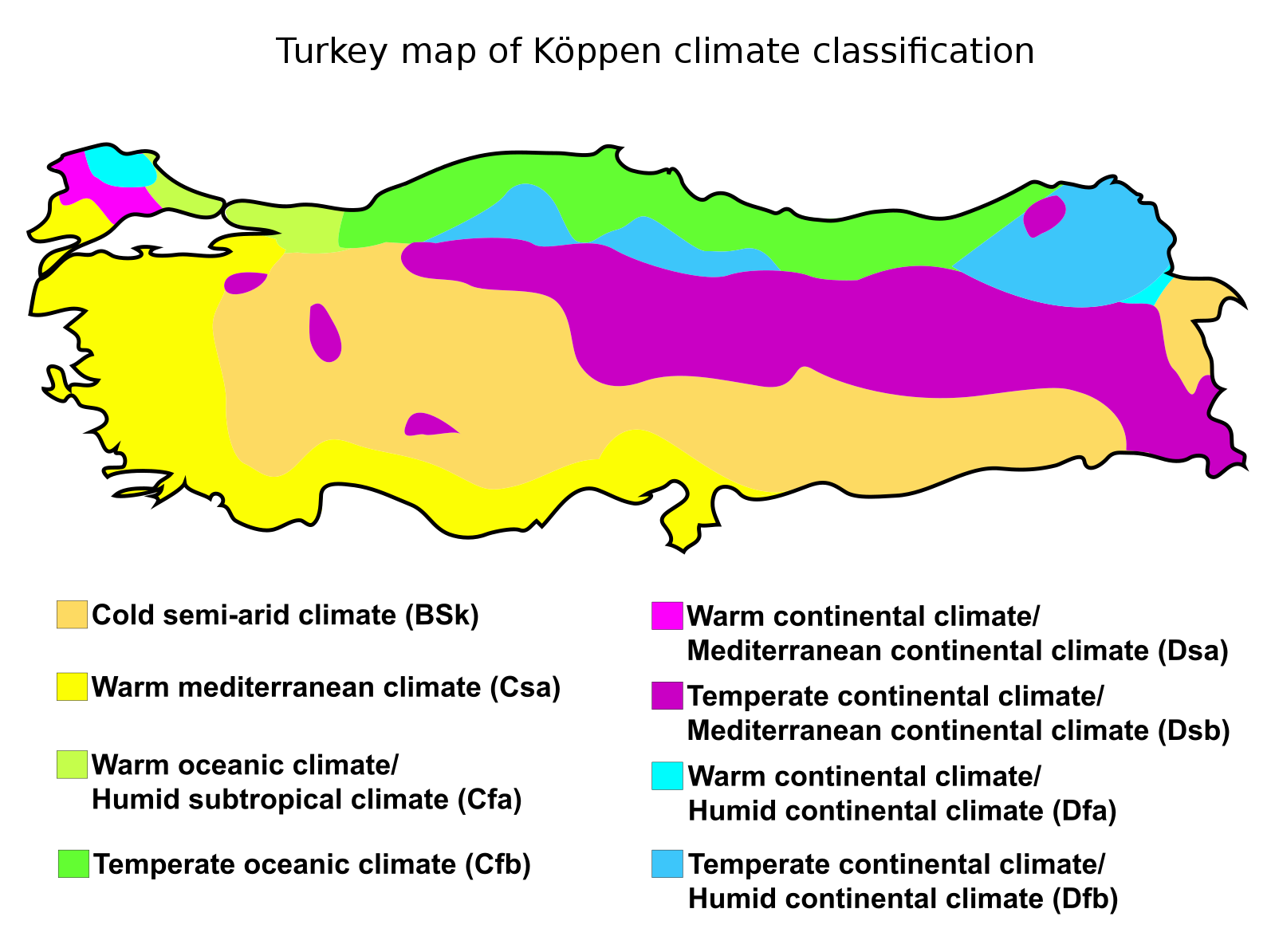
Climate and Variety
Climate has one of the most important effects on eating and farming due to variety.
In Turkey, various climate types can be observed in the different regions of the country.

Slide 5
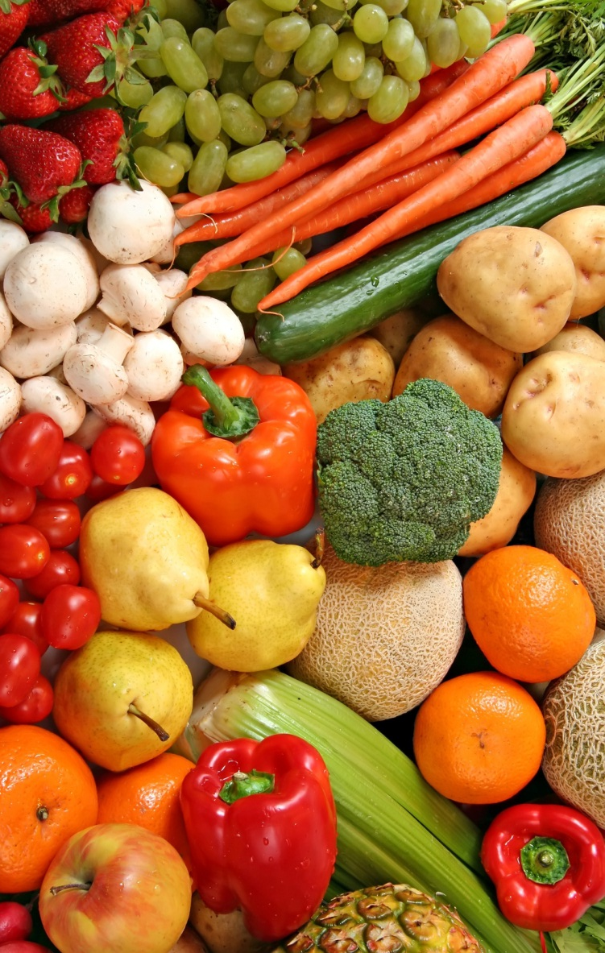
Fruits and Vegetables
Because of these climate types and many different effects of the earth fruits and vegetables are various all around the world. Even cooking styles and spice&salt amount changes up to the region.

Slide 6
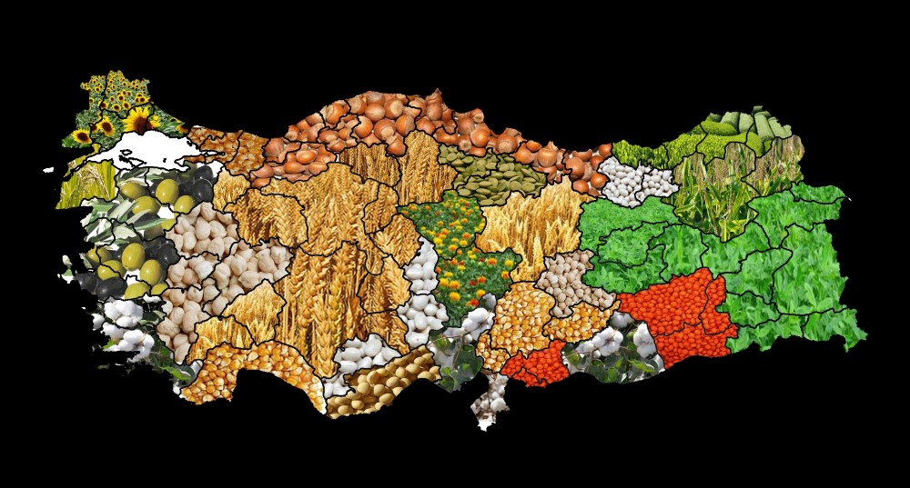
Here’s a visualized map of some of the common fruits and vegetables in Turkey.

Slide 7
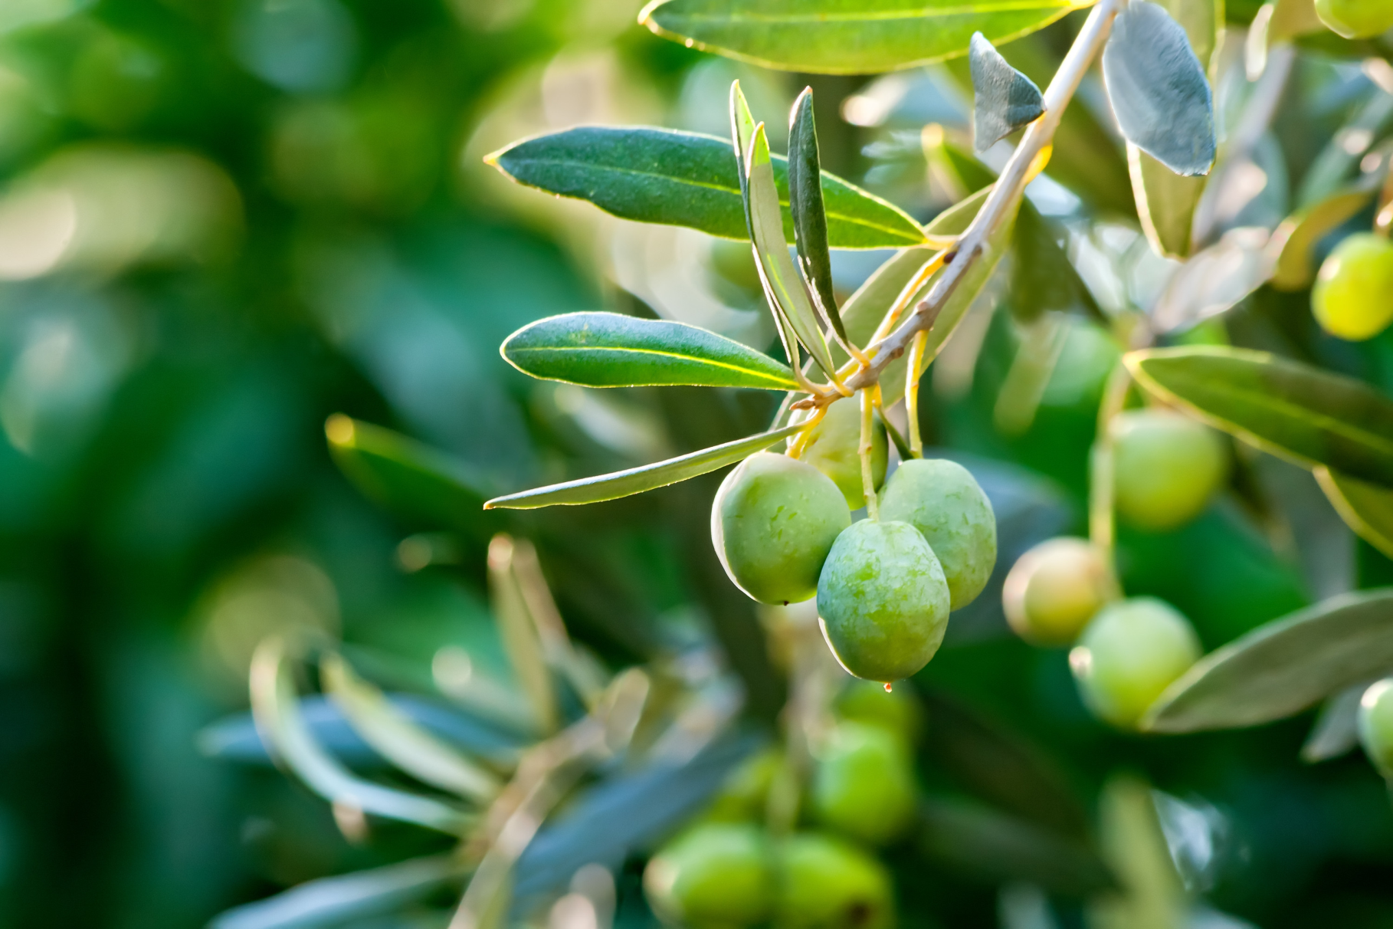
Olive

Slide 8
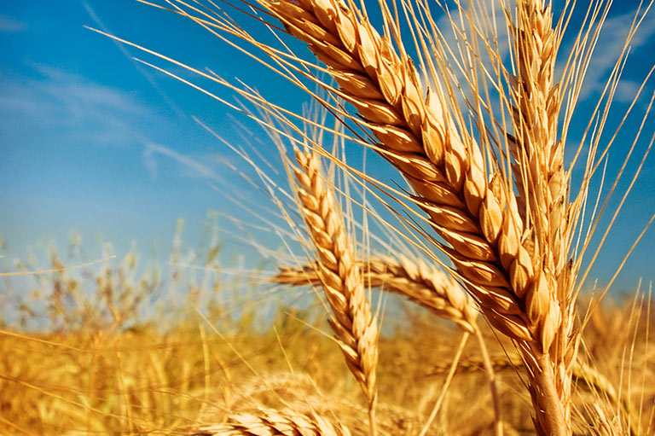
Wheat

Slide 9
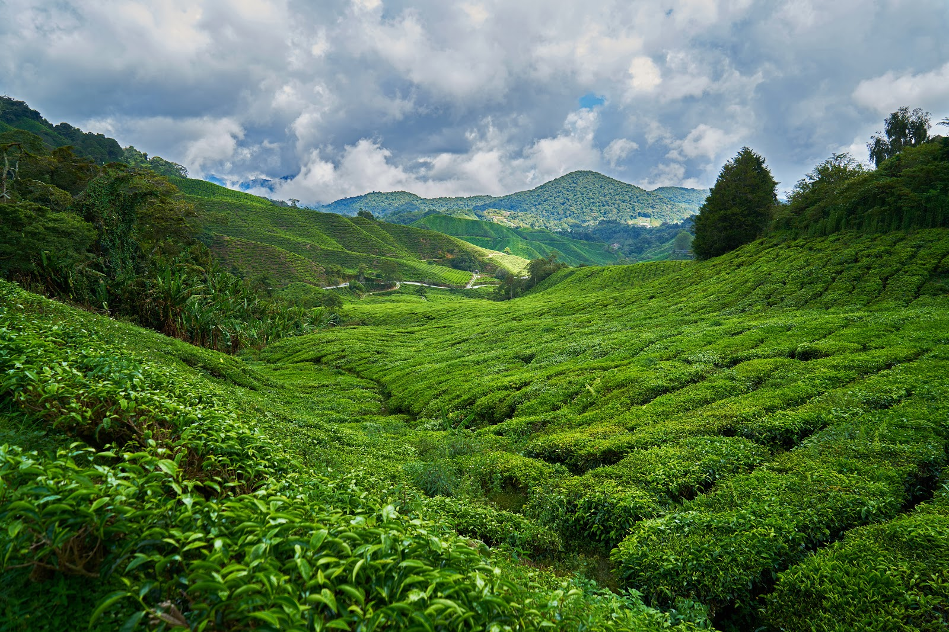
Tea

Slide 10
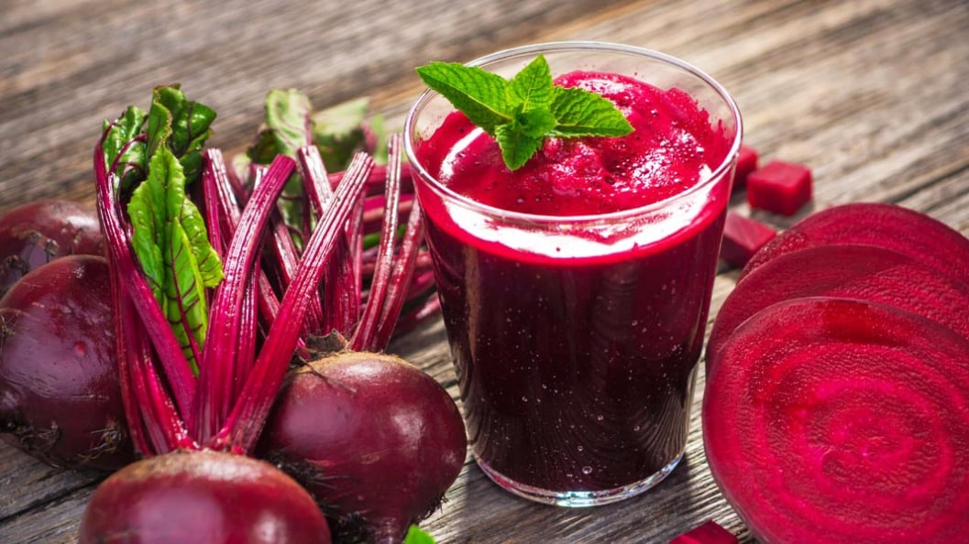
Turnips

Slide 11
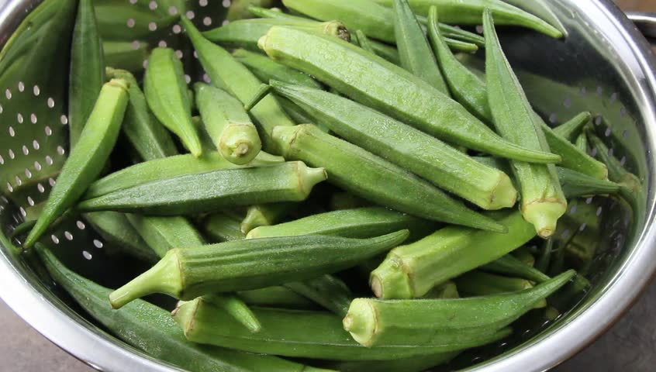
Okra

Slide 12
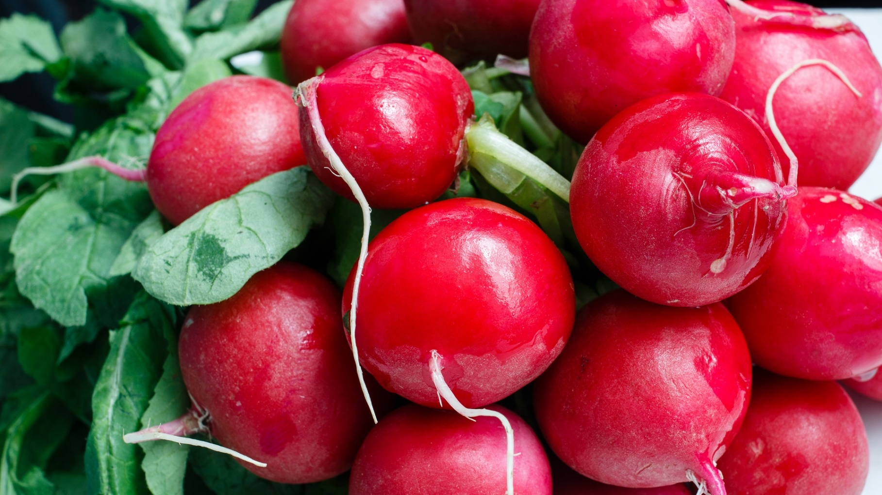
Radish

Slide 13
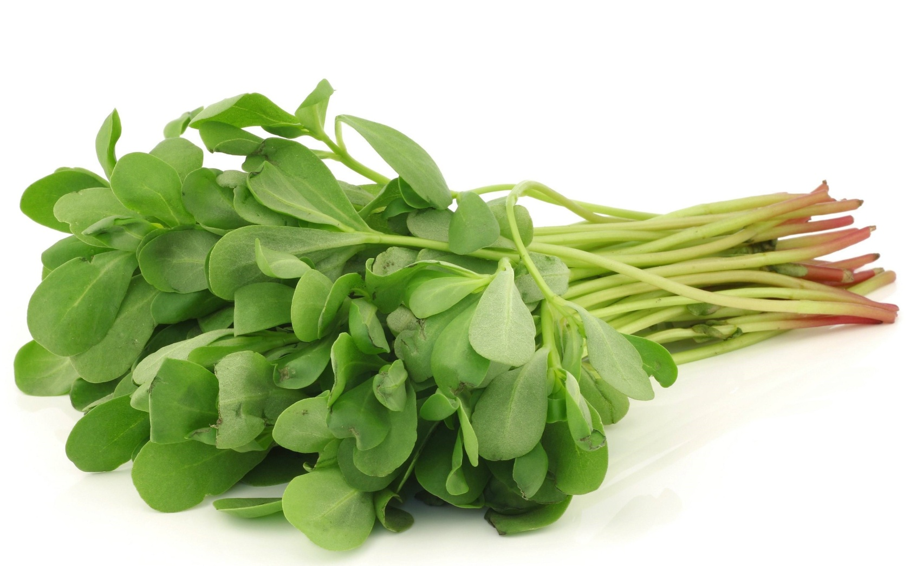
Purslane

Slide 14
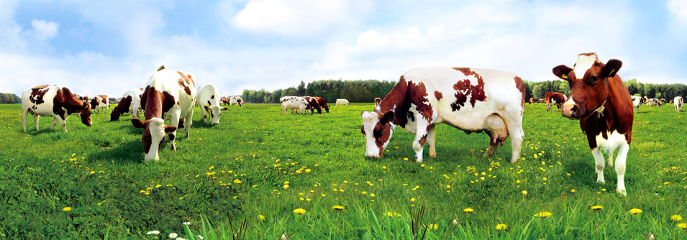
Slope and Elevation
In many places, especially agriculture changes due to the slope and elevation. If there’s a steep slope in the area, it makes planting harder. So, people who live in overland mostly live off animal breeding.

Slide 15
Fishing
Fishing is an important livelihood for many seaside and lakeside areas in our country.

Slide 16
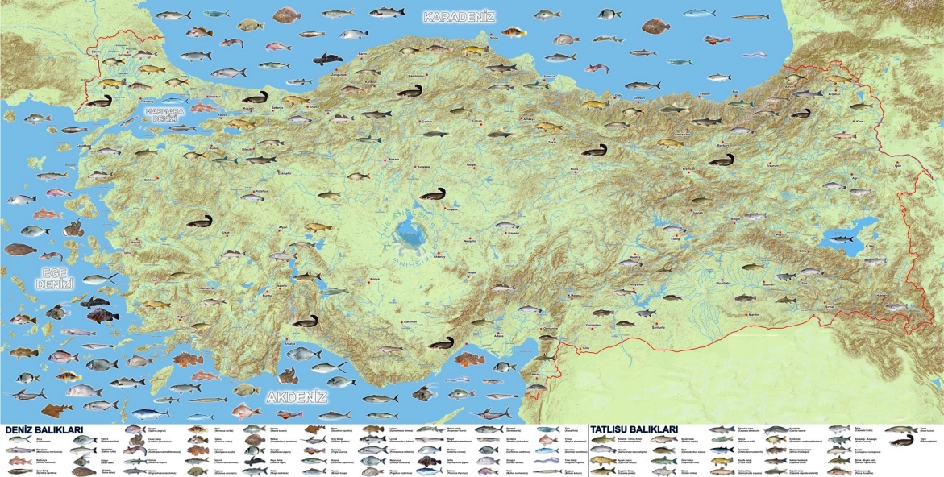
Some Famous Fishing Spots
Aegean Sea
Black Sea
Mediterranean Sea
Sea of Marmara – an inland sea.
Strait of Istanbul or the Bosphorus

Slide 17
