Slide 1
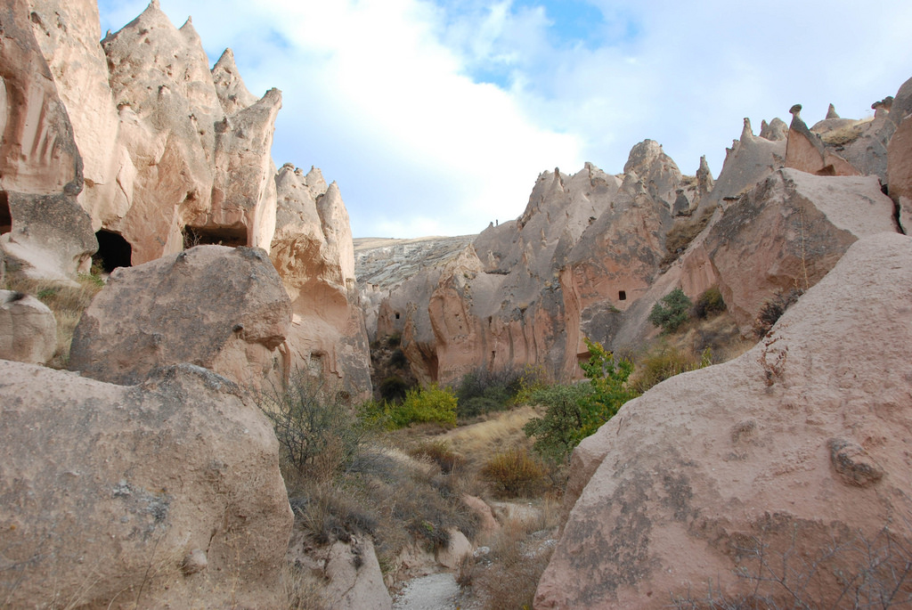
KATAKEKAUMENE:
THE BURNT COUNTRY

Slide 2
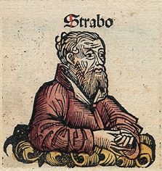
Katakekaumene
Kula Geopark has been known for 2 thousand years. The great geographer of the ancient period Strabo, born in Amasya, Turkey, describes Kula in detail in his book titled Geographika which is called as Katakekaumene (Burnt Country) because of coal black basalt stones.

Slide 3
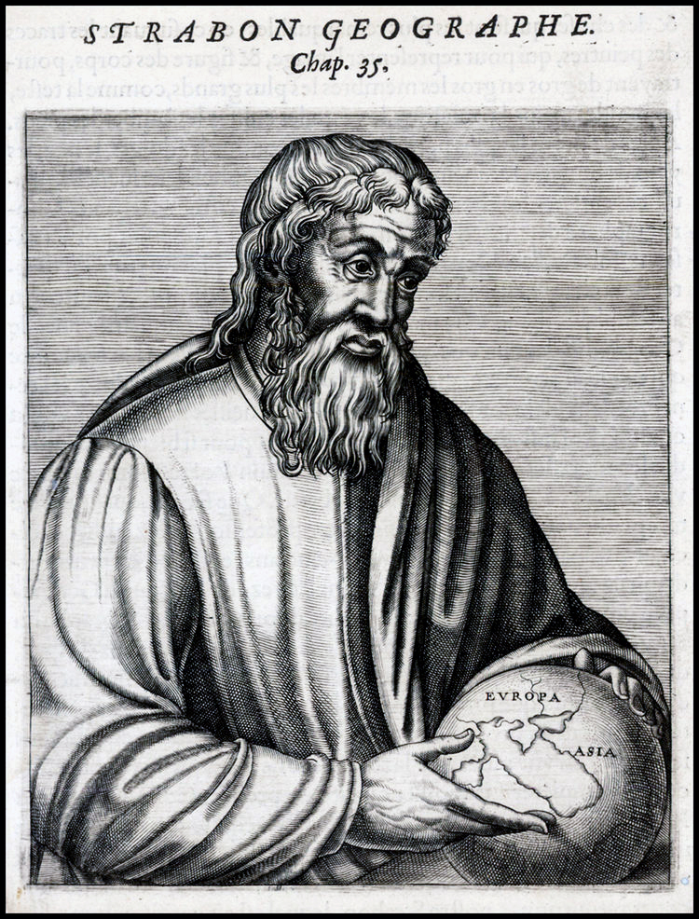
Here are some quotes from the two thousand years aged book “Geographika”, written by Strabo:

Slide 4
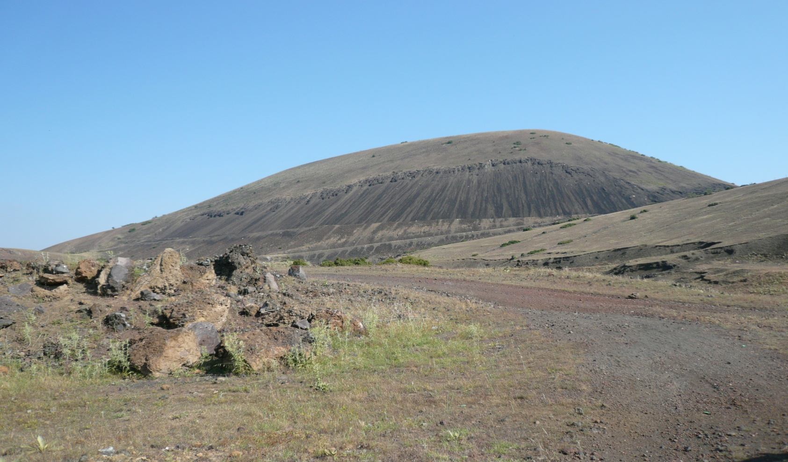
“The land of Katakekaumene will be reached after passing this empty area.”

Slide 5
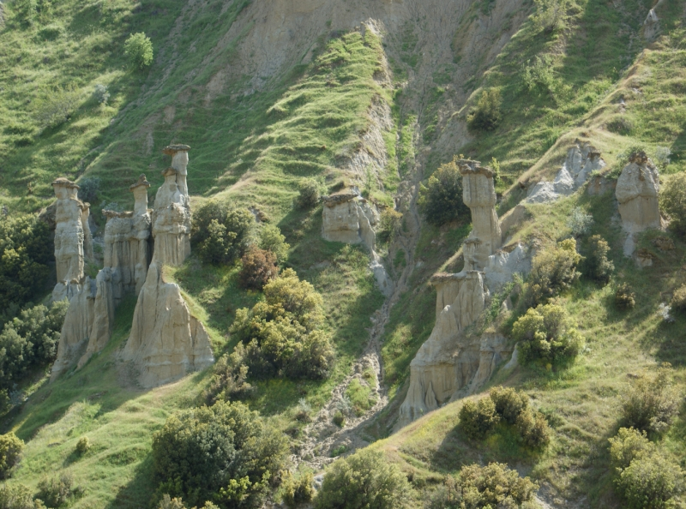
“In this region, there is not a single tree other than the trees that the most qualified wines of the region are made of.”

Slide 6
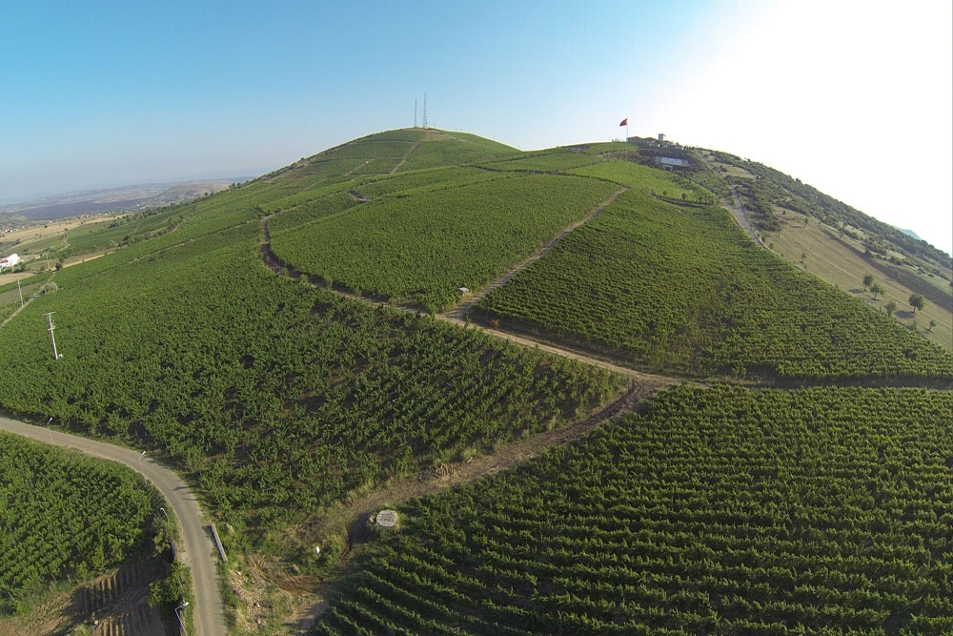
The Katakekaumene Vineyards are located on the lava stones on the slopes of the Divlit Volcano.
16 different varieties of grapes are grown in these vineyards.

Slide 7
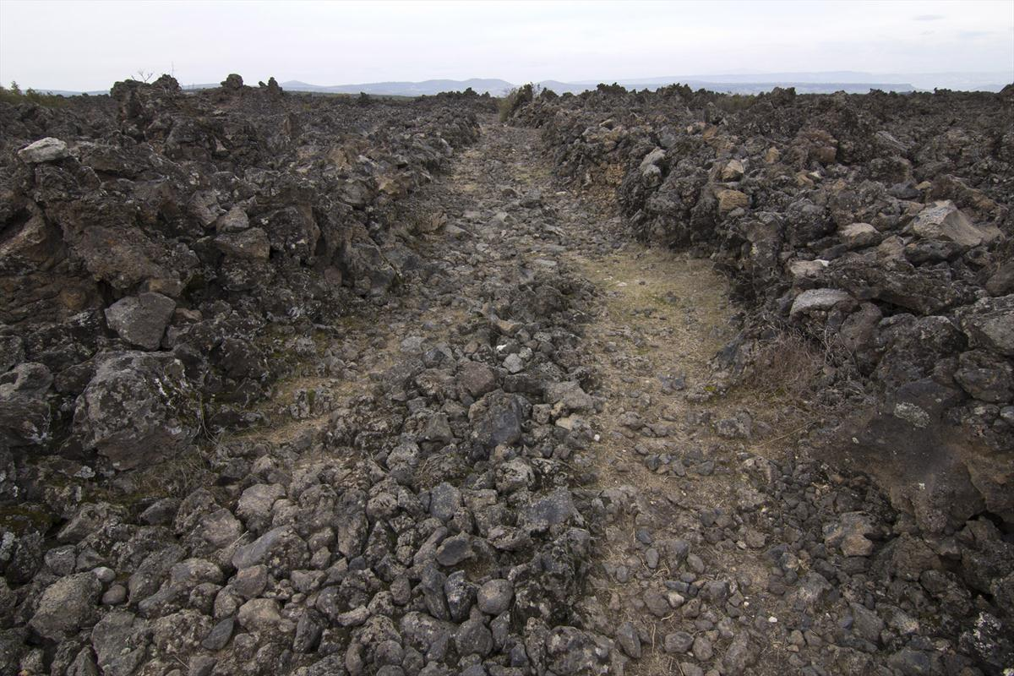
The surface of the soil is covered with a kind of ash and from mountain to stone, everywhere is as black as is burnt on fire.

Slide 8
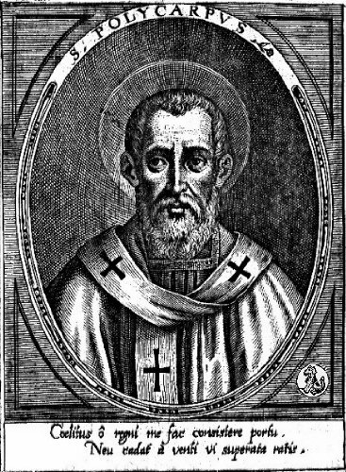
There’s a myth that in the term of the Roman Empire Decius(249 B.C.-251 B.C.), the leader Pionius, who is killed by the Pagans, interprets the region as a punishment for the unbelievers in his self-defense.
“Don't you see the fire-roasted land of Lydia, a sign for infidels?”

Slide 9
The fire-roasted land that Pionius mentioned

Slide 10
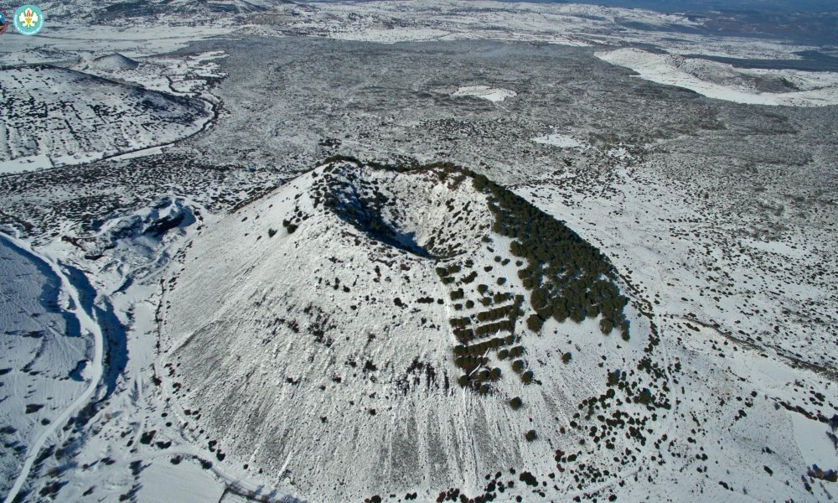
In the field, there are 3 pits known as “the breathing holes” which are called “Physse”.

Slide 11
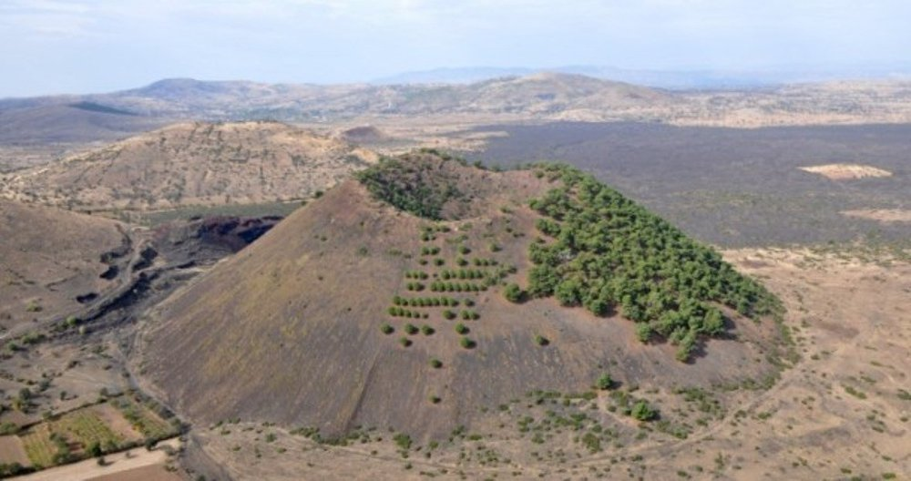
The steep hills above these breathing holes occur as a result of the accumulation of superheated masses that erupt up from the underground.

Slide 12
Strabo mentions Katakakeumene in his book while referring to the frequent earthquakes in neighboring Philadelphia(Alaşehir).
He says that Philadelphia, the neighbour city of Katakekaumene, shakes every single day and these shakes affect Katakekaumene as well.

Slide 14
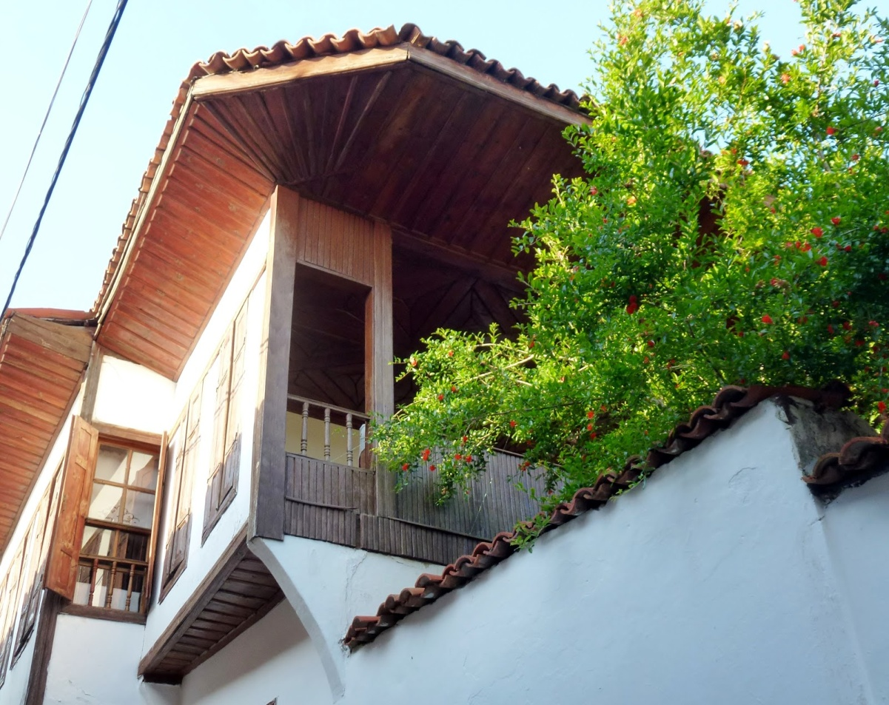
At this point, the residants of Katakekaumene are careful about these shakes and they build their houses according to the shakes.
That’s why Kula’s houses are not alike the rest of the Aegean Region’s houses.

Slide 15
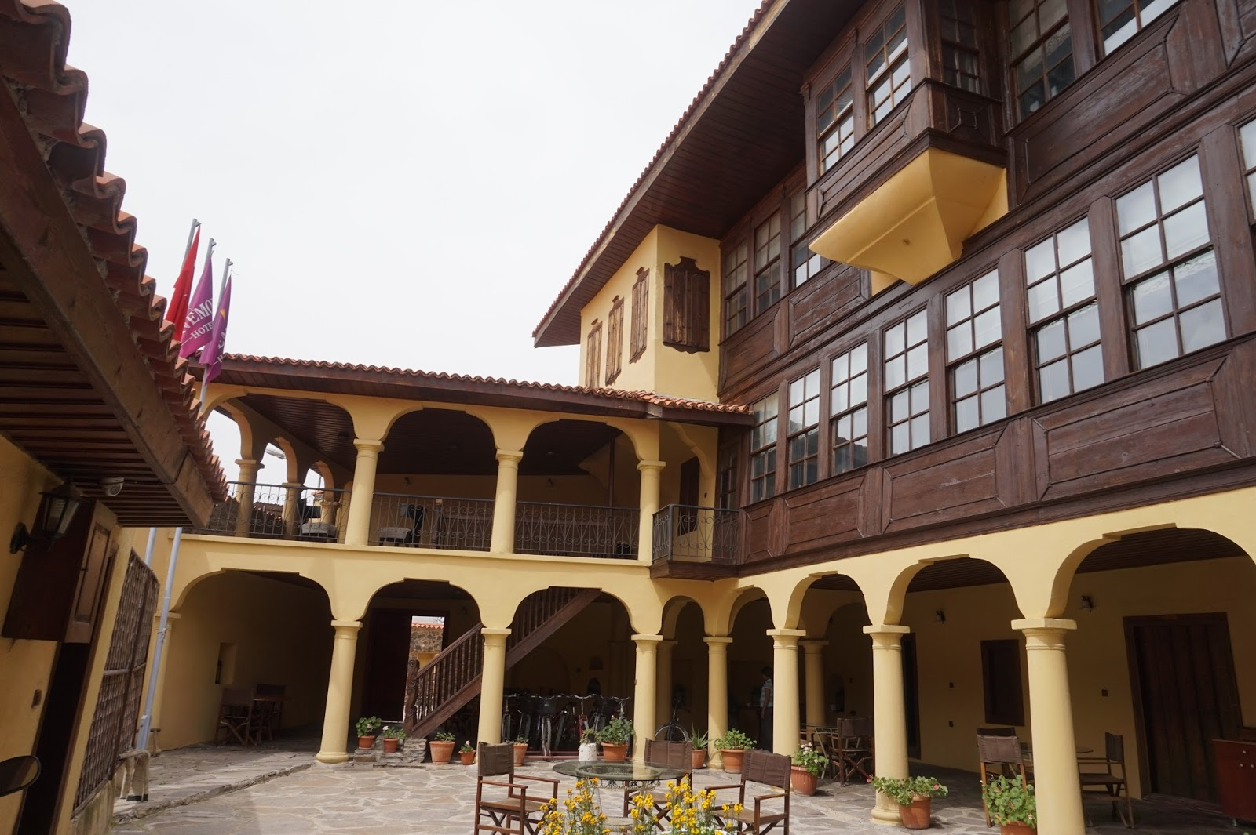
Here are some structures in Kula affected by these causes:
The Zabunlar Mansion

Slide 16
Here are some structures in Kula affected by these causes:

Slide 17
Here are some structures in Kula affected by these causes:

Slide 18
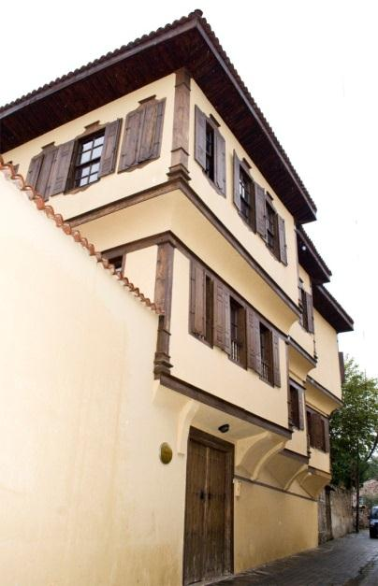
Here are some structures in Kula affected by these causes:

Slide 19
THE GEOGRAPHY OF KULA
Geological Map of the Area

Slide 20
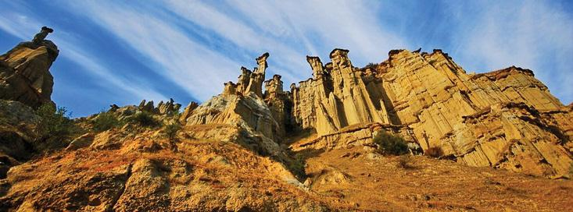
VOLCANO CONES AND CRATERS
There are 80 volcanic slag cones and 5 maars in Kula Geopark. The height of these slag cones are miniature sized and does not exceed 150 meters.

Slide 21
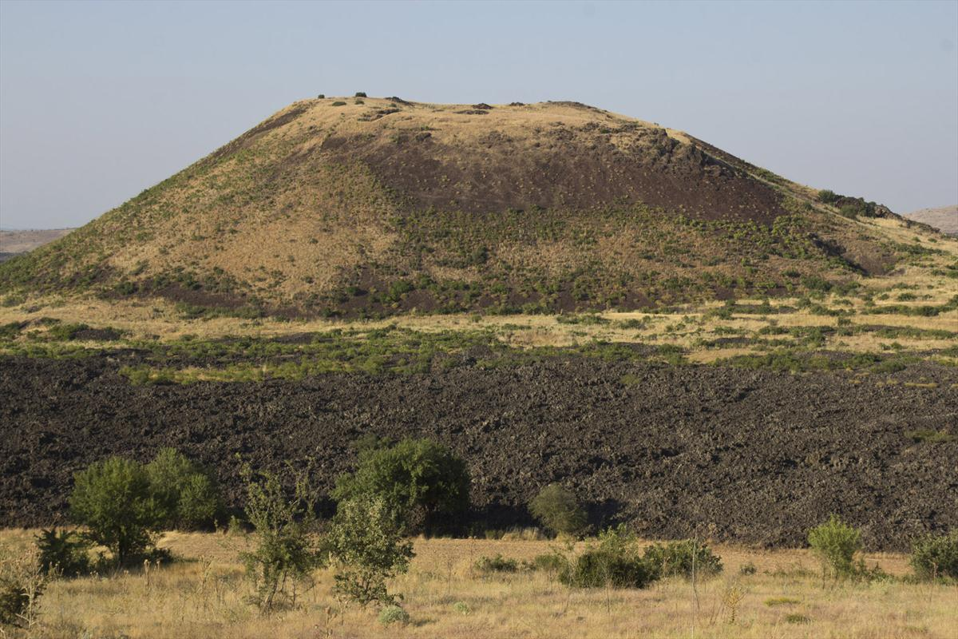
VOLCANIC CAVES AND TUNNELS
Volcano cones and craters

Slide 22
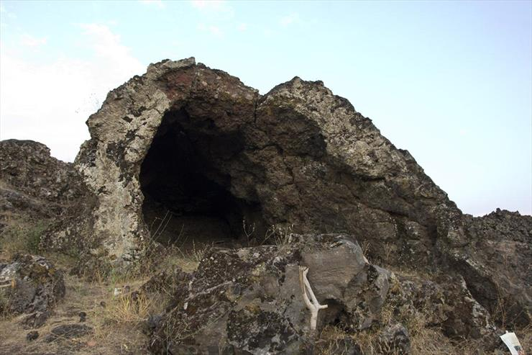
VOLCANIC CAVES AND TUNNELS
Lava tunnels are formed as a result of solidification of the parts of the lava which are in contact with the air.

Slide 23
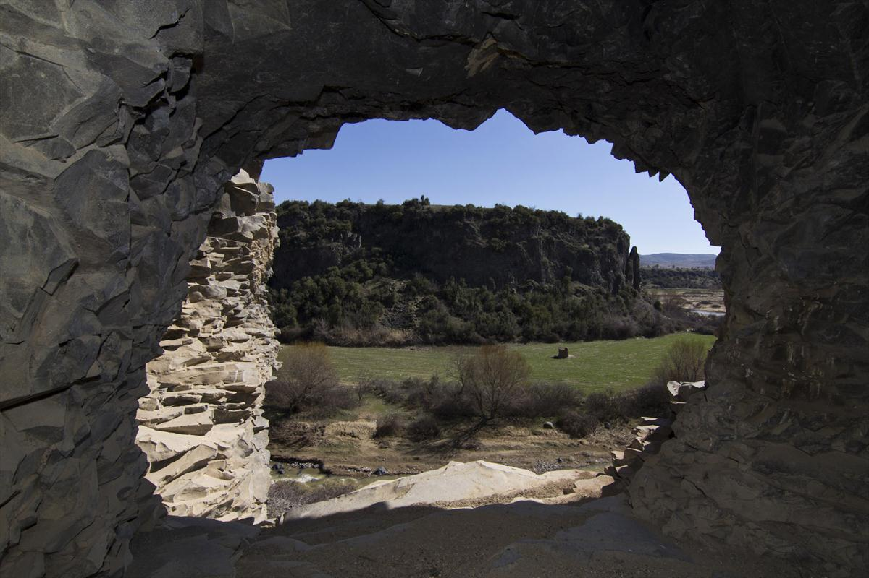
VOLCANIC CAVES AND TUNNELS
There are many lava tunnels on the Kula lava flows, which the lava flows through.

Slide 24
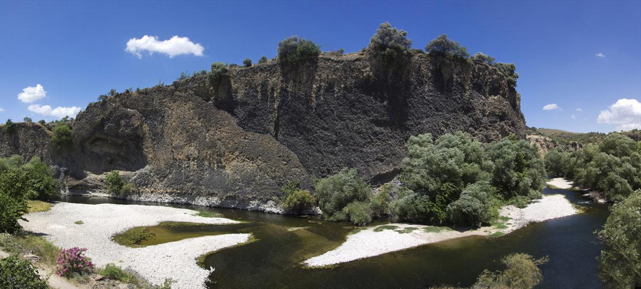
VOLCANIC CANYON AND WATERFALLS
Kula Volkanik Jeoparkında vadileri dolduran lavların Gediz nehri ve kolları tarafından parçalanması sonucu toplam uzunluğu 20 kilometreyi geçen volkanik kanyonlar oluşmuştur.
In the volcanic Geopark of Kula, volcanic canyons, with more than 20 kilometers total length, were formed as a result of the lavas that fill the valleys by the Gediz River and its branches.?????

Slide 25
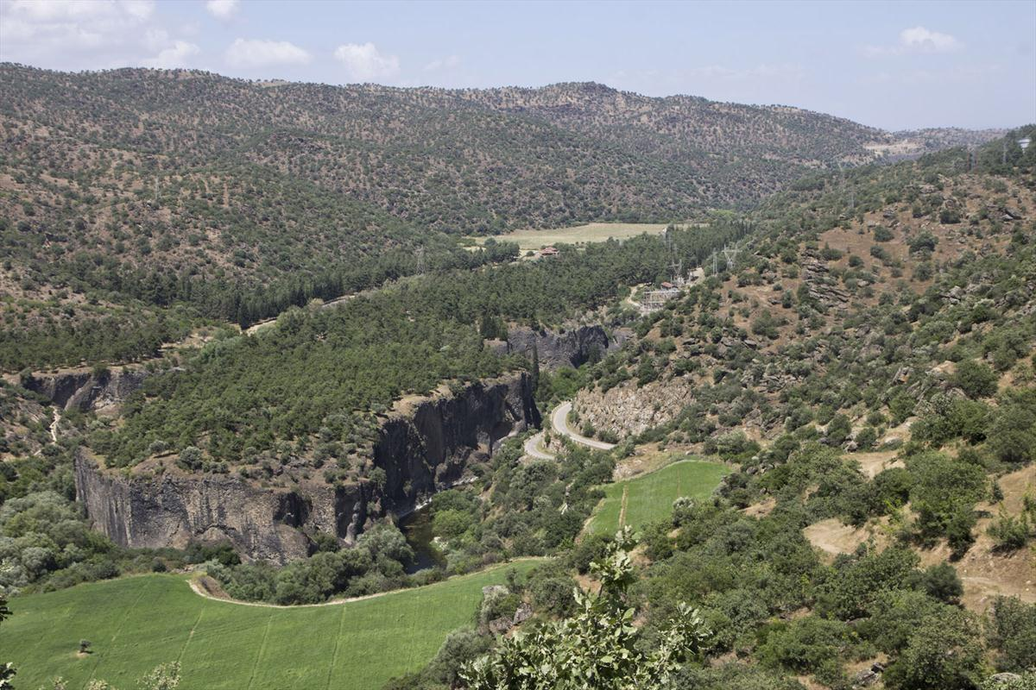
VOLCANIC CANYON AND WATERFALLS
Waterfalls are formed due to local collapses occured in these canyons.

Slide 26
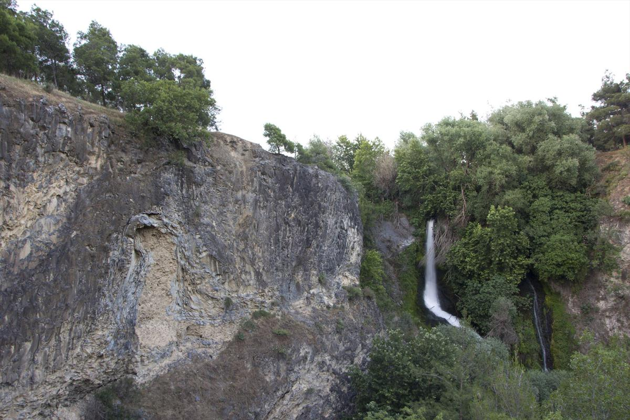
VOLCANIC CANYON AND WATERFALLS
The most famous of these waterfalls is the Suuçtu Waterfall in Adala Canyon, which has a 25 m drop.

Slide 27
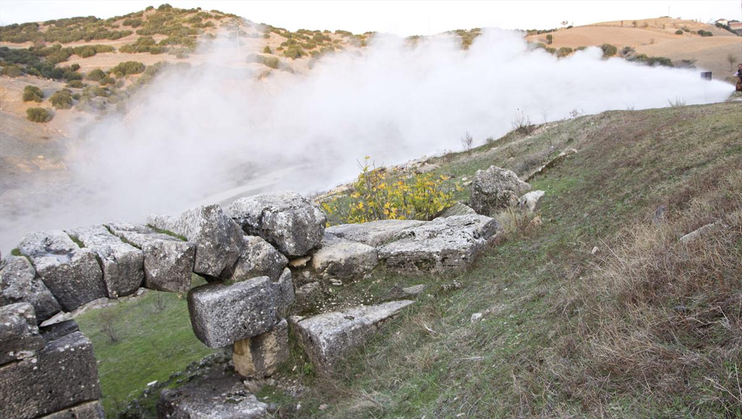
MINERAL WATERS
When Anatolia was not yet a continental , as a result of the contact of the sea water and the volcanos erupting in the ocean floor, the green coloured and slipperly surfaced rocks known as Serpantinid has formed.

Slide 28
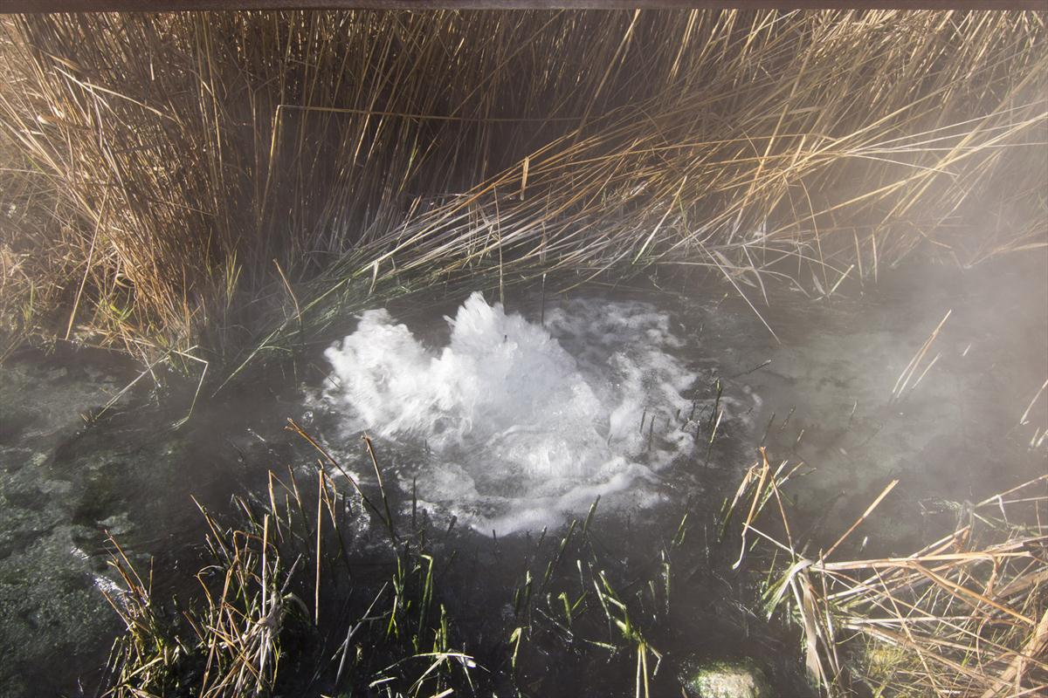
MINERAL WATERS
As a by-product of this process of metamorphosis, a white magnesite mineral was formed.

Slide 29
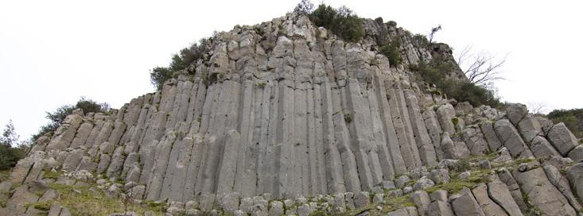
COLUMN BASALTS
In the volcanic Geopark of Kula, characteristic column basalts called Burgaz volcanites were formed in the first stage lava flowing.

Slide 30
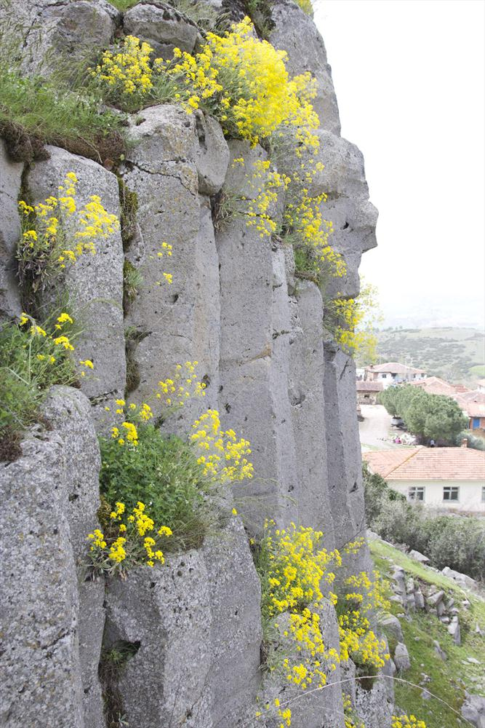
COLUMN BASALTS
Column basalts are vertical cracks due to shrinkage and stresses during rapid cooling of thick lava covers.

Slide 31
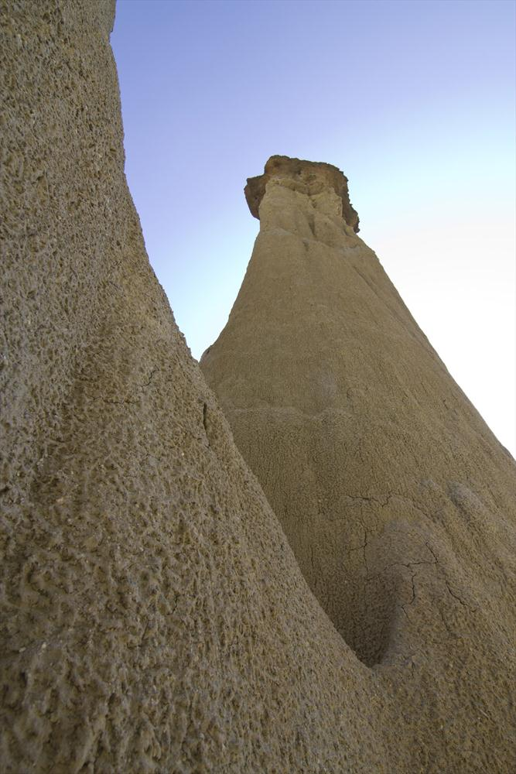
FAIRY CHIMNEYS
Kula has fairy chimneys similar to those in Cappadocia.

Slide 32
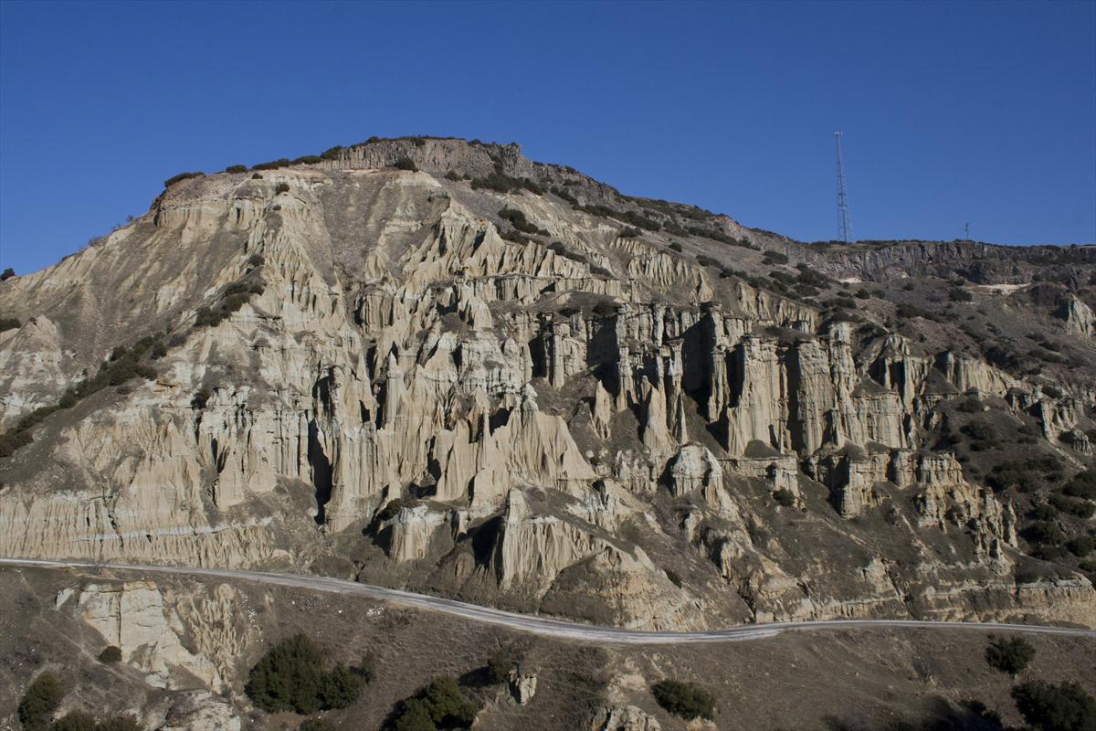
FAIRY CHIMNEYS
These rare natural beauties were formed as a result of stream erosion.

Slide 33
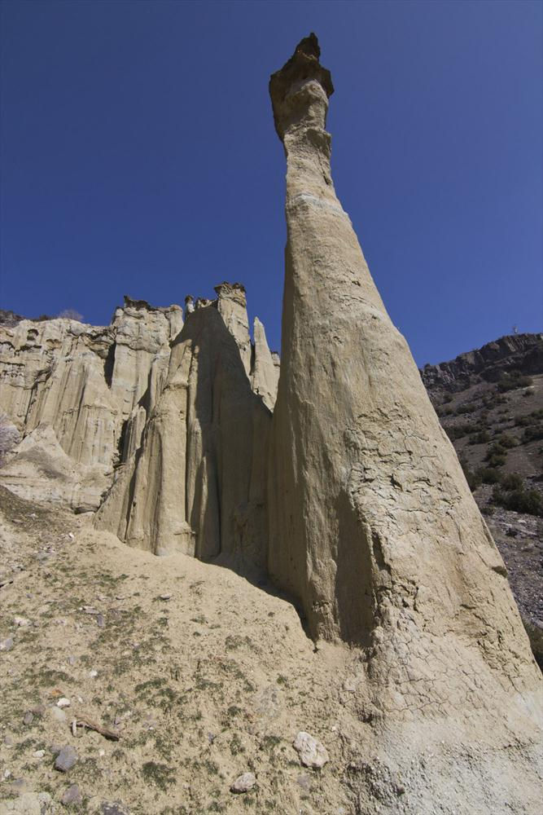
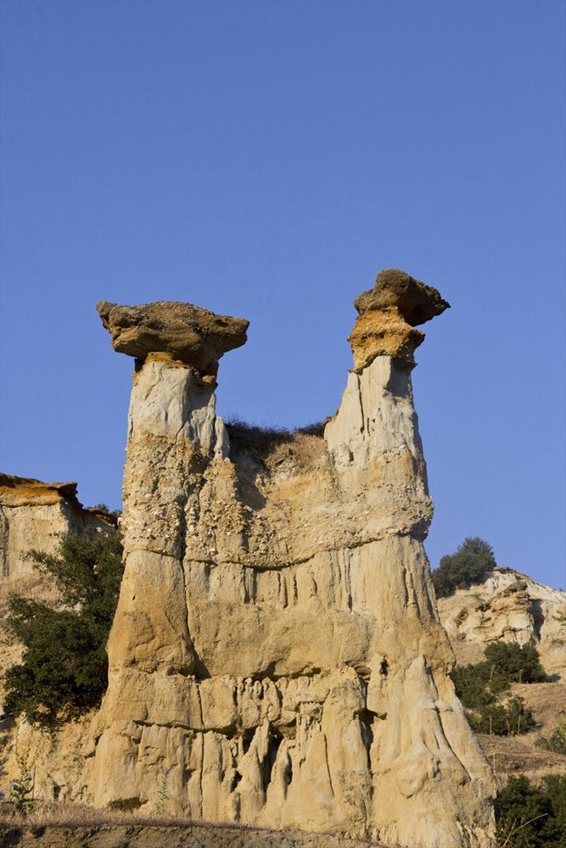
FAIRY CHIMNEYS

Slide 34
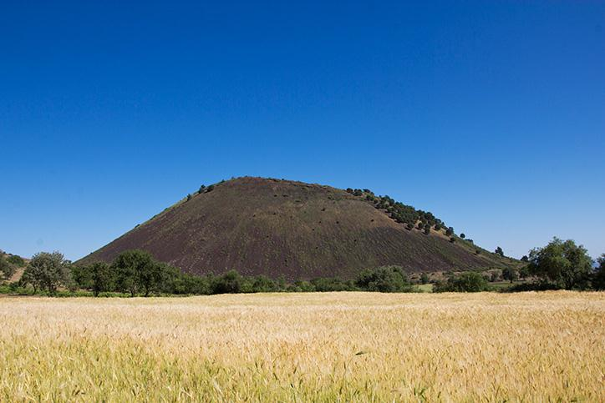
CULTURAL LEGACY
In 1954, more than 200 fossilized human footprints were discovered near the volcano cone but only a few of them remained in the field.

Slide 35
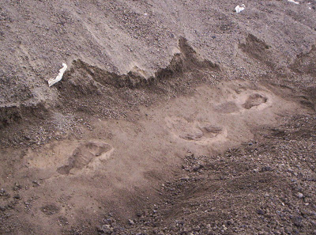
CULTURAL LEGACY
It is estimated that the footprints belong 3 people walking on a sloping slope.
The age analyses of the footprints indicate 10.000-12.000 years corresponding to the Mesolithic period.

Slide 36
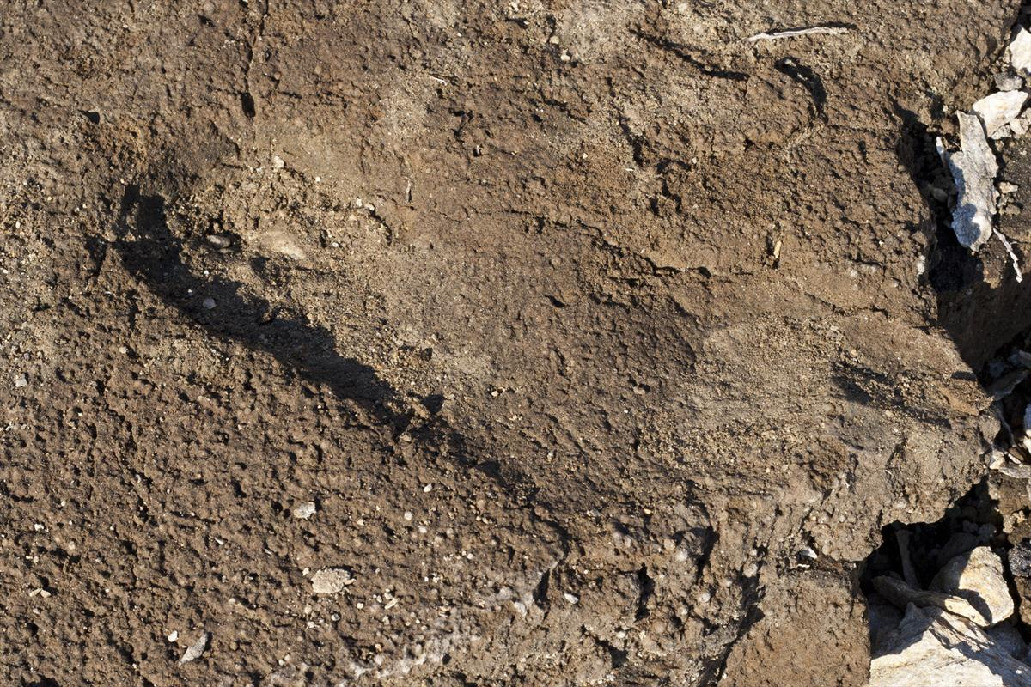
CULTURAL LEGACY

Slide 37
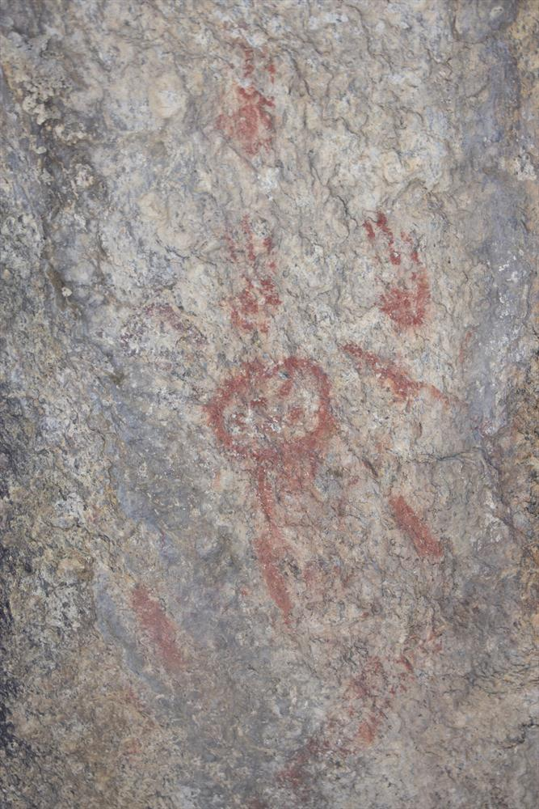
CULTURAL LEGACY
The prehistoric rock paintings, known as the Kanlıkaya (Bloodstone), are located near the fossil human footprints.

Slide 38
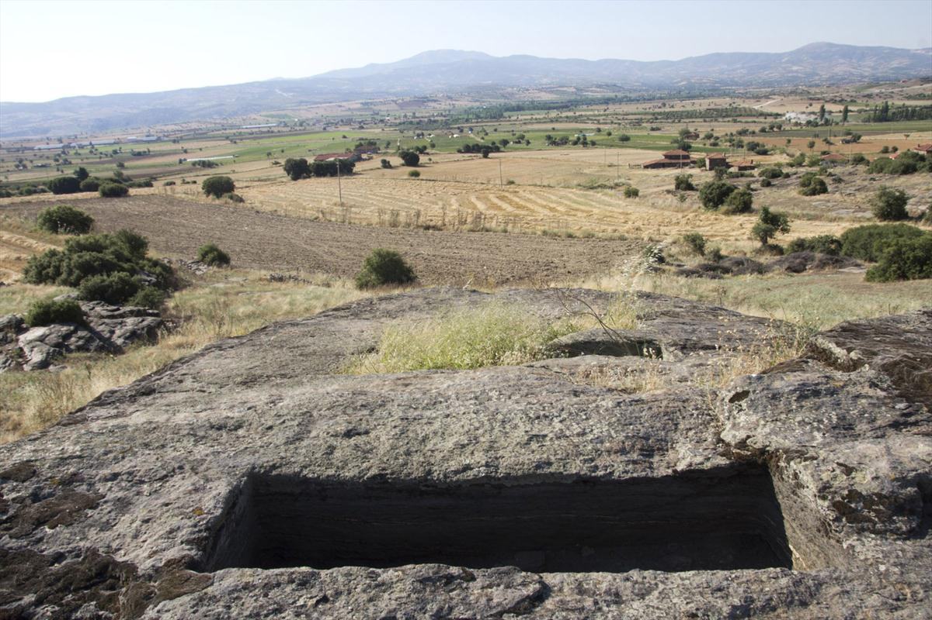
CULTURAL LEGACY
There are more than 500 rock tombs carved into the schist bedrock located in the west of the Hacıhasan and Elekçitepe volcano cones.

Slide 39
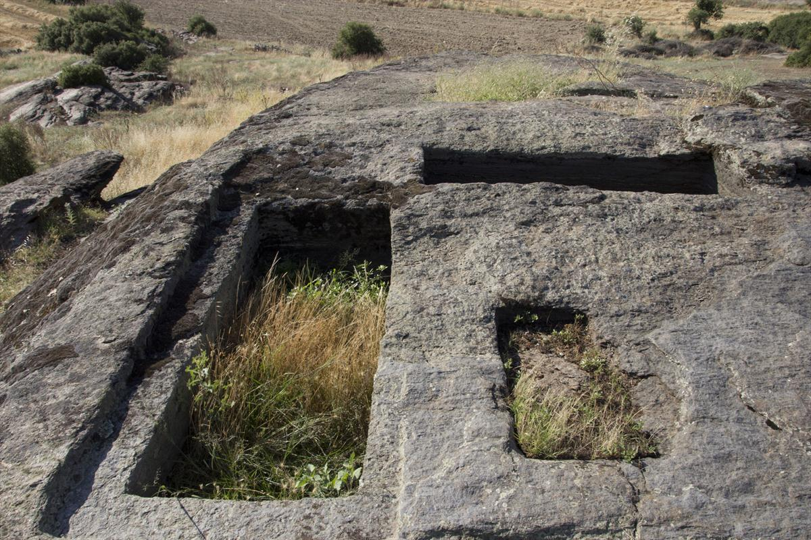
CULTURAL LEGACY
It is understood from the inscriptions and tombs that it was a necropolis belonging to the Late Hellenistic-Roman Periods and a sanctuary worshiped by Zeus, Mother Goddess and Apollon.

Slide 40
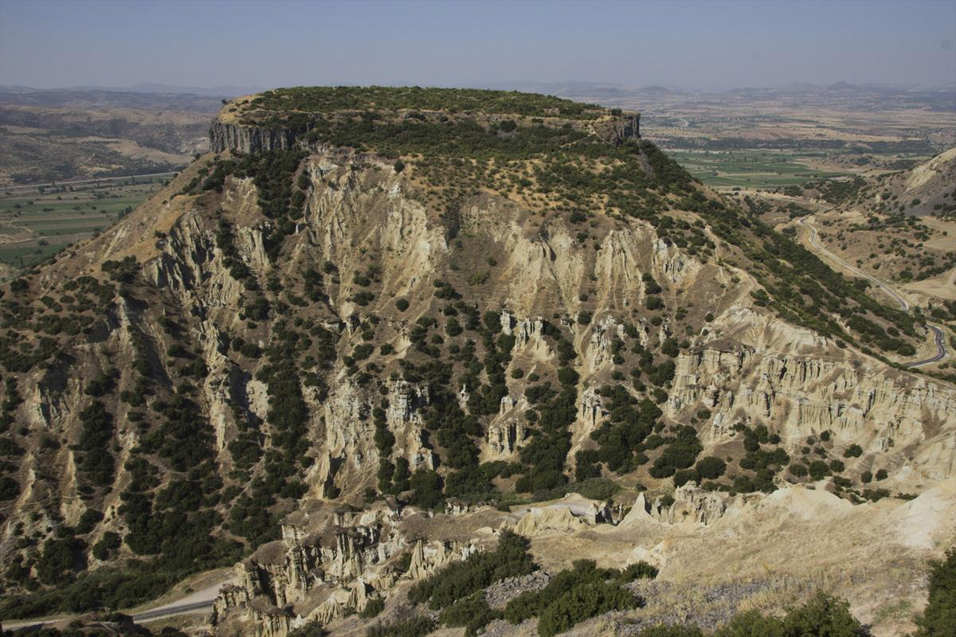
CULTURAL LEGACY
The mountain, which resembles a castle in its natural form, must have attracted the Romans, so that they built the Davala Castle to the top of it.

Slide 41
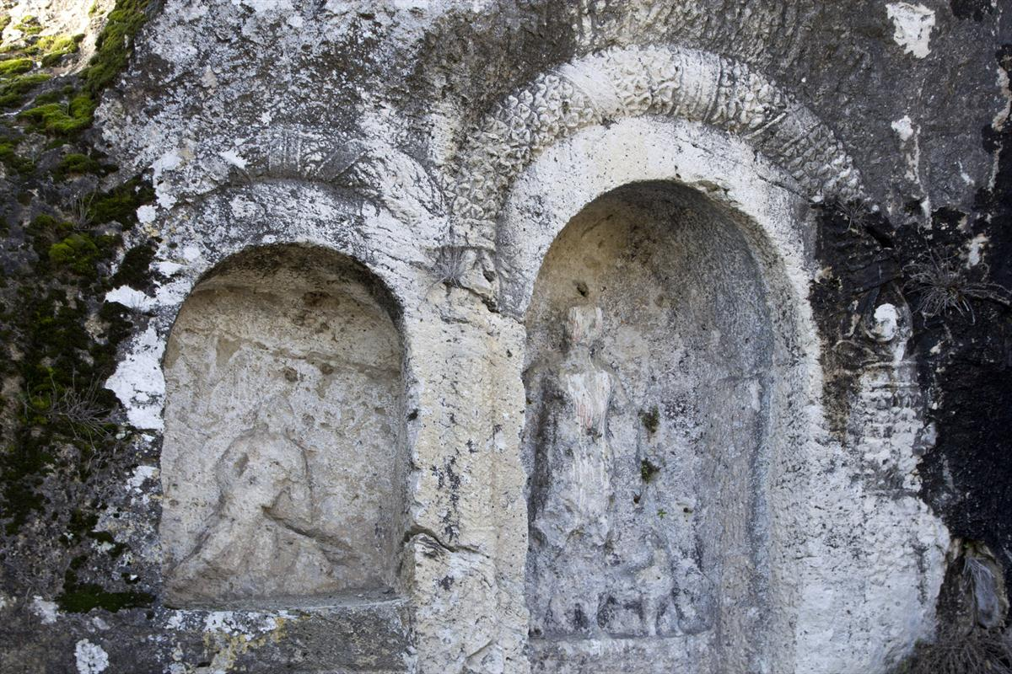
CULTURAL LEGACY
This archaeological site, Emir Hamamları, known as “Thermai Thesos” during the Roman period, was one of the important religious centers of the ancient period.

Slide 42
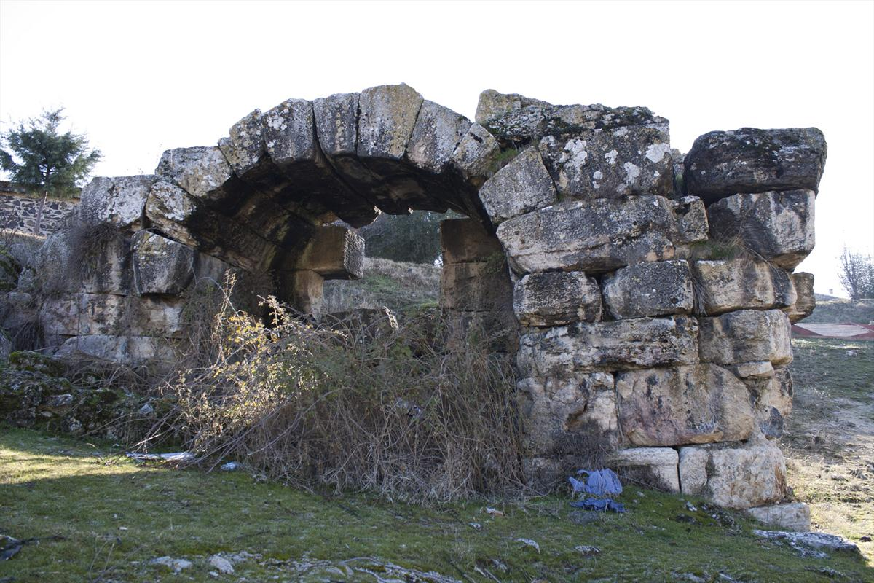
CULTURAL LEGACY
Emir Hamamları

Slide 43
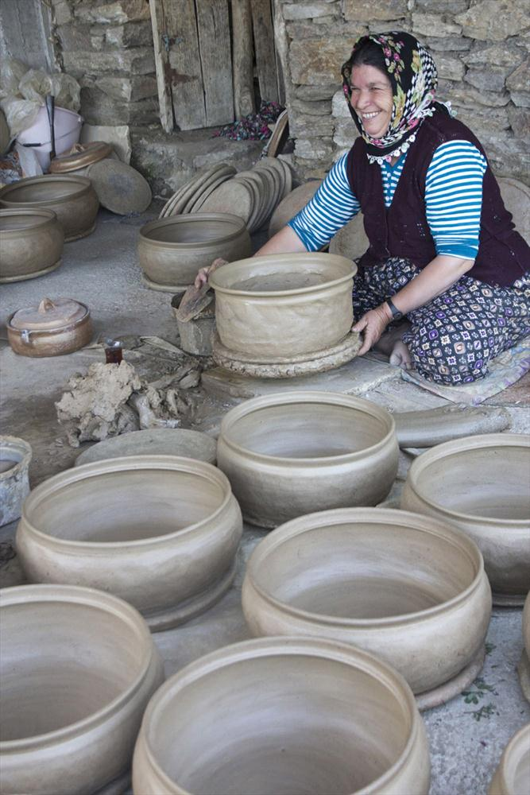
CULTURAL LEGACY
The pottery tradition, which lasted for centuries, is maintained by over 100 households in Gökeyüp.

Slide 44
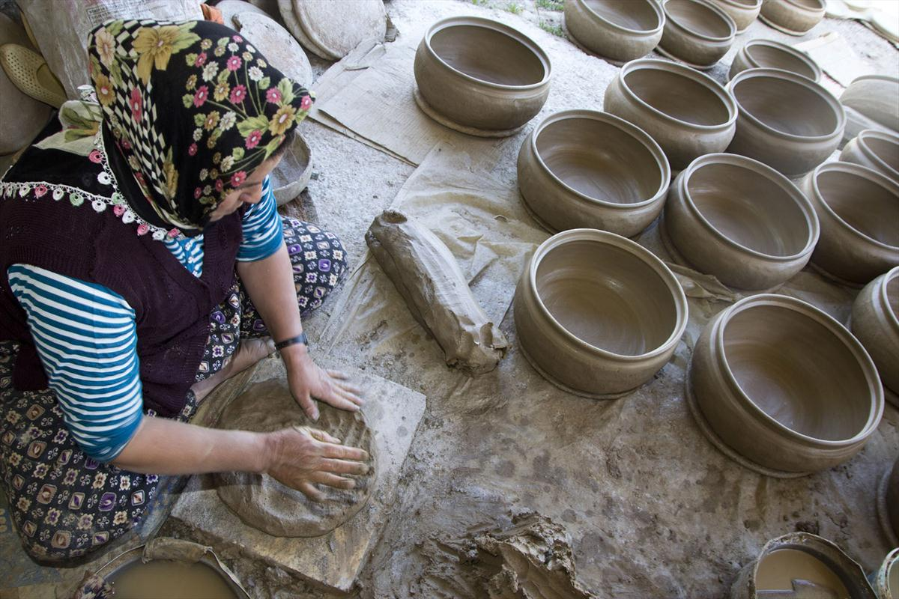
CULTURAL LEGACY
In Gökeyüp, where the old techniques are still used, gum of clay with dough is obtained by grinding the main rock.

Slide 45
KULA GEOPARK UNDER THE LIST OF UNESCO GLOBAL GEOPARKS
On September 4, 2013, Kula Geopark was announced as the Turkey’s first and the only Europe and UNESCO Global Geoparks Network member.

