Slide 1
Erasmus project

Slide 2
How does earth shape OF PEOPLE’S CULTURE IN TERMS OF HOUSING?

Slide 3
LAND FORMS
In geography, we learn land forms with details. But now we can group land forms into 2. These are rugged and straight. There are too many different scenes of land forms in the world.

Slide 4
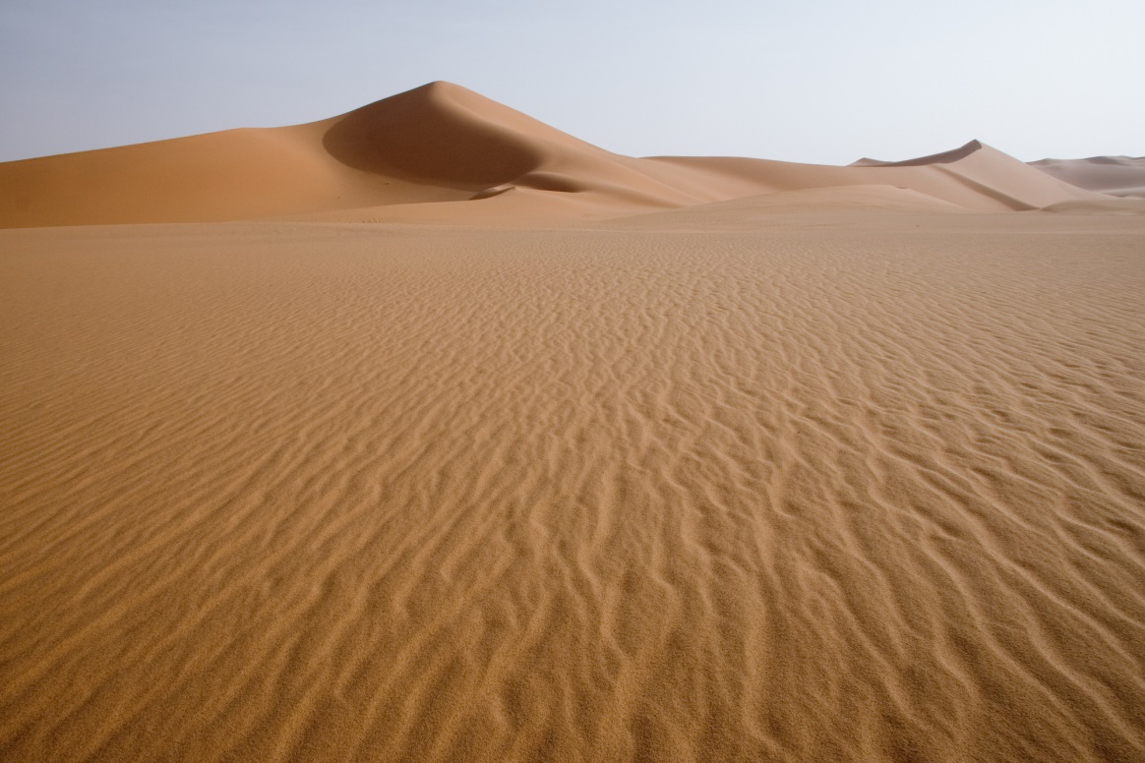
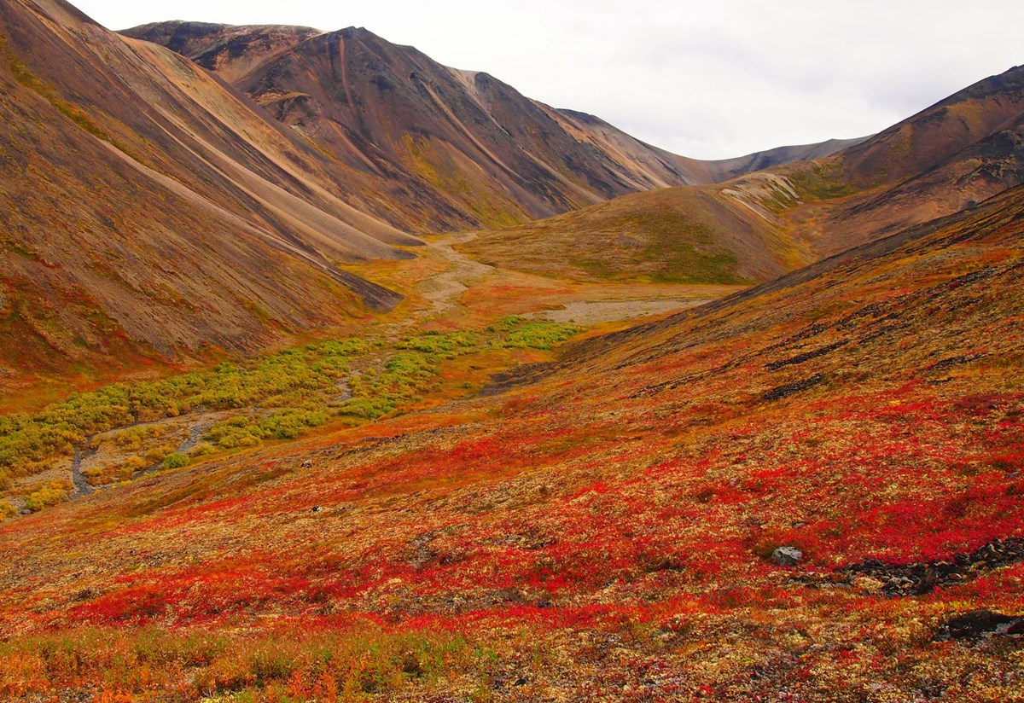
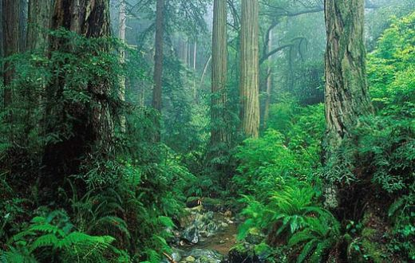

Slide 5
LAND FORMS in Turkey
In the Eastern, South East and Blacksea Regions, land forms are mostly rugged. But in the Eagean, Marmara, Mediterrenian regions, land forms are mostly straight. And it effects architecture. You can understand with looking types of residence in Turkey.

Slide 6
Types of RESIDENCE in Turkey

Slide 7
Wooden houses
Houses built using wood materials.
The windows are thin, the windows are wide, the roofs are tiled and the roof is more sloping and there are several floors.
We can see this type in Blacksea, Eagean and Mediterranean Regions. Mostly there is in countryside.

Slide 8
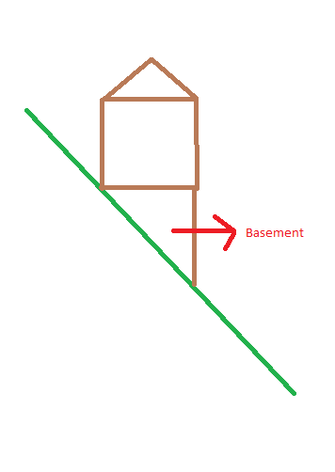
A small note: In the Blacksea Region, land form is rugged and people build house on hillside. When you build house on hillside, you have a skew room under your home. And people of Blacksea use it as basement.

Slide 12
Adobe house
It is not resistant to floods and earthquakes.
The roof is generally flat. It can also be used for summer sleep.
The thick walls prevent the heat entering inside in the summer and also the walls prevent the cold entering inside too much in winter.
We can see this type in Southeast Anatolia and Eastern Anatolia Regions. Mostly there is in moorland.

Slide 14
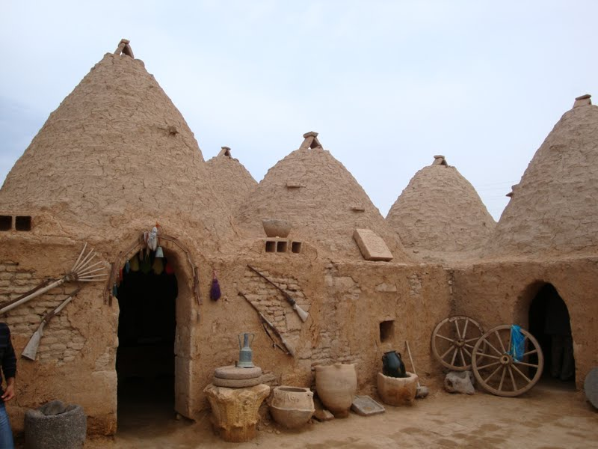

Slide 15
Stone house
Stone has been widely used in almost every region of our country.
It is usually seen in high mountains and highlands.
The roof is generally flat.

Slide 18
Nomadic Houses
They are made from wool, goat hair, felt and camel hair.
It is the shelter of nomadic and semi-nomadic shepherds who usually deal with animal husbandry.
We can see this type in Mediterrenian, Eastern and South East Region.

Slide 21
Our ancestors are nomad and they always move place to place. Nomadic houses are useful for this situation.

Slide 22
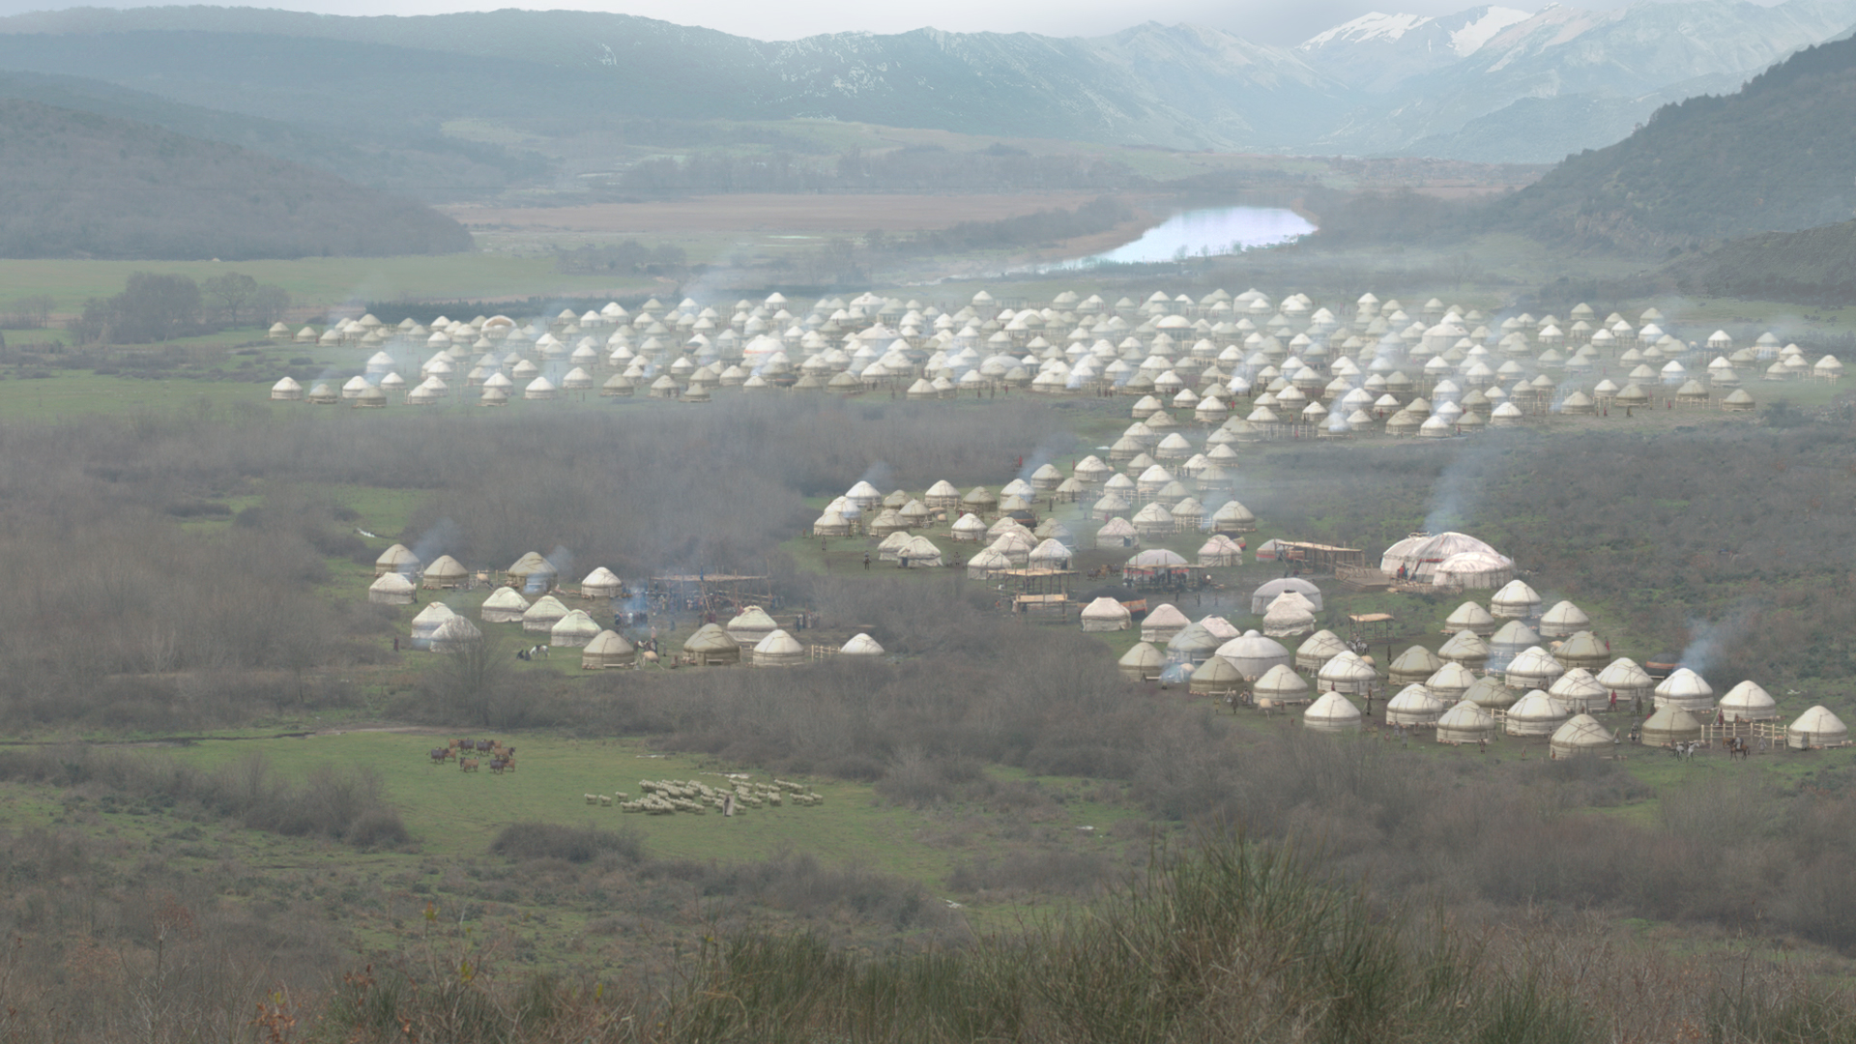
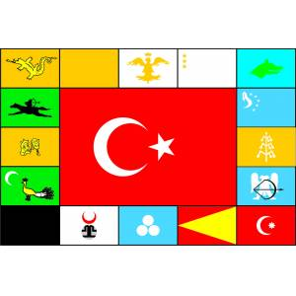

Slide 23
Other Building Materials Used in Dwellings
Brick: It is formed by pouring the lime into molds and drying.
Prefabricated: The basic elements of the house such as walls, roofs, doors and windows are produced in factories and are easily assembled and the construction of the building is completed.
Reinforced concrete: It is a type of building formed with the help of iron and cement. It is common in our cities.

Slide 24
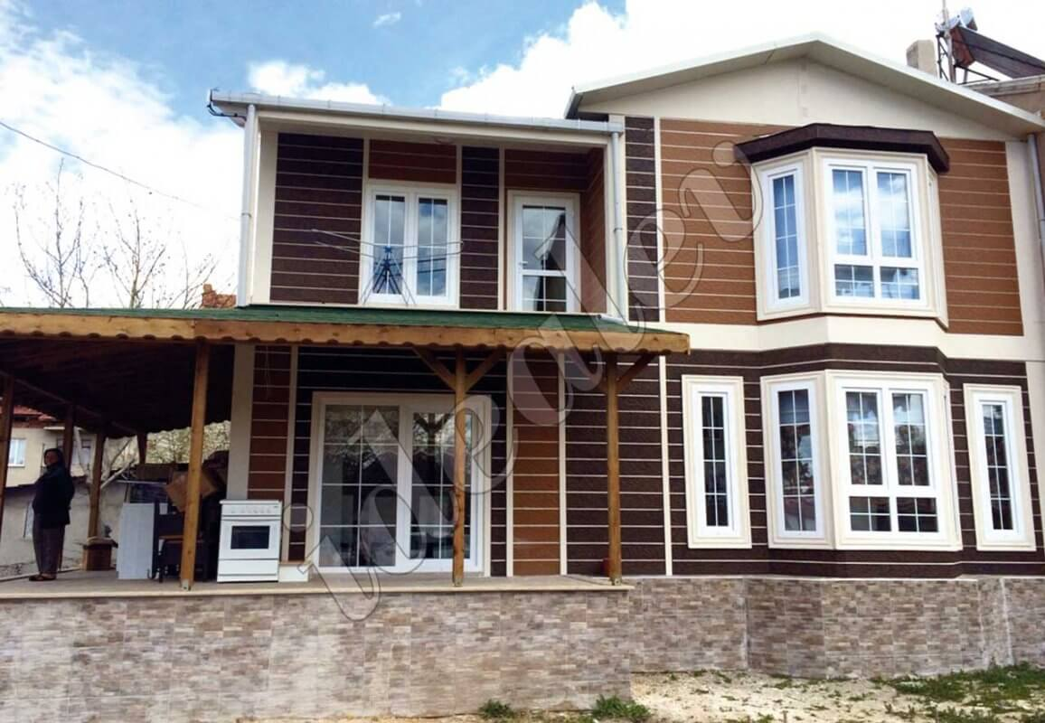
Prefabricated houses

Slide 25
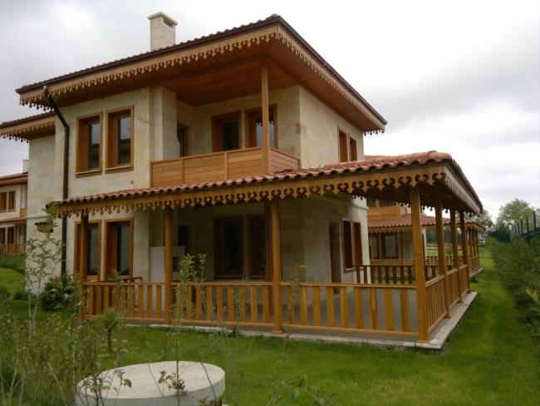
BRICK HOUSES

Slide 27
Extreme CONSTRUCTION: Sumela Monastery
The monastery began to be built in 365 AD and it fınıshed in 30 years. It is in Blacksea Region.

Slide 30
Using earth shapes as house
There are too many fairy chimneys in Nevşehir, Kapadokya, Ürgüp and Göreme. And fairy chimneys can be used like home by ancient people.

Slide 32
Sources
http://cografya.sitesi.web.tr/turkiyede-mesken-tipleri.html
https://www.kulturportali.gov.tr/turkiye/trabzon/gezilecekyer/meryem-ana-sumela-manastiri
https://www.kapadokyadayim.com/peri-bacalari/

Slide 33
Prepared by Mustafa Er,
Thanks for listening

