Slide 1
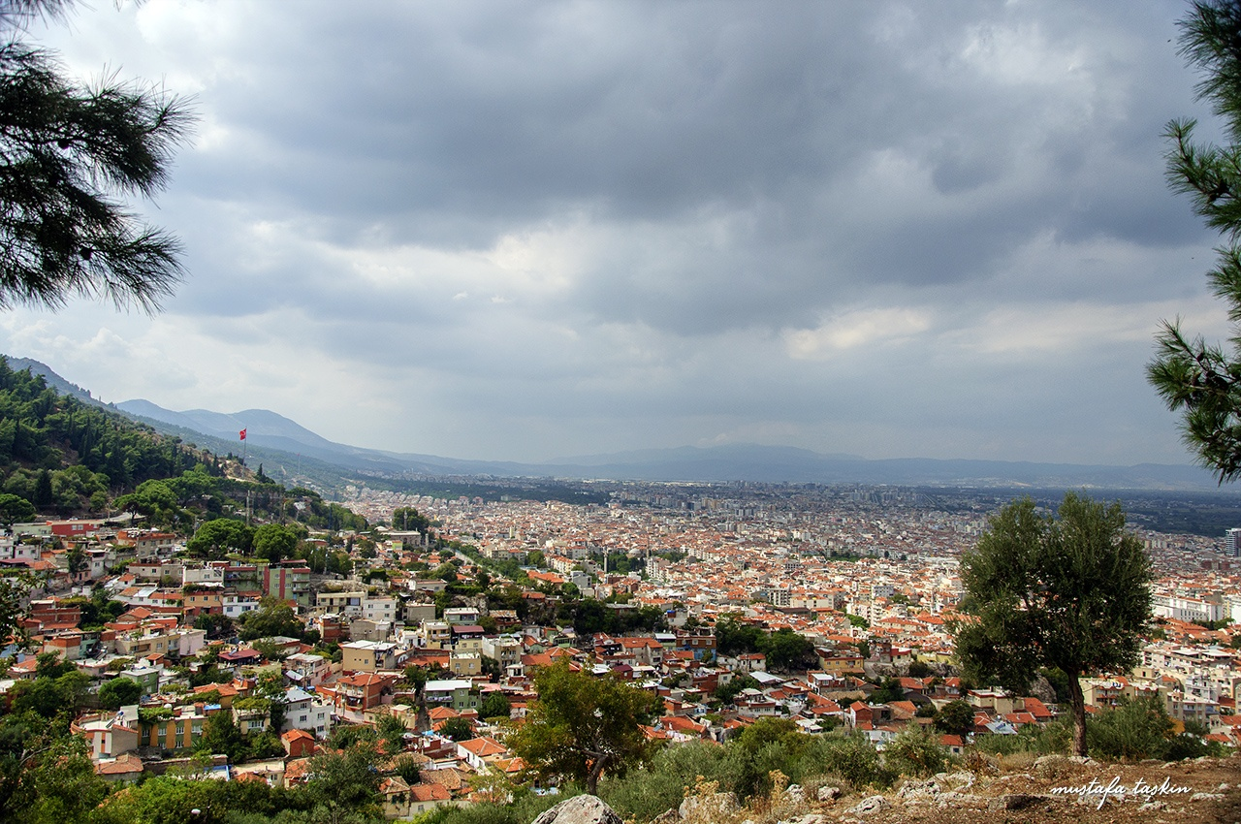
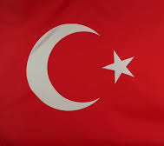
Manisa
Akhisar
Manisa
TURKEY

Slide 2
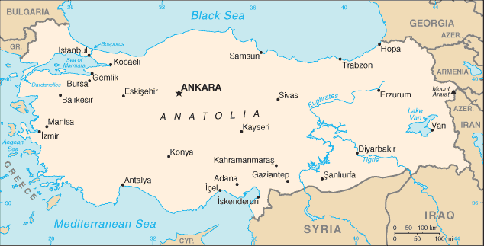
Where is Manisa?
Manisa is situated in the Aegean region of Turkey

Slide 3
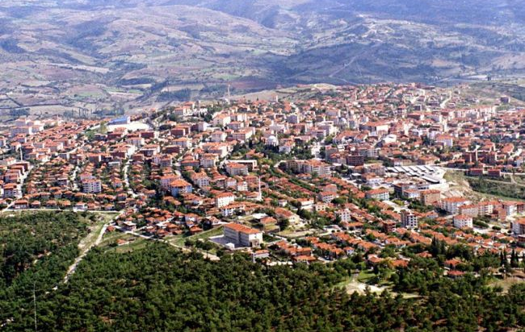
MANİSA
The population of the city is 1.396.945
İn the history of the city it is known Magnesia which means magnetic.-The Mountain Spyl contains lots of magnetic mines -

Slide 4
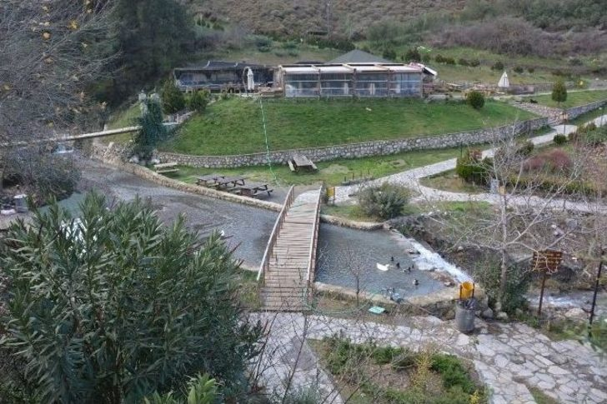
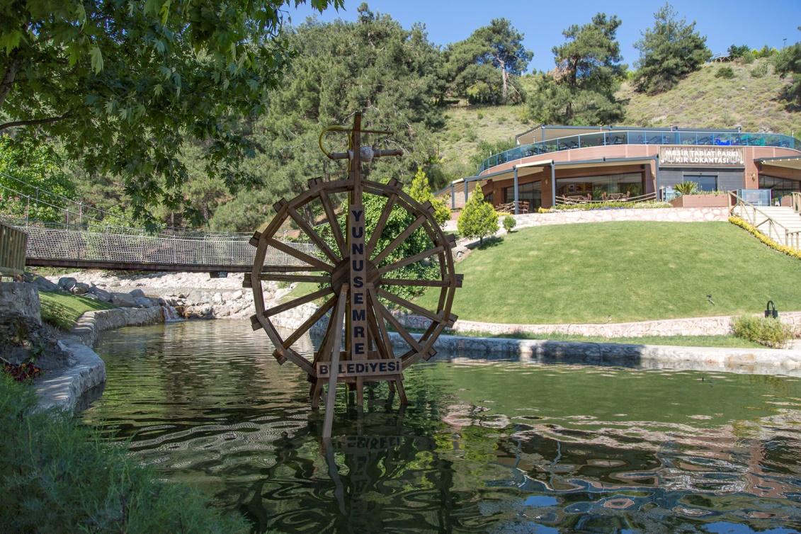
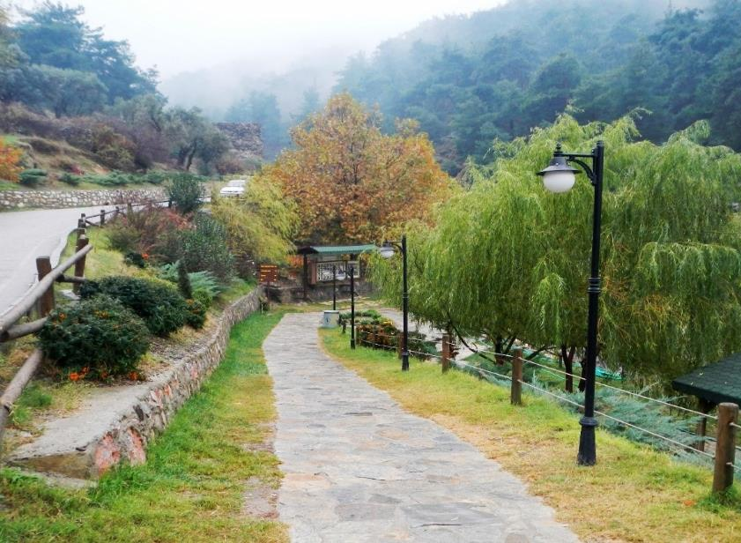
MESİR NATURE PARK

Slide 5
The Weeping Rock in Mount Sipylus, Manisa, Turkey, known as Niobe's Rock, a rock in the shape of a weeping woman, which the ancient Greeks believed to be Niobe.
WEEPİNG ROCK

Slide 6
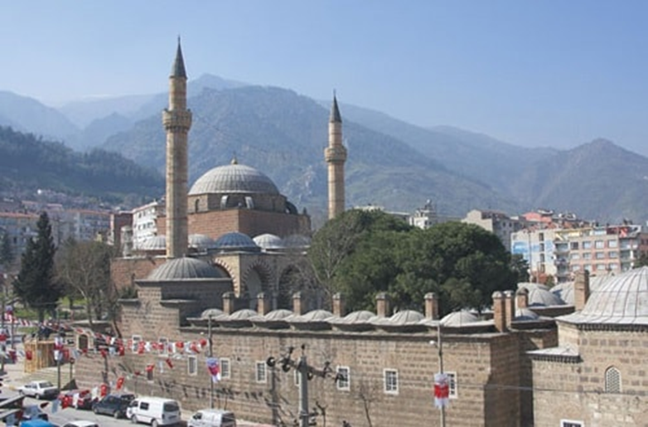
HAFSA SULTAN MOSQUE
The mosque and the adjoining religious complex were built in Manisa by Ayse Hafsa Sultan, the wife of Sultan Selim I and mother of Suleiman the Magnificent in 1522. The mosque complex consists of the mosque, a madrasa, a hospice, an elementary school, a double bath and a hospital.

Slide 7
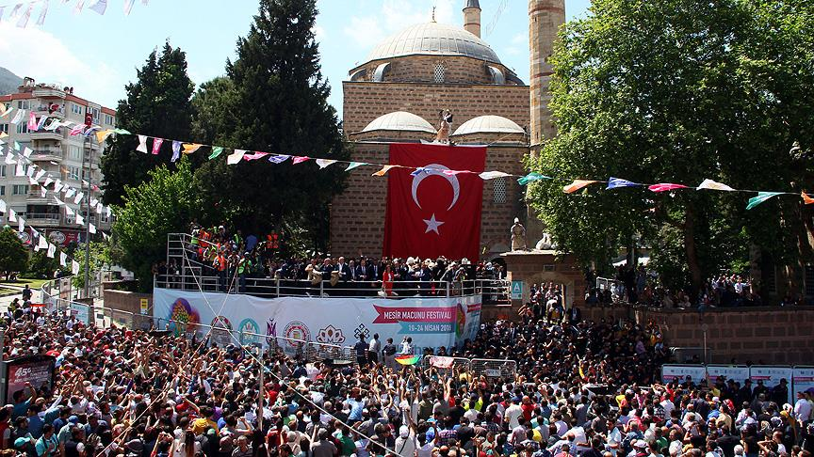
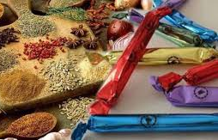
Commemorates the recovery of Hafsa Sultan, mother of Suleyman the Magnificent, who was cured of a disease by the invention of a paste known as Mesir Macunu in Turkish. The Sultan then ordered that the paste be disseminated to the public.

Slide 8
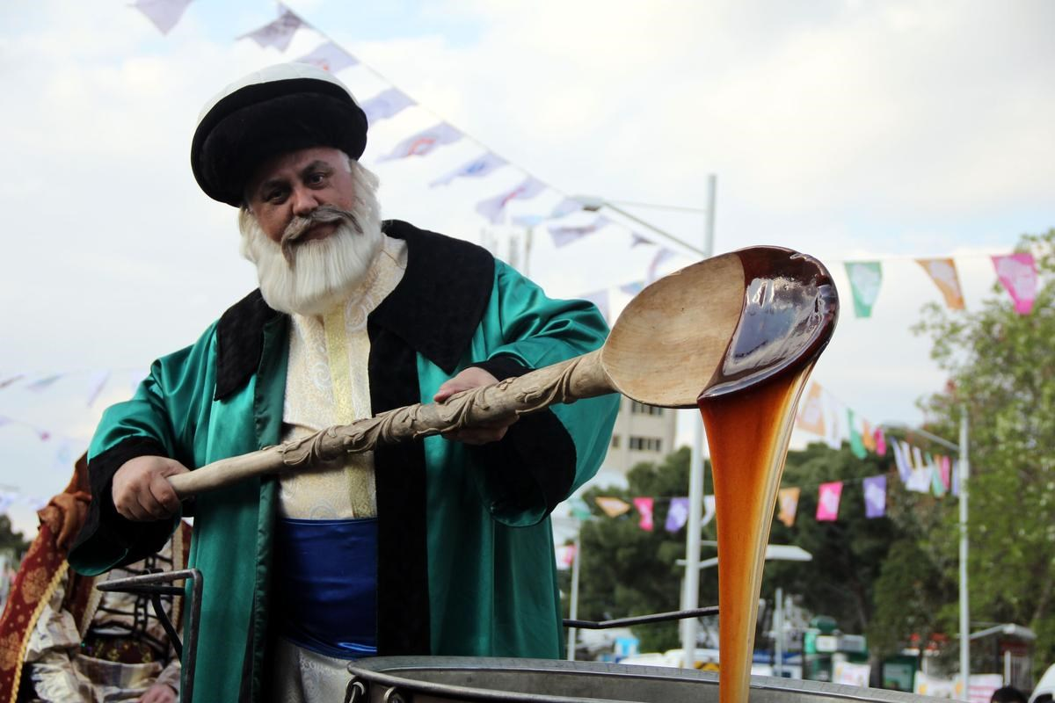
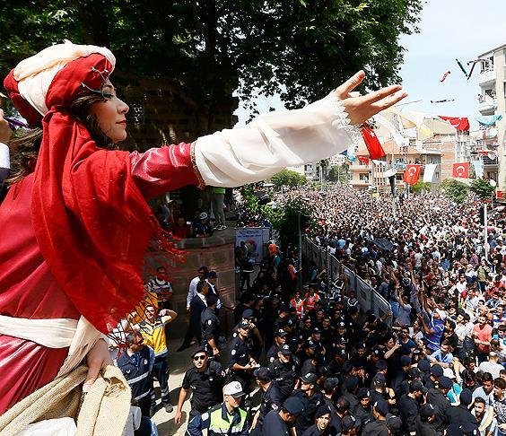
MESIR PASTE CELEBRATIONS IN TURKEY
Mesir Paste Festival is a large scale festival consists of various traditional practices and continues for over 470 years in center of Manisa province in Turkey. Local people of Manisa have a deep emotional attachment to the festival.

Slide 9
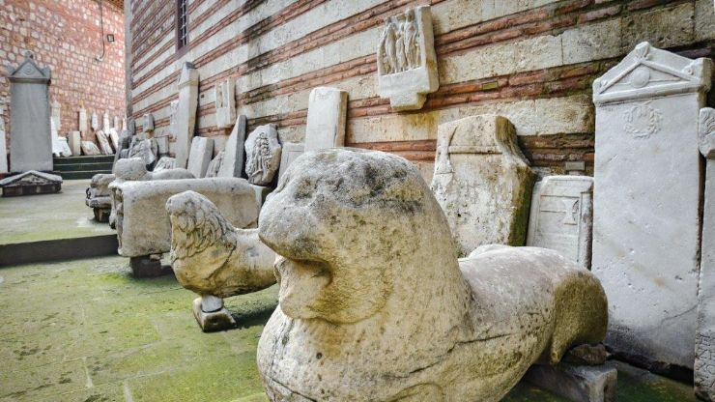
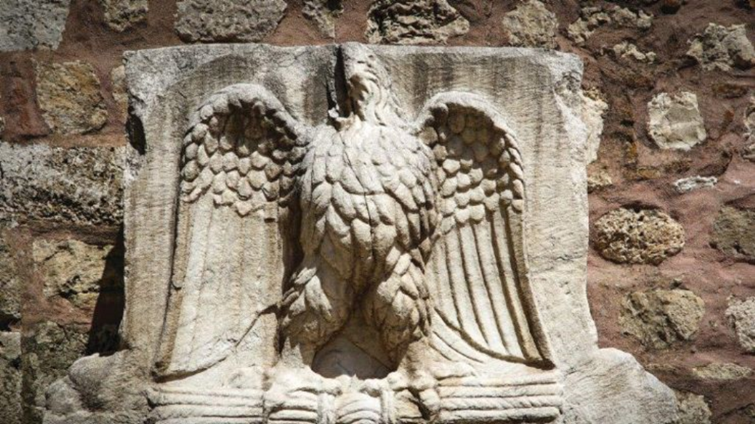
THE MUSEUM OF ARCHEOLOGY
Local and regional artefacts from antique magnesia, sardes-Sardis was the capital of the ancient kingdom of Lydia-and other regional towns are displayed.
Archeological Museum of Manisa is situated in the historic complex of Muradiye Mosque.

Slide 10
GOLET

Slide 11
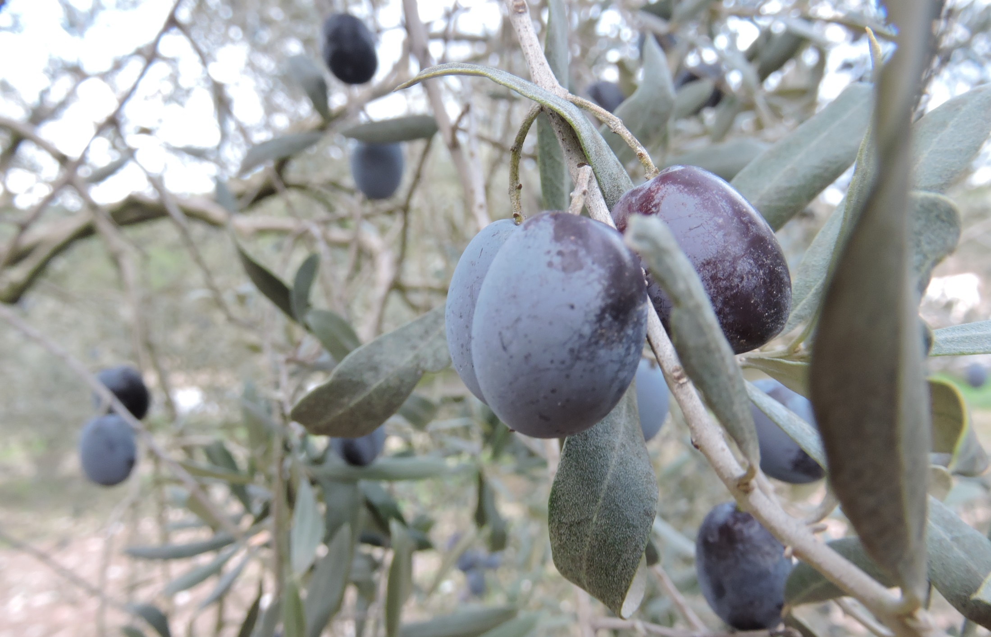
OLİVE FARMING

Slide 12
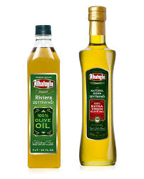
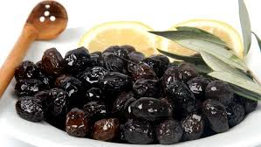
Eceolive and Alhatoğlu are the biggest olive
exporters of Akhisar.
İn Akhisar 5 kinds of olives are grown.
With its 14 million olive tree, and average more than 300
thousand tons of yield, Akhisar is one of the disputed centers in
the world.

Slide 13
THYATEİRA

Slide 14
In early Christian times, Thyateira was home to a significant Christian church, mentioned as one of the seven Churches of the Book of Revelation.

Slide 15
ULU MOSQUE
The old mosque was used as a temple when it was built at the very beggining. When the time of christianity period it was used as a church. By the 14th century it turned into a mosque.

Slide 16
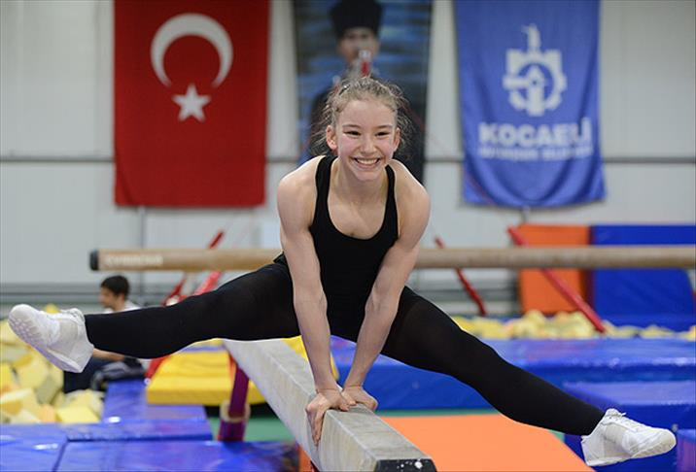
Ayse Begum Onbası
Ayse Begum is a talented athlete who was born in akhisar in 2001. She met with the sport when she was 3.
She started her career with balet. When her talent was discovered by her ballet teacher, she was offered to go in gymnastics.

Slide 17
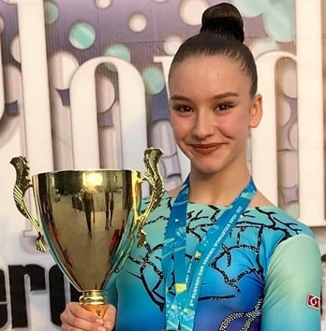
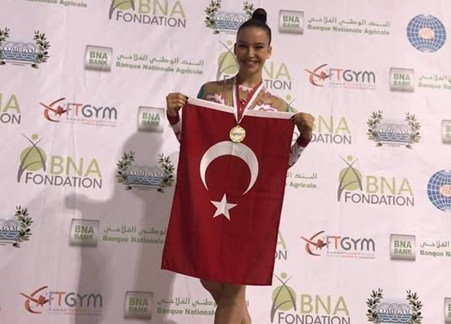
She won her 100th medal when she was only 16.
After she became world champion in 2016 she was the Europe champion in 2017. Determined athlete won gold medal in worldwide in 2018.

Slide 18
REFERENCES
Eceolive.com
Wikipedia.com
Tripadvisor.com
Manisakulturturizm.com

