Slide 1
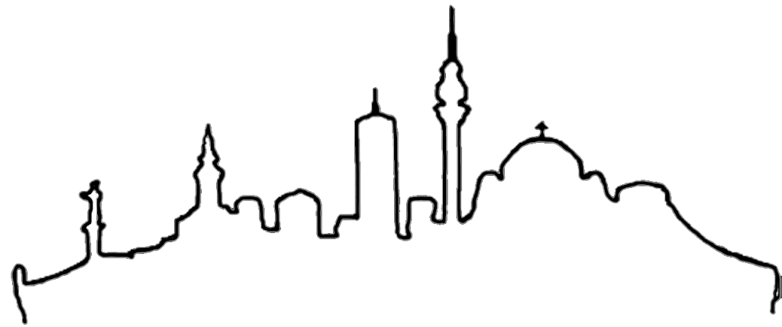
BELGRADE

Slide 2
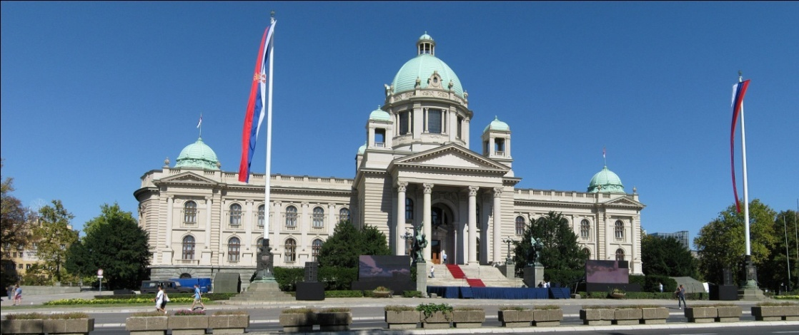
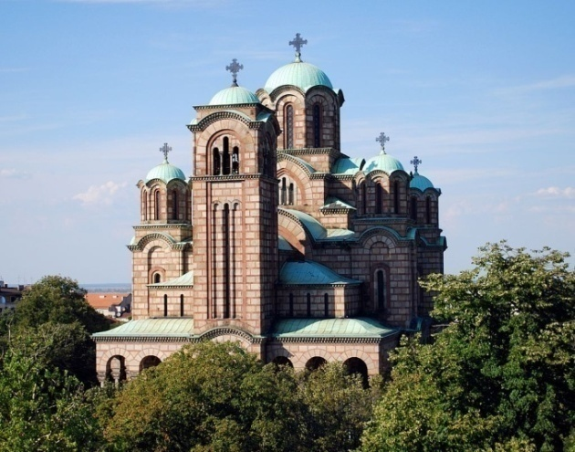
Belgrade is a capital city of Republic of Serbia .
It is the one among the oldest and largest cities in south eastern Europe.

Slide 3
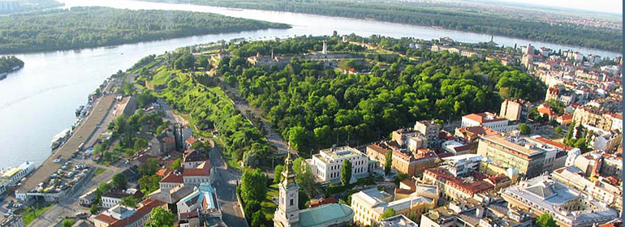
Belgrade is located at the confluence of the Sava and Danube rivers, where the Pannonian Plain meets the Balkans.
The urban area of the City of Belgrade has a population of 1.68 million, while nearly 1.7 million people live within its administrative limits.
Its metropolitan territory is divided into 17 municipalities, each with its own local council.

Slide 4
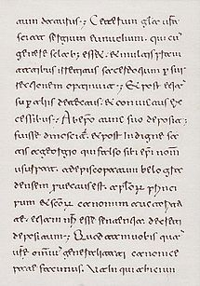
The name Belgrade (Bjelgrad, Belograd), was mentioned for the first time in the letter of Pope John VII to the Bulgarian prince Boris on April 16, 878.(10th row)

Slide 5
Belgrade hosts many annual international cultural events :
FEST - film festival held from 1971
BITEF - international theatre festival
Belgrade Days - official Belgrade holiday that covers Day of Open Theatres, Night of Museums, Fair of old Crafts, various concerts, exhibitions and sports events.
SINEMANIJA - movie festival
Belgrade Book Fair
BELEF – music and artistic performances
Belgrade Jazz Festival
BEMUS – festival of classic music, opera and choirs
Belgrade Beer Fest – festival of drink and known rock and pop bands
Bgd Foam Fest – festival of world known DJs

Slide 6
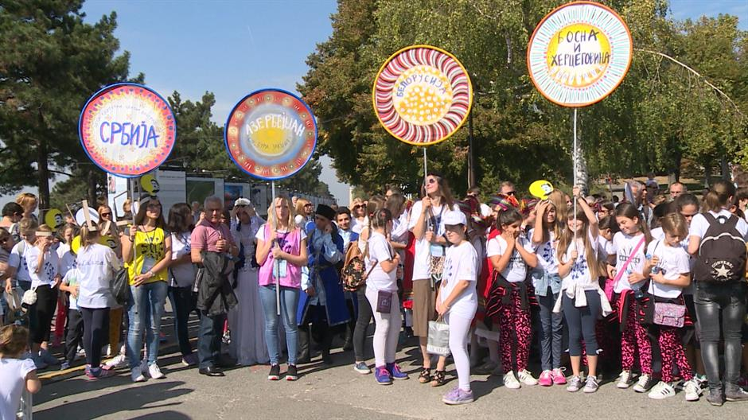
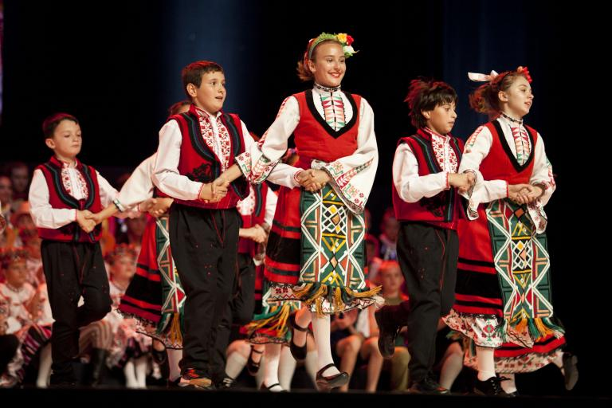
The Joy of Europe is a European dance festival with a long tradition.
The Joy of Europe festival started in 1969 and has been held every year since. The founder of the festival is the City of Belgrade, which together with the Belgrade Children's Centre organises the event.
The festival aims to bring together children from across Europe through song and dance by showcasing their own cultures and customs.

Slide 7
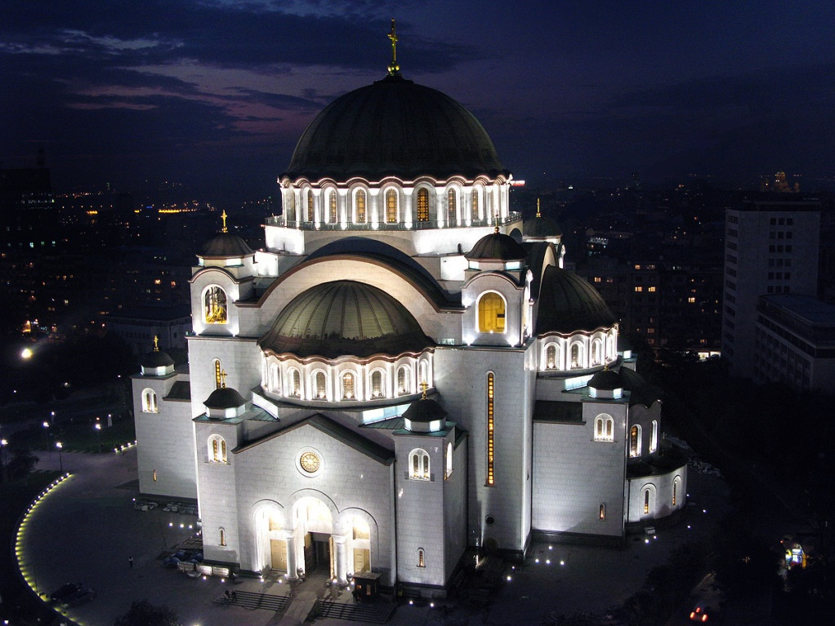
The Church of Saint Sava is a Serbian Orthodox church located on the Vračar plateau .It is one of the largest Orthodox churches in the world and ranks among the largest church buildings in the world.

Slide 8
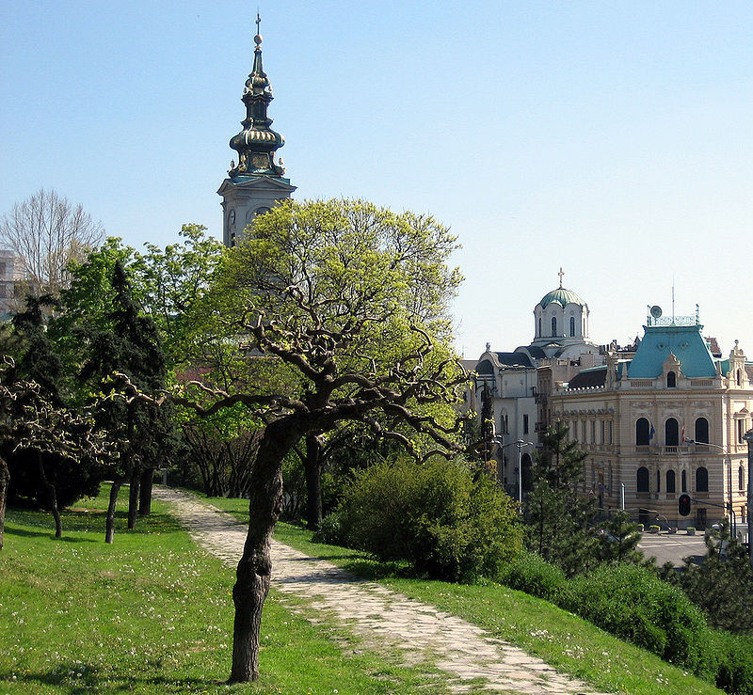
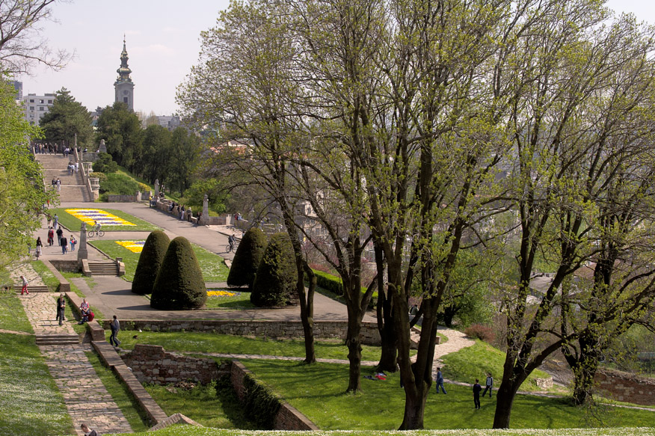
Kalemegdan, is the largest park and the most important historical monument in Belgrade. It is located on a 125-metre-high cliff, at the junction of the River Sava and the Danube. Its name is formed from the two Turkish words: "Kale" (meaning "fortress") and archaic word of Turkish origin ”megdan” (meaning "battlefield").
Belgrade Fortress and Kalemegdan Park together represent a cultural monument of exceptional importance.

Slide 9
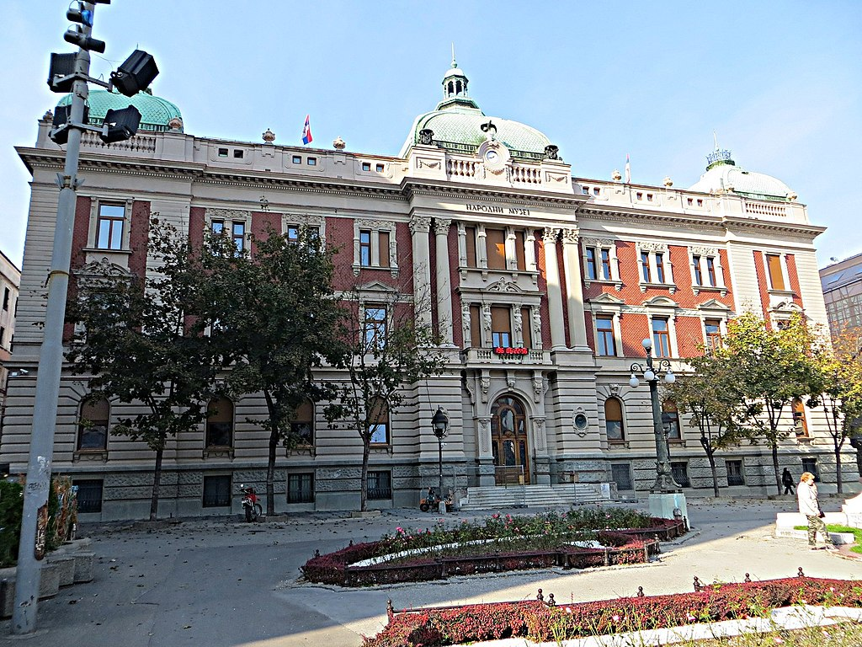
Belgrade has many Museums:
National Museum is the oldest and the most significant museum in Serbia. Founded in 1844,it has 34 archeological, numismatic, artistic and historical collections .
Museum of Applied Art
Ethnographic museum
Natural History Museum
The Fortress of Belgrade is a museum of the past of Belgrade. It had been developing from period from 1st to 18th century.

Slide 10
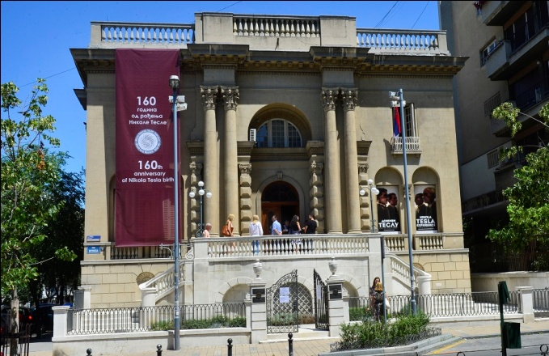
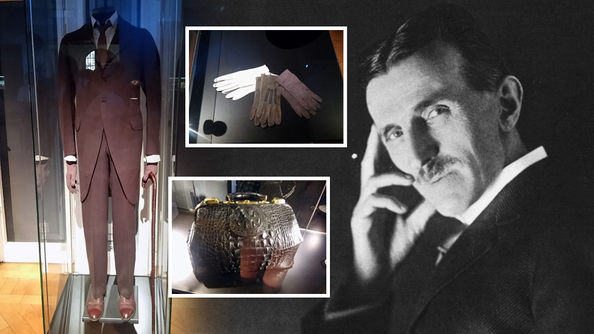
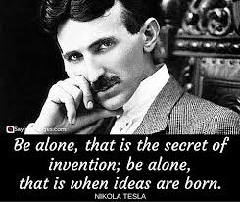
Museum of Nikola Tesla is the only museum in the world which treasures complete inheritance of the biggest Serbian scientist and inventor.

Slide 11
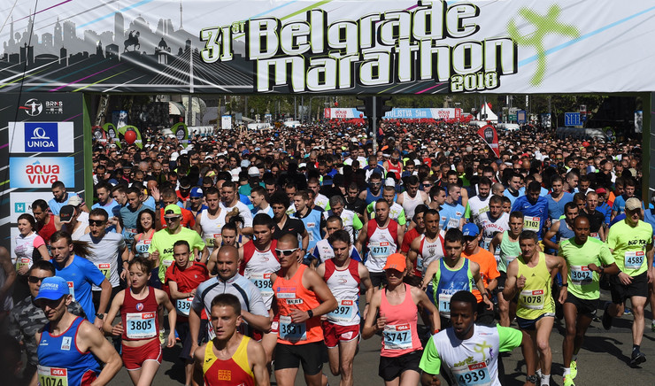
The Belgrade Marathon is held annually since 1988. It is one of the biggest sporting events in Serbia.
Belgrade Marathon is adapted for people of all ages, and is separated into the following categories:
The Kids Marathon is a race for children.
The Fun Run is the event with the most participants (5 km)
The Half-marathon is a half-distance marathon that is in accordance with world standards.
The Marathon is a standard 42.195 km length marathon

Slide 12
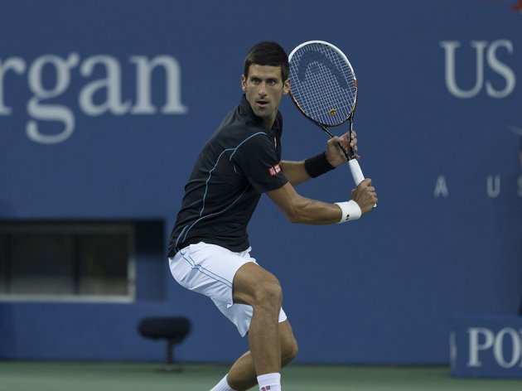
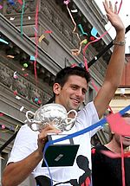
Novak Djokovic is Serbian professional tennis player. He has won 12 Grand Slam singles titles, five ATP Finals titles, 30 Masters 1000 series titles, 12 ATP World Tour 500 tournaments, and has held the No. 1 spot in the ATP rankings for a total of 223 weeks. In 2016, he became the eighth player in history to achieve the Career Grand Slam. Following his victory at the 2016 French open, he became the third man to hold all four major titles at once, the first since Rod Laver in 1969, and the first ever to do so on three different surfaces. Given these achievements, Djokovic is considered one of the greatest tennis players of all time.

Slide 13
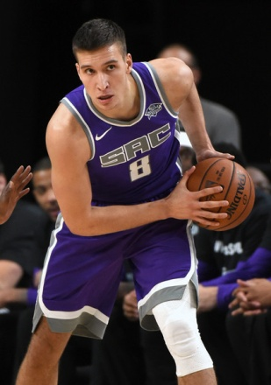
Bogdan Bogdanović is a Serbian professional basketball player for the Sacramento Kings (NBA). He also represents the Serbian national basketball team. He was named the 2017 All–Europe Player of the year.
Filip Filipović is a Serbian water polo player. He is one of the best players in the world ( voted as the male water polo "Athlete of the Year" in 2011 and 2014).

Slide 14
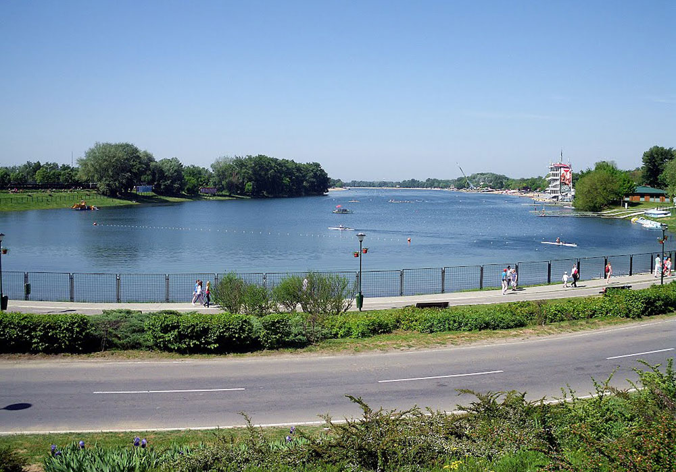
Belgrade has got plenty of places for rest and relaxing, adventure and entertainment.
Ada Ciganlija lake is one of the most favourite resorts

Slide 15
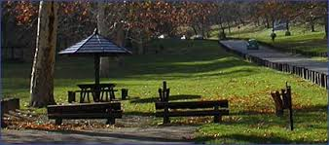
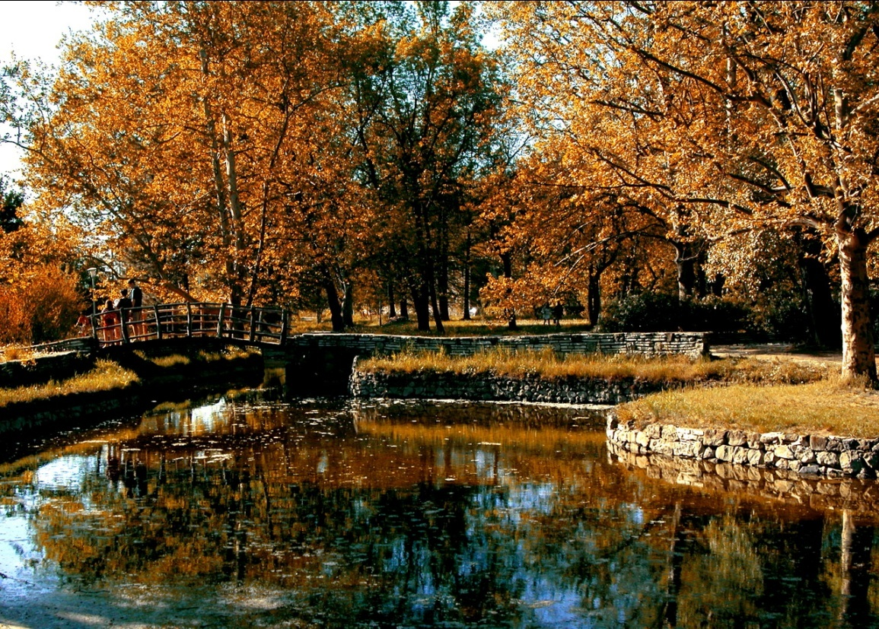
Košutnjak is famous park and resort spreading on the area of 330 hectares. Clean air, running path, a sport centre with swimming pools, and mini golf course attracts people .
Topčider is one of the most beautiful parks in the city.

Slide 16
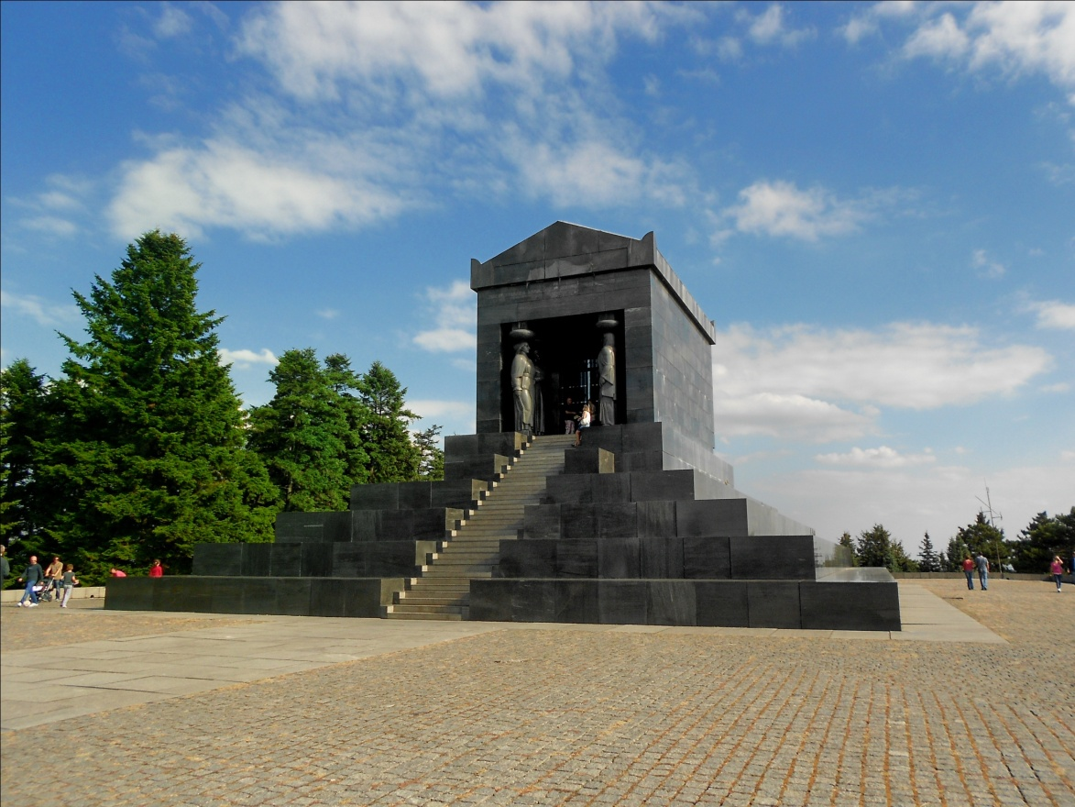
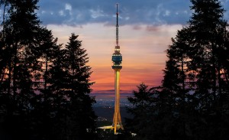
Avala mountain is about 20km away from Belgrade. It is covered by deciduous and larch forest. On the top of the mountain is a mausoleum, A Monument to an Unknown Hero, dedicated to the heroes from the World War I.
The trademark of Avala, and Belgrade itself, is Avala Tower (204.75m high).

Slide 17
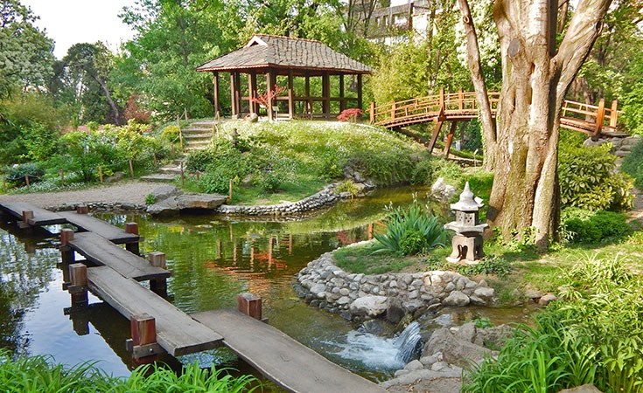
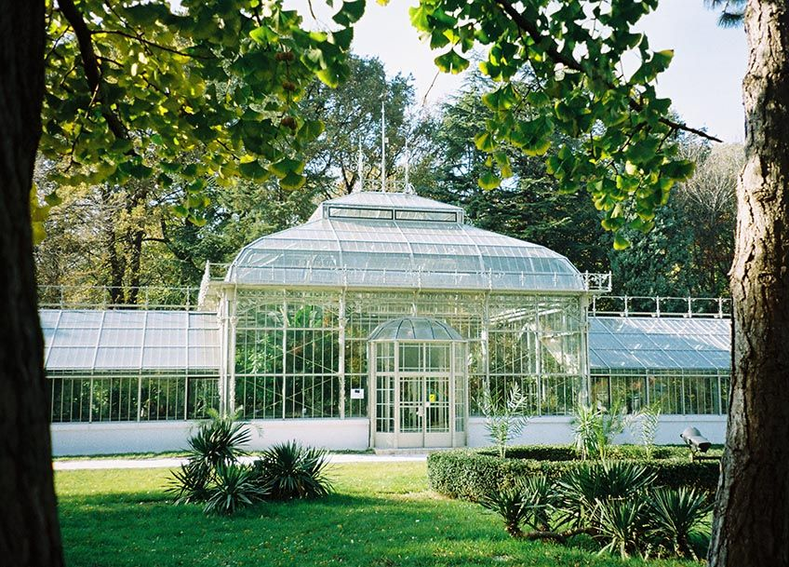
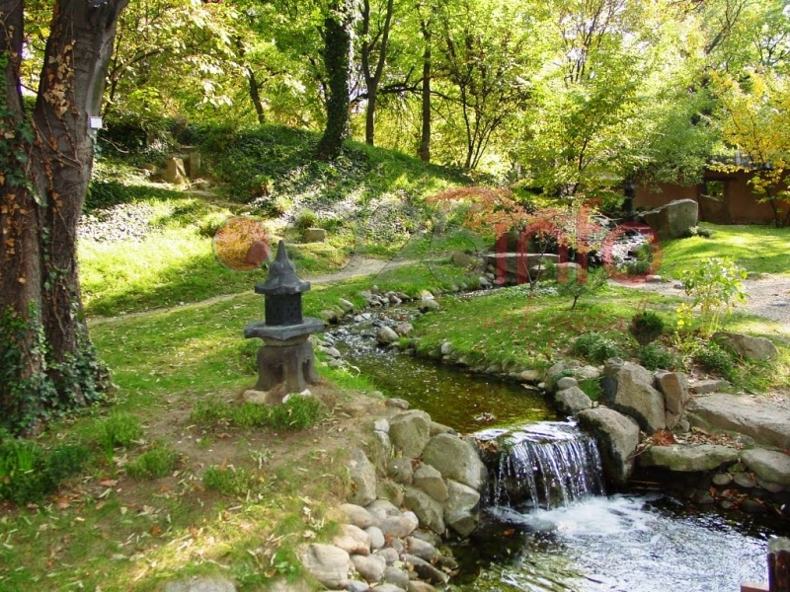
Botanical garden “Jevremovac” is located in the very center of Belgrade. It is founded in 1874, and spreads in the area of 5 hectares.

Slide 18
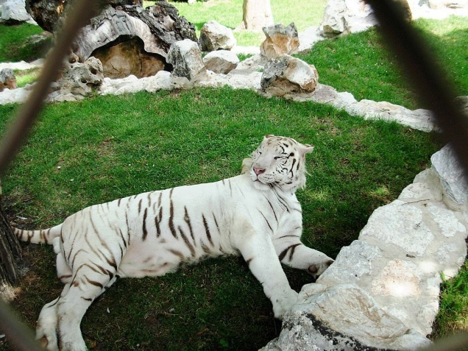
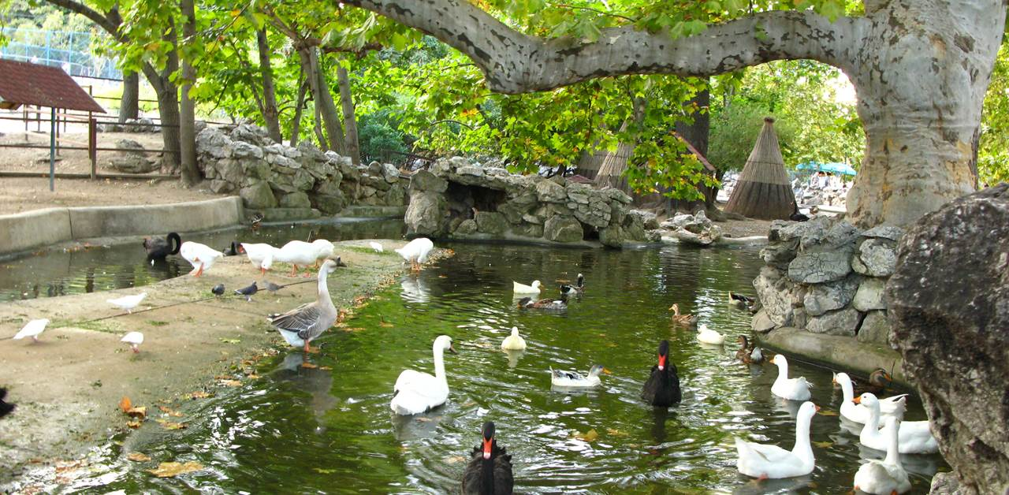
Beo zoo is a zoo located in Kalemegdan Park. It was founded in 1936 and is one of the oldest zoos in Europe.
The zoo covers an area of about 7 hectares, and has about 1,700 animals representing amore than 150 different species. It holds domestic as well as exotic wild animals.

Slide 19
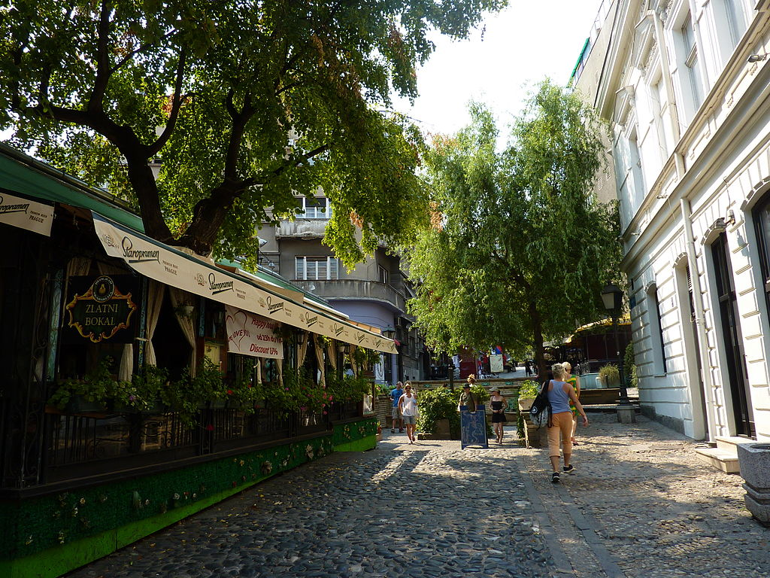
Skadarlija is a vintage street, generally considered the authentic bohemian quarter of Belgrade, similar to Paris‘s Montmartre.
It includes well-known restaurants, art galleries, antique and souvenir shops, and the Sebilj fountain. Groups playing Serbian brass or traditional urban music and actors dressed in traditional Serb costumes perform down the street.
Skadarlija is known as a place visited by young couples and entire families with children.

Slide 20
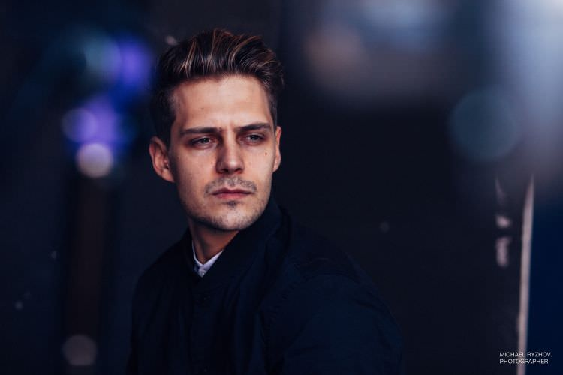
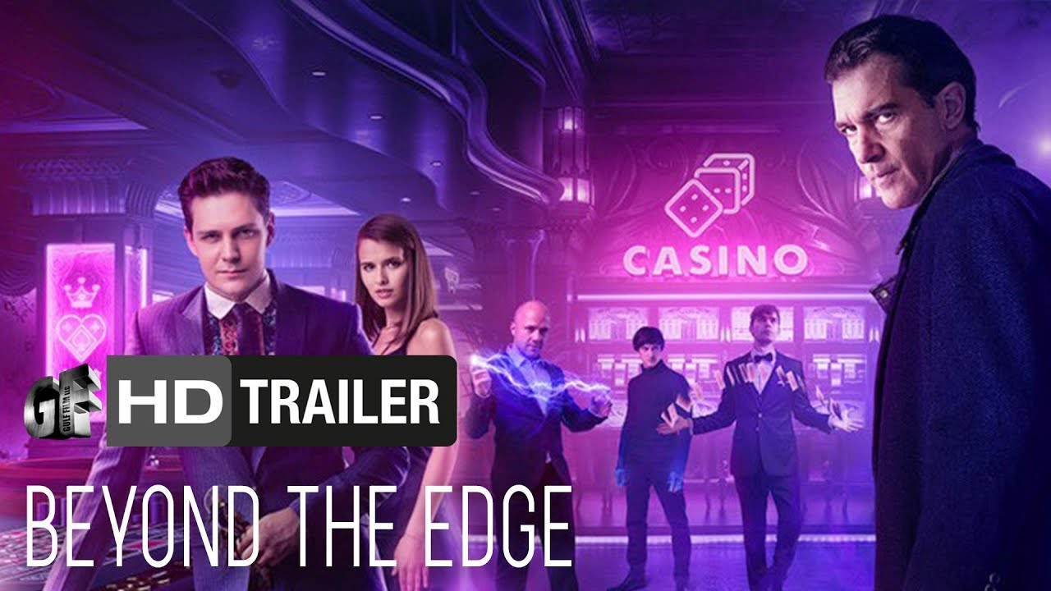
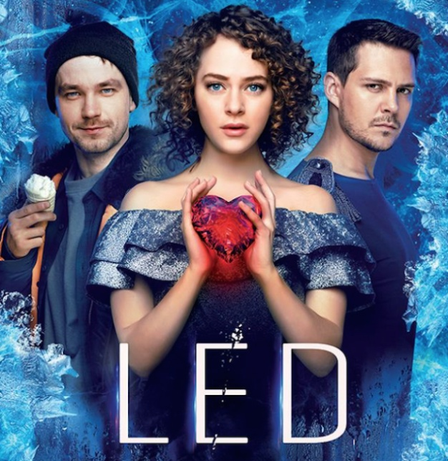
Miloš Biković is a Serbian actor and model. He is currently pursuing international career, making films in Russia with famous stars like Antonio Banderas.

Slide 21
The beauty of our city is in the smiles of people, their warmth and sincerity, and open heart.
Belgrade is our home town, and we are proud to present a small part of its greatness to you.
We invite you to visit us , and see for yourselves unique charm of Belgrade.

