Slide 1
Our school is the best choice ! Let’s see why ☺

Slide 2
We have four great classes :
IA - this class is for fans of Mathematics Informatics and Physics. We cooperate with the Academy of Young Artists and the Polish Information Processing Society. The students of this class take part in IT workshops in the Tatras and Pieniny Mountains where they can get engaged in robotics classes, website development or programming.
It is a very good choice for people who connect their future with Polytechnic faculties.

Slide 3
IB - there are fans of Mathematics Geography and English who can choose studies connected with economics, banking, marketing, hote management.
Being in this class, you have the chance to take part in various interesting geographic lectures, meet famous travellers who share their passion for adventures and knowledge about the world or visit The Stock Exchange in Warsaw

Slide 4
IC – this class brings together enthusiasts of science subjects : Chemistry and Biology. In the future you might consider studying chemistry, medicine, ecology, pharmacy or other natural sciences.
Students take part in field classes and outdoor workshops in Rogów, Białowieża Forest and Pieniny National Park. In cooperation with the Medical University and the Technical University of Lodz, students participate in workshops conducted by the employees of these universities. Students organize nature forums and participate in subject competitions.

Slide 5
ID -this class is a humanistic profile. There is a place for lovers of the Polish language, history or humanities in general. Are you interested in literature or maybe law ? This class will suit your needs.
Students of this class have the opportunity to publish their own texts in the school newspaper and a local newspaper. They take part in lectures and workshops organized by universities as well as in legal and journalistic education.

Slide 6
Interesting events in our school ?
BUDA – it means „Bardzo Udany Debiut Artystyczny” (A very successful artistic debut☺)
This is a school competition for the best artistic performance. Our classes compete with each other in this spring festival on the first day of spring. Instead of playing truant (which is a tradition on this day in Poland) they prepare a show in which they present their artistic talents. Each edition has a different theme. This year's edition focused on the films' classics. This is a cool event that allows you to get to know each other better and overcome your shyness.

Slide 7
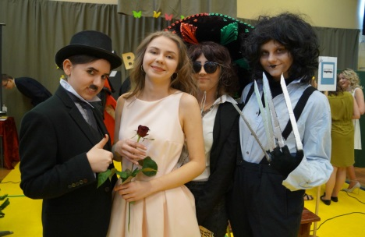
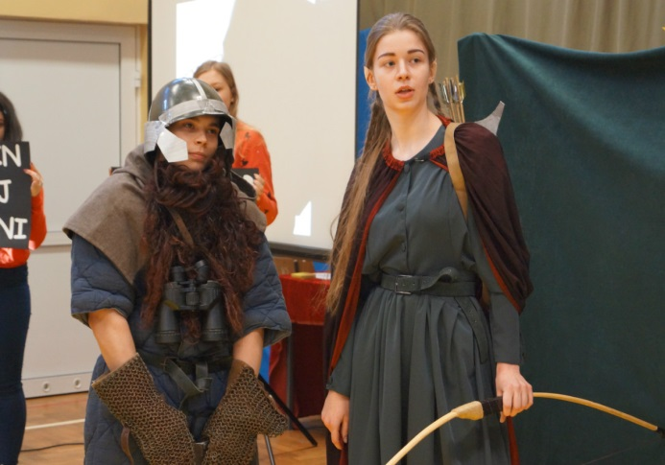
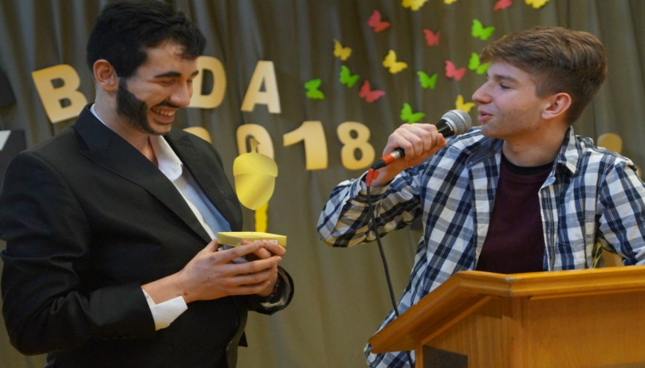
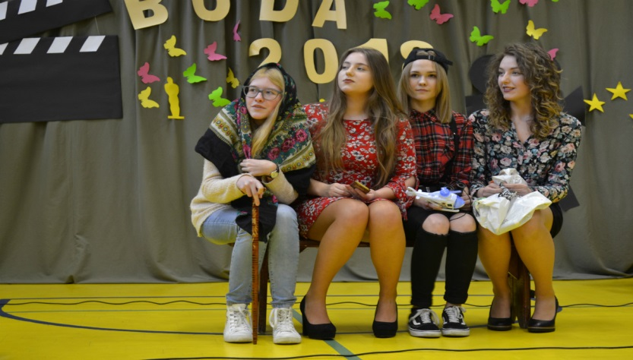
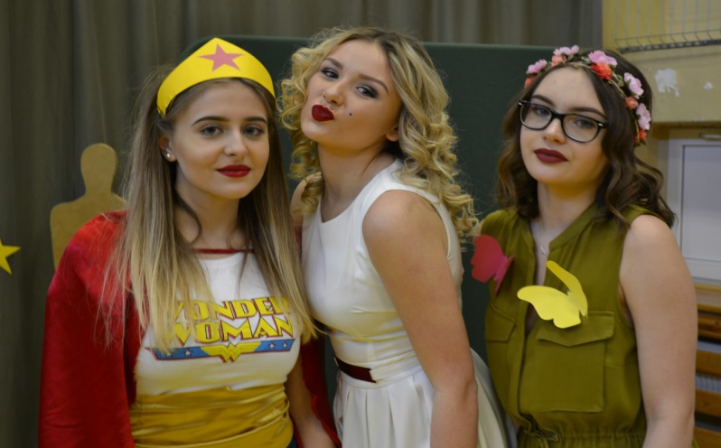
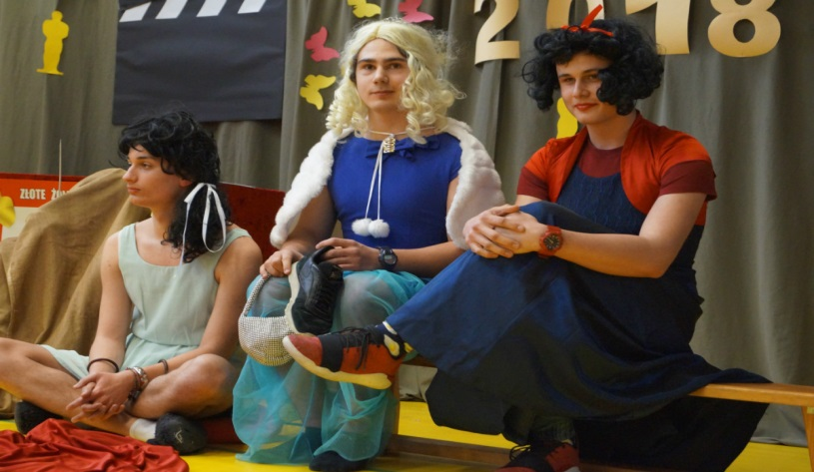
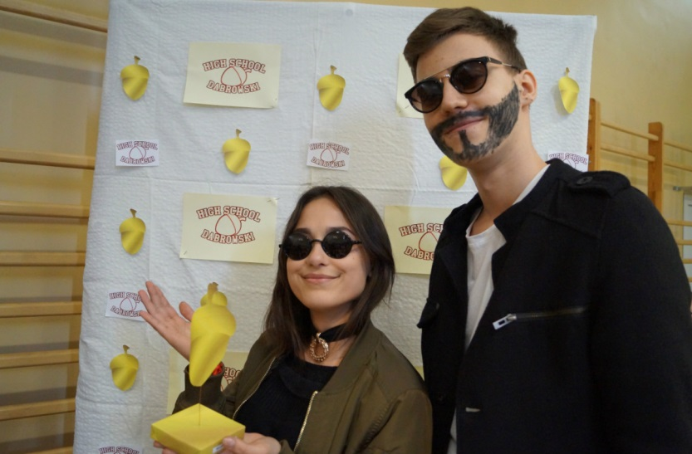
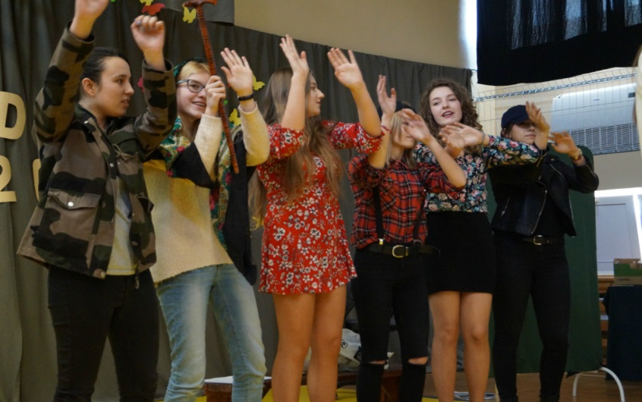

Slide 8
HEŃKI
The tradition of our school is that during the National Education Day there is a Henki gala(the name of the award comes from the middle name of the school patron), that is, the ceremony when the awards are given by pupils to teachers in many categories related to their style of behaving or teaching. Students want to show that they appreciate the teachers for their sense of humour.

Slide 9
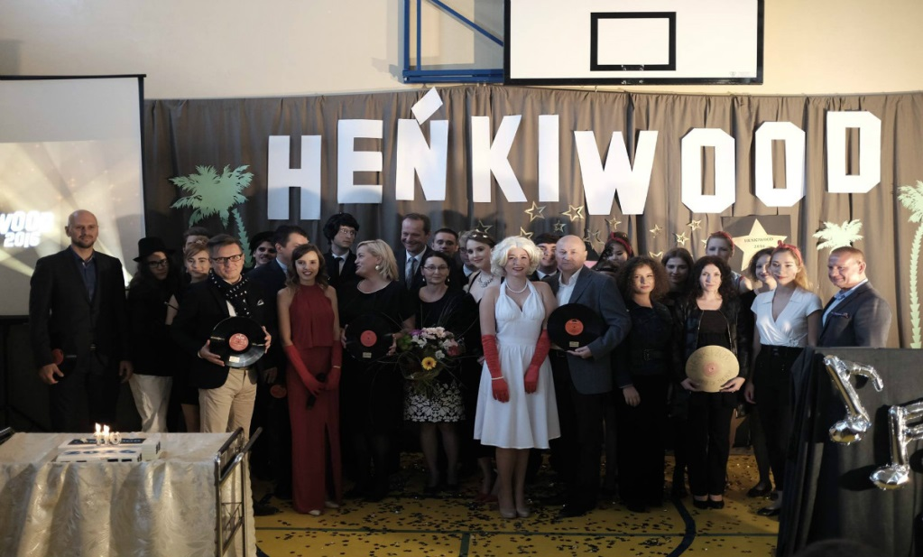
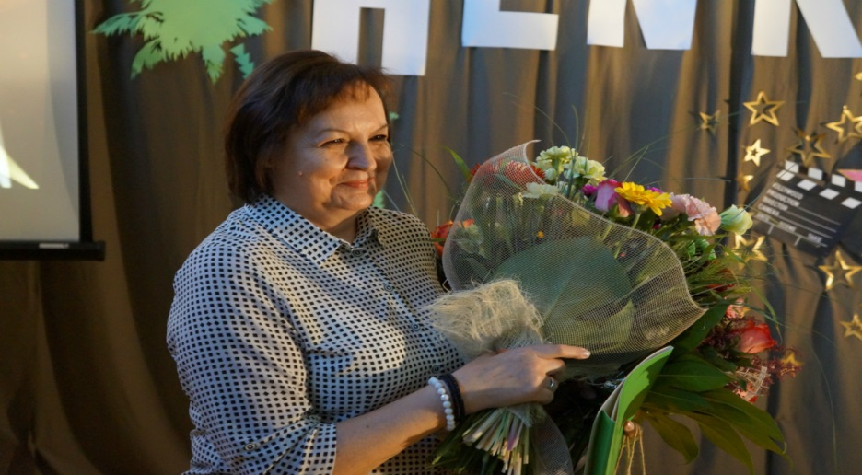
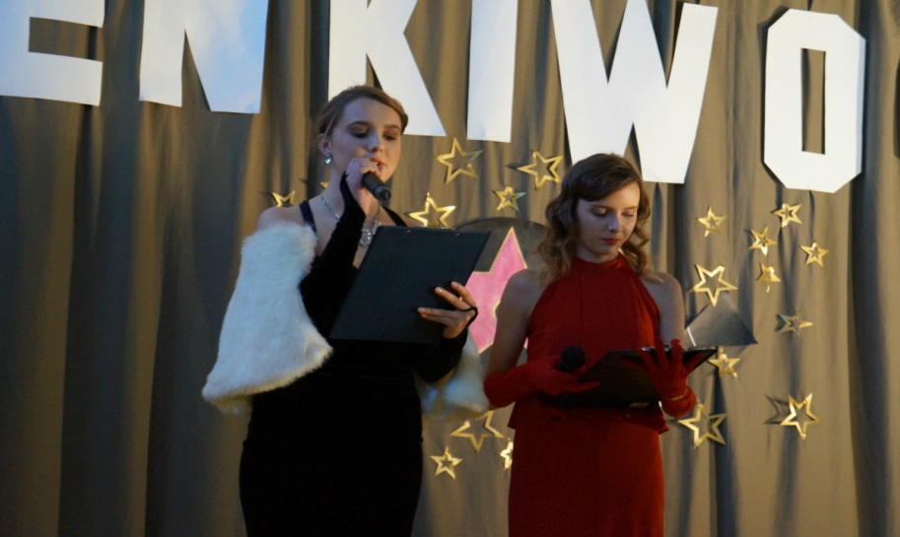
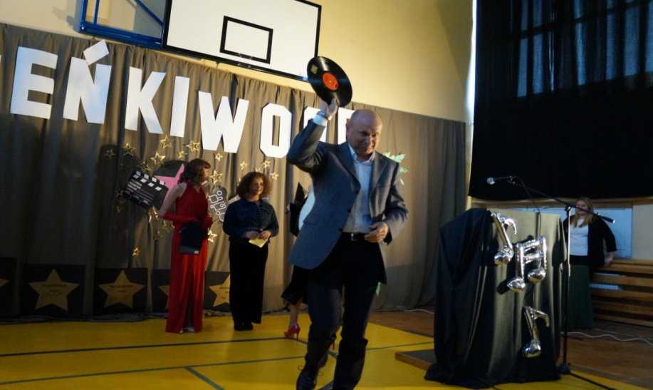

Slide 10
We also carry out international exchanges!
Every year there is a student exchange with a partner school in Geithain in Germany. We established a cooperation with the International School of Economics five years ago as part of the implementation of the joint project "The voice of teens". The students participate in sighseeing tours, sports activities (kajaking or football matches which we usually lose because our German friends are much better at sports)

Slide 11
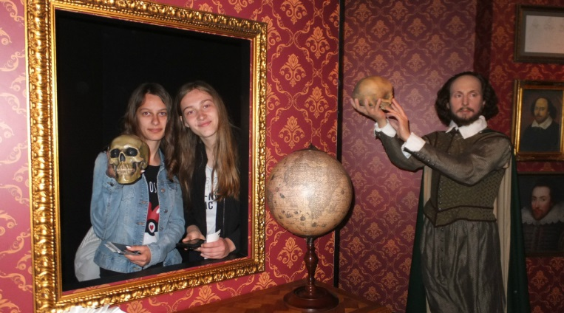
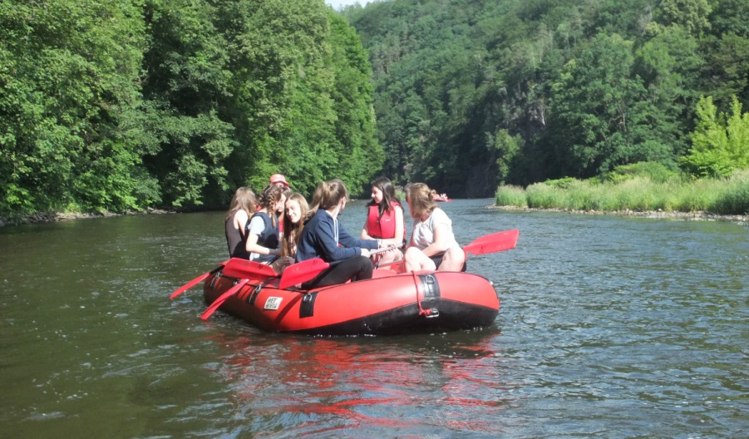
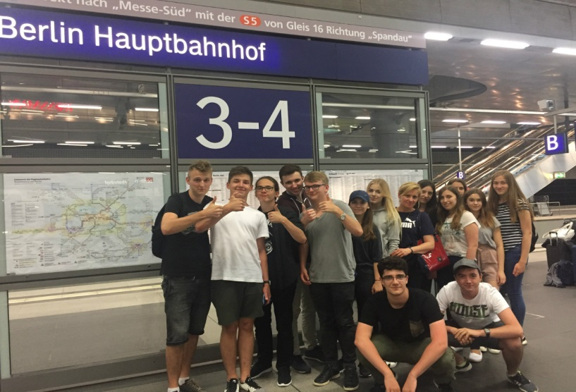
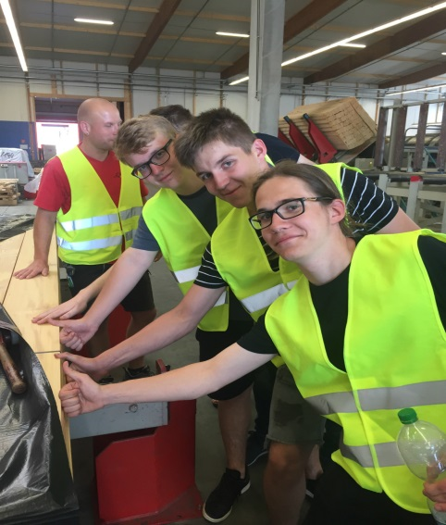
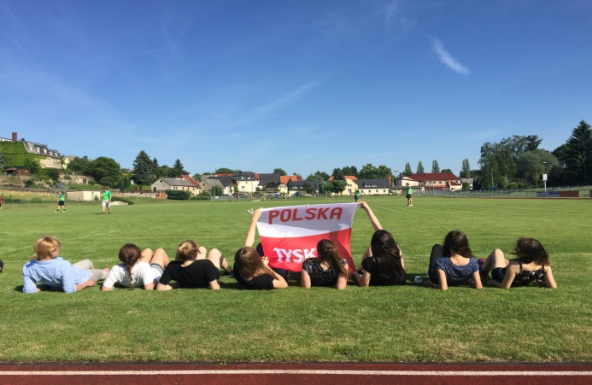

Slide 12
OSP Dąbrowszczak
On 1.02.2007 thefirst aid group AmRat was established at our school. As part of its activities, first aid training and demonstration presentations were organized. In addition, the rescuers offer their help during mass events (Eucharistic Congress of the Diocese of Lodz, "Termination of Summer" - organized by the PIONIER Housing Cooperative). Since 2010, they have been operating as the Medical Rescue Team of the OSP "Dąbrowszczak"

Slide 13
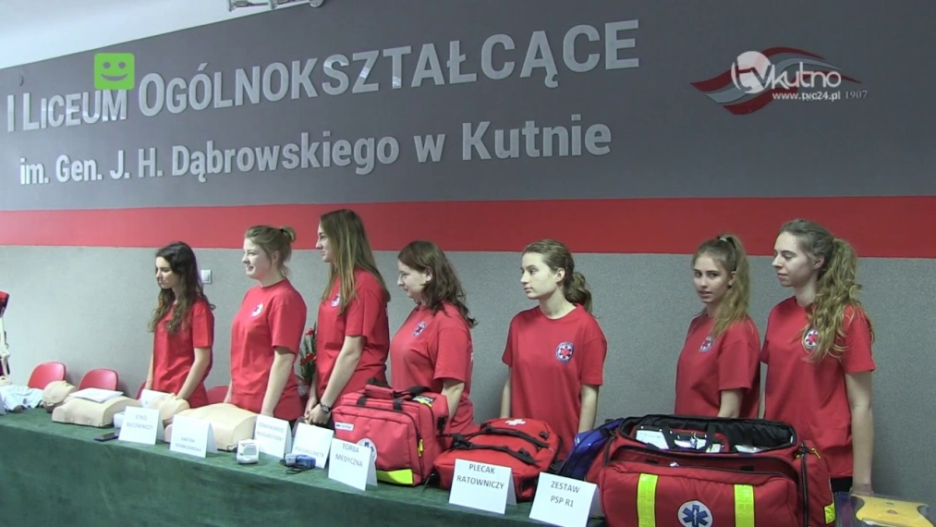
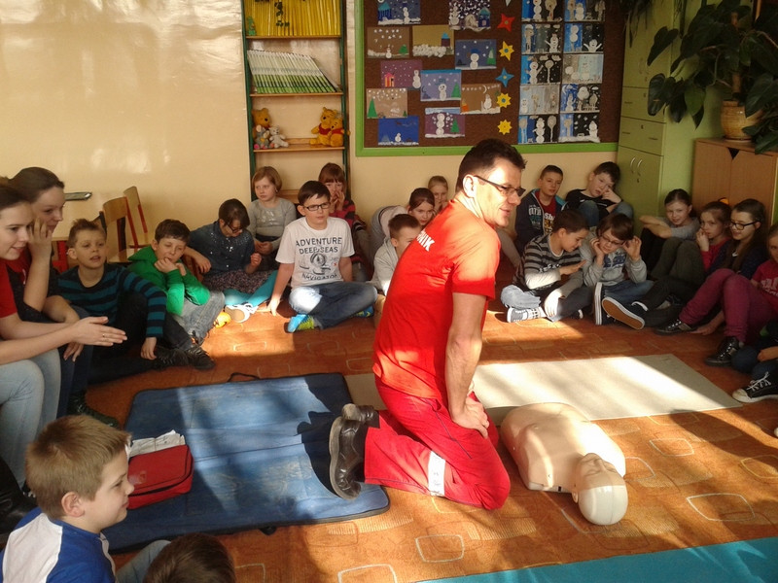
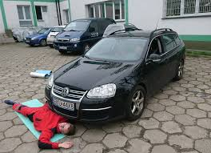
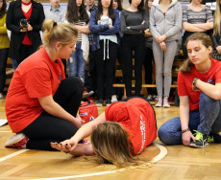
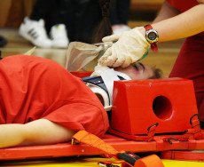

Slide 14
If you want to make new friendships , our school is a very good choice. There are lot of friendly and sociable people who want to befriend you .
We have many school events , which connect people and help you to over your shyness. ☺
There are a lot of opportunities to develop your passions and realize your dreams.
And our teachers guarantee that you will pass your final exams with flying colours. In the national rankings for school, we are the school with the bronze medal (we are ranked 310th in Poland, which makes us the best school in our town. )

