Slide 1
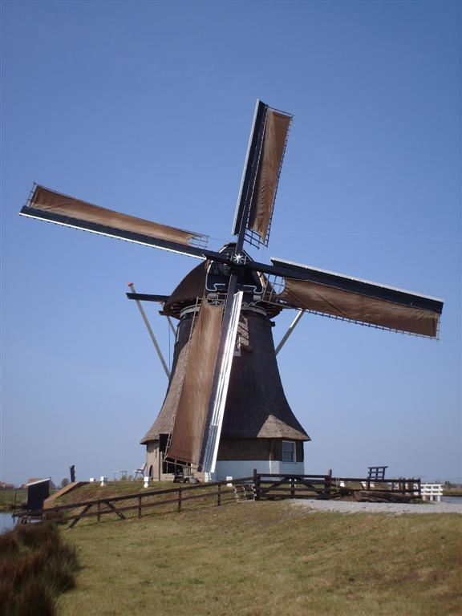
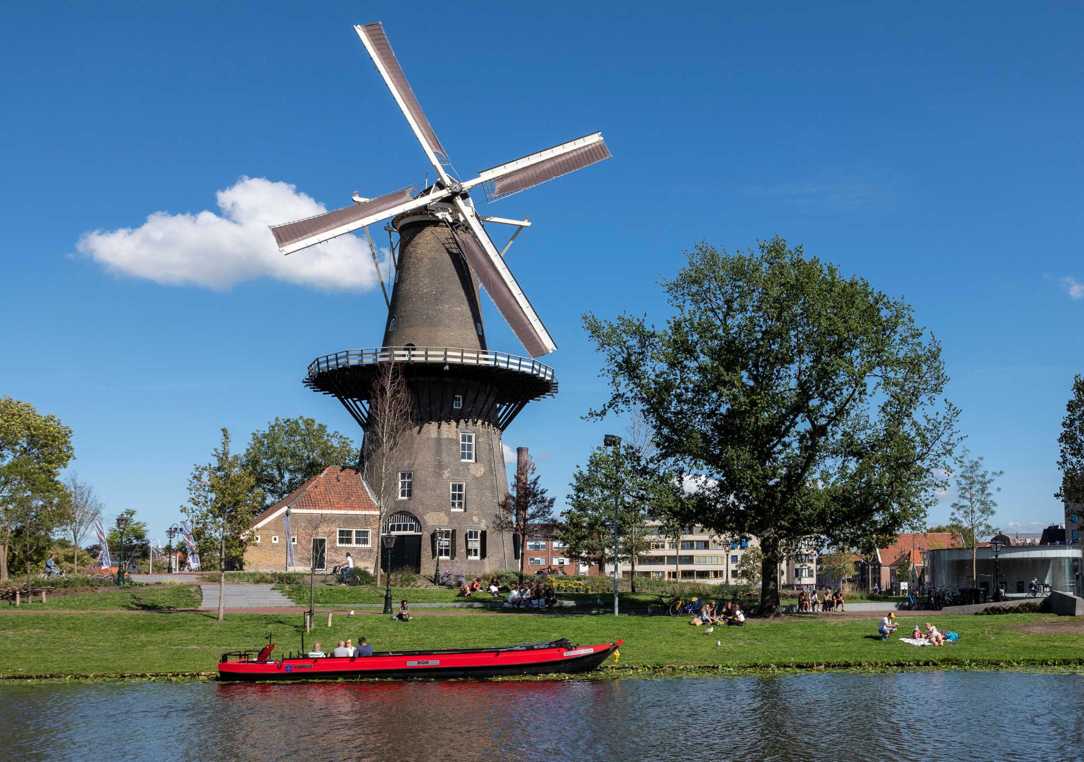
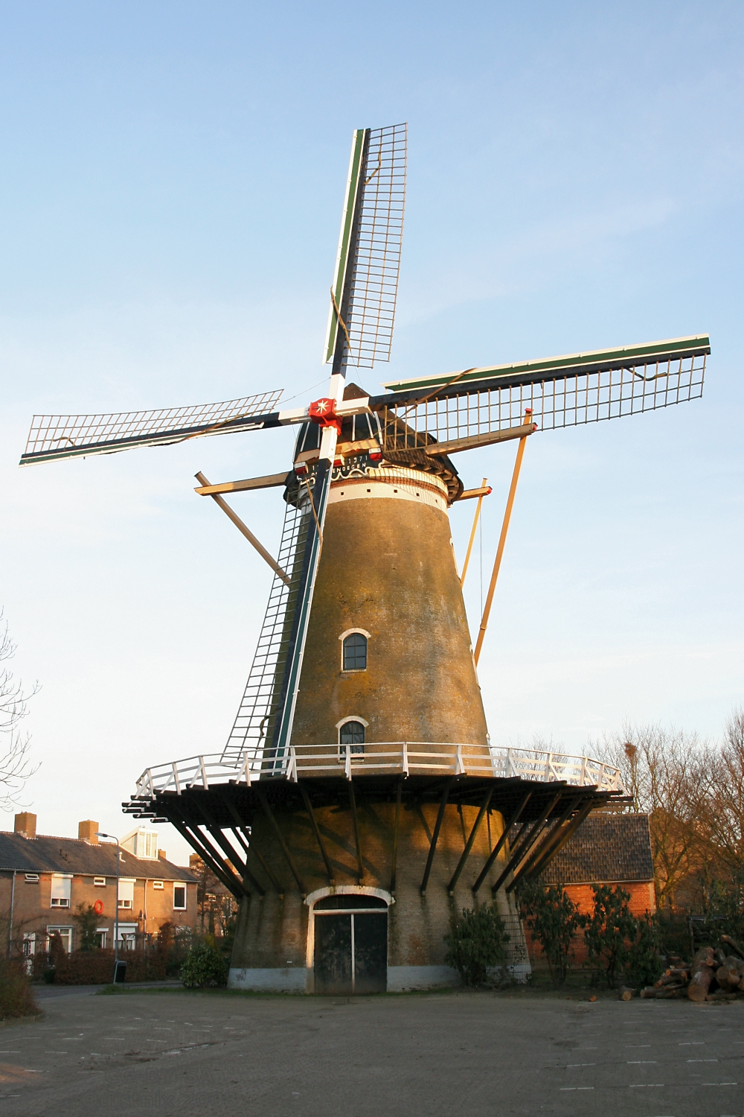
WindMills
Made by:
Maarten, Soeh, Denise and Milan

Slide 2
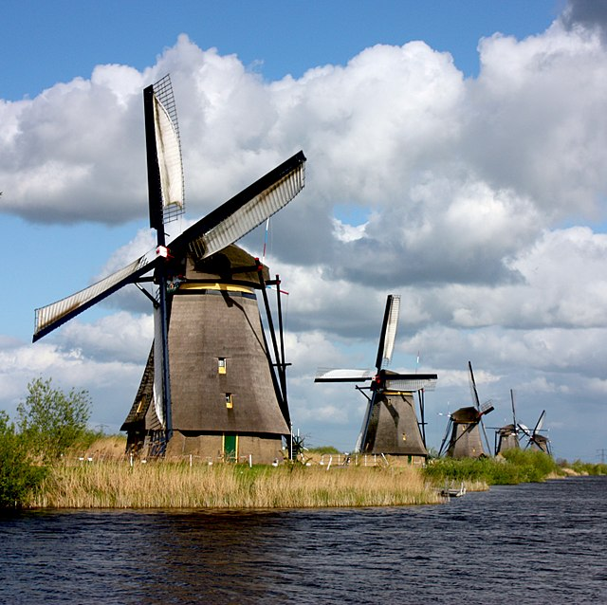
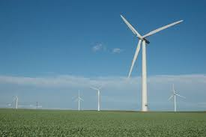
What are windmills exactly?
Windmills are a building used to harness the power of the wind for purposes such as grinding grain, pumping water, cutting logs and generating energy. However we don’t need these buildings anymore because we have more efficient windmills in the present day. Now they are generally used as a nice tourist attraction, You should visit one!

Slide 3
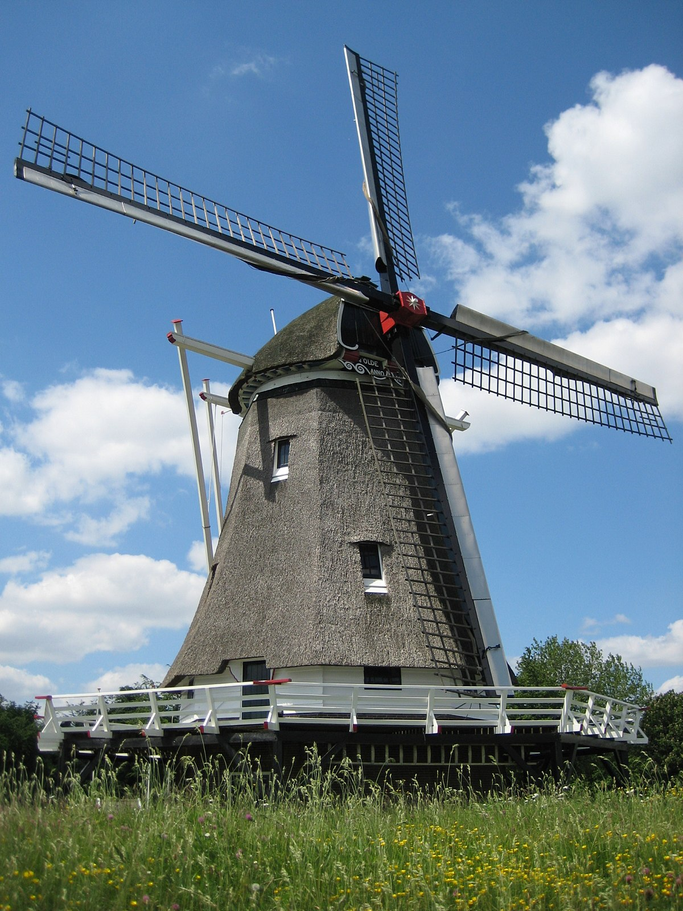
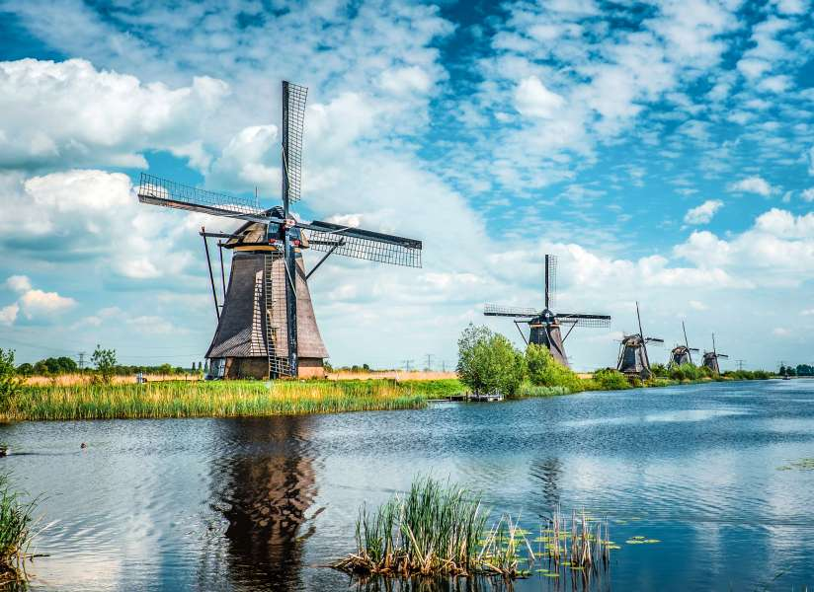
What are Mills and What are they used for?
Mills are tools that are powered by wind or by water. These are the windmills and the water mills. These are the two largest groups of mills. In addition, we know hand mills and horse mills that are driven by man or by a horse.

Slide 4
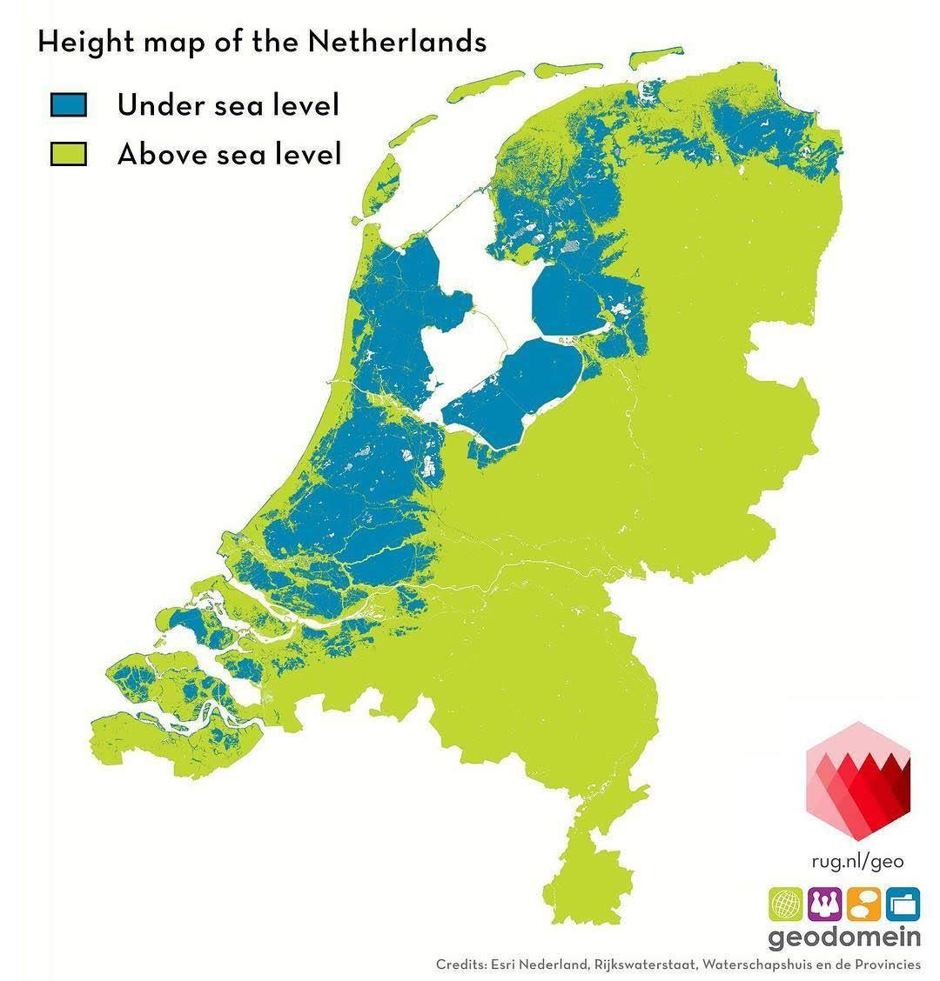
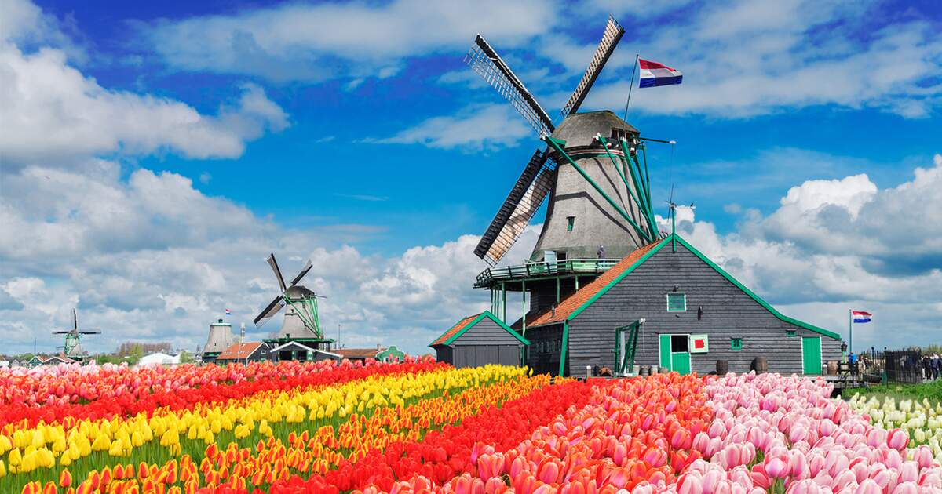
Why do the Dutch use windmills?
The Netherlands has so many windmills because they ensured that water was drained and therefore the land was not flooded. This was necessary because the Netherlands is 26% below sea level. Windmills were also used for sawing wood, grinding grain and spices, making paper, and pressing seeds for oil.

Slide 5
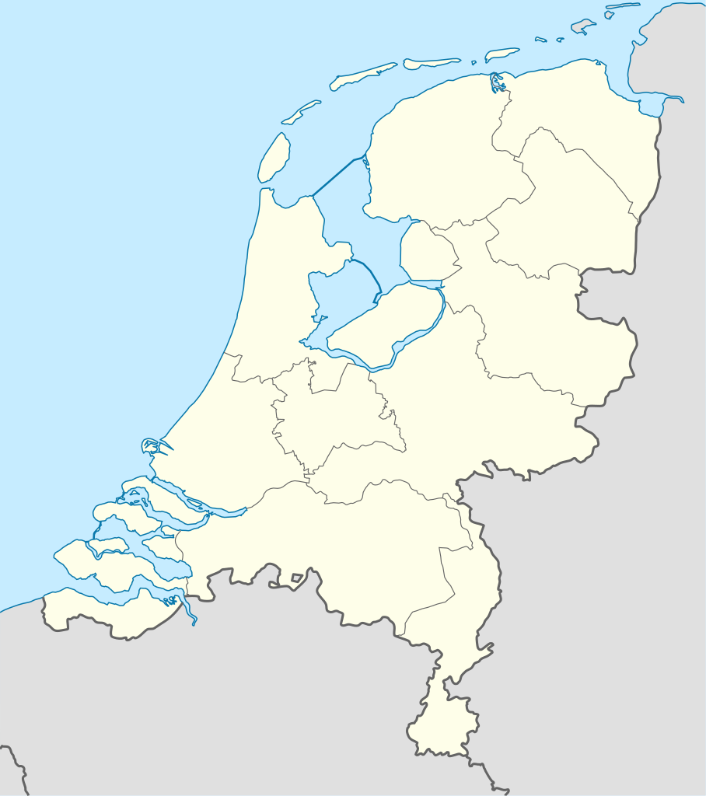
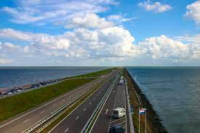
Everything to know about Dikes
Before we get in to the other facts let’s learn what a dike is. A dike is basically a dam used to split one body of water in to two. There would be windmills on the coasts to pump the water out of a body of water. Due to this the sea level of the smaller bodies of water has been lowering making more space for the country. This type of land was coincidentally really good for growing tulips, this explains why the Netherlands is the first placing country with tulip exporting.

