Slide 1
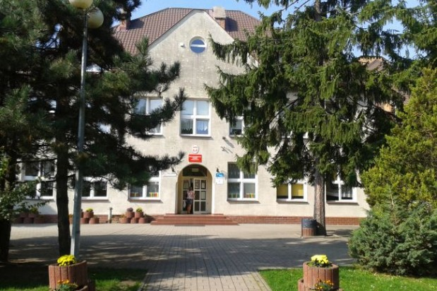
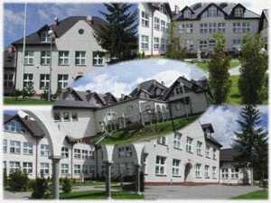
OUR SCHOOL
SP 86 W GDAŃSKU
POLAND

Slide 2
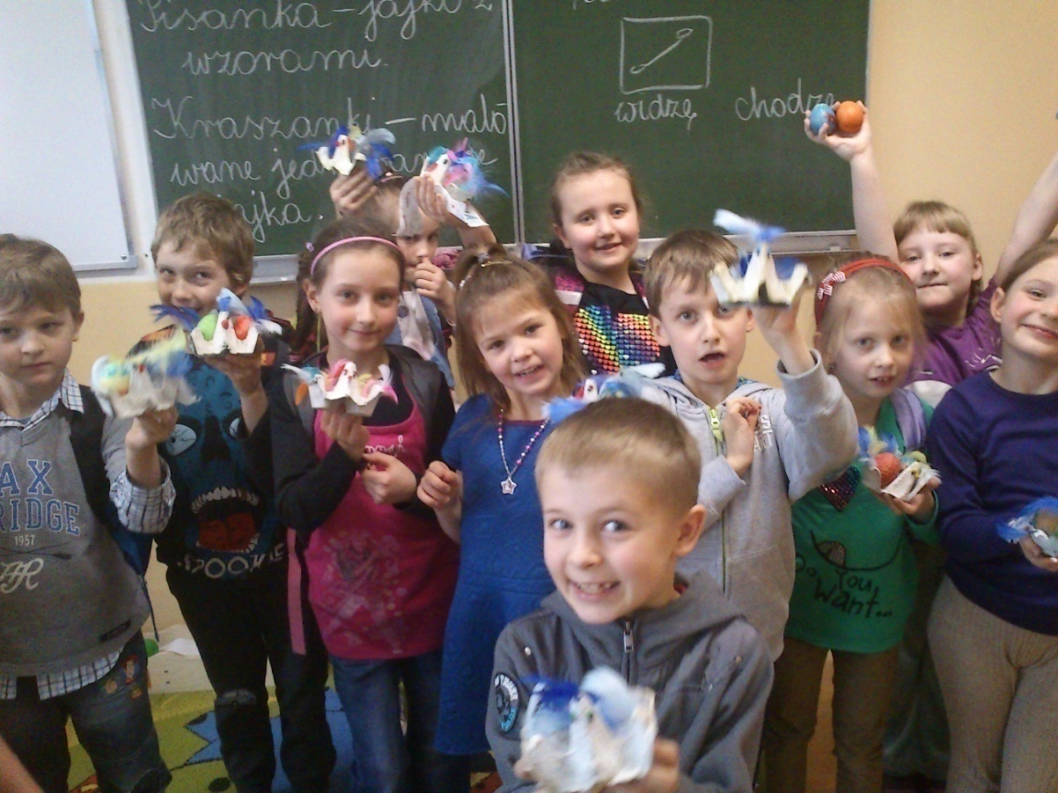
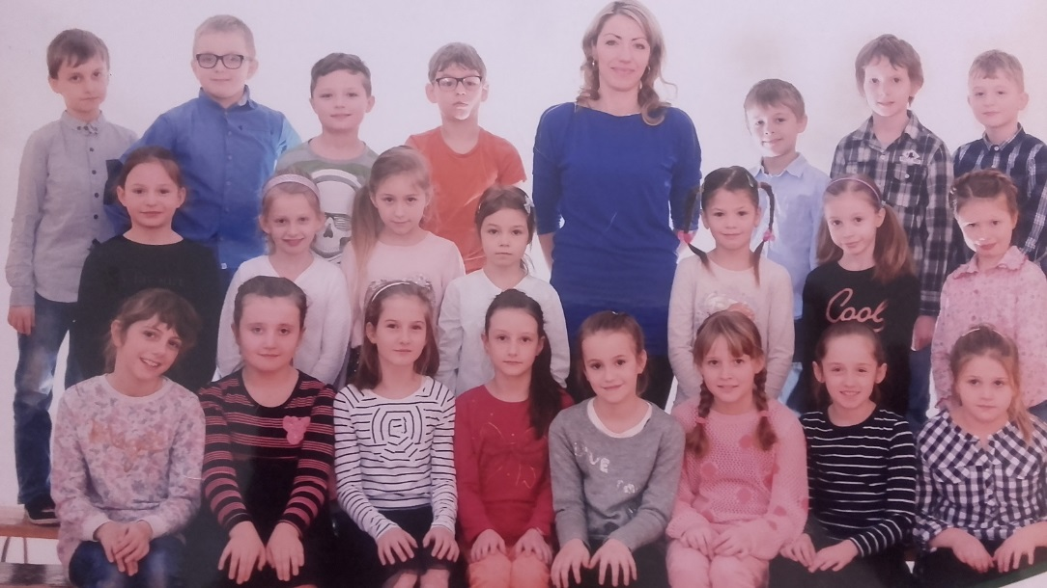
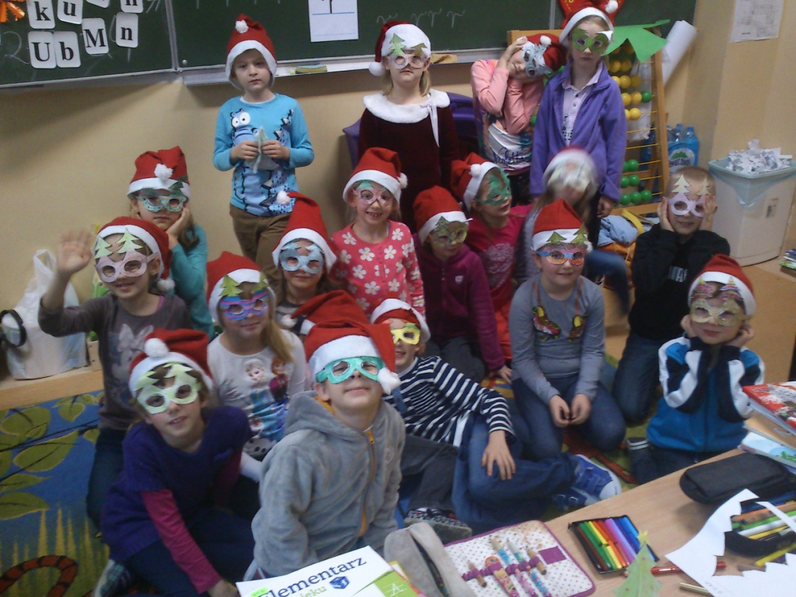
HERE WE ARE
CLASS 3C

Slide 3
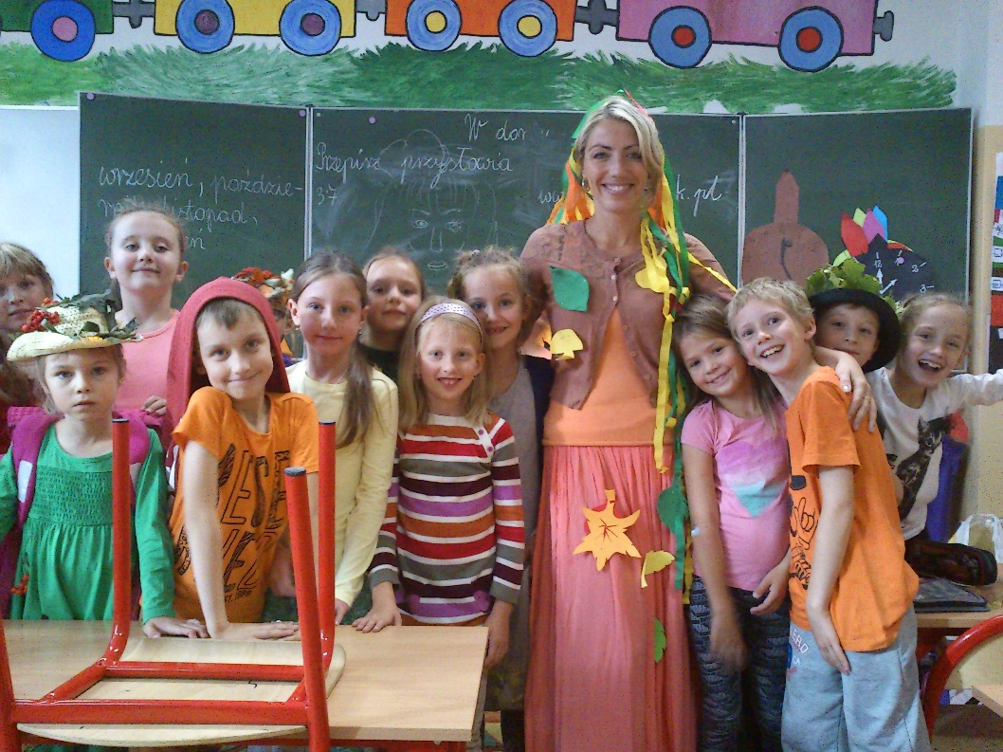
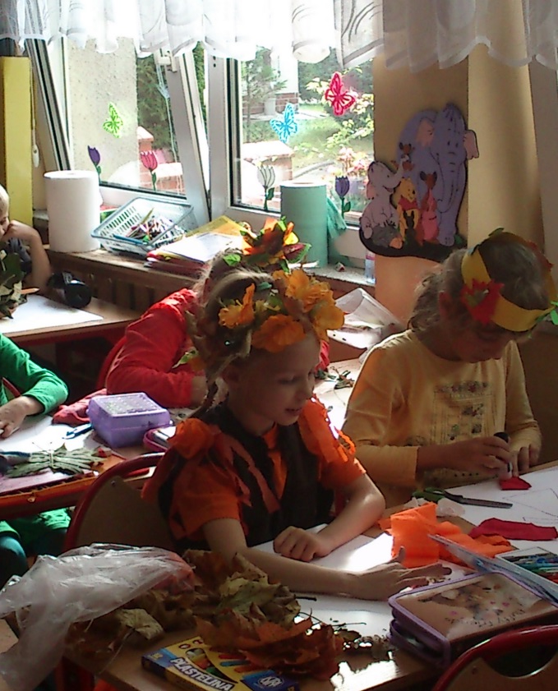
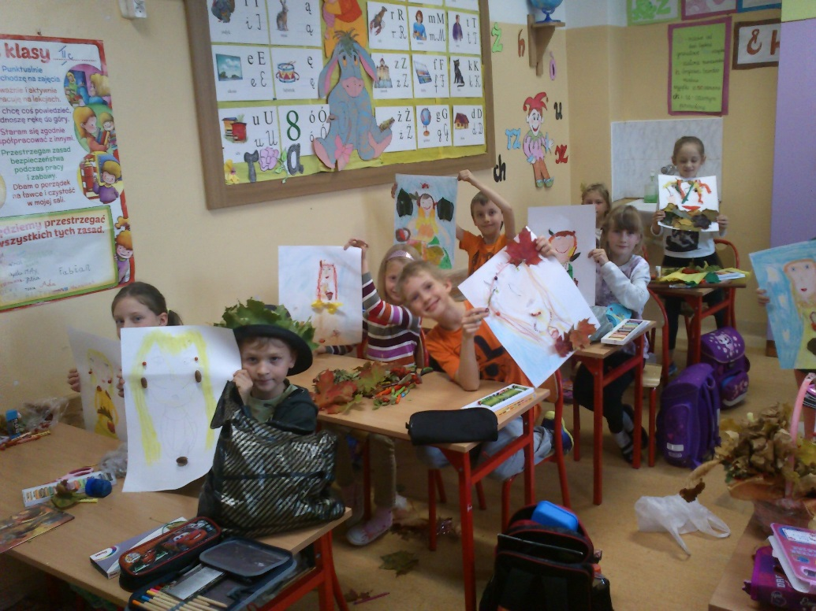
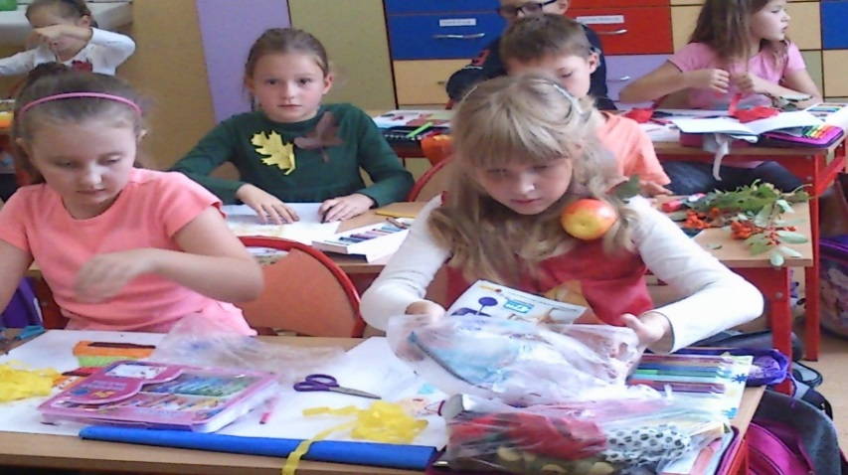
We welcome autumn

Slide 4
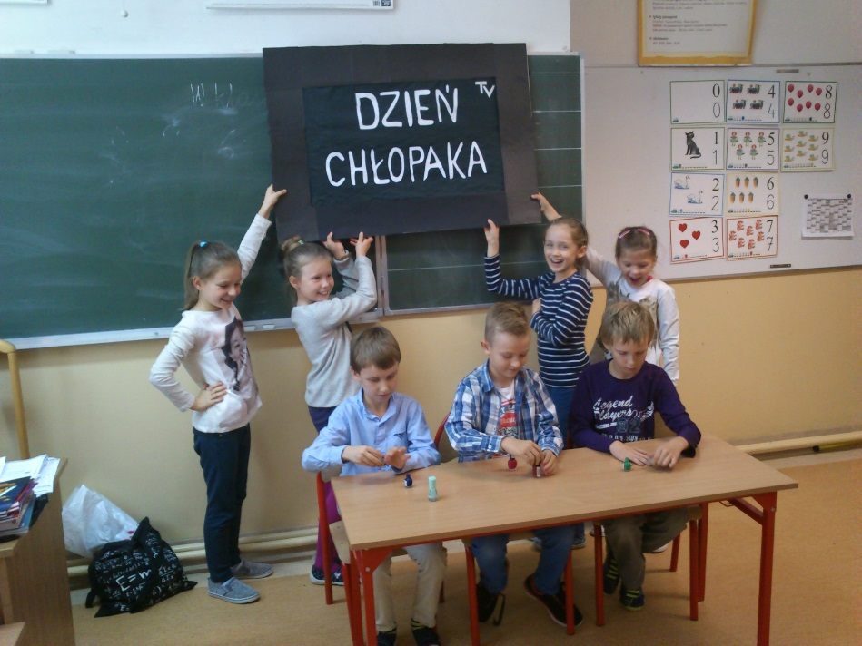
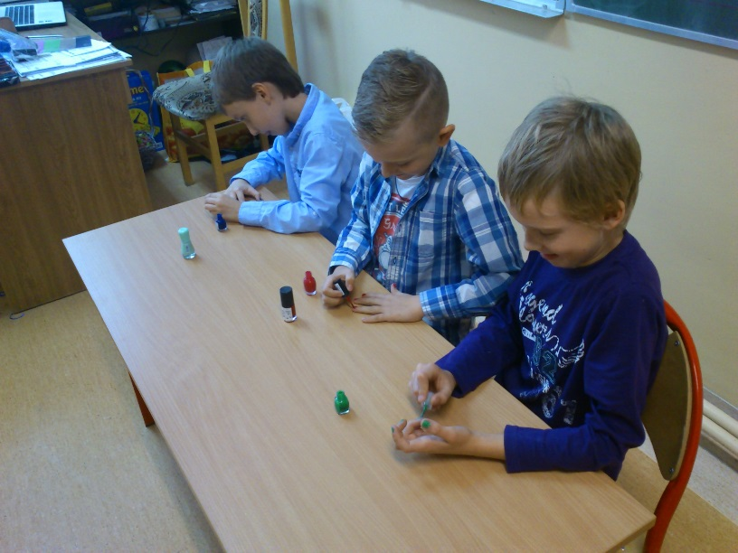
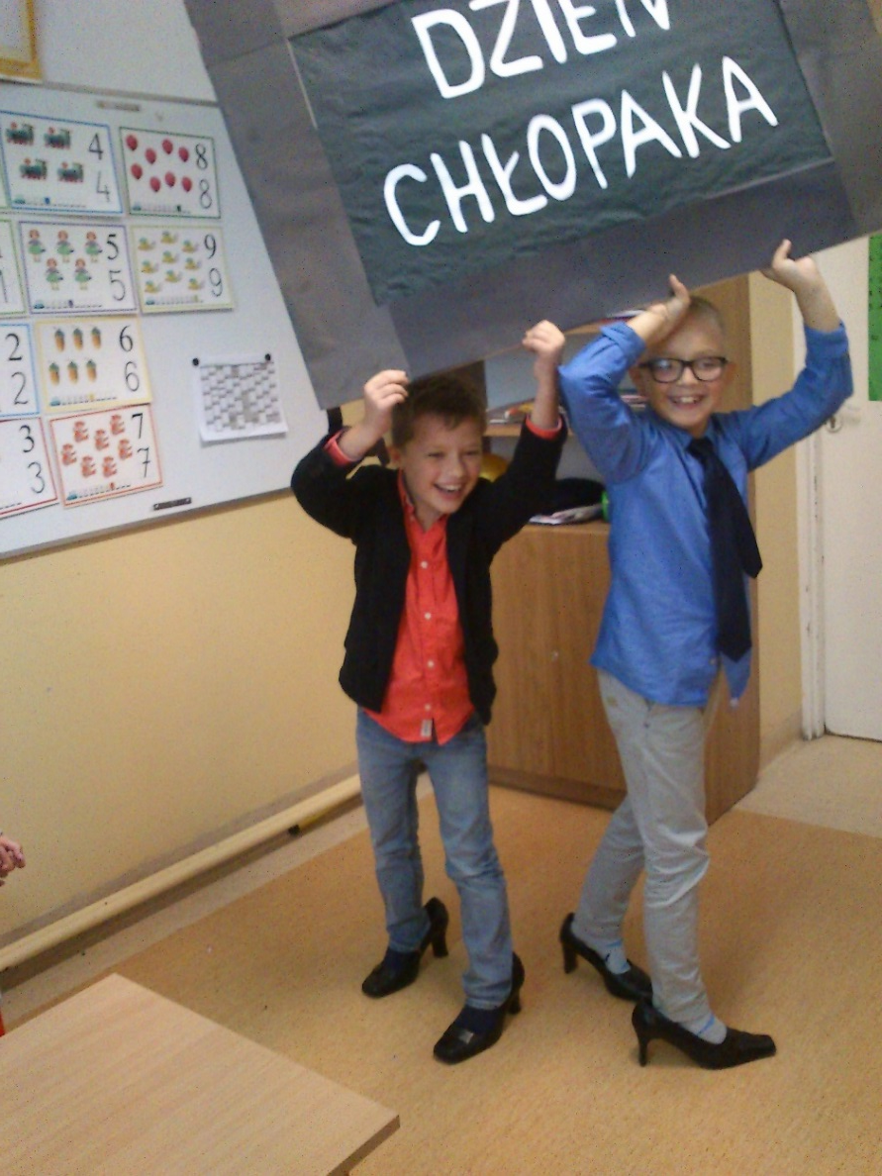
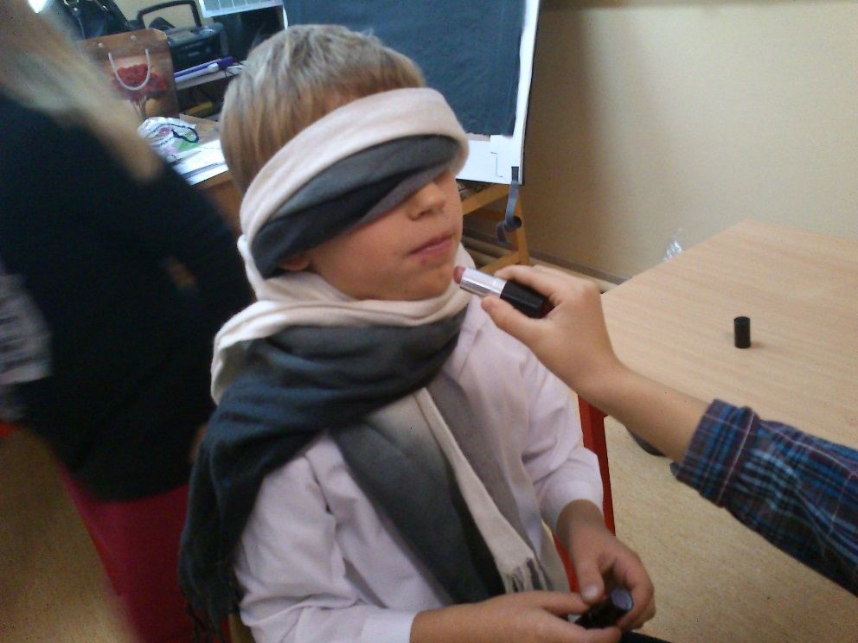
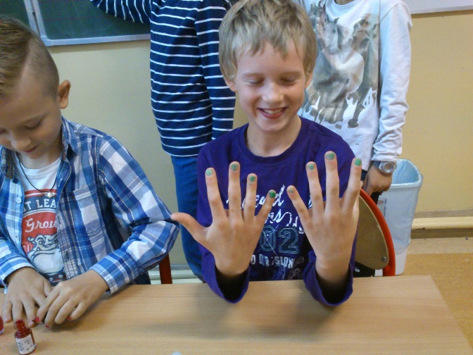
Sometimes we are crazy☺
30th September - BOYS’ DAY

Slide 5
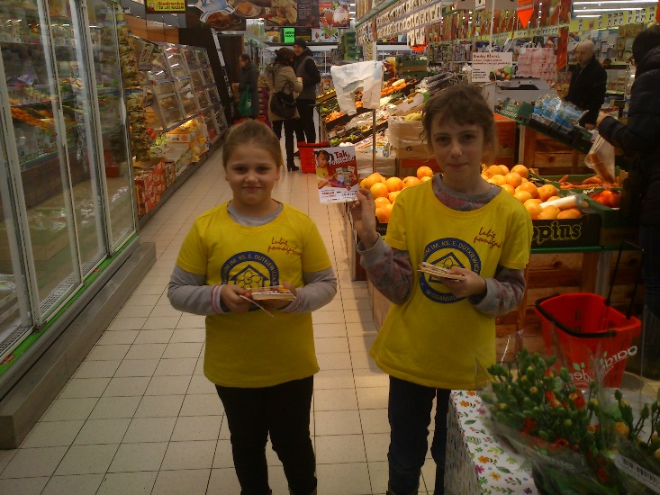
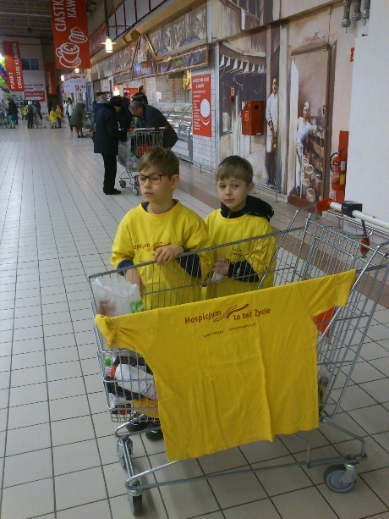
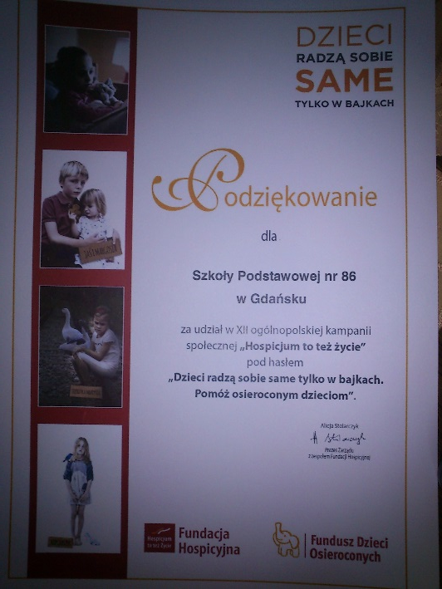
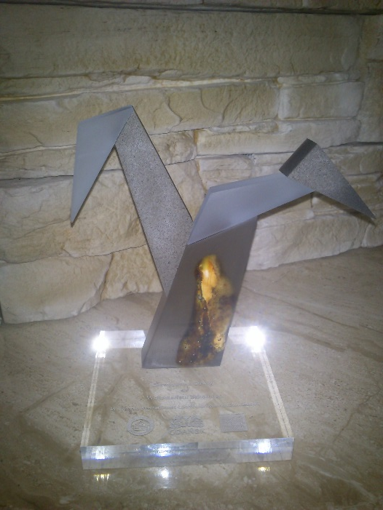
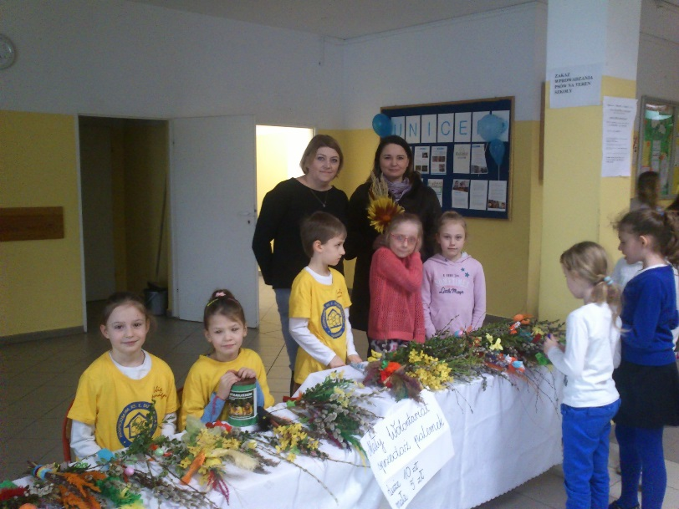
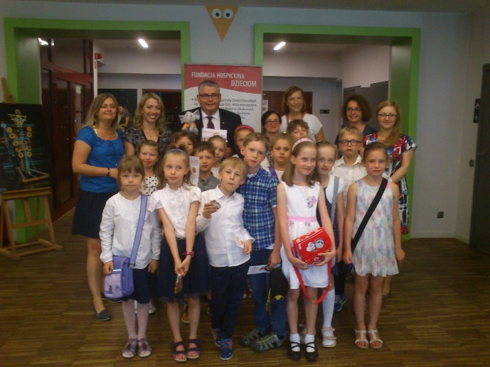
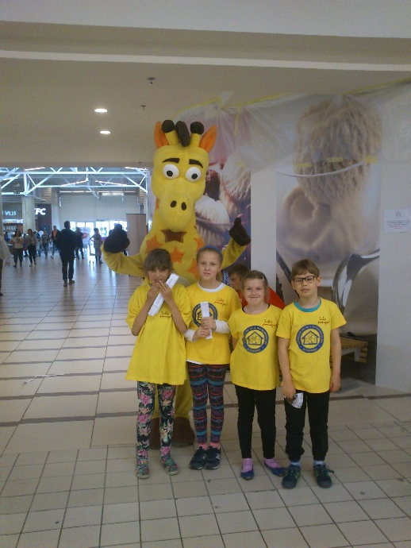
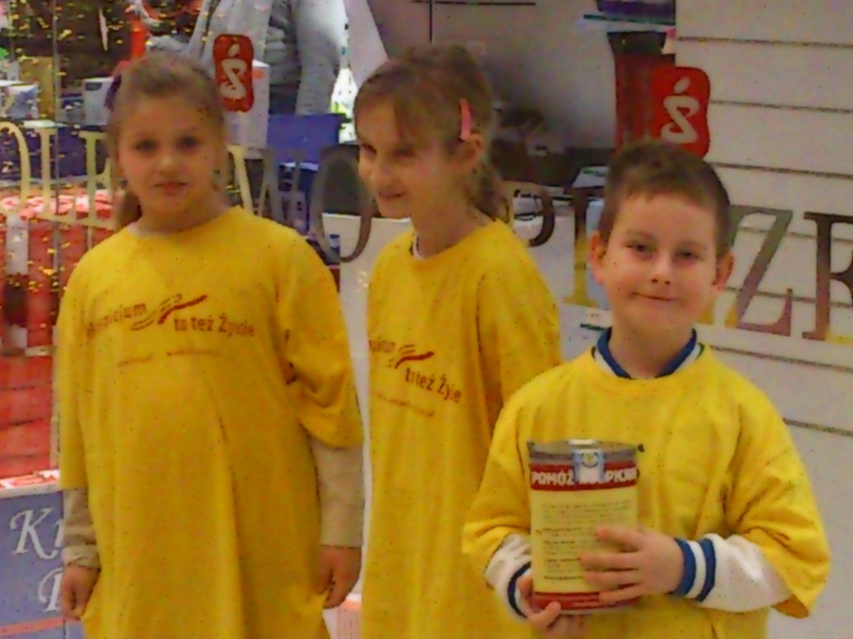
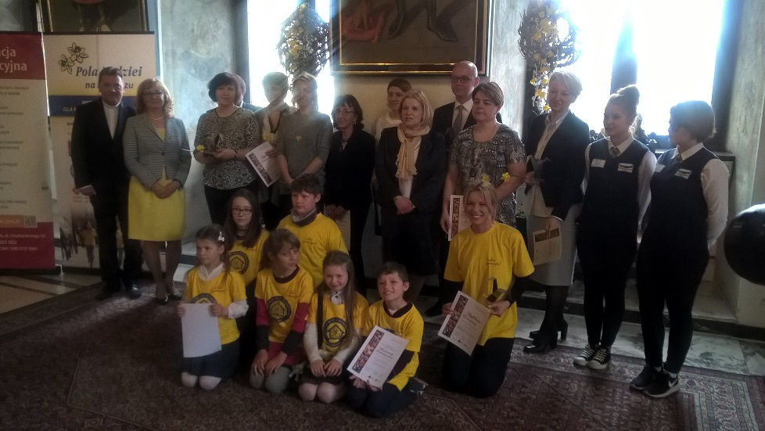
The prize for the most active charity school club.
Many of us are charity volunteers

Slide 6
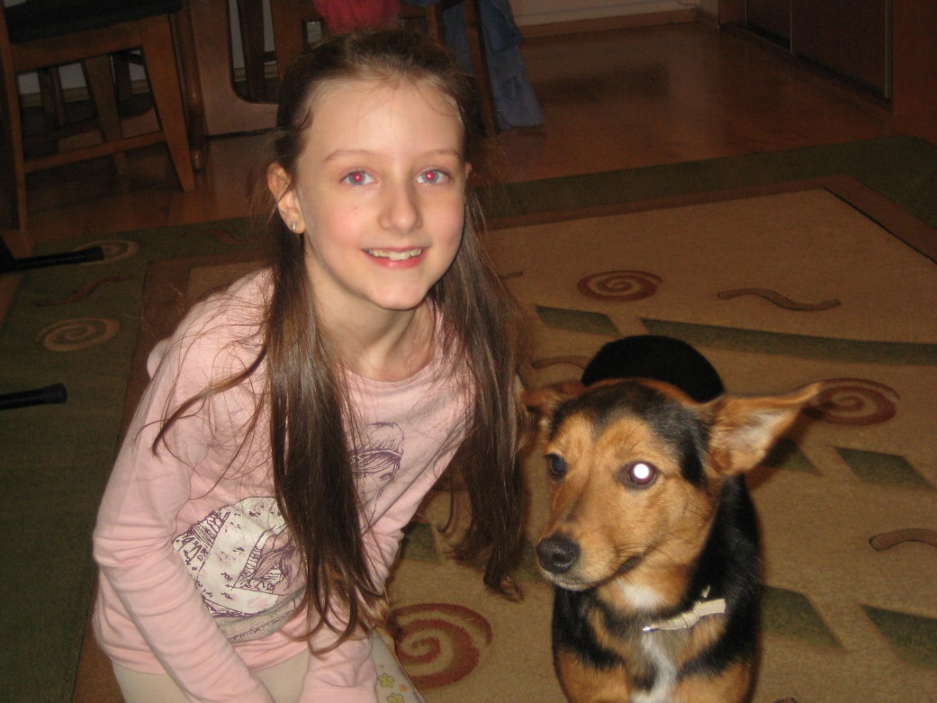
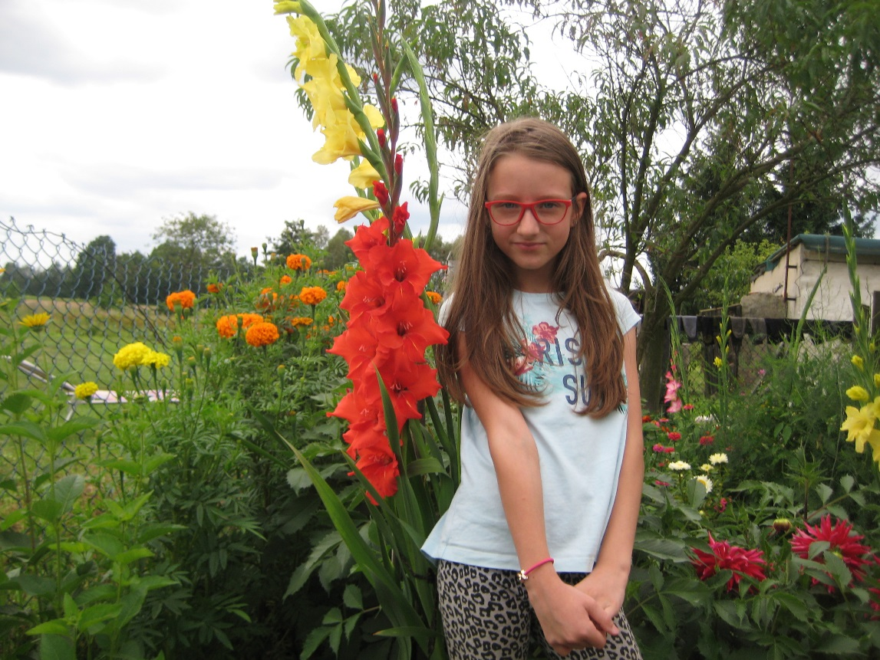
I'm 9 years old. I am in year 3 in 86th Primary School in Gdansk.
I have a small famly. I am the only child – it means I don't have a brother or a sister.
I love animals and riding a horse.
I also like playing the piano.

Slide 7
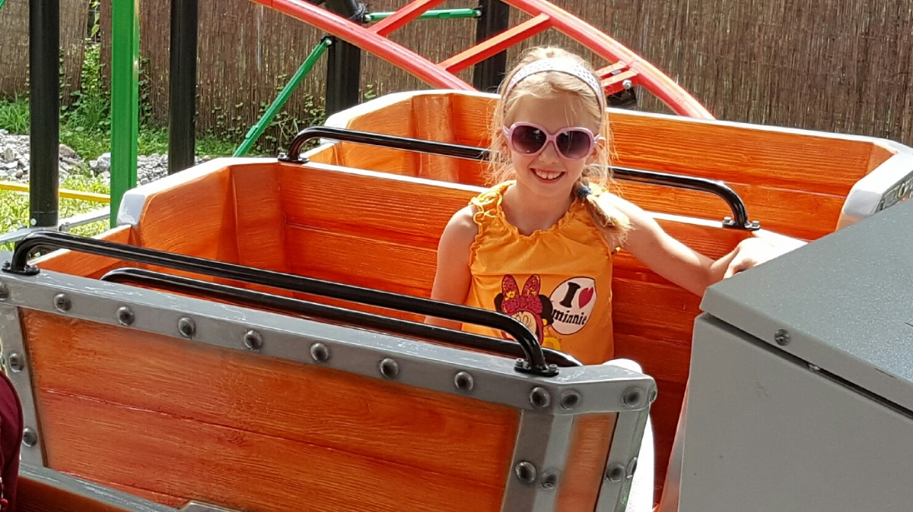
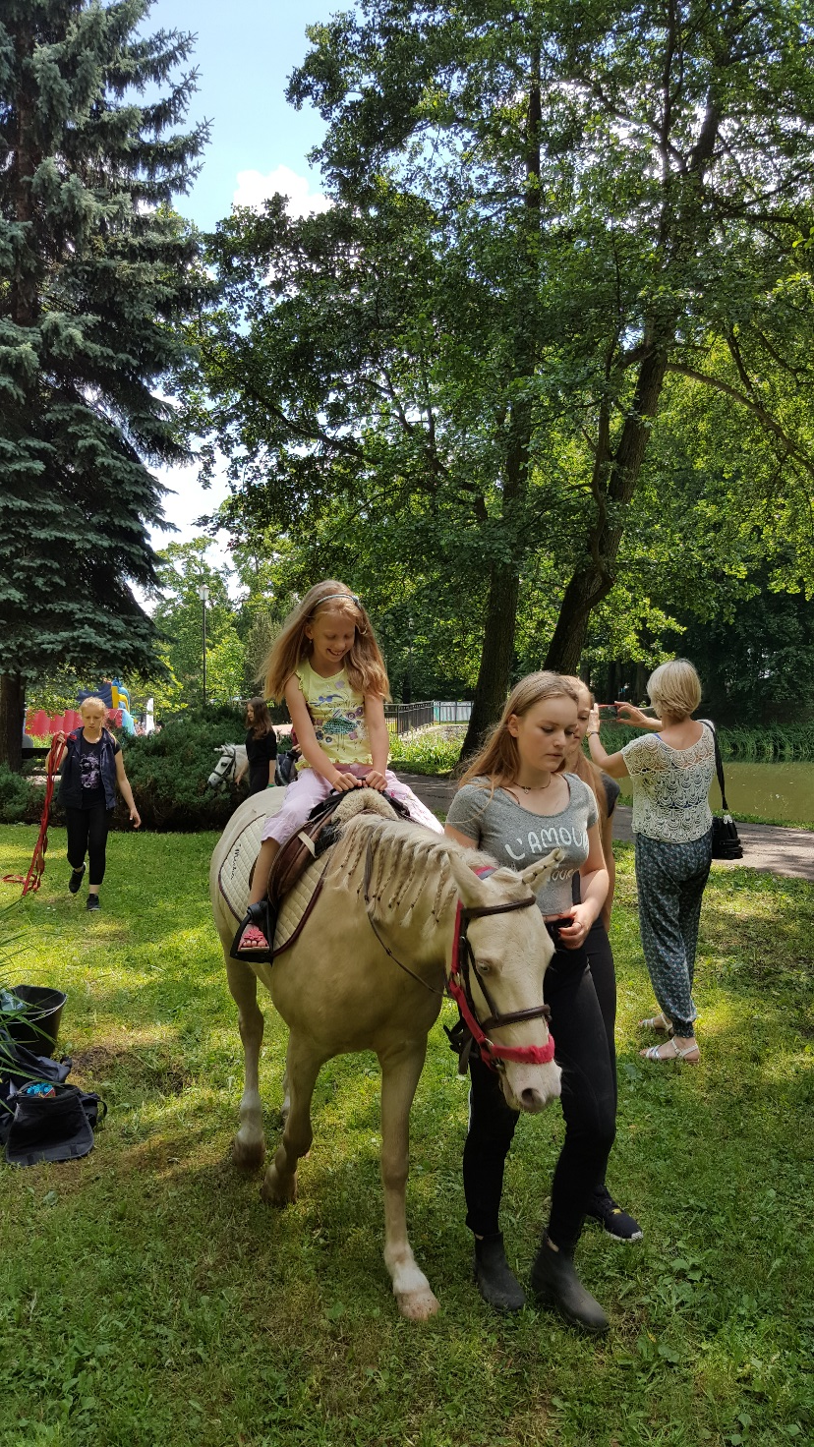
My name is Ada. I am 9 years old. I have got two brothers.
I like eating chicken, chips, pasta, pizza, ice-cream, eggs, strawberries, drinking water and orange juice.
My favourite colour is blue.
I like watching TV, swimming, dancing and spending time with my friend Tosia, too.

Slide 8
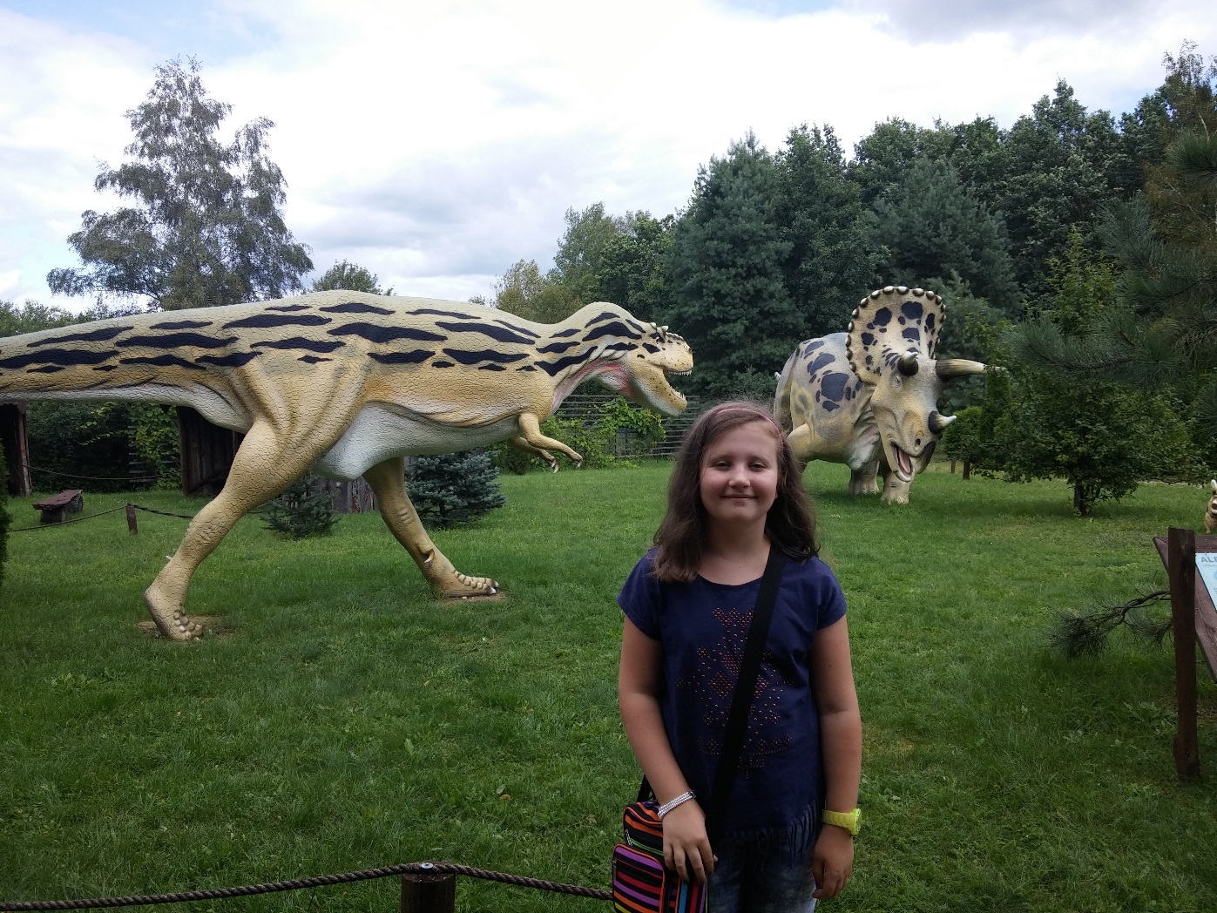
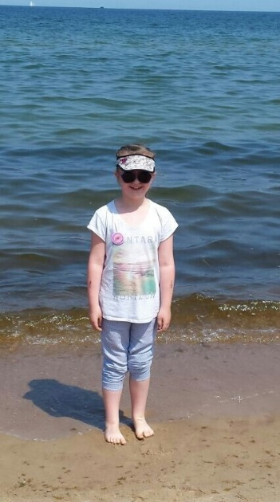
My name is Julia. I have got brown hair, blue eyes and
I wear earrings. I'm a pupil in class 3c in 86 th Primary School in Gdańsk.
l like eating chips, pasta, chicken and cake. I like playing various games and going out with my frends. My family consists of my mom, dad, sister and grandmother.

Slide 9
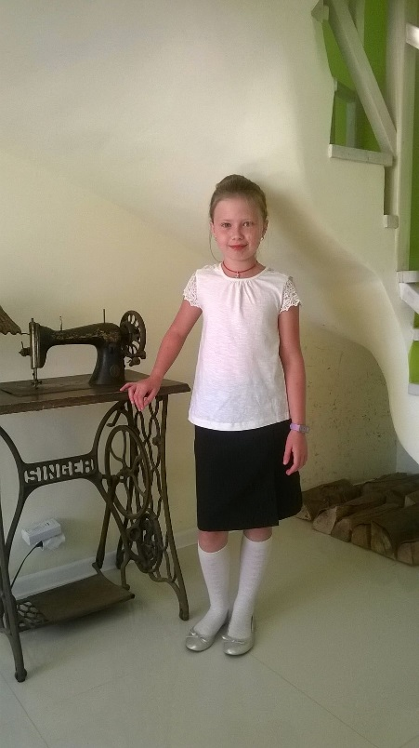
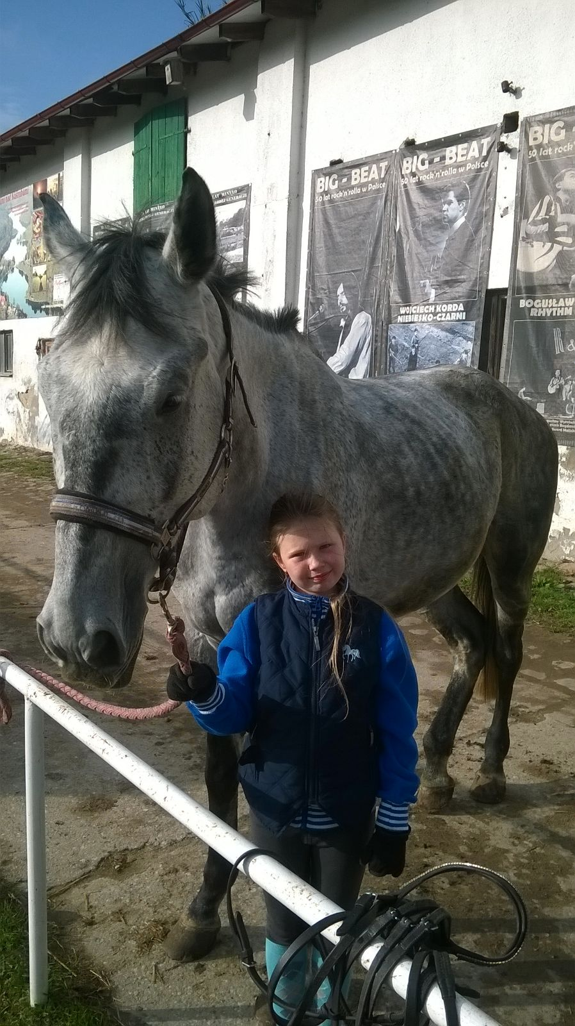
My name is Antonina Blandzi. I’m nine years old and a student of 86th Primary School in Gdańsk. . I have a long hair, grey- green eyes. My passion is horseriding. My favourite horse is Toledo. I have a big family but I live with my parents and sister.
My e-mail: antoninablandzi@wp.pl

Slide 10
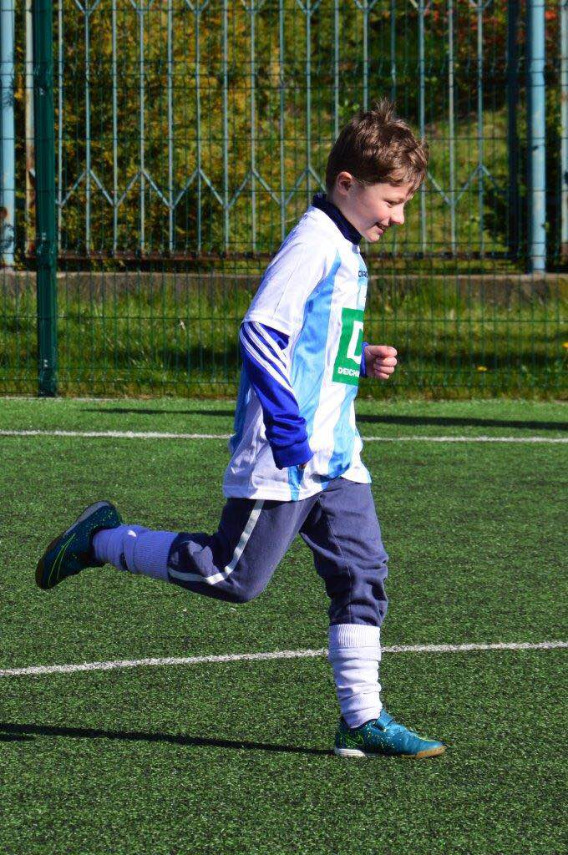
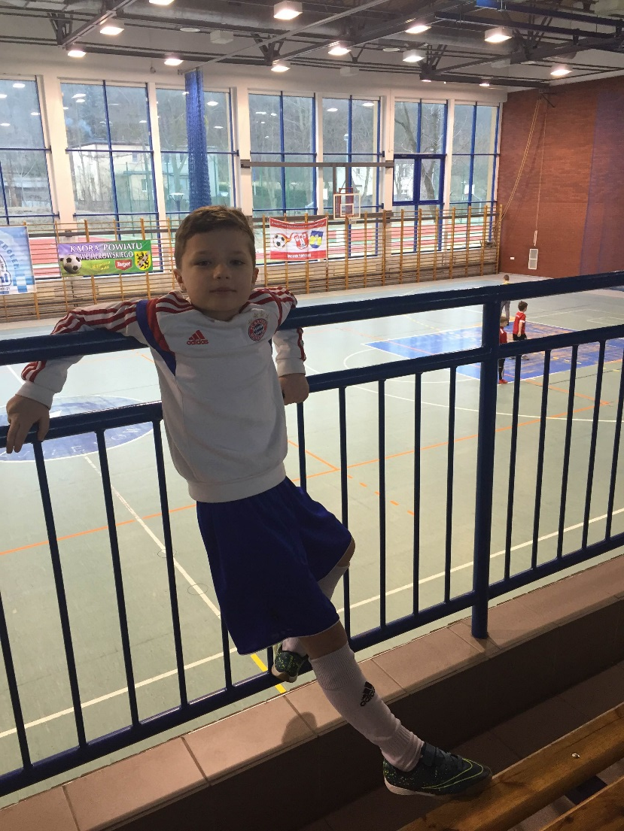
My name is Nikodem. I am 9 and I go to 86th Primary School in Gdansk. My favourite subjects are PE and IT. I have two brothers. I love playing football.

Slide 11
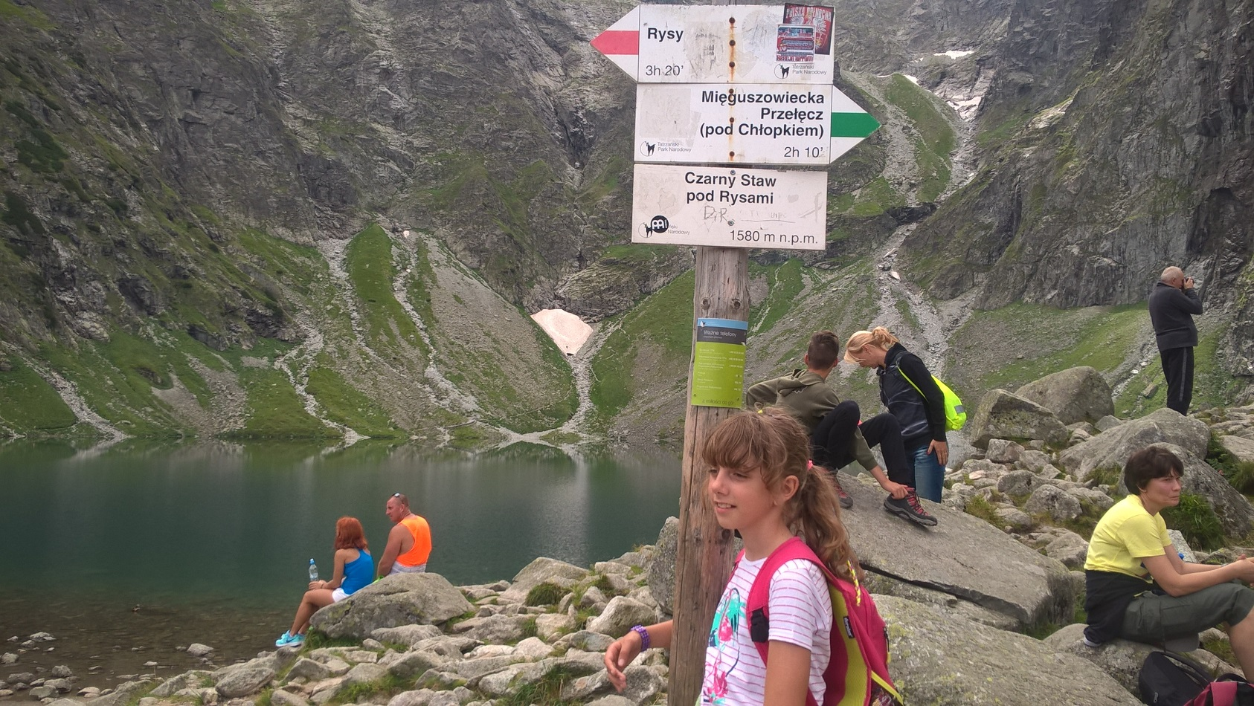
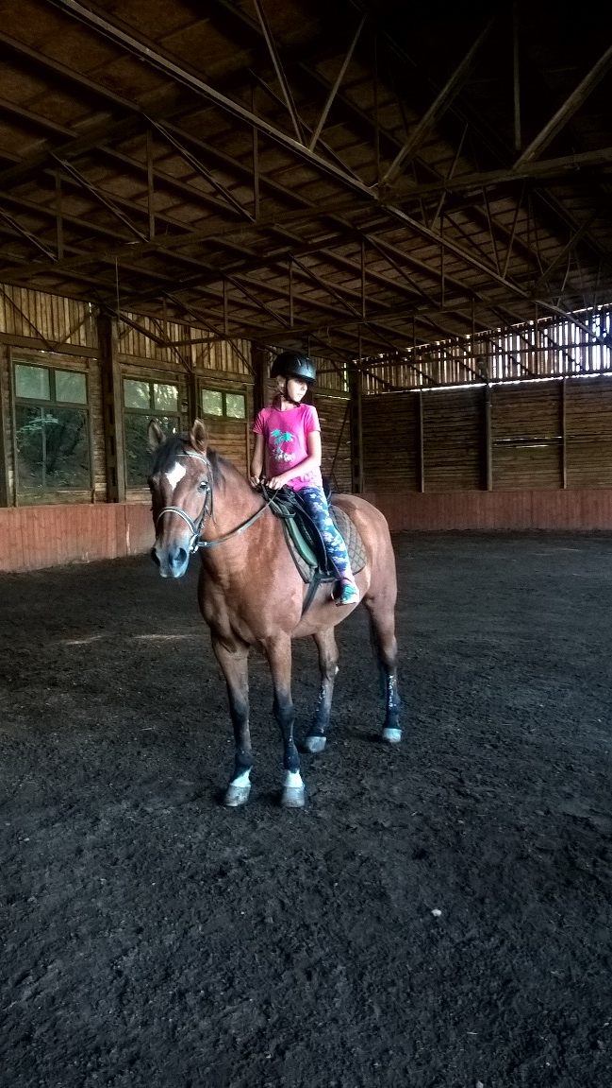
Hello, My name is Marta. I'm 9 years old.I'm in year 3 in 86th Primary School in Gdańsk. I'don't have a brother or a sister. I like pizza, ice-cream, coke and orange juice. I like singing, spending time with my friend Ola and my cat Rysiek,I also like riding a horse. My favorite colors are purple and light brown. I'm crazy.

Slide 12
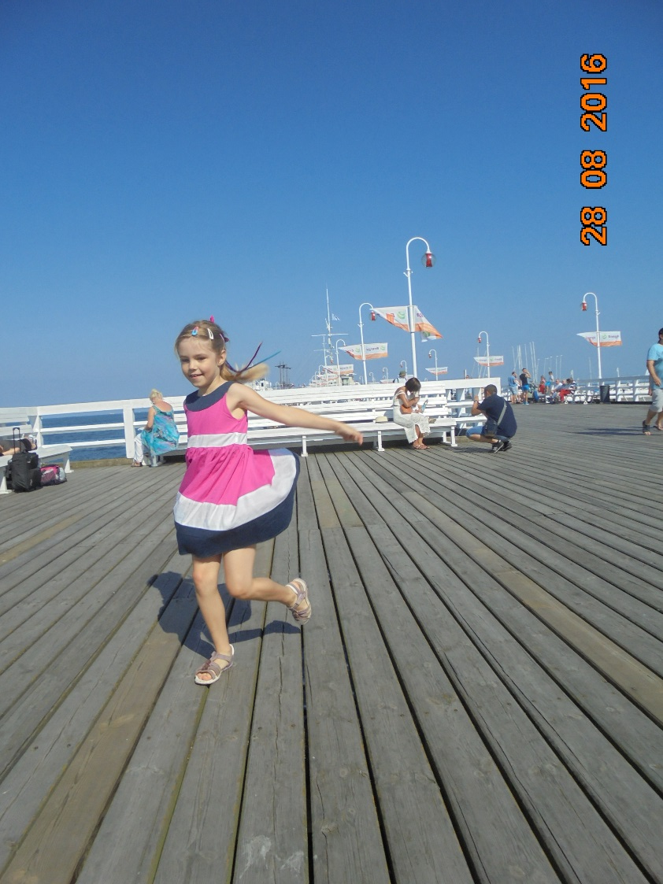
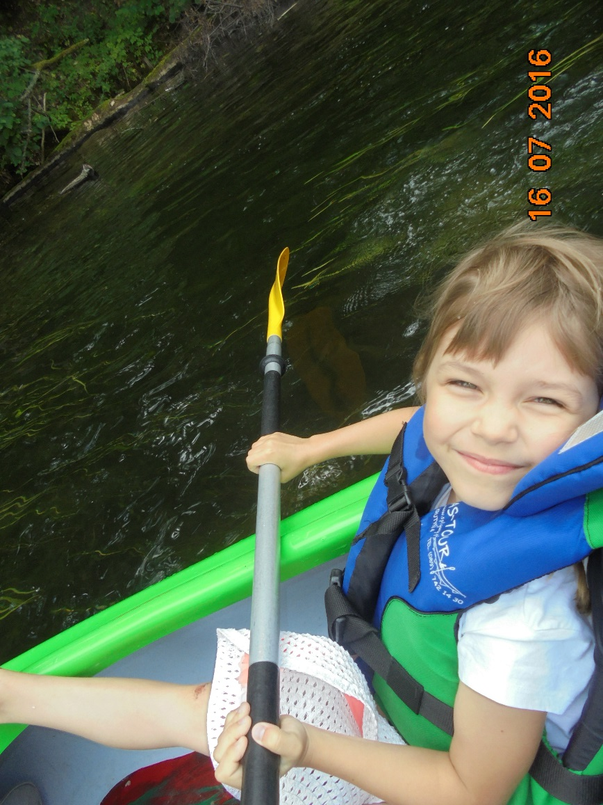
My name is Ola. I am 9 years old.
I like eating chicken, chips, pasta, pizza, ice-cream, eggs, strawberries, drinking water and orange juice.
My favourite colour is blue.
I like swimming and dancing. I love animals.

Slide 13
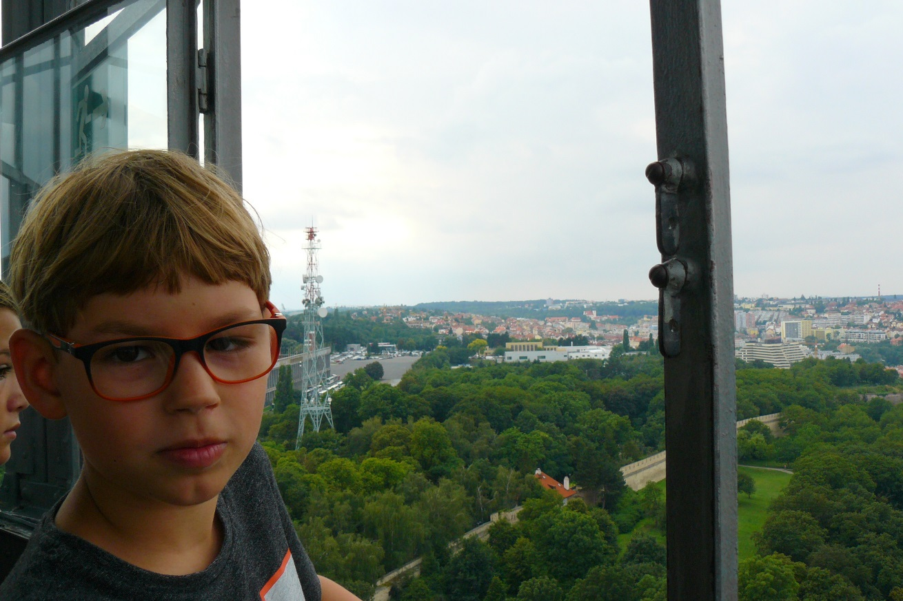
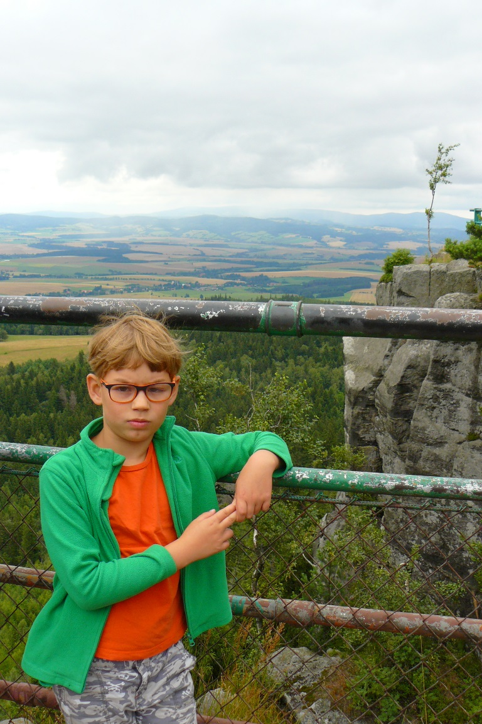
Hello,
My name is Wiktor. I’m nine years old.
I’m in year 3 in 86’th Primary school in Gdansk.
I have a small family. I have a sister, but I don’t have a brother.
I like eating apple juice and chips in Mc Donald’s and potato pancakes.
My favorite music is rock music.
I like playing football with my friends. Also my favorite sport is riding a bicycle.
I can swim and ride a bike very fast.
I like traveling and climbing mountains.
Goodbye .
Wiktor

Slide 14
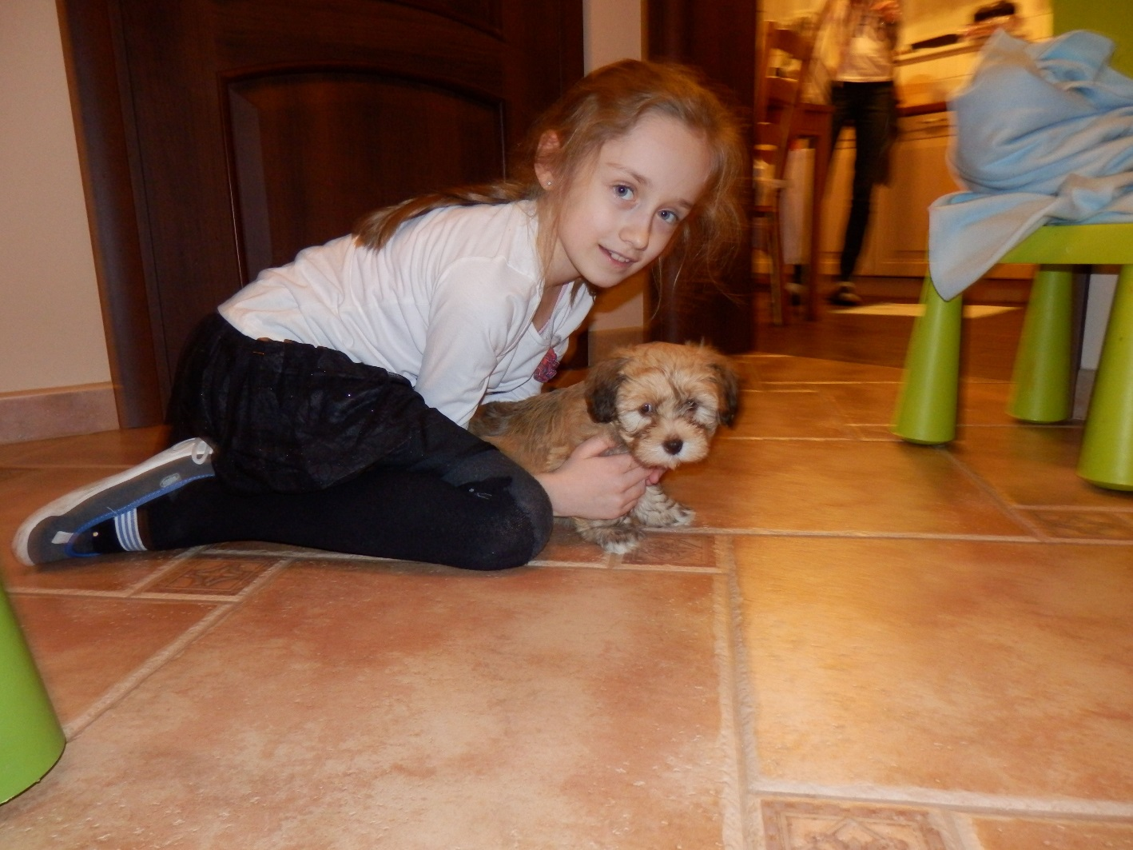
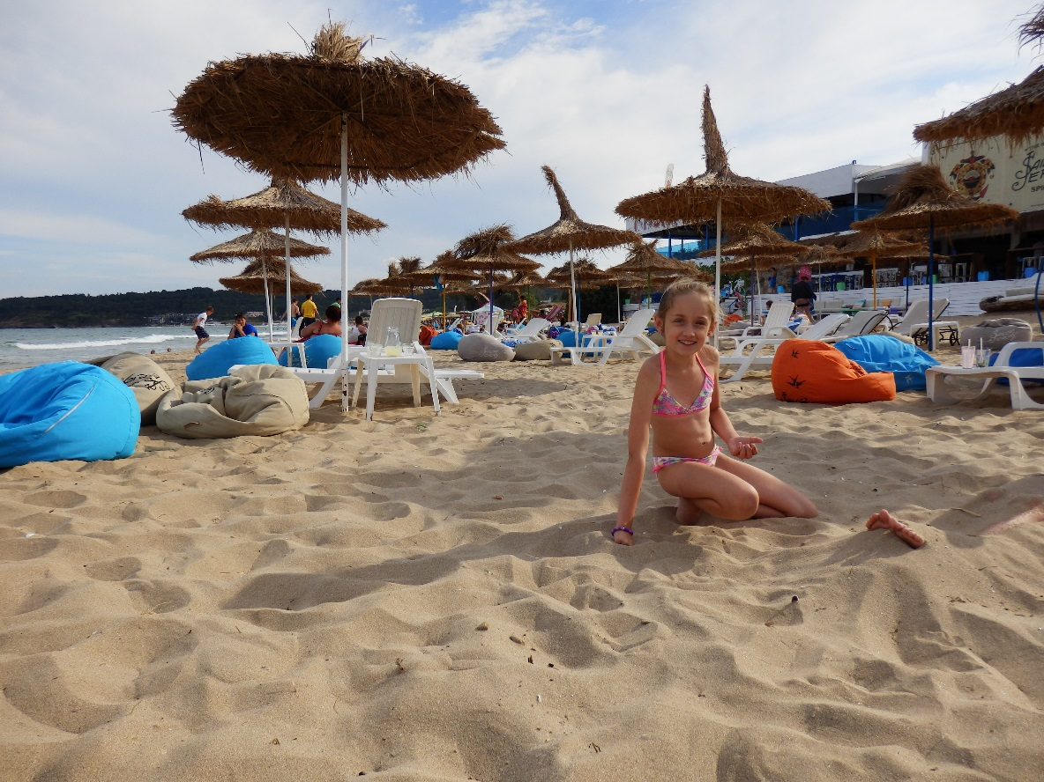
My name is Tosia. I'm 9 years old. I'm in class 3 in 86th Primary School in Gdańsk.
I like pizza, chicken, strawberries, orange juice and coke.
I like skiing, swimming, drawing, watching TV, spending time with my friends and playing with my dog - Bruma.
My best friends are: Ola, Ada, Kacper and Weronika.
I have got a big family. I have one brother and many cousins.

Slide 15
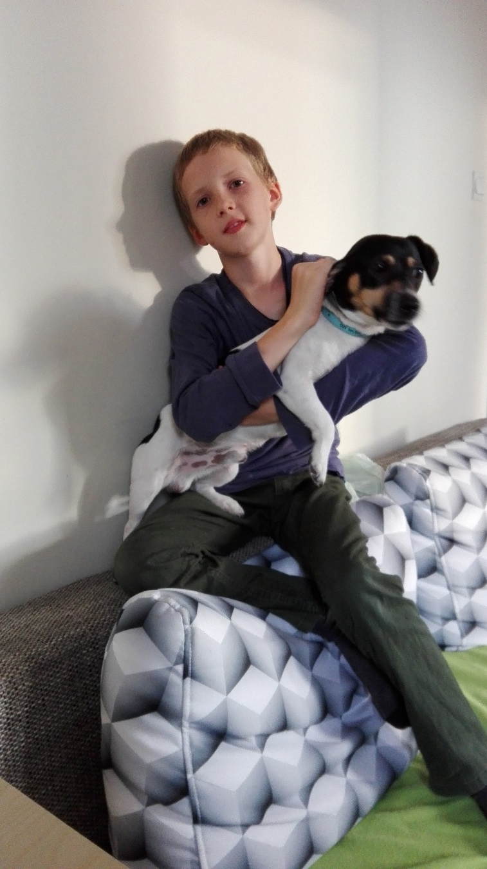
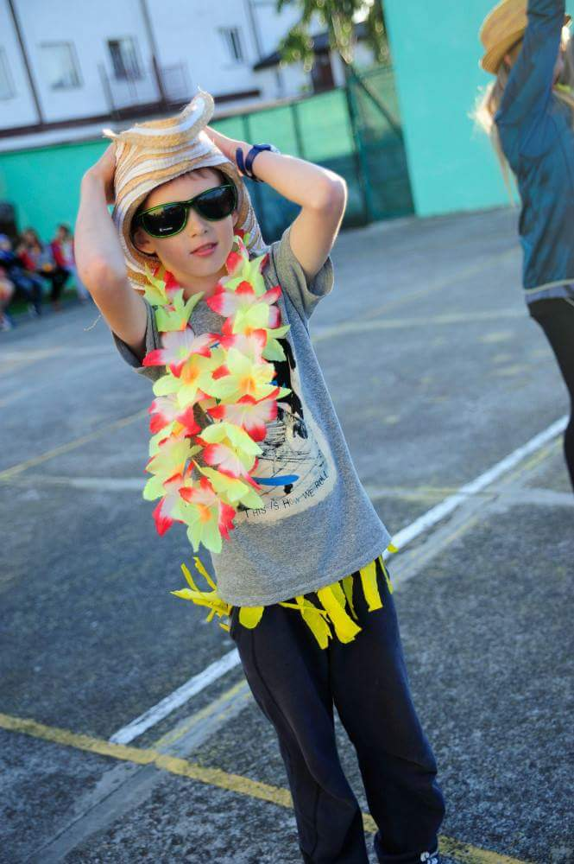
I'm John. I nine years old. My school is 86th Primary School in Gdansk. My brother's name is Antek.
I have a few animals – a dog called Ozi and a guinea pig – Ptyś.
I love pizza, ice cream and chips.
I don't like fish and buckwheat .

Slide 16
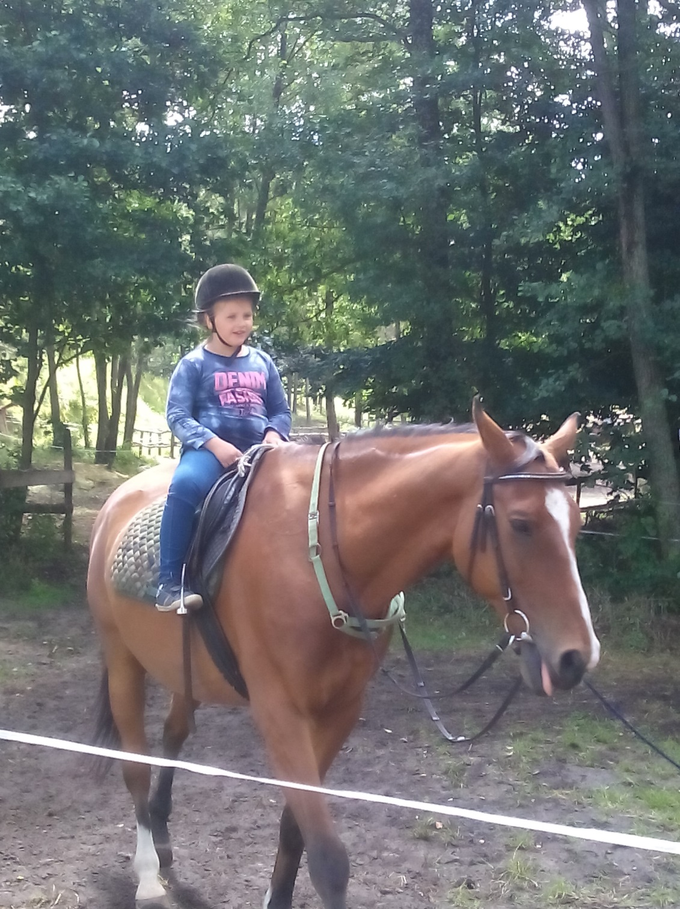
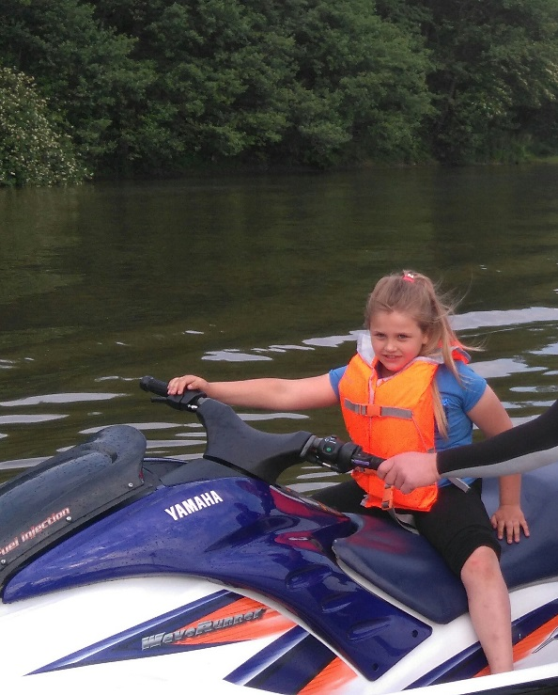
My name is Natalia .
I go to the third (3) class. I live in Gdańsk. I like swimming and horse riding. My favorite food is spagehetti, ice cream and fruit .I hare a sister Age. I like blue and aguamarine color. I like playing with my dog.

Slide 17
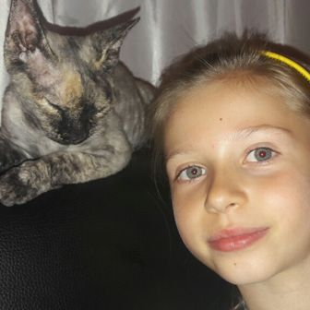
Hello, my name is Nela. I'm
8 years old. I'm in year 3 in 86th Primary Schol in Gdańsk. I have a small family- mother,father and a sister. I have a guinea pig and
a cat. I like chicken, ice cream, chips, eggs, pasta and pizza.
I like drinking, apple juice and water.
I like swimming, playing table tennis, cycling, running.
I like playing Minecraft and football.

Slide 18
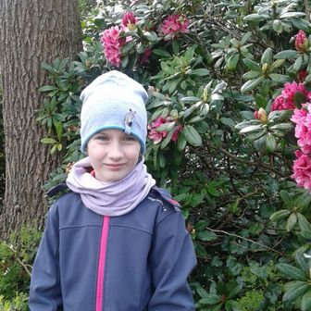
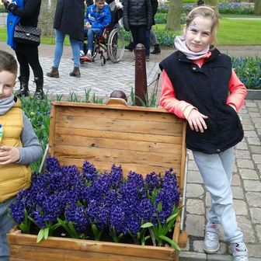
My name is Weronika.
I'm nine years old. I like horses, music and read books. I live in Poland, my city is Gdansk. I like travels and I like meet a new people. I've got brother, his name is Robert.

Slide 19
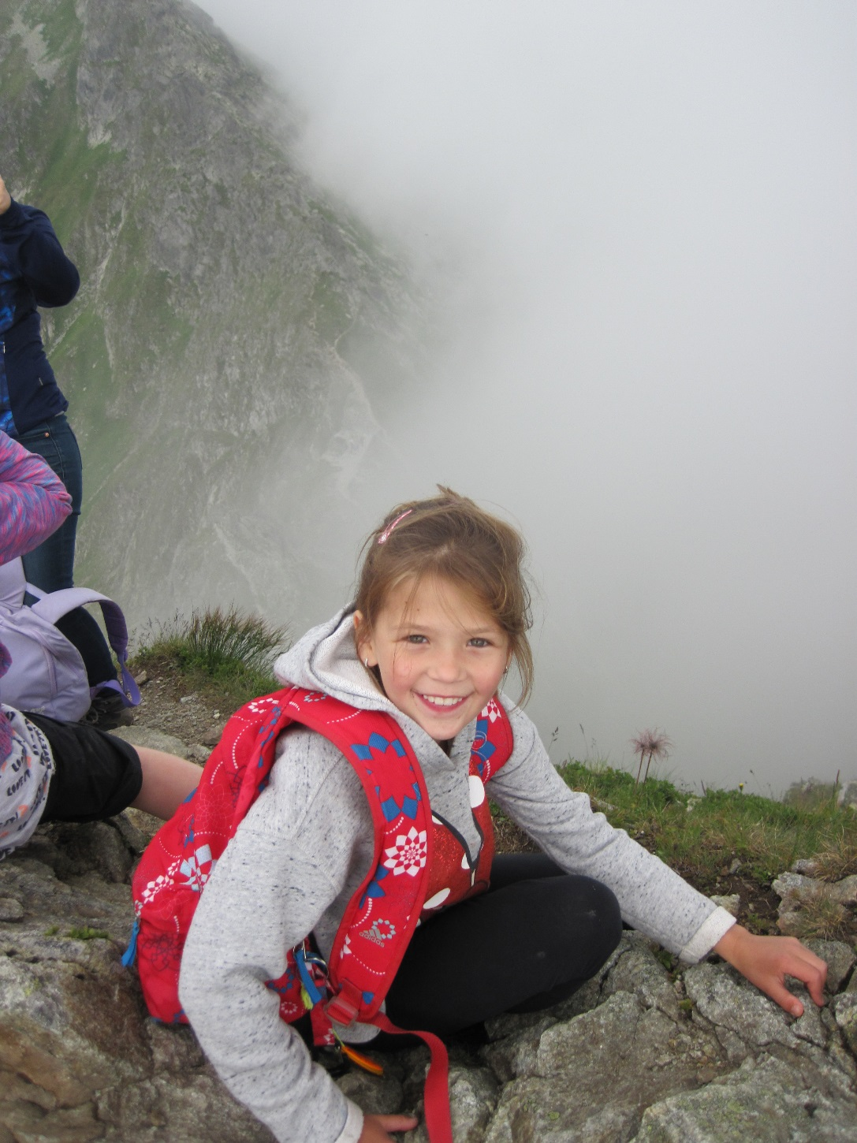
HELLO! I am Zuzia. I'm 8 years old. I'min year 3 i 86 Primary Schod in Gdańsk. I have a big family. I have a sister. I like chips and coke, apple juice. I like playing with my dog and riding horce, pop miusic.

Slide 20
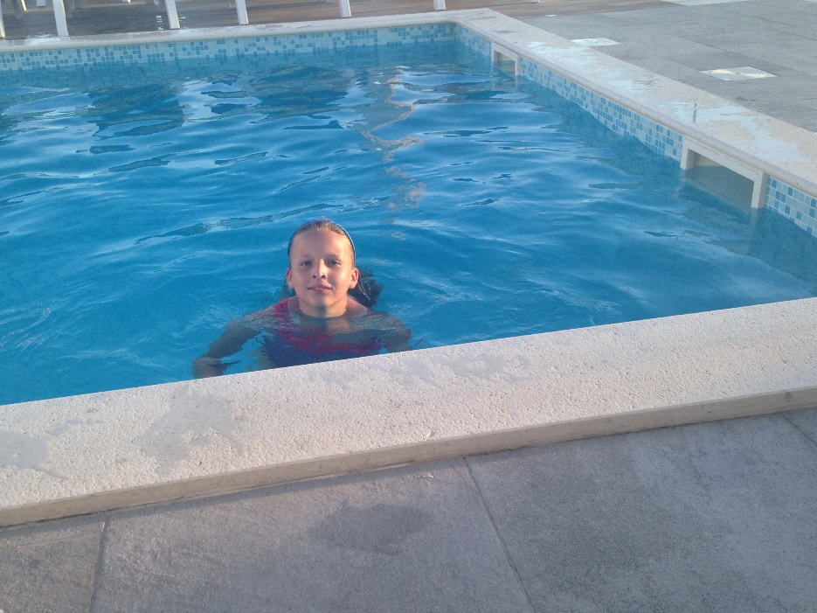
Halo, My name is Ola and I'm 9. I'm in year 3 in 86th Primary School.
I like eating chicken, chips, ice-cream, eggs and drinking water
I like swimming, watching TV and going outside.
I have a cat.
I hava a small family I have a brother,

Slide 21
Hello. My name is Aga. I am 8 years old. I am in the 3rd Class of the Primary School in Gdansk. I have got a big family. I have got a brother.
I like chicken and pizza.

Slide 22
Helow. My name is Szymon. I' m 9 years old.I' m in years 3 in 86 TH prymary.I have blue eyes.I' have short hair. I like pizza and I like plaing blocks.My favourite colour is blue.I have e cat and 2 dogs.I like playing with my cat. I like swim.

Slide 23
My name is Paulina. I like watching TV and meeting my friends. I like looking after small children and playing with them. I have a small cousin – Kaja.
My favourite food is chicken and pasta. I like drinking Cola.

Slide 24
My name is Weronika. I'm 9 and I learn in 86th Primary School. I like horse riding and swimming.
My favourite food is pizza and pasta.

Slide 25
I'm Bartek. I'm from Poland. I have got short brown hair, a small nce and brown eyes.
I like pasta but I don't like Coke.
I like football but I do't like horse riding.
I have got a smal family – I am an only child.
I can swim

