Slide 1
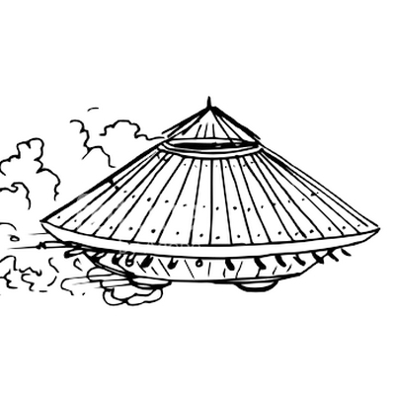
Bianca is
presenting
“War machines”.
AIИAMOЯ iohoɿoᗡ

Slide 2
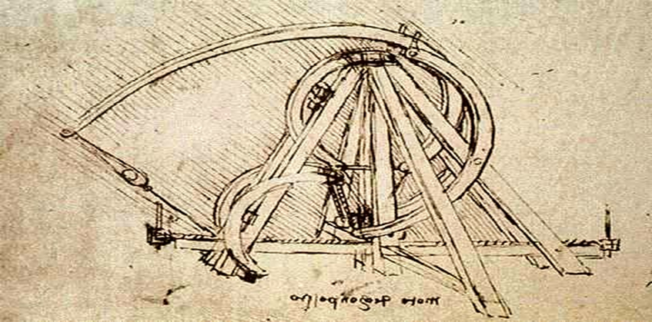
Leonardo’s intellectual curiosity led him to question how different objects functioned -how a bird’s wing created flight, how water moved great weights, how a knee bends, etc. This inquisitive mindset, defined by lengthy experimentation, observation, and recording processes, helped him provide the design services required by many ruling families. War machines must be precise, predictable, and reproducible. The function of every component must be understood by the designer in order for efficiency to be maintained. While many of Leonardo’s war machines appear excessive and needlessly bulky to the modern examiner, they provided answers to reoccurring military problems.

Slide 3
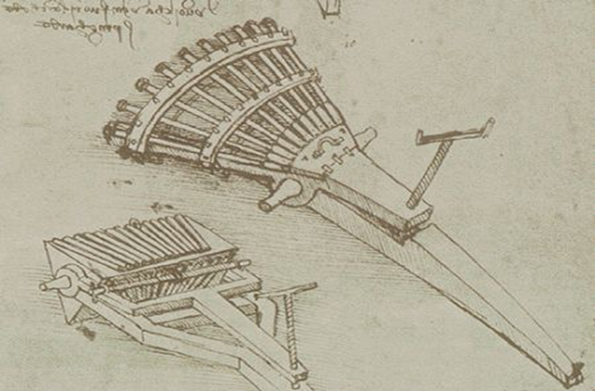
1. Barrel Organ
Leonardo designed the thirty three barrel canon to provide for two needs: 1) to cut through lines of infantry and 2) to allow simultaneous firing and reloading. While canons existed during Leonardo’s time they remained finicky and frequently misfired and took far too long to load. The thirty three small caliber guns featured in Leonardo’s machines were divided into three rows of eleven. To compensate for the inaccuracy of guns in this era, Leonardo’s machine fired eleven balls each cycle. Those in charge of the machine could refill the first row, while the next two rows remained in use.

Slide 4
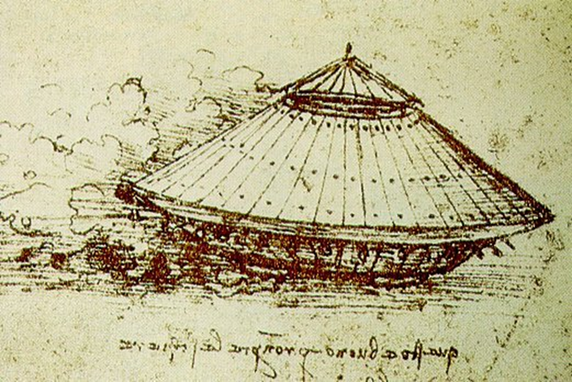
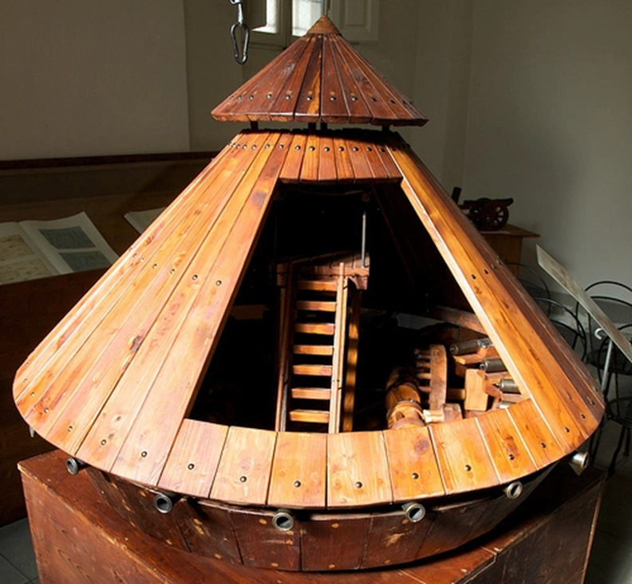
2. Armored Vehicle
Leonardo designed this machine to provide for three needs 1) 360 degree firing capability, 2) protection of soldiers, and 3) field intimidation. While the vehicle did not move quickly because it was powered by the eight men inside it, the overlapping flaps of medal reinforced with leather provided cover similar to a modern tank. Thirty two light weight canons radially laced the outside of the tanks circular lower base, allowing for 360 degree firing capability.

Slide 5
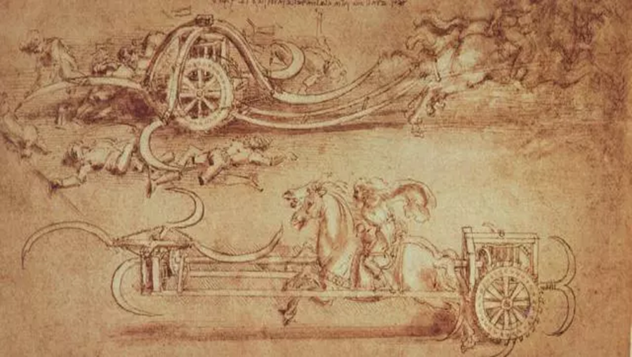
3. The Scythed Chariot
Leonardo attempted to modify the scythed chariot, a device employed previously by the Persians, in order to make it more deadly and decrease the amount of casualties to the home force. The scythed Chariot provided for two needs: 1) cutting down infantry and 2) intimidating the opposition visually. For centuries, knights and other armed retainers rode into battle mounted on impressive war horses. However, once infantry soldiers began using pikes and similar fastened, sharpened sticks to intercept mounted soldiers, armed retainers could no longer ride into battle physically elevated above lower ranking soldiers. The scythed chariot could cut through lines of pike-bearing infantry using the scythe attached to its front.
The machine worked by attaching the scythed chariot to the front two war horses. The mounted soldiers would then charge the chariot through the lines of opposing infantry, in the process making way for other mounted soldiers.

Slide 6
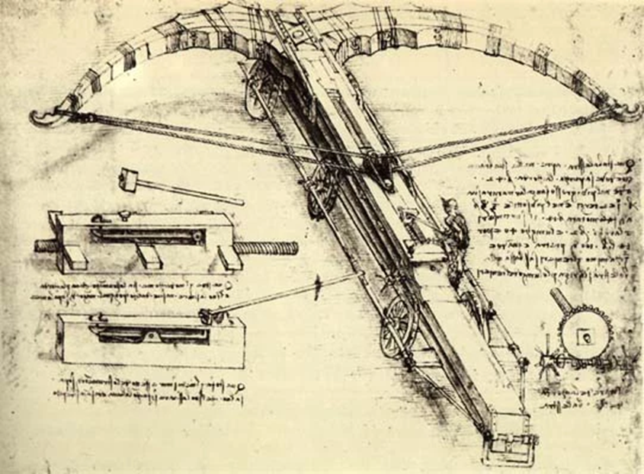
4. The Giant Crossbow
The giant crossbow provided for two needs: 1) to intimidate the enemy and 2) to launch stones or flaming material into enemy lines. Although catapults and trebuchets allowed armies to launch damaging material into enemy lines, encampments and cities for centuries, they did not provide the same degree of intimidation the giant crossbow might create.
Leonardo designed the machine to be twenty seven yards long with six wheels (three on each side) for mobility. The weapon would fire when a soldier released a pin holding the machine taught. The sketch of this particular device demonstrates the way Leonardo’s sketches brought complicated devices to life.

