Slide 1
ƎᗡOƆ IƆИIV Aᗡ
ʇɔǝɾoɹd ƃuıuuıʍ⊥ǝ
From Alina Dyadyuk
form 7-B
Khust Specialized school 3
Ukraine

Slide 2
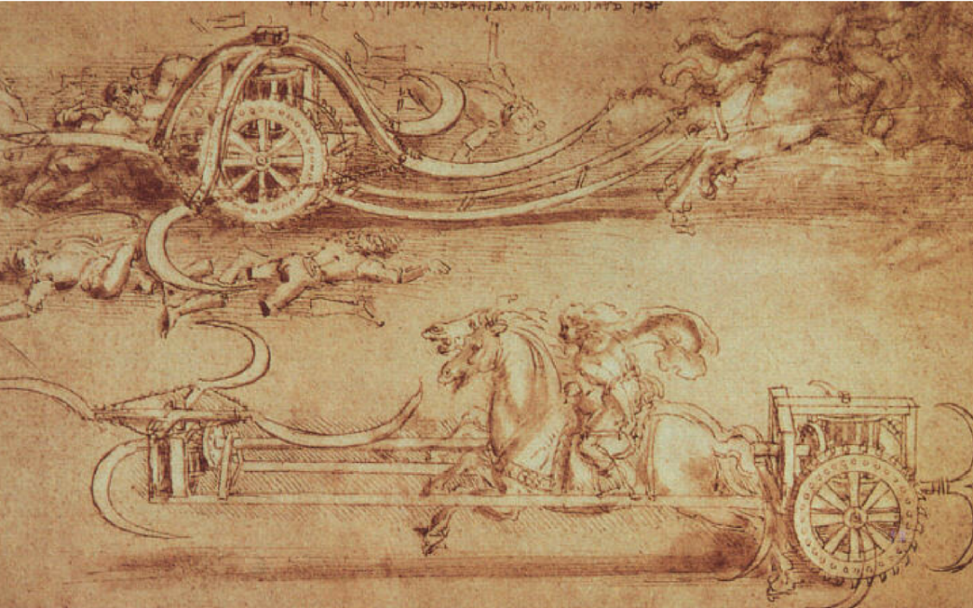
Alina is presenting “Painting”
Hi, I am Alina. I am 12.
I want to present you my materials
About Da Vinci’s Painting

Slide 3
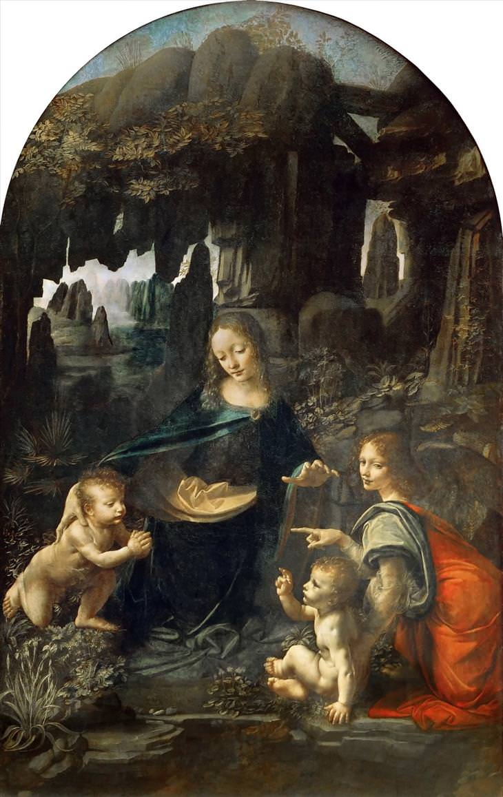
The Italy of the Middle Ages was not an era of particularly progressive thinking. Born in Tuscany in 1452, a young Leonardo da Vinci showcased his aptitude for art early on and was soon taken in by acclaimed artist Andrea del Verrocchio in Florence where he studied for 11 years.

Slide 4
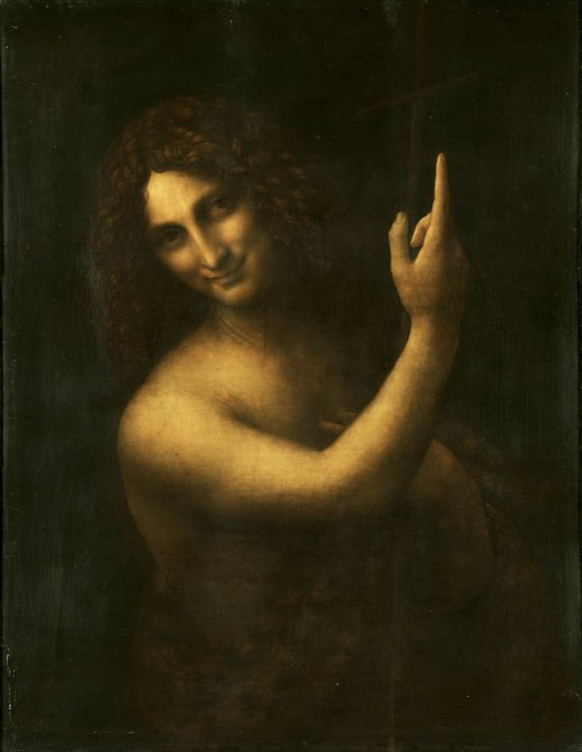
For Leonardo, no line could be drawn between science and art, or between the heart and the mind. That is why the figures on his paintings were created with great accuracy.

Slide 5
Although Leonardo was prolific, he was never in a hurry to finish individual projects. Many paintings and other works were abandoned including one of his most famous projects, Mona Lisa. When Leonardo died in 1519, he willed that unfinished painting and his other possessions to his assistant and close friend, Salai. Some art historians claim that a debilitating illness could have resulted in right-side paralysis that would have hampered his work in the last years of his life.

Slide 6
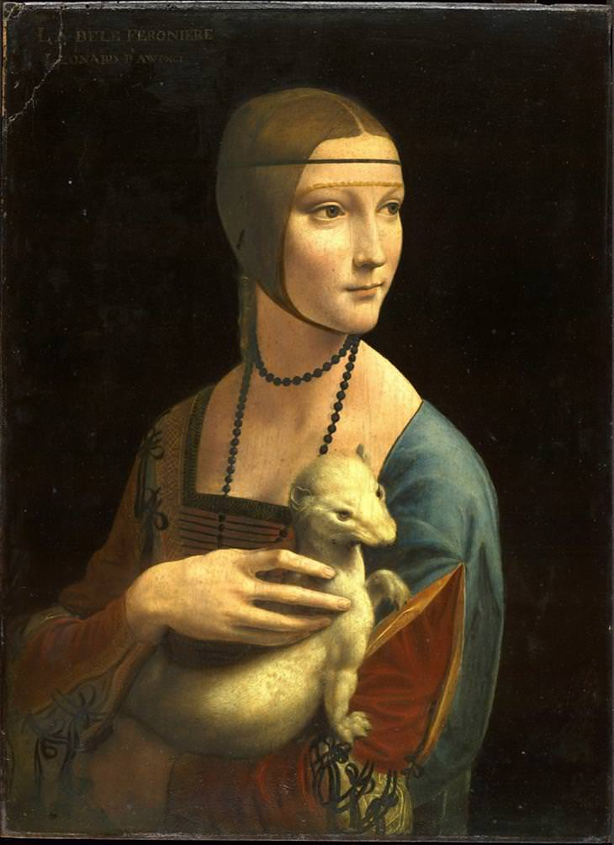
The Virgin and Child with St. Anne
Lady with an Ermine

