Slide 1
Diana and iasmina present : war machines

Slide 2
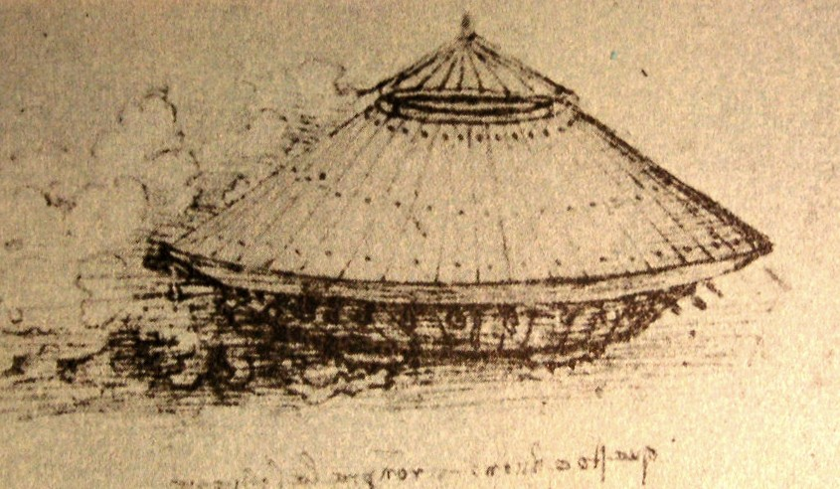
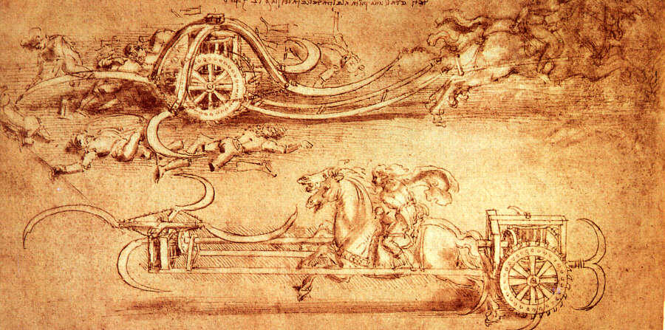
Renaissance Italy was a collection of independent city states who became engaged in incessant warfare with each other. This provided a market for the technically advanced weapons needed to gain military advantage over the enemy. Leonardo had studied and absorbed both classical and contemporary works on military engineering. In his famous letter to Ludovico il Moro Sforza, Duke of Milan, he listed nine categories of military engineering among the many skills that he was proficient in. His items included: new weaponry, bridging, bombarding machines and trench draining.
Da Vinci's design for an armoured vehicle made from wood and operated by eight men was made in 1487. The 'tank' was operated by turning the cranks.
Da Vinci's scythed chariot was perhaps a throwback inspired by antique machines. Leonardo suggested raising the scythes when traveling through the ranks of men, so that no one on your side will be injured!

Slide 3
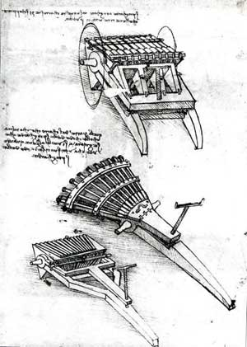
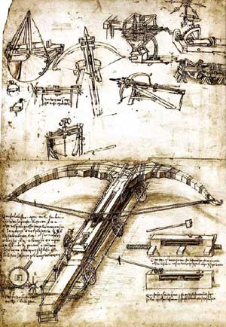
Firearms in renaissance times were inaccurate and suffered from a slow rate of fire. Leonardo, in his design for a multi-barrelled cannon of 1481, sought to overcome the slow rate of fire. The three racks of barrels allowed the re-loading of one rack while another was being fired and could maintained continuous fire power. The 'fan type' gun with it's array of horizontal barrels allowed for a wide scattering of shot. These breech loading, water-cooled guns were years ahead of their time and its interesting to note that steam cannons were used in World War II. Guns with array of horizontal barrels and gun with three racks of barrels. c1481. . Leonardo designed a huge crossbow,(his ballista), and it was truly huge (86 feet long). The weapon boasted a worm and gear mechanism to draw the bowstring and was mounted on canted wheels providing a stable base on rough ground. Two alternate firing mechanisms allowed the bow to release by a hammer blow or by lever action. He also made drawings for a repeating 'machine gun’ operated by a man-powered treadmill. Leonardo had also considered the possibility of an enemy using flying machines in battles, and designed weapons that would shoot them down!

