Slide 1
Leonardo Da Vinci
Of Leonardo da Vinci’s many areas of study, perhaps this Renaissance man’s favorite was the area of aviation. Da Vinci seemed truly excited by the possibility of people soaring through the skies like birds.
One of da Vinci’s most famous inventions, the flying machine (also known as the "ornithopter") ideally displays his powers of observation and imagination, as well as his enthusiasm for the potential of flight. The design for this invention is clearly inspired by the flight of winged animals, which da Vinci hoped to replicate. In fact, in his notes, he mentions bats, kites and birds as sources of inspiration.

Slide 2
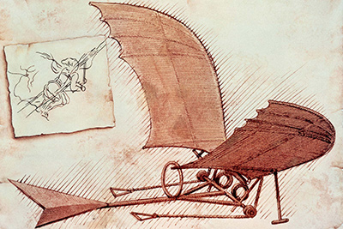
Flying Machine

Slide 3
Armoured Car
The precursor to the modern tank, Leonardo da Vinci’s armored car invention was capable of moving in any direction and was equipped with a large number of weapons. The most famous of da Vinci’s war machines, the armored car was designed to intimidate and scatter an opposing army.

Slide 4
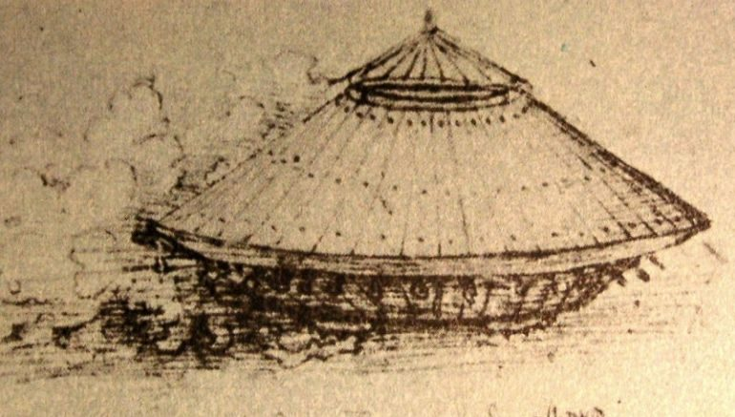
Armoured Car

