Slide 1
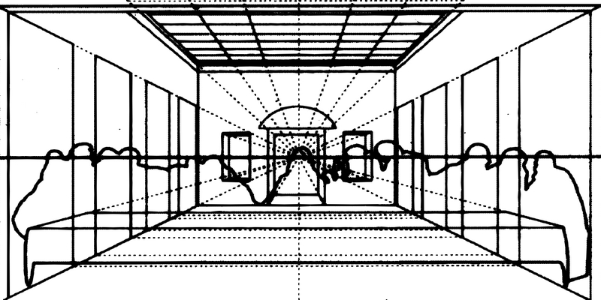
Cosmina is
presenting
“Perspective:
geometry,
architecture”.
AIИAMOЯ iohoɿoᗡ

Slide 2
"Non mi legga chi non e matematico.”
(Let no one read me who is not a mathematician.)
The Franciscan friar, Luca Pacioli is best known for his compendium of fifteenth century mathematics, Summa de arithmetica, geometrica, proportioni et proportionalita (1494).
The friar also befriended many of the artists of the time, including Leonardo Da Vinci. Da Vinci briefly studied geometry with Pacioli but focused on considerations of shape, size, and perspective, descriptive features of objects rather than their theoretical foundations. Da Vinci illustrated Divina proportione, supplying sixty plates for the work.

Slide 3
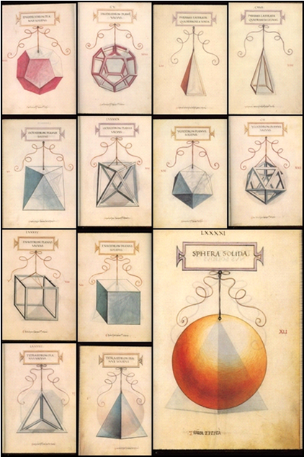
Of all the topics in the Tratatto, we are mainly interested in perspective. Leonardo had said that "perspective is the rein and rudder of painting." Invented by Brunelleschi, codified by Alberti and Piero, it was perfected by Leonardo.

Slide 4
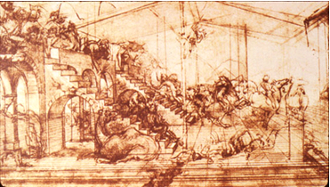
Leonardo's notes on linear perspective are apparently lost, but he made great use of perspective in his own paintings, such as this study of the unfinished Adoration. Note the strict Albertian grid on the pavement.

Slide 5
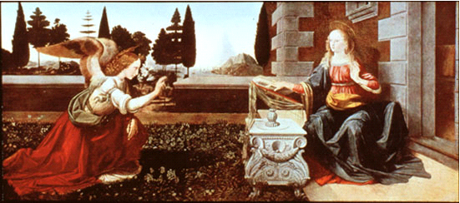
His Annunciation shows a carefully worked out perspective framework. Incised lines beneath the paint on this wood panel show his construction. Note though that the Virgin's arm appears too long. Studies have shown that Leonardo departed from the correct perspective here for the sake of a more expressive gesture, a common practice in the Renaissance.

Slide 6
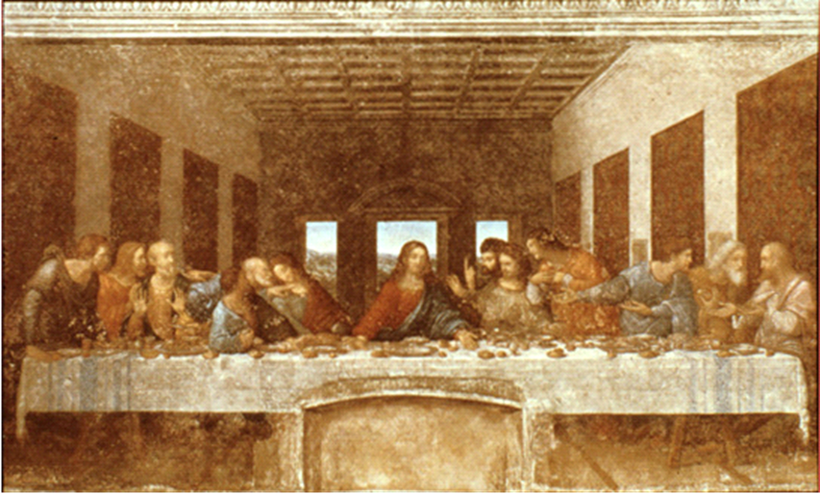
Leonardo's most famous perspective painting, like all the other Last Suppers, this one is placed in a refectory or dining hall, here in the Convent of Santa Maria delle Grazie, Milan. The vanishing point is placed at Christ's right eye, where he dominates the foreground. Even Christ's arms reinforce the perspective, with his arms along the lines of the visual pyramid.

