Slide 1
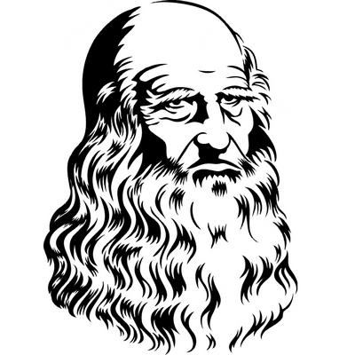
Bianca is
presenting
“His life”.
AIИAMOЯ iohoɿoᗡ

Slide 2
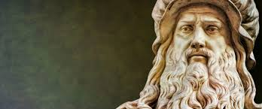
Leonardo da Vinci was an artist, scientist, and inventor during the Italian Renaissance. He is considered by many to be one of the most talented and intelligent people of all time. The term Renaissance Man (someone who does many things very well) was coined from Leonardo's many talents and is today used to describe people who resemble da Vinci.

Slide 3
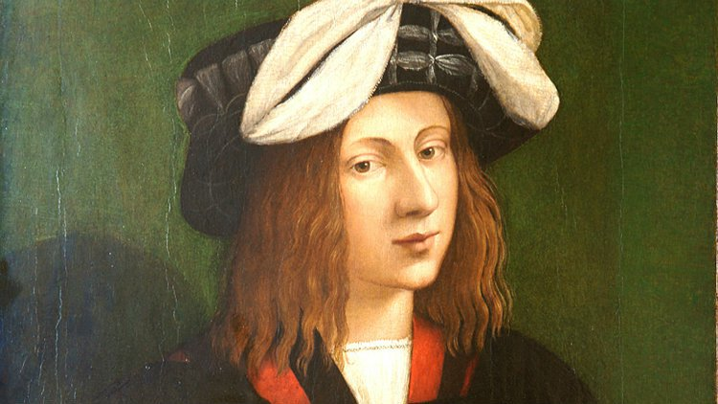
Leonardo was born in the town of Vinci, Italy on April 15, 1452. Not much is known about his childhood other than his father was wealthy and had a number of wives. About the age of 14 he became an apprentice to a famous artist named Verrocchio. This is where he learned about art, drawing, painting and more.

Slide 4
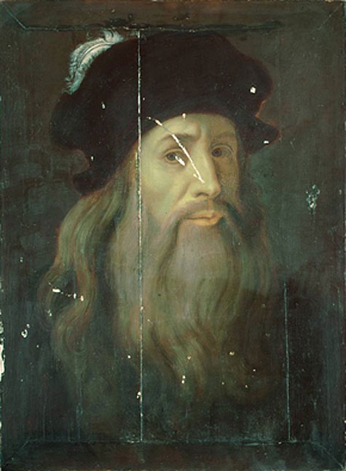
For about a decade, Da Vinci refined his painting and sculpting techniques and trained in mechanical arts. When he was 20, in 1472, the painters’ guild of Florence offered Da Vinci membership, but he remained with Verrocchio until he became an independent master in 1478. Around 1482, he began to paint his first commissioned work, The Adoration of the Magi, for Florence’s San Donato, a Scopeto monastery.

Slide 5
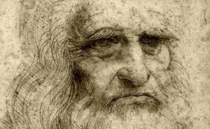
Leonardo was the true Renaissance Man. He lived life based on a philosophy that man’s capacity for personal development and expansion was without limits. As a Renaissance Man, it was an individual’s goal to reach their fullest potential in life. The fervor of intellectual pursuits still required creativity in arts, the honing of the physical body, and the pursuit of emotional truth. It was a way of living that saw life as a complete whole through many different forms.

Slide 6
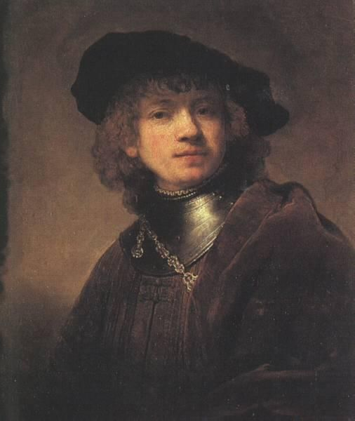
Leonardo was extremely passionate about immersing himself in studies of the natural world around him. You might find him observing the flight of birds to discover aeronautical principles, or dissecting human and animal bodies to better understand anatomy. By the early 1490’s Da Vinci had started a rich collection of notebooks filled to the brim with beautiful sketches and observations centered around four themes – painting, architecture, mechanics, and human anatomy.

