Slide 1
Bianca presents : perspective geometry architecture

Slide 2
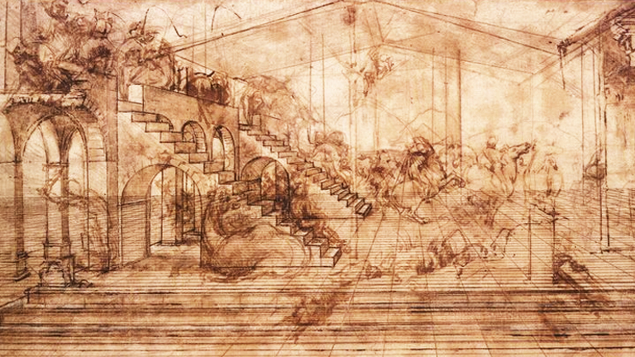
Alberti’s book about painting had a huge influence on painters during the Renaissance, including Leonardo. He learned about Alberti’s theory of linear perspective, and all of Leonardo’s paintings, even his early ones, show that he not only understood linear perspective, he took the idea of perspective even further. Leonardo considered a painting a window to the outside world, and wanted everything in his paintings to look as if it were a scene through a window, happening before the viewer’s eyes. Because he was a careful observer of nature, he noticed that at different times of day objects in the distance looked more or less sharp and took on Linear Perspective.

Slide 3
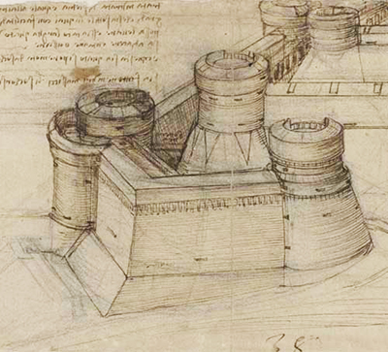
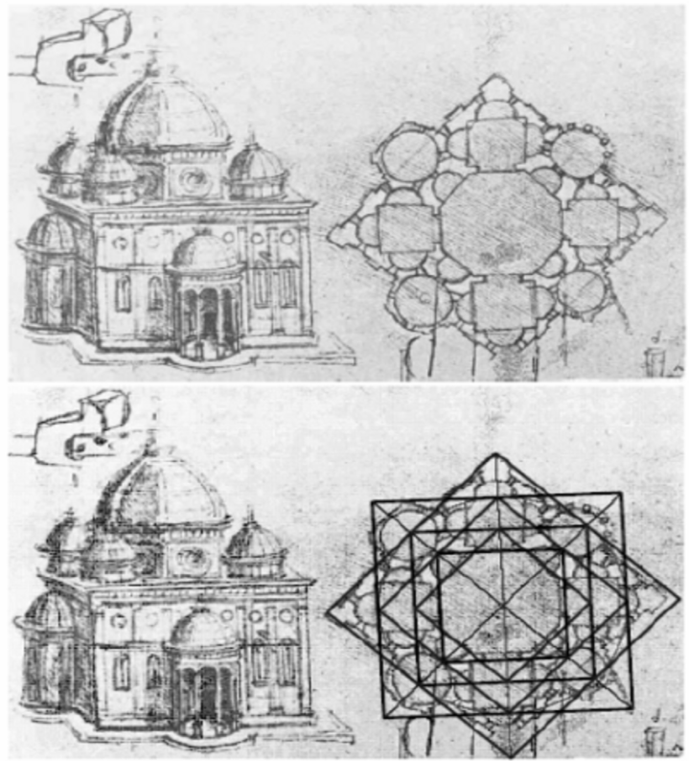
Leonardo noticed that in the morning light, distant objects (such as hills or mountains) looked less distinct and more blue than closer hills or mountains. He also noticed that the farther away the image was, the more its color blended into the color of the air around it. As a result of his observations, Leonardo came up with some simple rules for painters to follow in creating what he called aerial perspective: the nearest object should be painted its true color, the one immediately behind the nearest one should be painted proportionately bluer, and the object farther away should be proportionately bluer still.

